Slide 1
Lecture 7 :
Intro. to STL (Standard Template Library)

Slide 2
STL
a set of C++ template classes to provide common programming data structures and functions
  Data structures (container class)
    expandable arrays (vector)
    doubly linked lists (list)
    (priority) queue , stack , set, map, …
  Functions (algorithms) on the data structures
    sort(), search(), merge(), min(), max(), swap(), …
    Set operations (union, difference, intersection, …)
included in C++ standard library

Slide 3
3 categories of STL
Container class
  A holder object that stores a collection of other objects with any (user defined or built-in) data types
Iterator
  similar to pointer (point to element of container)
  Implemented for each type of container
  Elements of containers can be accessed through iterators
Algorithm
  Perform operations(e.g. sort , search, …) on STL objects

Slide 4
Container Classes
Sequences : sequential collection
  vector, list, deque (double ended queue)
Associative Container :
  set (duplicate data are not allowed) : Collection of ordered data in a balanced BST. Fast search
  map : associate key-value pair held in balanced BST
    Ex) person[“hongkildong”] = person_object;
  hash_set, hash_set : uses hash (fast but no order)
Container Adapters
  Implemented on top of another container
  stack , queue , priority queue

Slide 5
Iterators
Iterators provide common interface to step through the elements of any arbitrary type STL containers.
“Algorithms” can have ways to access any types of “Containers” through “Iterators”.
There are iterators for going sequentially forward and/or backward as well as random access iterators.
Iterators are used by the STL algorithms. Iterator syntax uses the ++, --, and * operators which are familiar to users of pointers.

Slide 6
Iterators
Containers
Algorithms
Iterators

Slide 7
algorithms
The header <algorithm>
  defines a collection of functions (such as searching and sorting) especially designed to be used on ranges of container elements.
Access container elements thru iterators
therefore will work on any container
which provides an interface by iterators

Slide 8
Let’s look at examples of Sequence Containers
(vector, list, deque, …)

Slide 9
Sequence Containers: Access, Add, Remove
Element access for all:
  front()
  back()
Element access for vector and deque:
  [ ]: Subscript operator, index not checked
Add/remove elements for all
  push_back(): Append element.
  pop_back(): Remove last element
Add/remove elements for list and deque:
  push_front(): Insert element at the front.
  pop_front(): Remove first element.

Slide 10
Sequence Containers: Other Operations
Miscellaneous operations for all:
  size(): Returns the number of elements.
  empty(): Returns true if the sequence is empty.
  resize(int i): Change size of the sequence.
Comparison operators ==, !=, < etc. are also defined.
  i.e., you can compare if two containers are equal.
“List” operations are fast for list, but also available for vector and deque:
  insert(p, x): Insert an element at a given position.
  erase(p): Remove an element.
  clear(): Erase all elements.

Slide 11
vector
Dynamic array of variables, struct or objects.
elements are stored in contiguous storage locations
Able to resize itself automatically when inserting or erasing a vector element
vector is good at
  Accessing individual elements by their position index, O(1).
  (random access)
  Iterating over the elements in any order (linear time).
  Add and remove elements from its end
What about inserting/erasing an element in the middle?

Slide 12
Vector declaration
Header file include
  #include <vector>
Declare :
  vector<data type> variable_name;
  Ex) vector<int> vec_int;
Dynamic allocation
  Ex) vector<int>* vec_intp = new vector<int>;

Slide 13
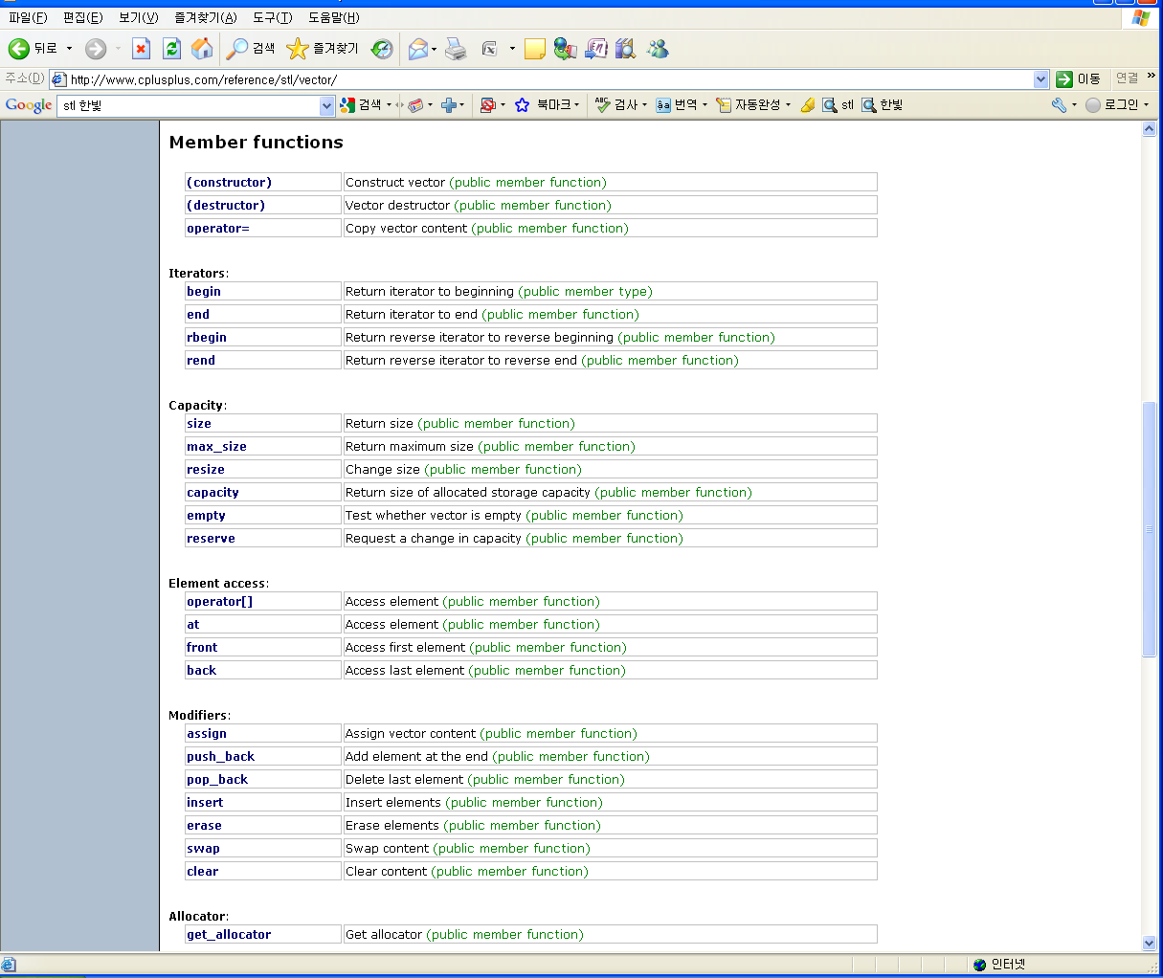
vector member functions

Slide 14
vector member functions

Slide 15
vector example1
// constructing vectors
#include <iostream>
#include <vector>
using namespace std;
int main ()
{
unsigned int i;
// constructors used in the same order as described above:
vector<int> first; // empty vector of ints
vector<int> x(10); // vector with size=10;
vector<int> second (4,100); // four ints (size=4) with value 100
vector<int> third (second.begin(),second.end()); // iterating through second
vector<int> fourth (third); // a copy of third
// the iterator constructor can also be used to construct from arrays:
int myints[] = {16,2,77,29};
vector<int> fifth (myints, myints + sizeof(myints) / sizeof(int) );
cout << "The contents of fifth are:";
for (i=0; i < fifth.size(); i++)
cout << " " << fifth[i];
x[0]=7;
x[1]=x[0]+5;
return 0;
}
The contents of fifth are: 16 2 77 29

Slide 16
vector example2
// vector::begin
#include <iostream>
#include <vector>
using namespace std;
int main ()
{
vector<int> myvector;
for (int i=1; i<=5; i++) myvector.push_back(i);
vector<int>::iterator it;
cout << "myvector contains:";
for ( it=myvector.begin() ; it < myvector.end(); it++ )
cout << " " << *it;
cout << endl;
return 0;
}
myvector contains: 1 2 3 4 5

Slide 17
vector example 3
// vector::pop_back
#include <iostream>
#include <vector>
using namespace std;
int main ()
{
vector<int> myvector;
int sum (0);
myvector.push_back (100);
myvector.push_back (200);
myvector.push_back (300);
while (!myvector.empty())
{
sum+=myvector.back();
myvector.pop_back();
}
cout << "The elements of myvector summed " << sum << endl;
return 0;
}
The elements of myvector summed 600

Slide 18
vector example4
// comparing size, capacity and max_size
#include <iostream>
#include <vector>
using namespace std;
int main ()
{
vector<int> myvector;
// set some content in the vector:
for (int i=0; i<100; i++) myvector.push_back(i);
cout << "size: " << (int) myvector.size() << "\n";
cout << "capacity: " << (int) myvector.capacity() << "\n";
cout << "max_size: " << (int) myvector.max_size() << "\n";
return 0;
}
size: 100
capacity: 141
max_size: 1073741823

Slide 19
vector example5
// erasing from vector
#include <iostream>
#include <vector>
using namespace std;
int main ()
{
unsigned int i;
vector<unsigned int> myvector;
// set some values (from 1 to 10)
for (i=1; i<=10; i++) myvector.push_back(i);
// erase the 6th element
myvector.erase (myvector.begin()+5);
// erase the first 3 elements:
myvector.erase (myvector.begin(),myvector.begin()+3);
cout << "myvector contains:";
for (i=0; i<myvector.size(); i++)
cout << " " << myvector[i];
cout << endl;
return 0;
}
myvector contains: 4 5 7 8 9 10

Slide 20
stack (LIFO)
Member functions
  constuctor
  empty
  size
  top
  push
  pop

Slide 21
stack example
// stack::push/pop
#include <iostream>
#include <stack>
using namespace std;
int main ()
{
stack<int> mystack;
for (int i=0; i<5; ++i) mystack.push(i);
cout << "Popping out elements...";
while (!mystack.empty())
{
cout << " " << mystack.top();
mystack.pop();
}
cout << endl;
return 0;
}
Popping out elements... 4 3 2 1 0

Slide 22
list
Doubly-linked list
Fast access to front and back only
Add and remove elements at any position

Slide 23
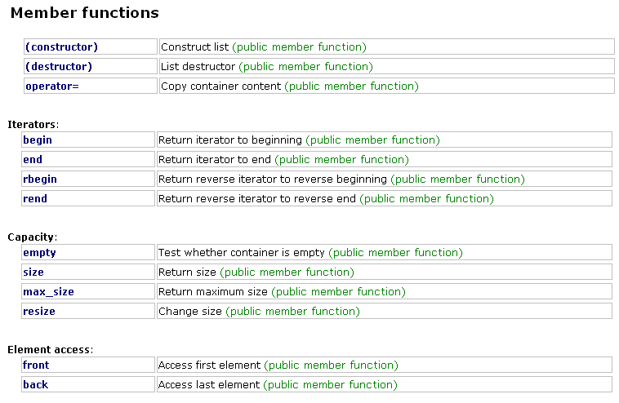
list member functions

Slide 24
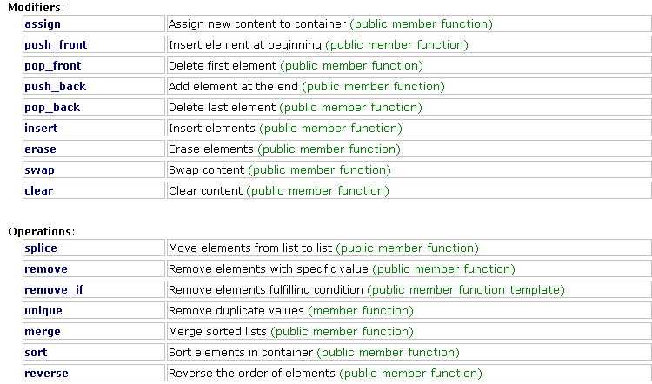
list member functions

Slide 25
list example 1
push_front, push_back
pop_front, pop_back
// list::push_front
#include <iostream>
#include <list>
using namespace std;
int main ()
{
list<int> mylist (2,100); // two ints with a value of 100
mylist.push_front (200);
mylist.push_front (300);
cout << "mylist contains:";
for (list<int>::iterator it=mylist.begin(); it!=mylist.end(); ++it)
cout << " " << *it;
cout << endl;
return 0;
}
300 200 100 100

Slide 26
list example 2
insert
// inserting into a list
#include <iostream>
#include <list>
#include <vector>
using namespace std;
int main ()
{
list<int> mylist;
list<int>::iterator it;
// set some initial values:
for (int i=1; i<=5; i++) mylist.push_back(i);
// 1 2 3 4 5
it = mylist.begin();
++it; // it points now to number 2
mylist.insert (it,10); // 1 10 2 3 4 5
// "it" still points to number 2
mylist.insert (it,2,20); // 1 10 20 20 2 3 4 5
--it; // it points now to the second 20
vector<int> myvector (2,30);
mylist.insert (it,myvector.begin(),myvector.end());
// 1 10 20 30 30 20 2 3 4 5
cout << "mylist contains:";
for (it=mylist.begin(); it!=mylist.end(); it++)
cout << " " << *it;
cout << endl;
return 0;
}
mylist contains: 1 10 20 30 30 20 2 3 4 5

Slide 27
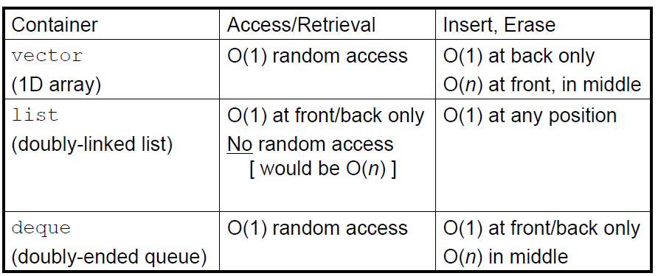
Standard Sequence Containers
They differ in how quickly different access operations can be performed. n is the number of elements currently in the container.

