Slide 1
Lecture 8-1 :
Introduction to
UML (Unified Modeling Language)

Slide 2
Motivation of Modeling
Realistic and useful systems are large and complex
  UNIX system V : 1M SLOC (source lines of code)
  Windows2000 : 40M SLOC
Systems require the work of many people
  Developers, testers, managers, clients, users, etc
Systems have an extended life cycle, hence they evolve
1M SLOC with 100 persons ≠ 10k SLOC with 1 person
Modeling

Slide 3
Systems, Models, and Views
System
  a set of interacting or interdependent entities forming an integrated whole.
  subsystem : is a system itself and a part of a larger system
Common characteristics of system : Systems have
  Structure
    defined by parts and their composition
  Behavior
    involves inputs, processing and outputs of materials, energy or information
  Interconnectivity
    the various parts of a system have functional as well as structural relationships between each other

Slide 4
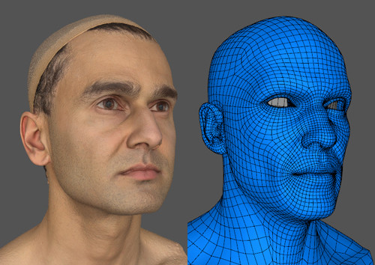
Systems, Models, and Views
Model
  Abstraction describing a system (or a subset)
  ex) computer model, business model, data model, mathematical model, economic model, …, etc
View
  Selected aspects of a model
Notation
  Set of rules for representing views
Views and models of a single system can overlap each other

Slide 5
What is UML?
UML → “Unified Modeling Language”
  Emerging standard for modeling complex object-oriented Software
  Language: express idea, not a methodology
  Modeling: describing a software system at a high level of abstraction
  Unified: UML has become a world standard

Slide 6
What is UML?
More description about UML:
  It is a industry-standard graphical language for specifying, visualizing, constructing, and documenting the artifacts of software systems
  The UML uses mostly graphical notations to express the OO analysis and design of software projects.
  Simplifies the complex process of software design

Slide 7
Why we use UML?
  Use graphical notation: clearer than natural language (imprecise) and code (too detailed).
  Help acquire an overall view of a system.
  UML is not dependent on any one language or technology.
  Standard
  share idea and the results of system design among clients, system analysts, and programmers

Slide 8
Models, Views, and Diagrams
A model is a complete
description of a system
from a particular
perspective
State
Diagrams
State
Diagrams
Class
Diagrams
Use Case
Diagrams
Use Case
Diagrams
State
Diagrams
Use Case
Diagrams
Use Case
Diagrams
State
Diagrams
Use Case
Diagrams
Object
Diagrams
Sequence
Diagrams
Scenario
Diagrams
State
Diagrams
Scenario
Diagrams
State
Diagrams
Collaboration
Diagrams
Component
Diagrams
Models
Scenario
Diagrams
Component
Diagrams
Scenario
Diagrams
Component
Diagrams
Statechart
Diagrams
Deployment
Diagrams
Activity
Diagrams

Slide 9
3 categories of UML diagrams
Structure Diagrams : what things must be in the system being modeled
  Class diagram
  Component diagram
  Composite diagram
  Deployment diagram
  Object diagram
  Package diagram
Behavior Diagrams : what must happen in the system being modeled
  Activity diagram
  State diagram
  Use case diagram
Interaction Diagram (subset of behavior diagram) : the flow of control and data among the things in the system being modeled
  Communication diagram
  Interaction overview diagram
  Sequence diagram
  Timing diagram

Slide 10
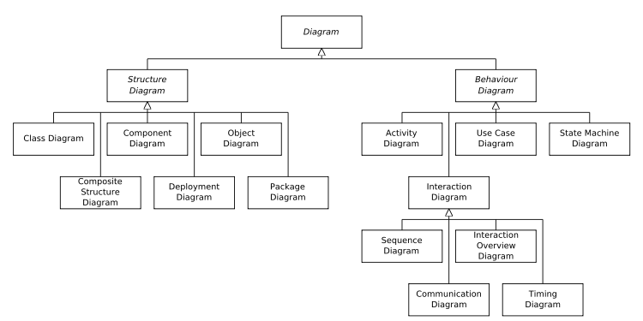
3 categories of UML diagrams

Slide 11
UML History
Year Version
Currently UML 2.3 (released in May 2010)
2005: UML 2.0
2001: UML 1.4
1999: UML 1.3
1997: UML 1.0, 1.1
1996: UML 0.9 & 0.91
1995: Unified Method 0.8
Booch ‘93
OMT - 2
Other methods
Booch ‘91
OMT - 1

Slide 12
UML Diagrams
Each graphical notation of UML is used for drawing diagrams
The purpose of diagrams is to provide views from different perspective.
Model is a set of views
We will look at summary of each diagram in the following slides

Slide 13
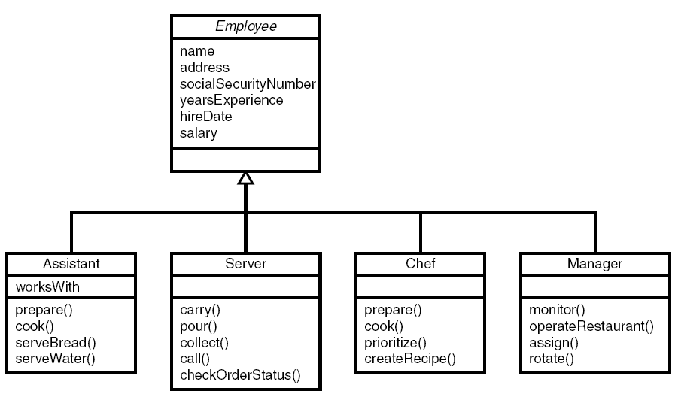
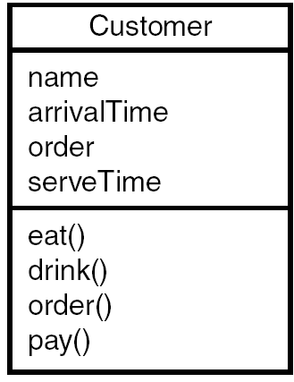
Class Diagram
Describe the static structure of the system
Objects, attributes, and associations

Slide 14
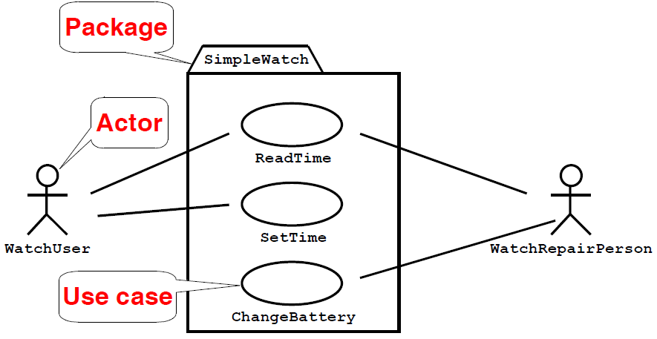
Use-Case Diagram
shows the functions provided by a system in terms of actors, their goals represented as use cases, and any dependencies between those use cases

Slide 15
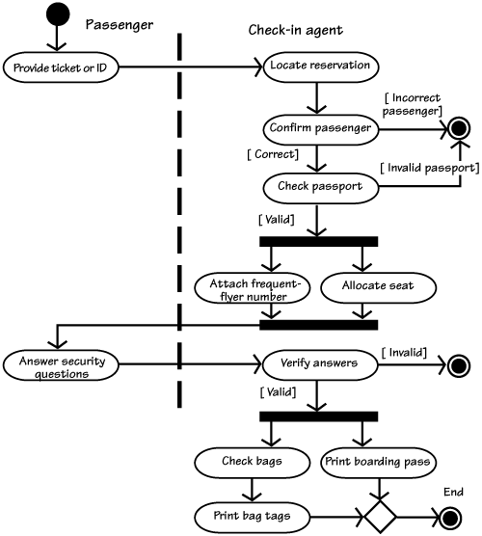
Activity Diagram
Step-by-step workflows
Shows overall flow of control
(flowchart)

Slide 16
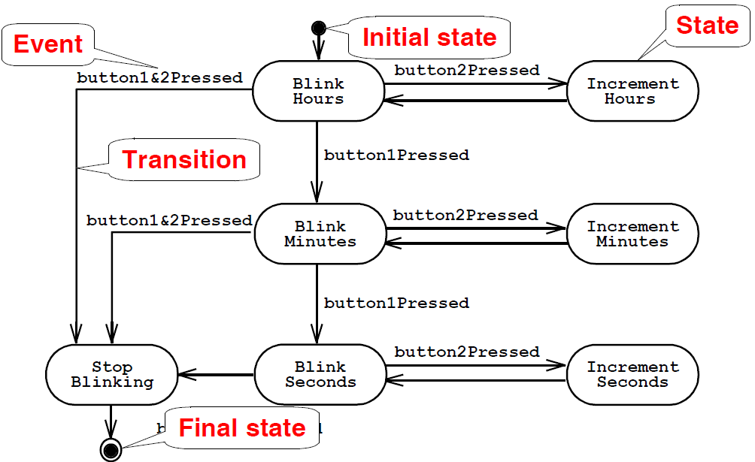
State (Statechart) Diagram
Describe the dynamic behavior of an individual object as a finite state machine.

Slide 17
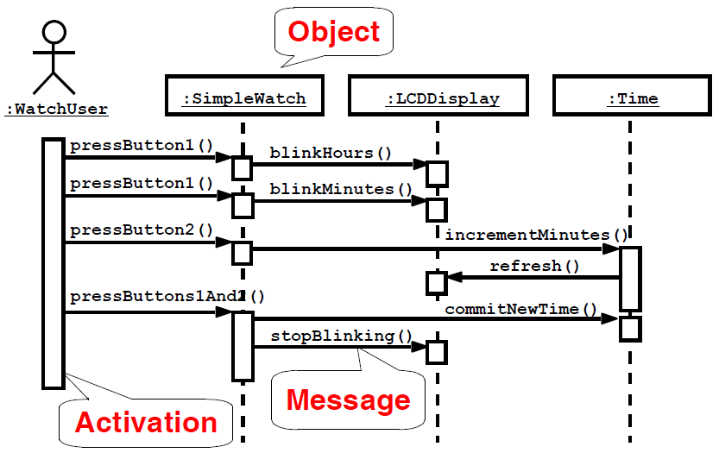
Sequence Diagram
Describe the dynamic behavior between actors and the system and between objects of the system.

Slide 18
Why so many diagrams?
Multiple aspects of a complex system
Need for detailed analysis and design

Slide 19
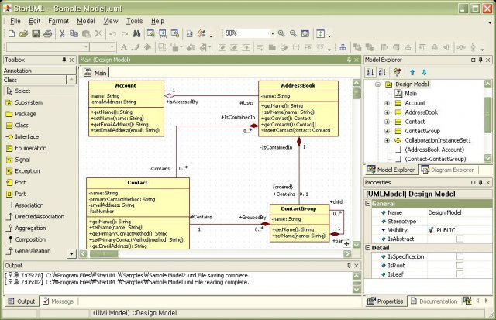
Free UML tool
StarUML
  Open source/platform
  draw diagrams, automatic code generation, …
  http://staruml.sourceforge.net/

