Slide 1
Lecture 8-2 :
Class Diagrams

Slide 2
Class Representation
Class Name
Attribute1 Attribute2 …
Operation1 Operation2 …
responsibility

Slide 3
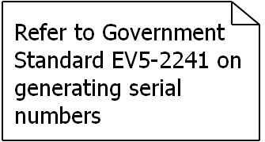
Class
Note
WashingMachine
<<id info>> brandName : String modelName serialNumber : Integer <<machine info>> Capacity
<<clothes-related>> addClothes(C:String) : void removeClothes(C:String) : void addDetergent(D:int) : int <<machine-related>> turnOn() : Boolean
Responsibility : Take dirty clothes as input and produce clean clothes as output
{capacity =5 or 8 or 10 Kg}
Stereotype
Constraints

Slide 4
Class Modeling
Nouns during conversation with clients
Class name
attribute1 attribute2 …
operation1 operation2 …
responsibility
Nouns during conversation with clients
, which are related to class name.
Verbs during conversation with clients의뢰

Slide 5
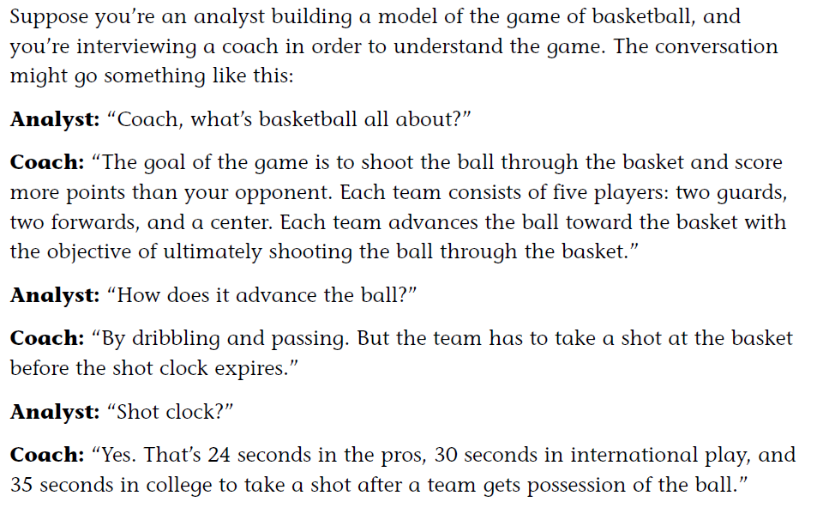
Example : modeling basketball game

Slide 6
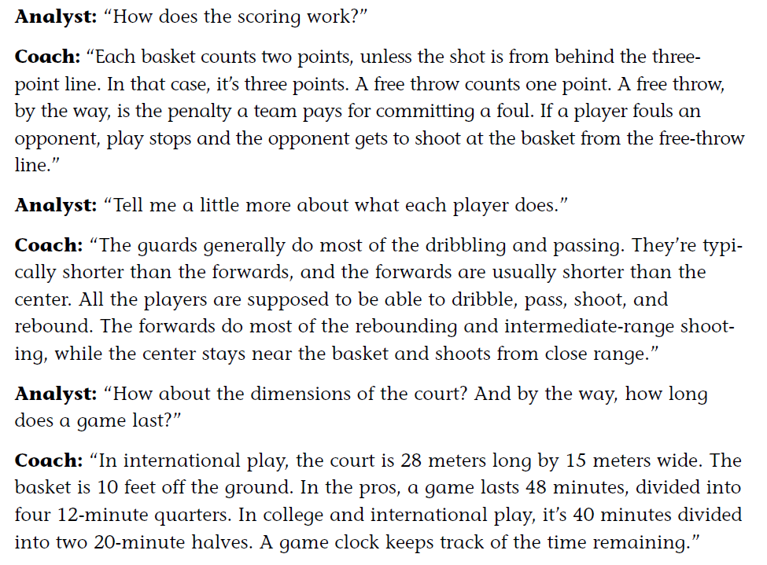
Example : modeling basketball game

Slide 7
Basketball Game
Conversation with coach
noun
ball, basket, team, players, guards, forwards, cener, shot, shot clock, three-point line, free throw, foul, free-throw line, court, game clock
verb
Shoot, advance, dribble, pass, foul, rebound
Initial Class Diagram

Slide 8
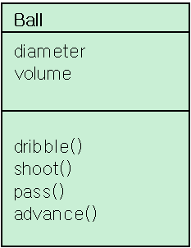
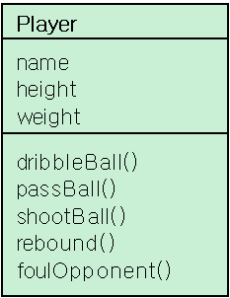
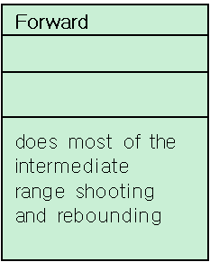
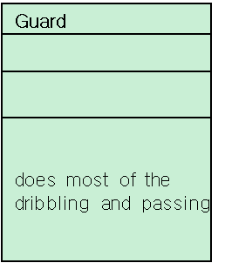
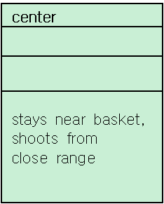
Initial class diagram
Team
Basket
ShotClock
{pro = 24 sec
college = 35sec
Int’l = 30 sec}
Shot
Foul
GameClock
{pro = 4 12-minute quarters
college and Int’l=2
20-minute halves}
Court
ThreePointLine
FreeThrow
Duration
{pro = 48minutes
college and Int’l =
40 minutes
FreeThrowLine

Slide 9
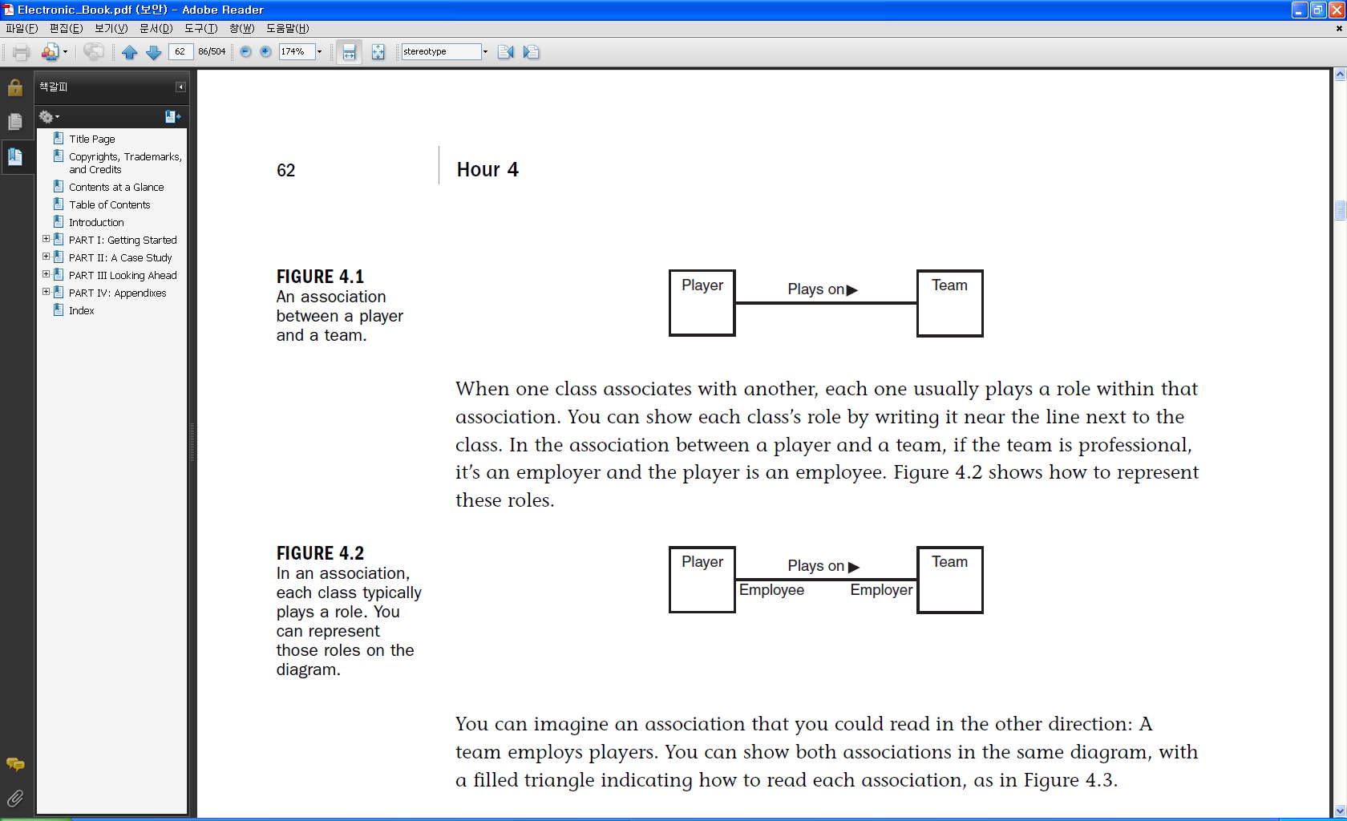
Association
When classes are connected together conceptually, that connection is called association

Slide 10
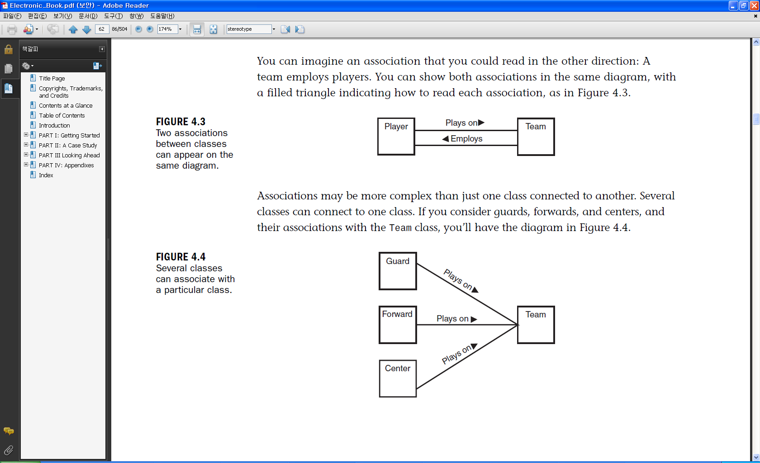
Association

Slide 11
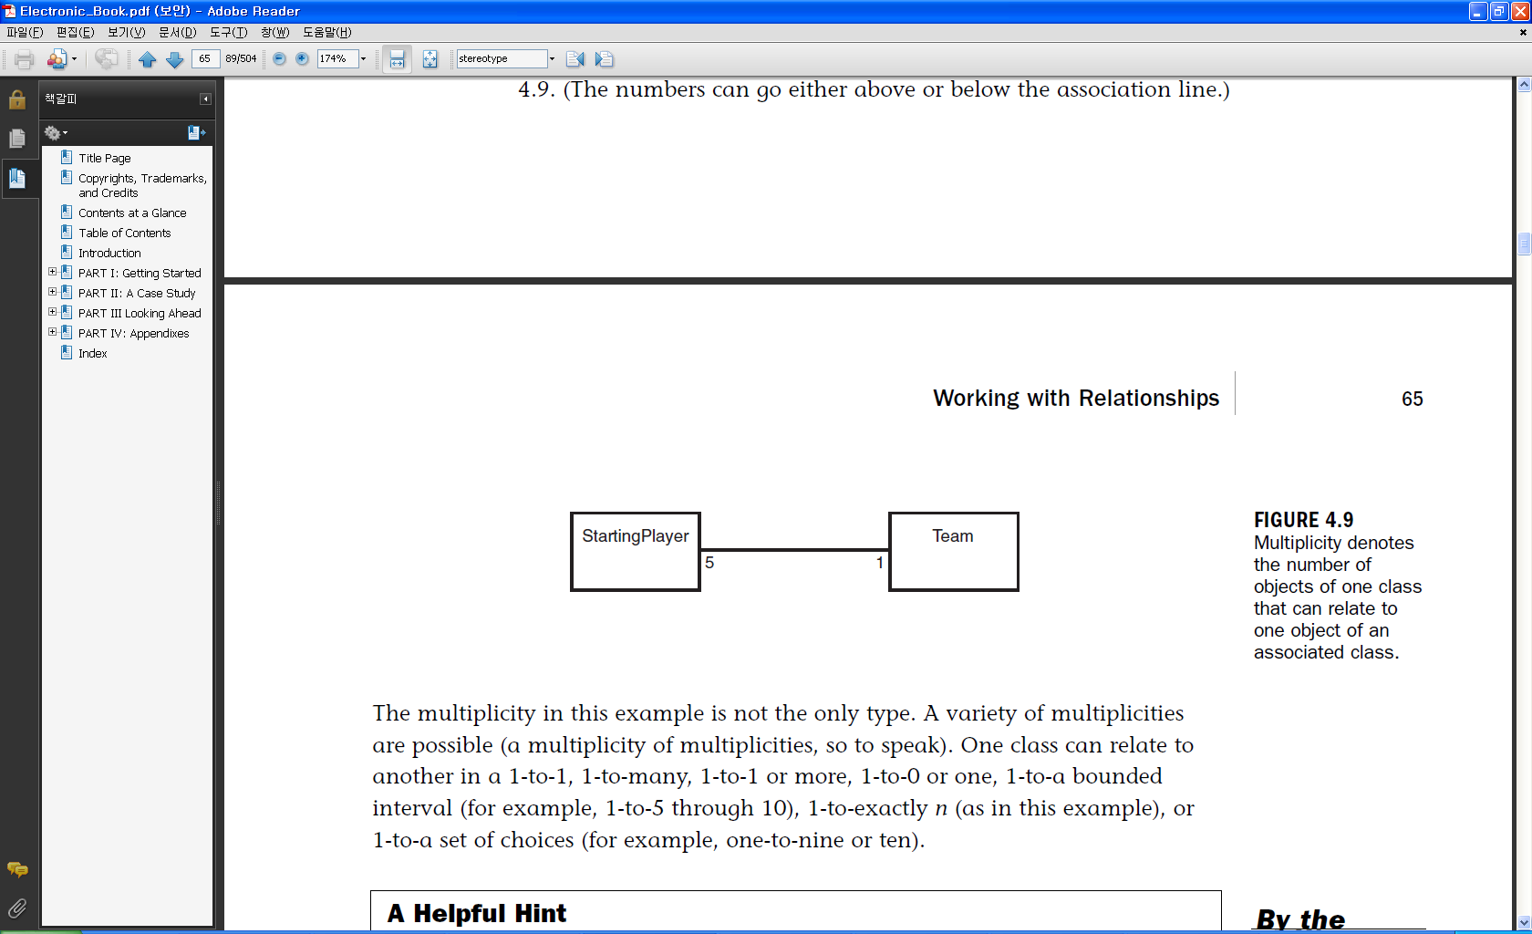
Multiplicity
The number of objects from one class that relate with a single object in an associated class.
    One – to – one
    One – to – many(*)
    One – to – one or more(*)
      1..*
    One – to – zero or one
    One – to – a bounded interval
      ex. one – to – 5 through(..) 10
    One – to exactly n
      ex. One – to – 10
    One – to – a set of choices
      ex. One – to – 5 or(,) 10

Slide 12
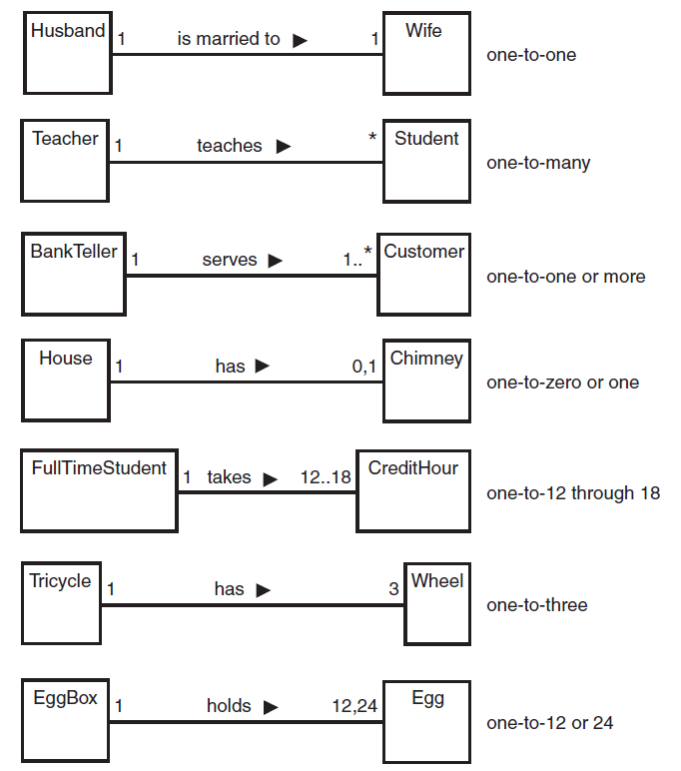
Multiplicity
Possible multiplicities
and how to represent them in UML

Slide 13
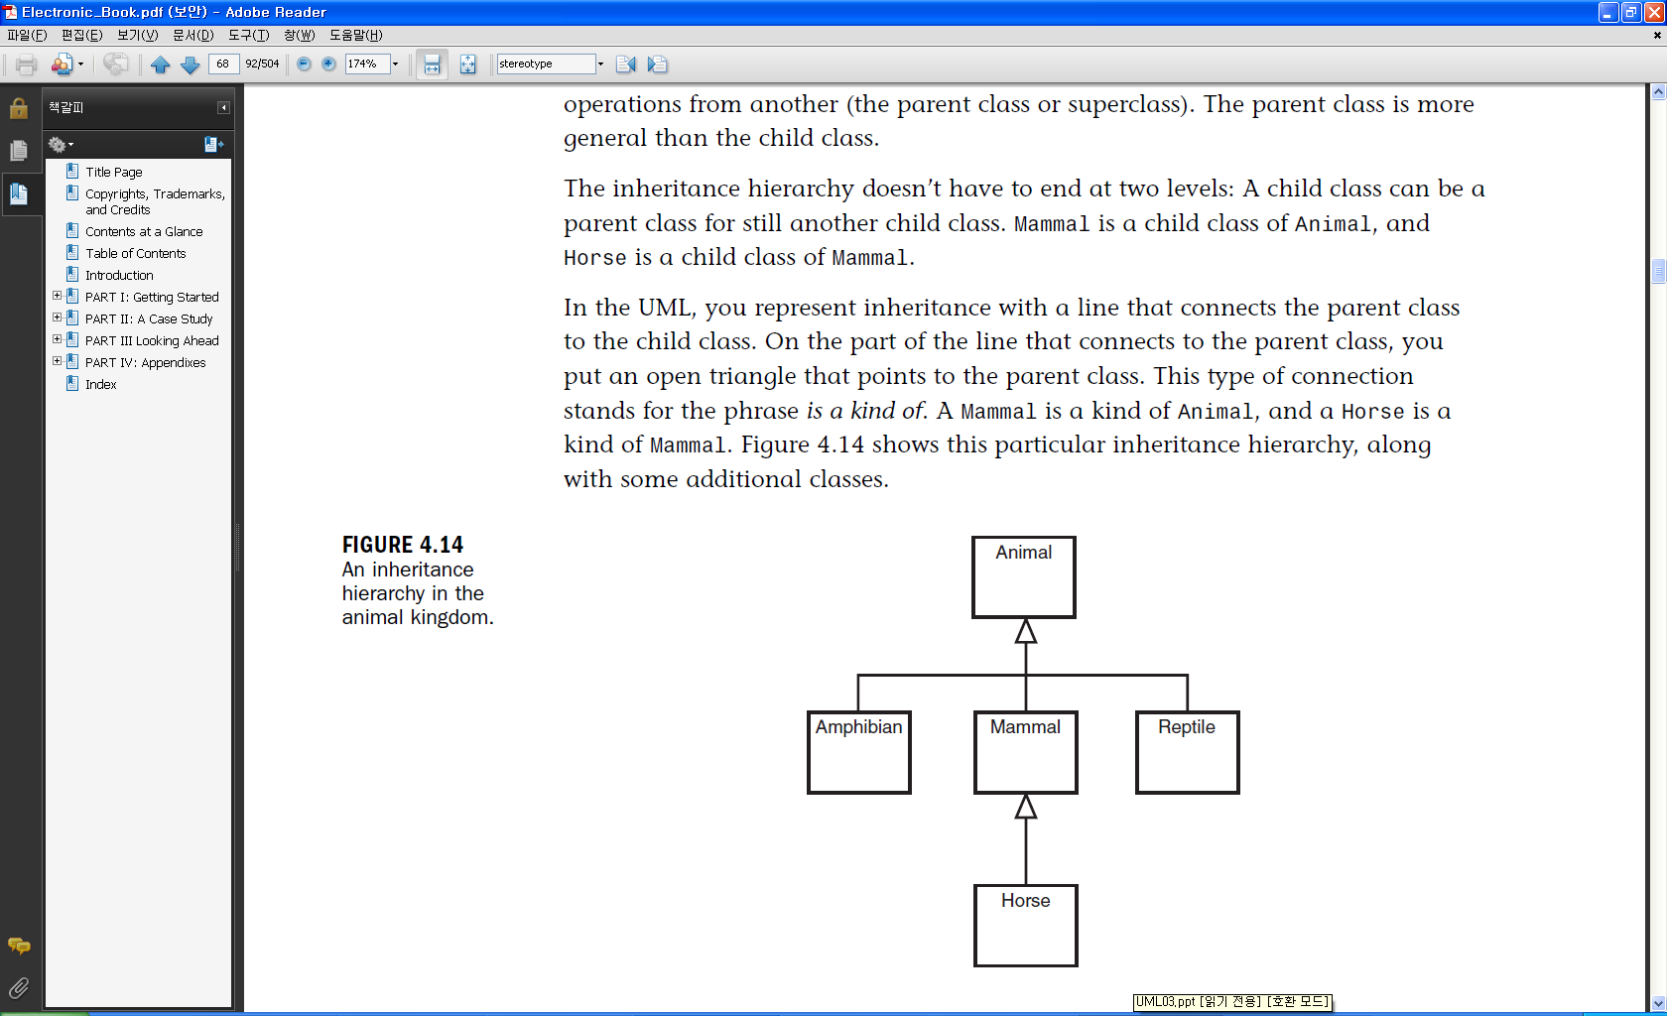
Inheritance
Inheritance
  Is-a relationship

Slide 14
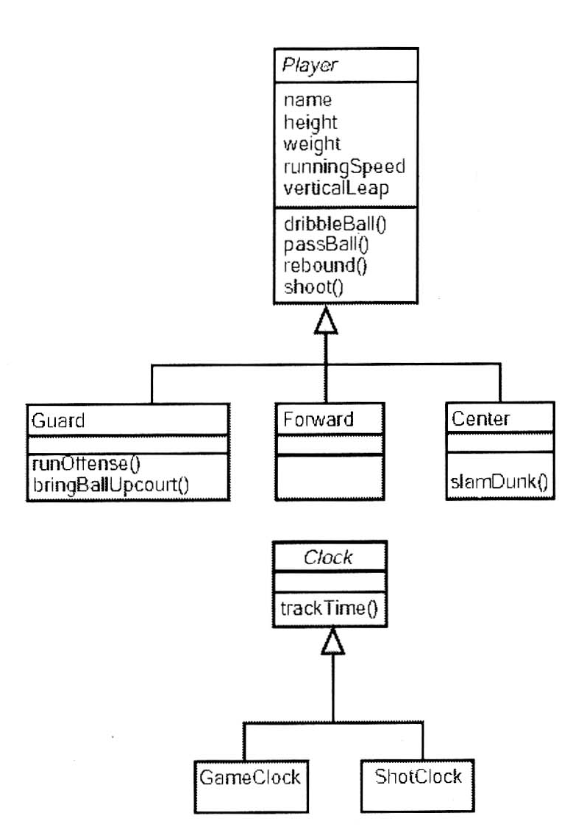
abstract class
Class that does
not have an instance
italic font

Slide 15
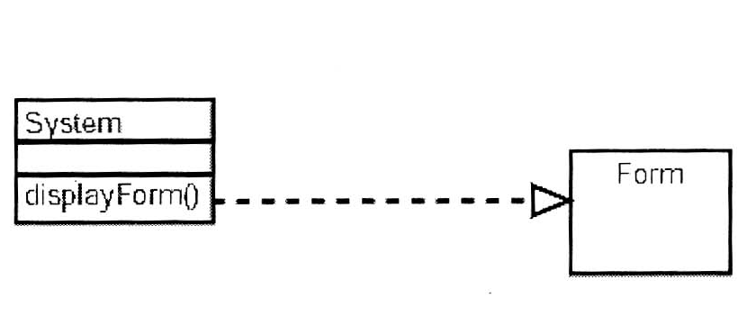
Dependencies
one class may use another.
The most common usage of dependency is to show that the signature of one class’s operation uses another class

Slide 16
More about class diagrams
집합연관(Aggregation)
복합연관(Composition)
문맥(Contexts)
인터페이스(Interface)
실체화(Realization)
가시성(Visibility)

Slide 17
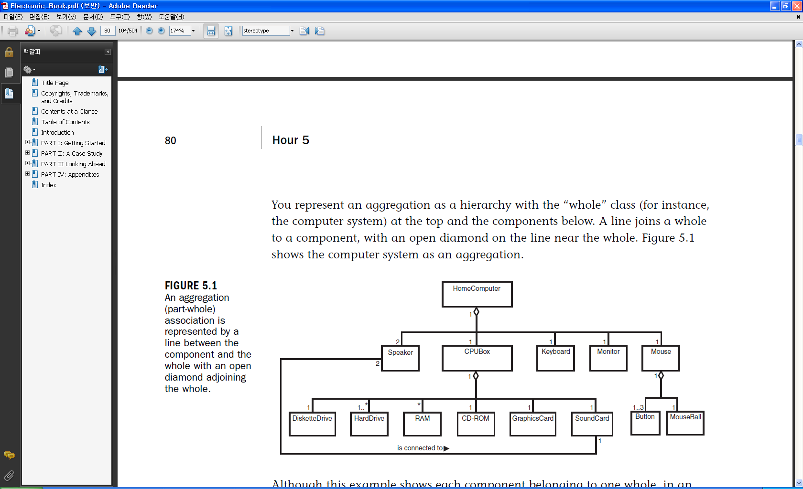
Aggregations
A class consists of a number of component classes

Slide 18
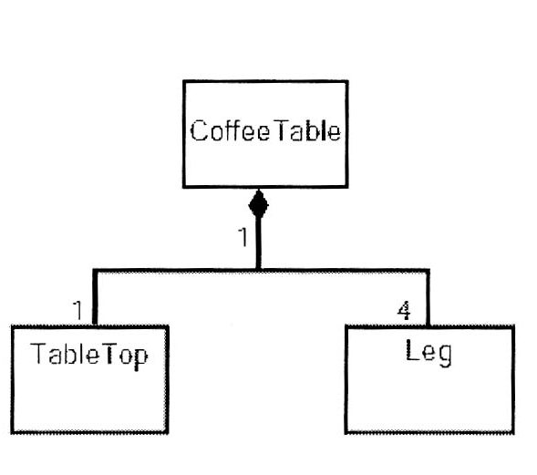
Composite
A strong type of aggregation
  Each component in a composite can belong to just one whole

Slide 19
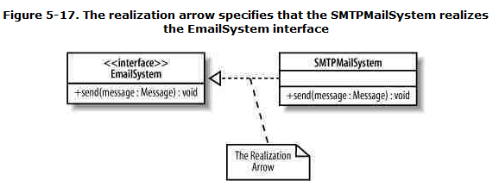
Interface and Realization
One entity (interface) defines a set of functionalities as a contract, and the other (class) realizes the contract by implementing the functionality defined in the contract.

Slide 20
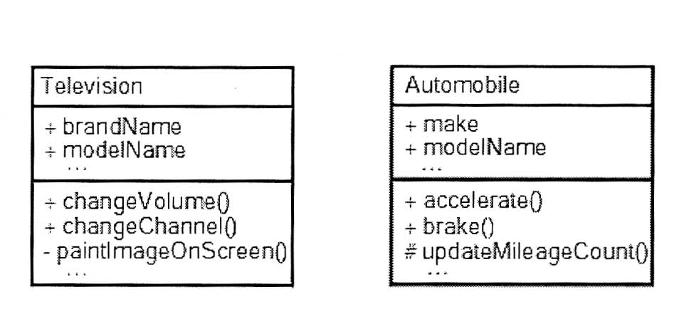
Visibility
  + : public
  # : protected
  - : private

Slide 21
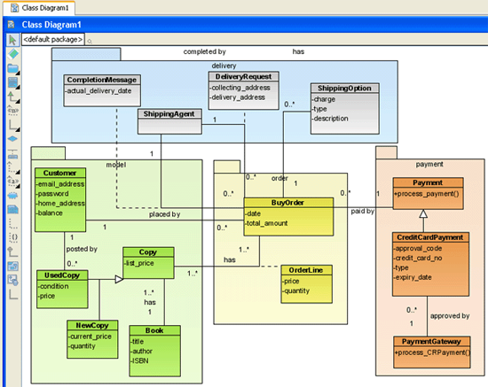
Ex) Class Diagram

Slide 22
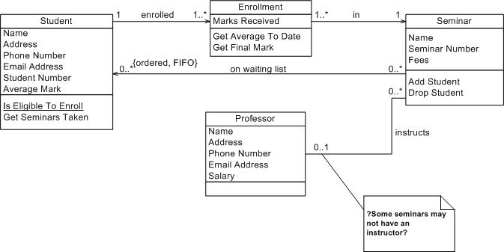
Class diagram (example)

Slide 23
Package Diagram

Slide 24
Package Diagram
logical hierarchical decomposition of a system
usually organized to maximize internal coherence within each package and to minimize external coupling among packages.
Often organize Use-Case diagrams and class diagrams.

Slide 25
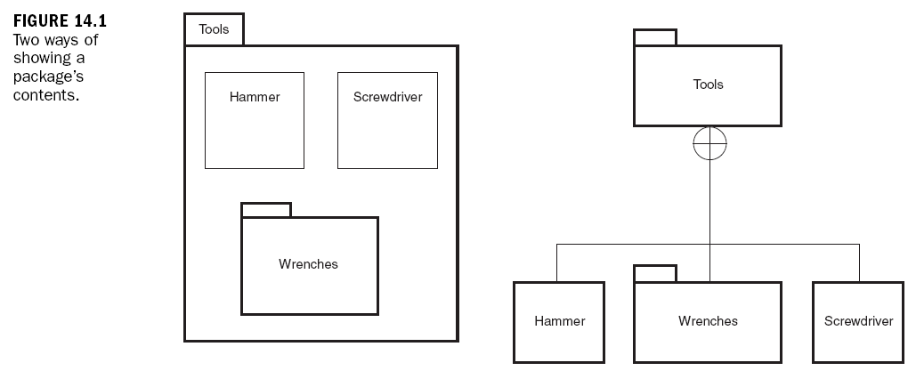
Goal of Package
Group diagram components (e.g. class , use case, …) into a package
Similar to Namespace in C++ (e.g. Tools::Hammer)

