Slide 1
Lecture 2
Intro. To Software Engineering and Object-Oriented Programming
(2/2)

Slide 2
OOP
What is problem?
  Traditional structured programming is not sufficient for large software maintenance and reuse.
Solution? OOP
  Improve reusability
  SW reliability is increased using reusable modules which are already well-tested and error-free .

Slide 3
OOP concepts
Data Abstraction
  Abstract Data Type
Object
  Information hiding/encapsulation
Class
Inheritance
Polymorphism
Dynamic binding

Slide 4
ADT(Abstract Data Type)
A set of data variables and associated operations that are precisely specified independent of any particular implementation.
ADT = data + operations (no implementation)
In OOP,
  We don’t define data for defining procedures,
  But we do define procedures necessary for defining data
  ADT is a type that combines data and the procedures

Slide 5
class
In C++, “class” is used for defining ADT
Defines attributes and behaviors of an object
  Attributes : member variables
  Behaviors : member functions

Slide 6
Object
Object is an instance of class
Consists of
  Internal data
  Internal operations
  Interface operations
Only class methods can access the internal data of an object.
Message passing
  Request some work to other object through calling a method.

Slide 7
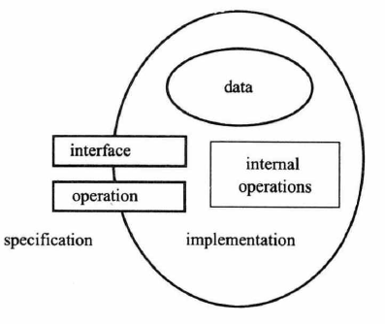
Object Overview

Slide 8
Information Hiding/Encapsulation
Encapsulation conceals the functional details of a class from objects that send messages to it.
Internal data of an object can be modified only through an interface

Slide 9
Class vs Object
Each object generated by the same class is different objects
  When the objects are created, different memory space and address are assigned to each object with unique identifier.
Objects created by the same class share the class’s methods.
An object can be dynamically constructed or destructed in memory during run-time.

Slide 10
Inheritance
A child class (Sub class) inherits attributes and behaviors of parent classes (super class).
and can define their own attributes and behaviors.
The properties (variables,methods) of a child class should be mostly similar to the properties of parent classes.
Goal : Object (class) Reuse
In large SW development, code reuse reduces costs.
We can reuse well-defined classes.
Related programs can define new classes using inheritance.

Slide 11
Polymorphism
Allows the same method (message) to different meaning.
the ability of objects belonging to different data types to respond to method calls of the same name, each one according to an appropriate type-specific behavior.
In C++
  Virtual function
  Operator overloading
  Function overloading
  Template

Slide 12
dynamic binding
Binding
  Determination of association between object name (identifier) and its actual memory address and value.
Static binding
  Binding occurs at compile-time
  Faster compared to dynamic binding
Dynamic binding
  Binding occurs in run-time
  Relatively slow
  Sending a message to a pointer of an object. The pointer is determined in run-time and appropriate message is sent.
  In C++, virtual function

Slide 13
Benefits of Object Model
Builds a system that evolves over time
  Entendible
  Stable
Thinking in terms of objects and classes is much easier for humans
Separating the client and implementor prevents accidental damage through data encapsulation
Reusability

