Slide 1
C++ Introduction : C++ compilation Standard Input/Output: cin, cout Functions Array, Pointer class File Input/Output

Slide 2
C++ Compiler
C++ compiler generates executable file from C++ source code (files).
Visual Studio 20xx
Installed in our PC rooms (Building 208 4th, 5th, 6th floors)
g++ (LINUX, MS Windows, cygwin, Mac, …)
> g++ -o TestProg TestProg.cpp
> ./TestProg

Slide 3
Useful Youtube Tutorials for C++ Beginner
Compile C++ with Visual Studio 2017
https://youtu.be/2Oi0jynRy9E
C++ Tutorial for Beginners – Full Course
https://youtu.be/vLnPwxZdW4Y
Using Makefile for compiling multiple C++ source files
https://youtu.be/aw9wHbFTnAQ

Slide 4
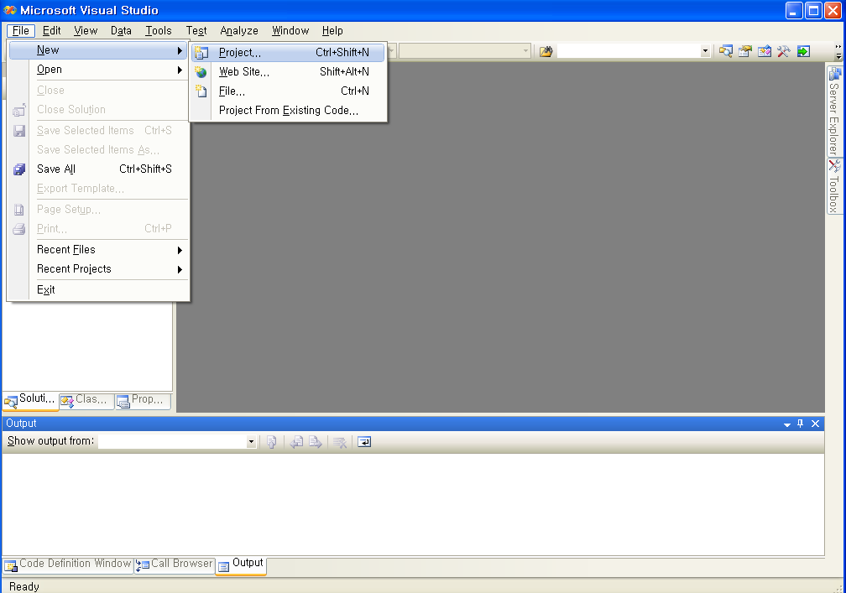
Visual Studio 2008 : Creating Command-Line Program

Slide 5
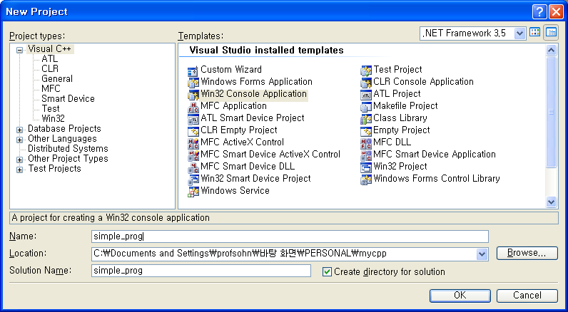
Visual Studio 2008 Creating Command-Line Program

Slide 6
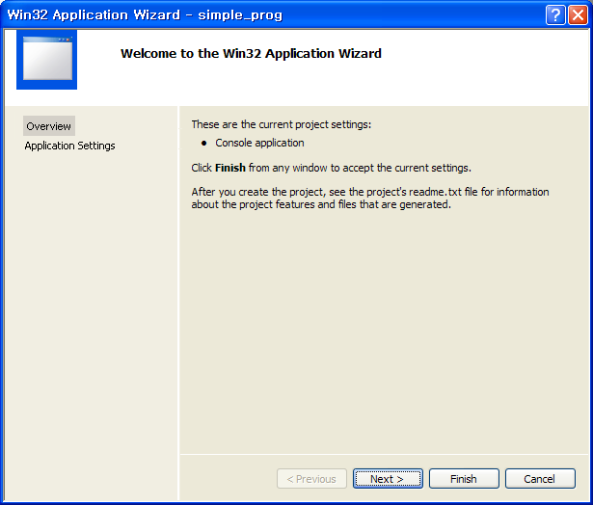
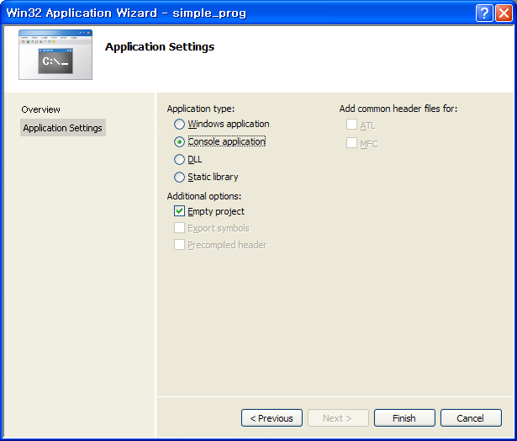
Visual Studio 2008 Creating Command-Line Program

Slide 7
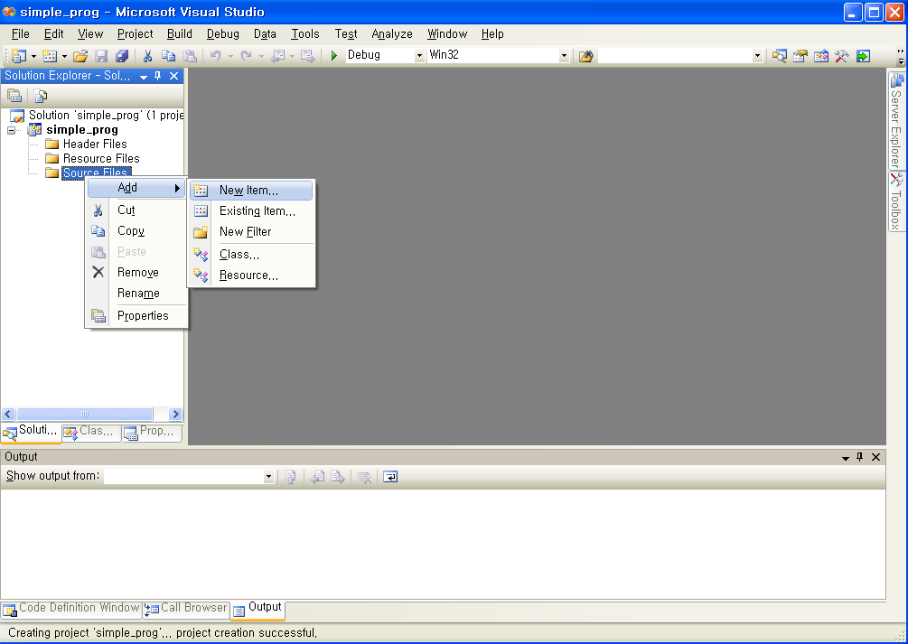
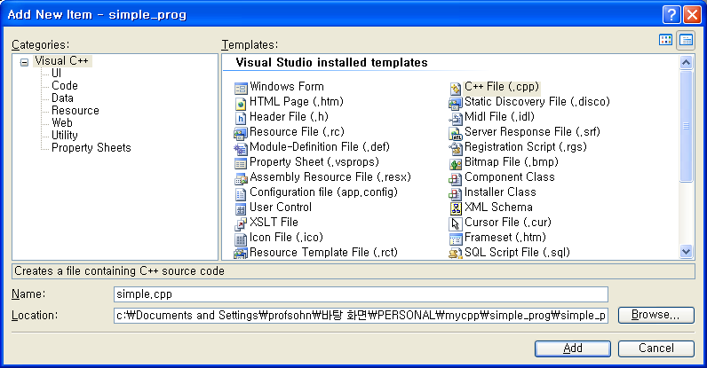
Visual Studio 2008 Creating Command-Line Program

Slide 8
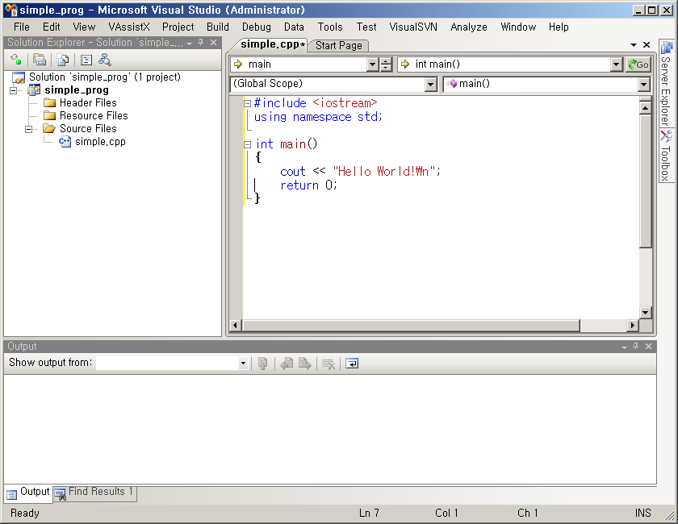
Visual Studio 2008 Creating Command-Line Program
Build (compile)
&
execute

Slide 9
C++ Introduction : C++ program structure

Slide 10
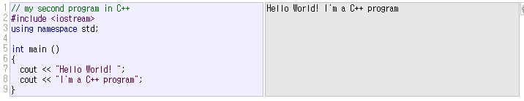
It is OK to use C code in C++ program

Slide 11
C++ Introduction : C++ Standard Input/Output

Slide 12



Standard Output (cout)
cout : screen stream object

Slide 13

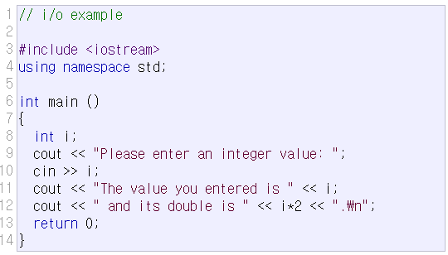

Standard Input (cin)
cin : keyboard stream object

Slide 14
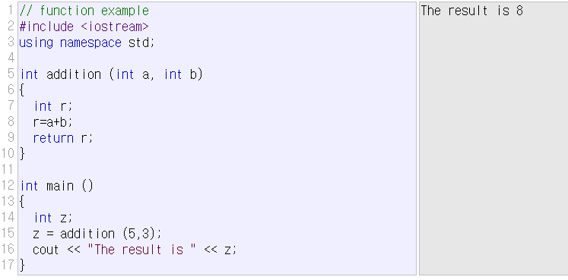
C++ Introduction : Functions

Slide 15
C++ Introduction : array/pointer/dynamic allocation
Array/Pointer : almost same as C
Dynamic allocation
malloc (in C) ⬄ new (in C++)
free (in C) ⬄ delete (in C++)
Ex) in C
int *x;
x=(int*)malloc(10*sizeof(int));
…
free(x);
Ex) in C++
int *x;
x=new int[10];
…
delete[] x;

Slide 16
C++ Introduction : C++ class

Slide 17
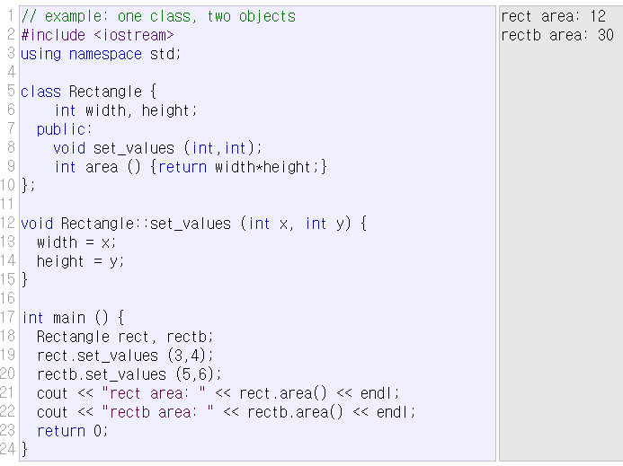
class
class : data structure type that can contain member data and member functions.

Slide 18
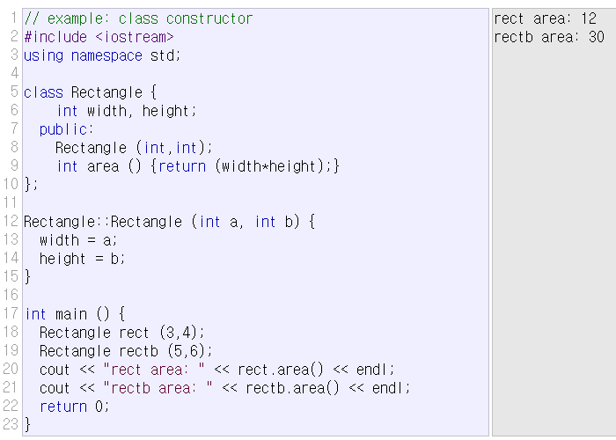
class constructor/destructor
member function that is automatically called when the object is created/deleted.

Slide 19
pointers to class object
#include <iostream>
using namespace std;
class Rectangle {
int width, height;
public:
Rectangle() { width=1; height=1; }
Rectangle(int x, int y) : width(x), height(y) {}
int area() { return width*height; }
};
int main()
{
Rectangle obj(3,4);
Rectangle *foo, *bar, *baz;
foo = &obj;
bar = new Rectangle(5,6);
baz = new Rectangle[2];
cout << "obj's area: " << obj.area() << '\n';
cout << "*foo's area: " << foo->area() << '\n';
cout << "*bar's area: " << bar->area() << '\n';
cout << "baz[0]'s area: " << baz[0].area() << '\n';
cout << "baz[1]'s area: " << baz[1].area() << '\n';
delete bar;
delete[] baz;
return 0;
}

Slide 20
C++ Introduction : Input/Output with Files

Slide 21
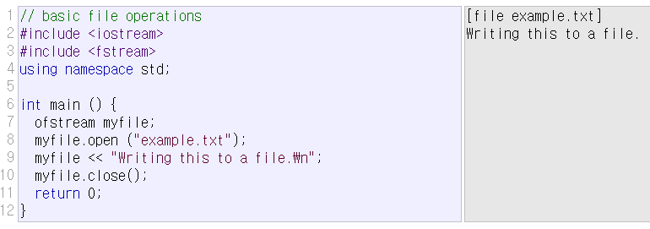
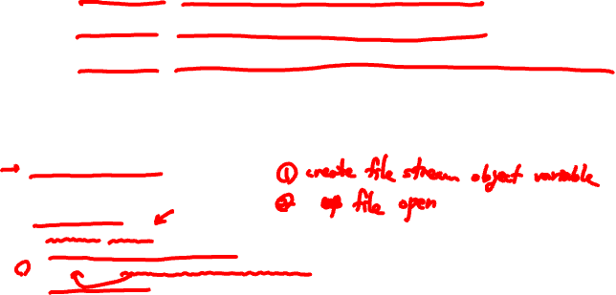
file stream class
ofstream: stream class to write on files
ifstream: stream class to read from files
fstream: stream class to read and write from/to files

Slide 22
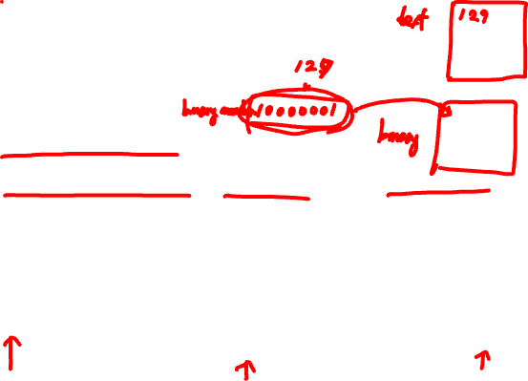
File Processing
File Open
Text? Or Binary?
In case of writing, append? Or truncate?
File Position (automatic? Or User-Control?)
File Processing
(Read/Write)
File open
File close

Slide 23
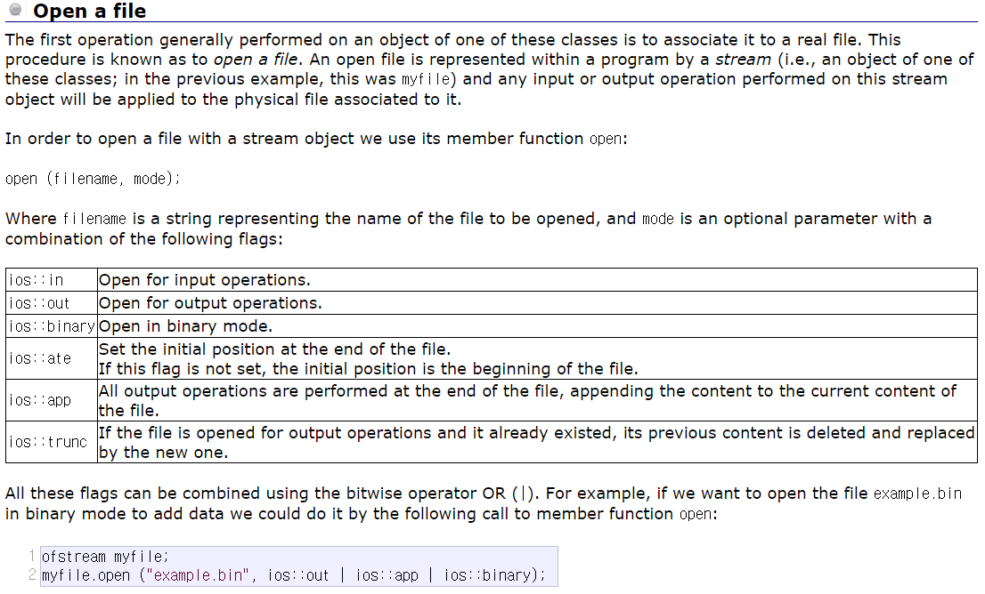

File open mode

Slide 24

File Open/Close
Default mode
Check if file open was OK
Closing a file

Slide 25

Text File (Write)- Example

Slide 26

Text File (Read) - Example

Slide 27
Status Check

Slide 28
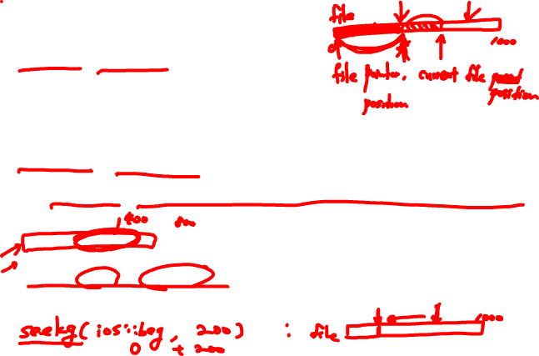
Get and Put Stream Positioning
tellg()/tellp()
Returns current get/put position
seekg()/seekp()
Change the location of the get/put position
seekg(position);
seekp(position);
seekg(offset, direction);
seekp(offset, direction);

Slide 29
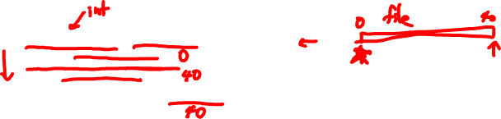
File Position Example

Slide 30

Binary File Processing

