Slide 1
C++ in Summary

Slide 2
1. C++ Compiler
Compiler
Converting high-level language code to machine language code
C++ compiler generates executable file (binary code) from C++ source code (files).
Visual Studio 20xx
Installed in our PC rooms (Building 208 4th, 5th, 6th floors)
g++ (LINUX, macOS, MS Windows, cygwin, …)
> g++ -o TestProg TestProg.cpp
./TestProg
C++ program
int main…
Compiler
Machine
language
010101…

Slide 3
2. Useful Youtube Tutorials for C++ Beginner
Compile C++ with Visual Studio 2017
https://youtu.be/2Oi0jynRy9E
C++ Tutorial for Beginners – Full Course
https://youtu.be/vLnPwxZdW4Y
Using Makefile for compiling multiple C++ source files
https://youtu.be/aw9wHbFTnAQ

Slide 4
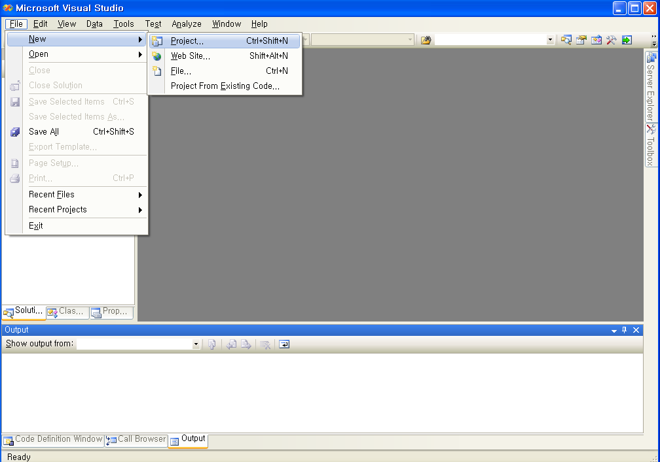
Visual Studio 2008 : Creating Command-Line Program

Slide 5
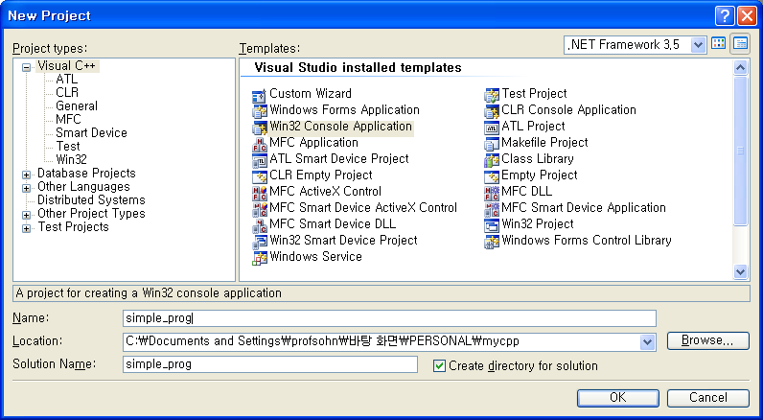
Visual Studio 2008 Creating Command-Line Program

Slide 6
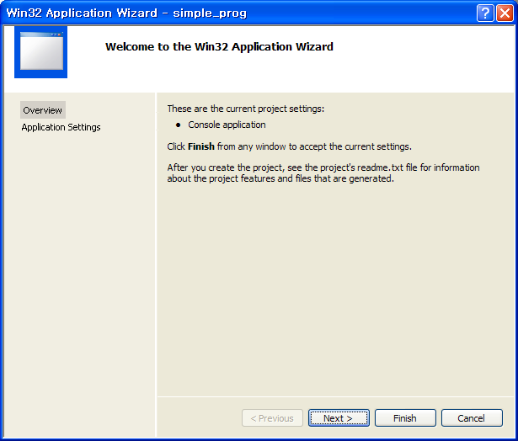
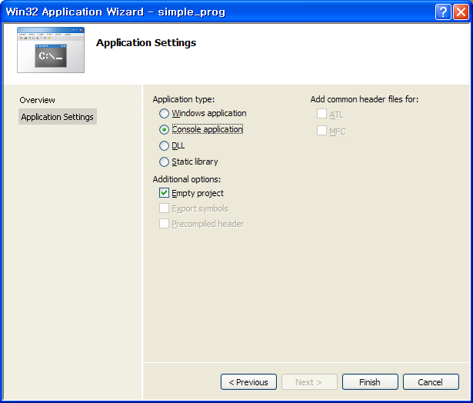
Visual Studio 2008 Creating Command-Line Program

Slide 7
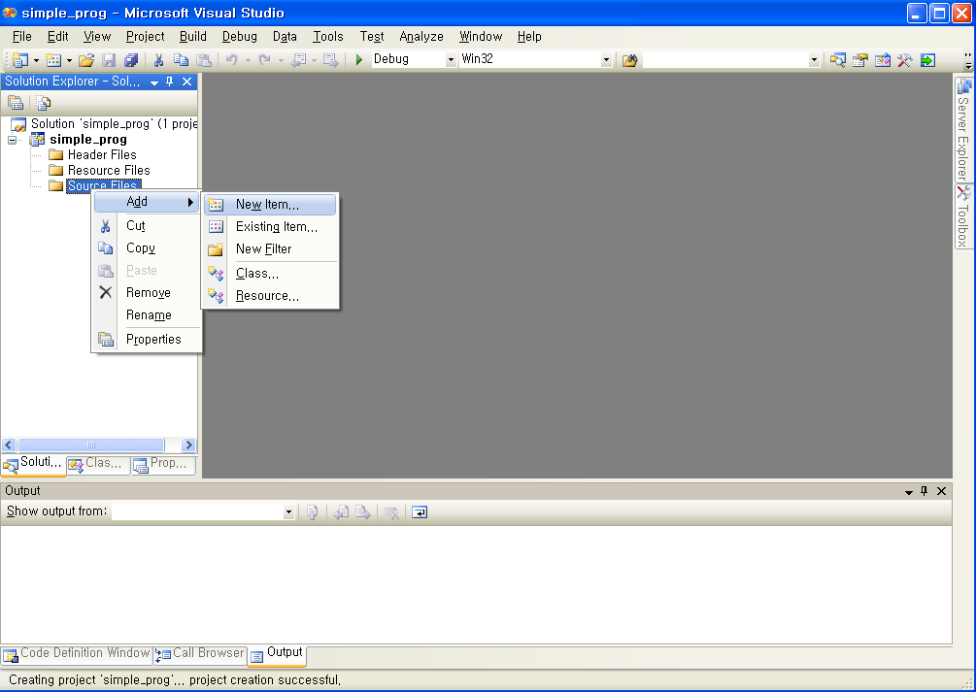
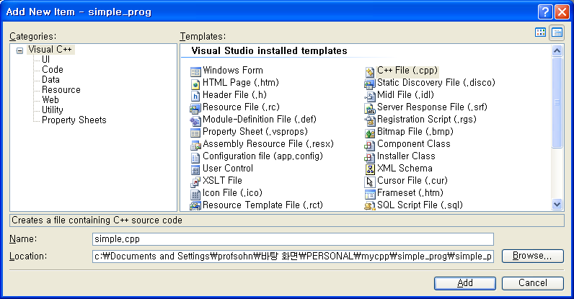
Visual Studio 2008 Creating Command-Line Program

Slide 8
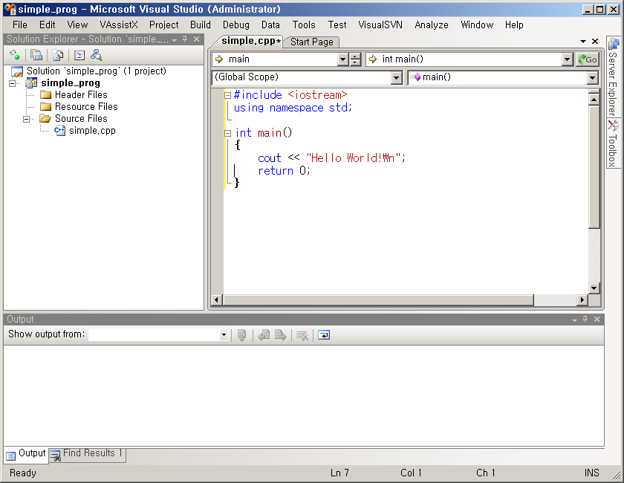
Visual Studio 2008 Creating Command-Line Program
Build (compile)
&
execute

Slide 9
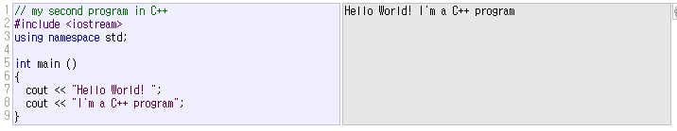
3. “Hello World!” code
header file
It is OK to use C code in C++ program

Slide 10



4. Standard Input/Output
cout : screen stream object
(standard output)
comments

Slide 11

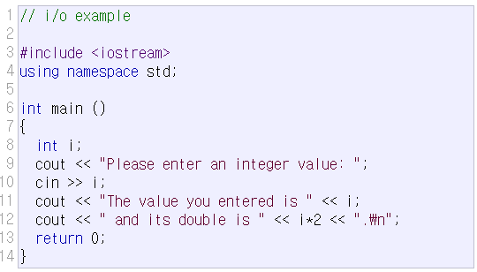

4. Standard Input/Output
cin : keyboard stream object
(standard input)

Slide 12
Formatting
formatting similar to printf
std::format (C++20)
std::print (C++23)
// src_print.cpp
#include <iostream>
#include <cstdio>
#include <print>
#include <format>
using namespace std;
int main()
{
double pi=3.141592;
int age = 21;
printf("pi=%7.2f , age=%d\n",pi,age);
cout << format("pi={:7.2f} , age={}\n",pi,age);
print("pi={:7.2f} , age={}\n",pi,age);
return 0;
}
[program output]
pi= 3.14 , age=21
pi= 3.14 , age=21
pi= 3.14 , age=21

Slide 13
5. Variables and Data Types
Variable
Named memory location where data value is stored
Each variable has a certain type
Variables must be declared before use in a program
char (1 byte) : capable of holding one character (ascii code)
int (4 bytes) : integer
float (4 bytes) : single-precision floating point
double (8 bytes) : double-precision floating point
type | size | min value | max value
char | 1byte | -2⁷ = -128 | 2⁷-1 = 127
short | 2byte | -2¹⁵ = -32,768 | 2¹⁵-1 = 32,767
int | 4byte | -2³¹ = -2,147,483,648 | 2³¹-1 = 2,147,483,647
min/max values are defined in <limits> header file
use unsigned type when representing only positive numbers
unsigned char , unsigned short, unsigned int

Slide 14
6. string type
standard type for storing and manipulating text
(a class provided by the C++ standard library)
Unlike C-style strings (char *),
string automatically manages memory and
provides many convenient functions
getline(cin,str) function is used to read a line of text.
Example code
src_string.cpp
src_getline.cpp

Slide 15
7 : Control Structures if, loop (while, for)

Slide 16
Conditional Statement: if
block : enclosed by { }
if , if-else , if – else if - else
Example
if ( num1 >= num2 )
{
printf(“num1 is greater than num2\n“);
printf(“The difference is: %d\n”, num1- num2);
} else {
printf(“num2 is greater than or equal to num1\n”;
printf(“The difference is: %d\n”, num2 – num1);
}

Slide 17
while - loop
num = 1;
Sum = 0;
true
sum = sum + num;
num = num + 1;
num <= 10
num = 1;
sum = 0;
while (num <= 10) {
sum = sum + num;
num = num + 1;
}
false

Slide 18
for - loop
Repetition
control variable initialization
Test Conditon
Modification of control variable value
order : (1) (2) body (3) (2) body (3) (2) body … body (3) (2)
* Example
sum=0;
for(int num = 1; num <= 10; num++ ) {
sum += num;
num++;
}
for ( (1); (2); (3) )
{
(body)
}
(1)
(2)
FALSE
TRUE
body
(3)

Slide 19
break & continue
break in loop
go out of the loop block and execute next to the loop
Example
while (1) {
cin >> j;
if (j == 0)
break;
result = i/j;
}
continue in loop
go to condition-test and next iteration of the loop
Example
sum = 0;
for (i = 0; i <= n; i++) {
if (i % 2 == 0)
continue;
sum += i;
}

Slide 20
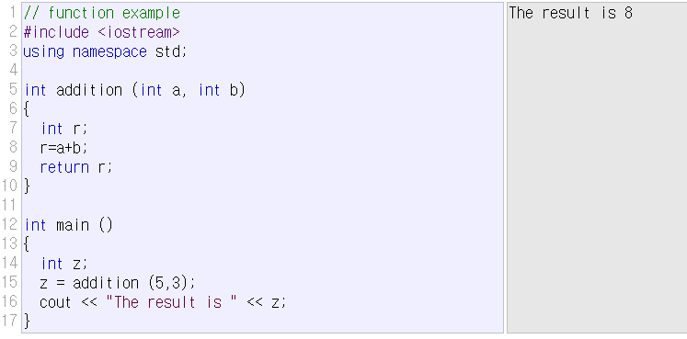
8. Functions
local variables vs global variables
local variables (including parameter variables)
created when function is called
deleted when function returns

Slide 21
why use functions?
many reasons
– Don’t have to repeat the same block of code many times. Make that code block a function and call it when needed.
– Reuse : useful functions can be reused in a number of programs.
– top-down technique : Make an outline and hierarchy of the steps needed to solve your problem and create a function for each step.
– Easy to debug : Get one function working well then move on to the others.
– Easy to modify and expand : Just add more functions to extend program capability
– Readabilty : Make program self-documenting and readable.

Slide 22
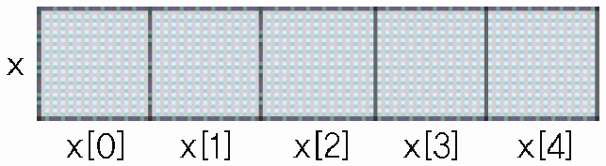
9. array
a fixed-sized collection of elements of the same type
stored consecutively in memory
fast random access (ex) x[15]=3;
string as an array of characters (ex) src_string_cstyle.c
int main()
{
int x0, x1, x2, x3, x4;
cout << "Get 5 integers : ";
cin >> x0;
cin >> x1;
cin >> x2;
cin >> x3;
cin >> x4;
cout << "Reverse Order : ";
cout << x4 << " ";
cout << x3 << " ";
cout << x2 << " ";
cout << x1 << " ";
cout << x0 << ”\n";
return 0;
}
int main()
{
int x[5], i;
cout << "Get 5 integers : ";
for (i = 0; i < 5; ++i)
cin >> x[i];
cout << "Reverse order : ";
for (i = 4; i >= 0; --i)
cout << x[i] << " " ;
cout << "\n";
return 0;
}

Slide 23
10. pointer
pointer type variable
“pointer” usually means memory address
a variable that stores memory address
size is always: 8 bytes (in 64-bit systems), 4 bytes (in 32-bit systems)
Remember
*
multiplication operator (binary operator), ex) z=x*y;
the-value-of operator (unary operator), ex) *x=5;
pointer type declaration, ex) int *x;
&
bitwise-AND operator (binary operator), ex) z=x&y;
address-of operator (unary operator), ex) x=&y;
reference type declaration, ex) int& y=x;
int *xPtr, x; // xPtr is pointer
// x is an integer type
x = 5; // assignment
xPtr = &x; // xPtr points to x that means
// the value of xPtr is the address of x
*xPtr = 10; // the value xPtr points to is changed to 10
// that means x becomes 10
cout << x; // result is 10

Slide 24
11. Dynamic memory allocation
array/pointer : almost the same as C
dynamic memory allocation
“dynamic” means “… occurs at run-time (execution-time)”
malloc (in C) ⬄ new (in C++)
free (in C) ⬄ delete (in C++)
static allocation vs dynamic allocation
see the class webpage , src_array.cpp
ex) in C
int *x;
x=(int*)malloc(10*sizeof(int));
…
free(x);
ex) in C++
int *x;
x=new int[10];
…
delete[] x;

Slide 25
12. C++ class

Slide 26
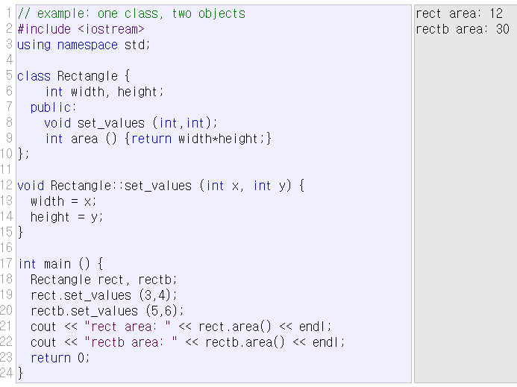
class
class: data structure type that can contain member data and member functions.

Slide 27
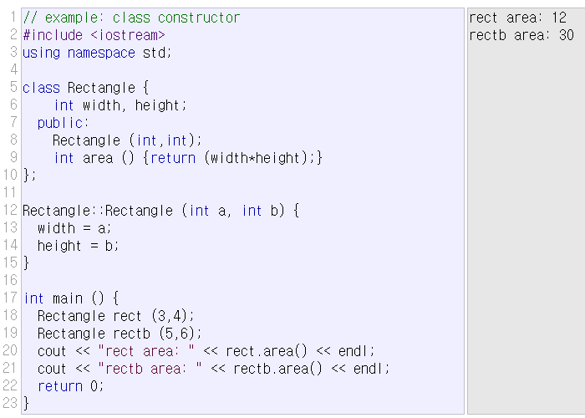
class constructor/destructor
member function that is automatically called when the object is created/deleted.

Slide 28
pointers to class object
#include <iostream>
using namespace std;
class Rectangle {
private:
int width, height;
public:
Rectangle() { width=1; height=1; }
Rectangle(int x, int y) : width(x), height(y) {}
int area() { return width*height; }
};
int main()
{
Rectangle obj(3,4);
Rectangle *foo, *bar, *baz;
foo = &obj;
bar = new Rectangle(5,6);
baz = new Rectangle[2];
cout << "obj's area: " << obj.area() << '\n';
cout << "*foo's area: " << foo->area() << '\n';
cout << "*bar's area: " << bar->area() << '\n';
cout << "baz[0]'s area: " << baz[0].area() << '\n';
cout << "baz[1]'s area: " << baz[1].area() << '\n';
delete bar;
delete[] baz;
return 0;
}

Slide 29
13. C++ File Processing

Slide 30
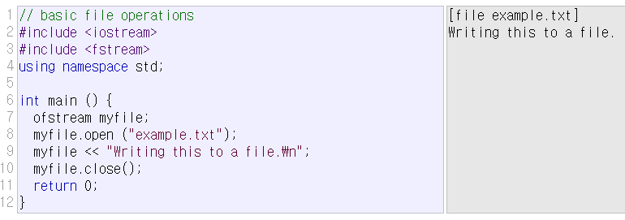
file stream class
ofstream: stream class to write on files
ifstream: stream class to read from files
fstream: stream class to read and write from/to files

Slide 31
File Processing
File Open
Text? Or Binary?
In case of writing, append? Or truncate?
File Position (automatic? Or User-Control?)
File Processing
(Read/Write)
File open
File close

Slide 32
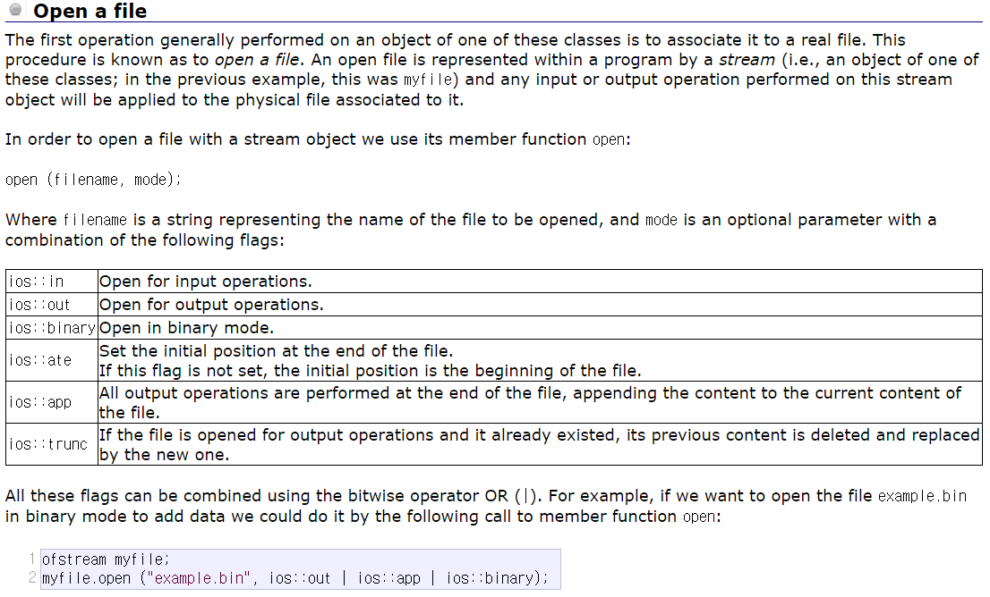
File open mode

Slide 33
File Open/Close
Default mode
Check if file open was OK
Closing a file

Slide 34
Text File (Write)- Example

Slide 35
Text File (Read) - Example

Slide 36
Status Check

Slide 37
Get and Put Stream Positioning
tellg()/tellp()
Returns current get/put position
seekg()/seekp()
Change the location of the get/put position
seekg(position);
seekp(position);
seekg(offset, direction);
seekp(offset, direction);

Slide 38
File Position Example

Slide 39
Binary File Processing

