Slide 1



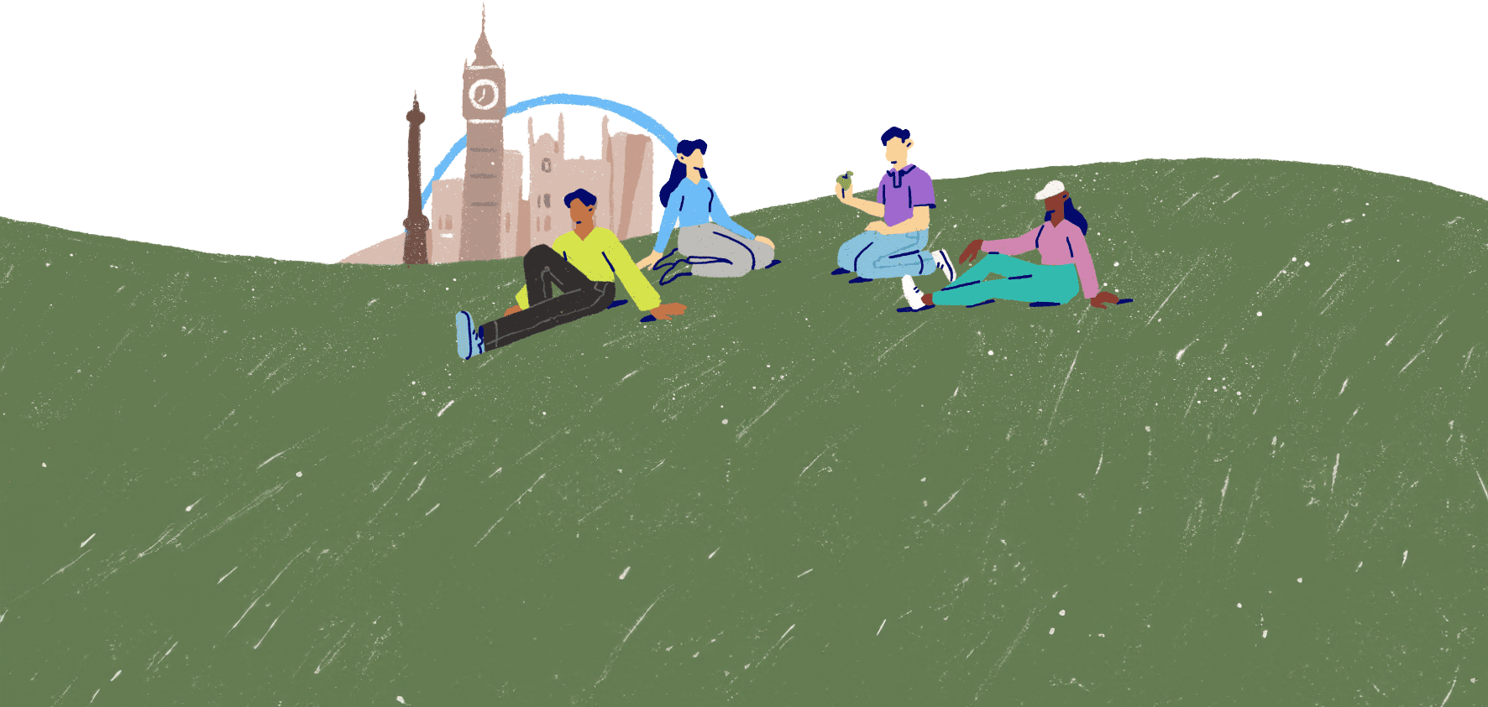
Seeking support
Lesson 10

Slide 2

Getting the help we need
What might prevent a person from getting help with their mental health and wellbeing?
Remember – help IS out there!
Support is available because lots of people need it.
It's OK not to be OK – and it's more than OK to get help when you need it, just as you would if you needed help with your physical health.
Understanding emotions, common types of mental ill health and recognising the symptoms are all important first steps.
Getting help usually comes next, but it isn't always easy. Some people might not know how to get help or might feel embarrassed or uncomfortable about needing help.

Slide 3
Reaching out
If you feel that you or someone you know might need help with mental health or wellbeing concerns, it's important to get help.
It's often useful to speak to more than one person, to get different views, advice and support. Different difficulties might suit conversations with certain people.
You could speak to...
a nurse
a family member
a friend
a religious leader
an adult at a community group
a friend's parent
a therapist
a teaching assistant
a counsellor
Who might you speak to about mental health and wellbeing queries or concerns?
a charity helpline
a teacher
Your GP

Slide 4

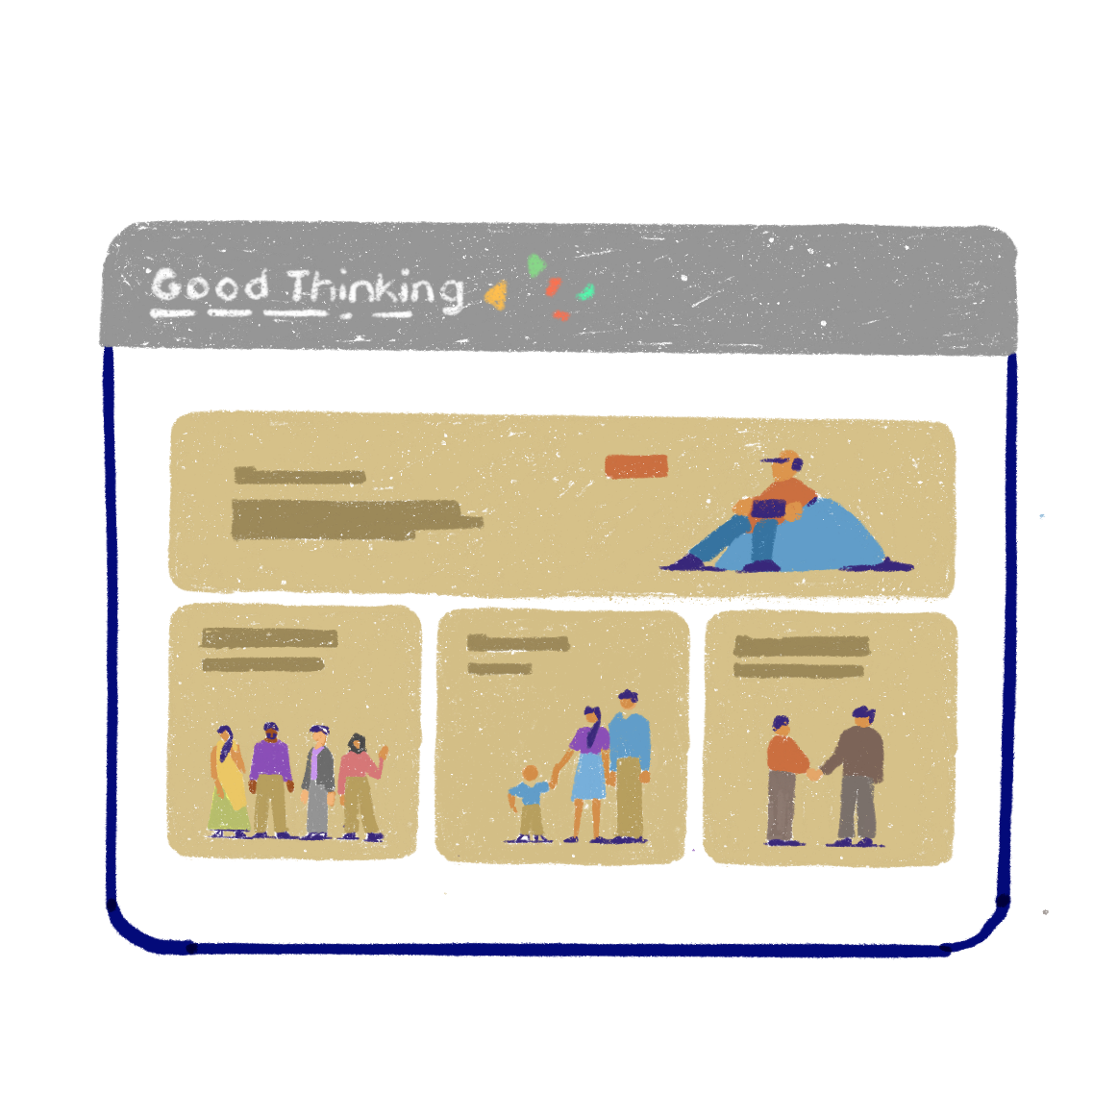
Reliable resources
There is an enormous wealth of information, advice and support available for anyone needing help with their mental health and wellbeing.
However, it's important to use reliable sources, such as the NHS or other professional health organisations.
The Good Thinking website is a great place to start if you need support with anxiety, low mood or stress.

Slide 5
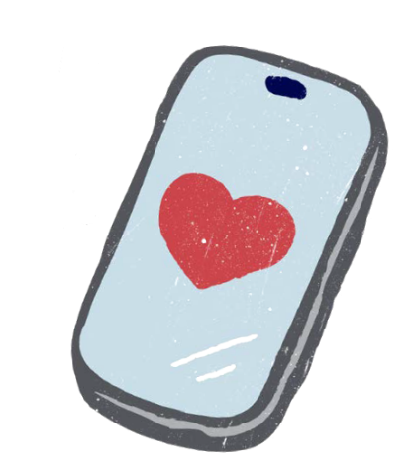




There's an app for that!
The digital age offers many benefits, including support with our mental health and wellbeing.
If technology is a big part of your life, you may find online support and apps are an effective means of support for you.
Some free apps to help with stress, anxiety or low mood include:
Be Mindful
My Possible Self
Feeling Good
Clear Fear
Meditainment

Slide 6


Has it helped?
Photo from Canva
Let's imagine a person has taken a step towards getting help.
Perhaps they've researched information and advice online, or they've reached out to someone. Maybe they've tried some self-care, or they've tried using an app. But it hasn't helped.
They're still struggling with their mental health or wellbeing.
What can they do?

Slide 7



Don't give up!
Photo from Canva
The key to getting the right support is to not give up.
There are always more things a person can try and more people they can reach out to if the things they have tried haven't worked or aren't enough.

Slide 8





Five ways to seek support
Speak to someone at home
Speak to someone at school
Speak to a health professional
Speak to a friend
Use reliable websites and apps

Slide 9

"Just because no one else can heal or do your inner work for you doesn't mean you can, should, or need to do it alone."
Lisa Olivera
Photo by Tobias Mrzyk on Unsplash

