Slide 1



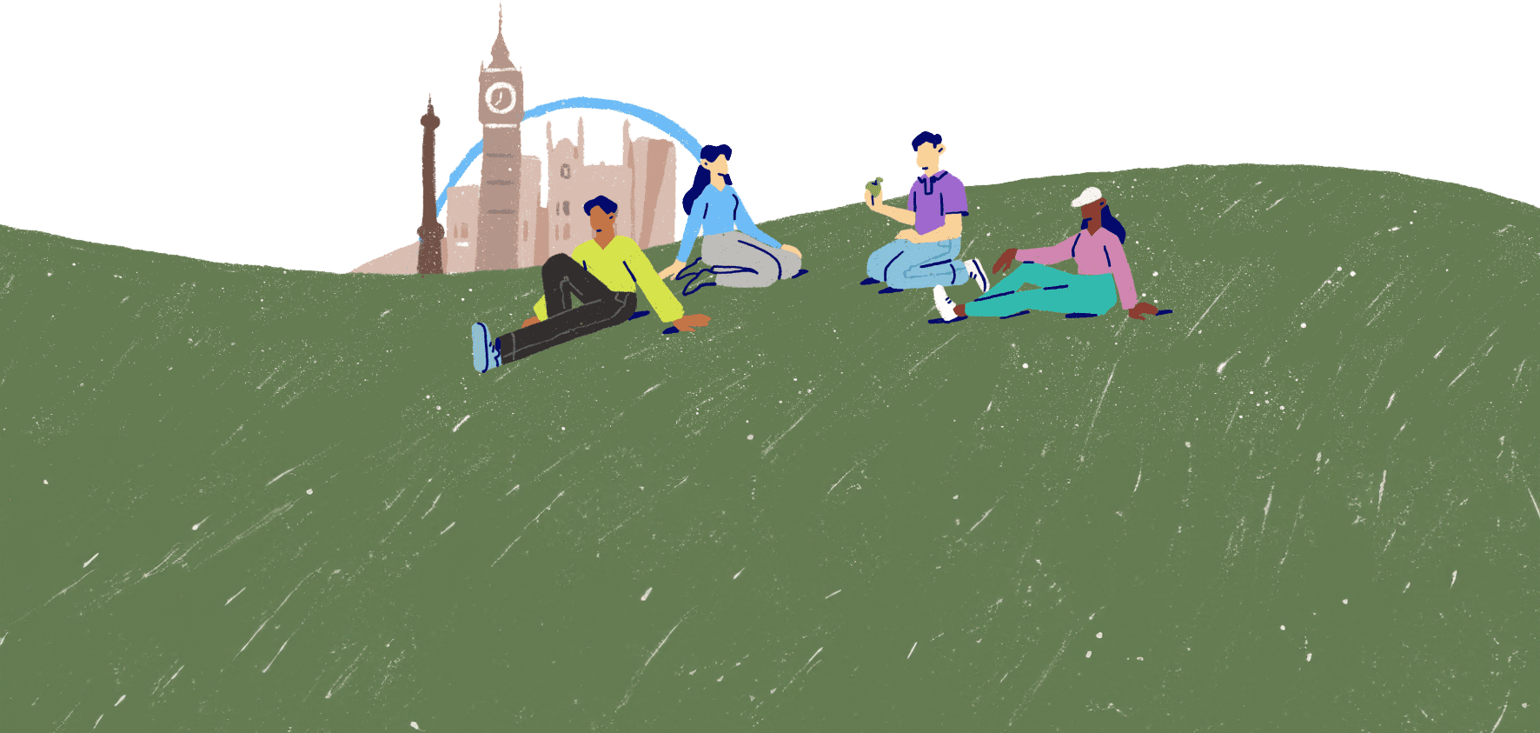
The way we think
Lesson 6

Slide 2

Thoughts and feelings
Photo from Canva
Our thoughts and feelings are closely linked.
Positive thoughts lead to positive emotions. A person who uses positive thinking styles is more likely to feel positively about their mental wellbeing.
But there are a lot of common unhelpful thinking styles that can lead to uncomfortable or difficult emotions. Addressing these thinking styles can help support good mental wellbeing.
Do you know of any unhelpful thinking styles?

Slide 3
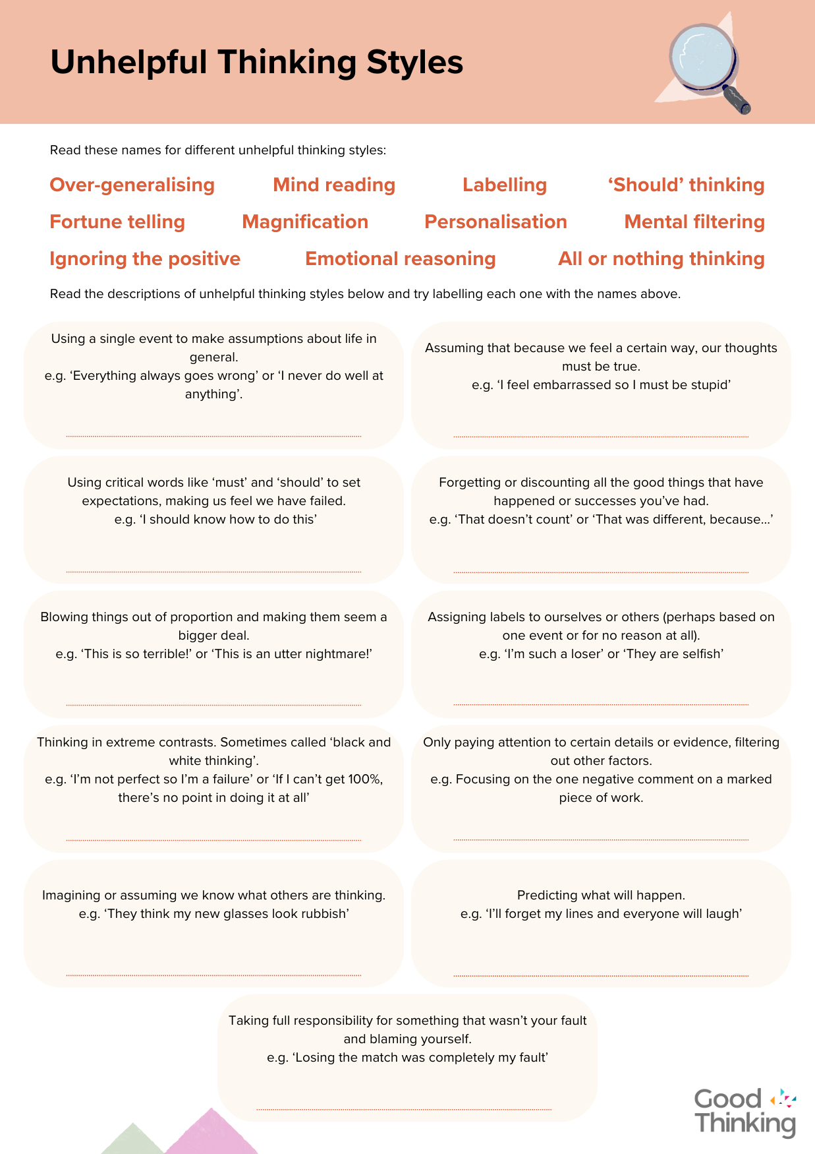
Unhelpful thinking styles
Unhelpful thinking styles involve a person's thoughts becoming distorted or biased in some way.
There are many common unhelpful thinking styles and most of us will recognise some of them as things we do.
See if you can match up the type of unhelpful thinking with its definition on your Unhelpful Thinking Styles activity sheet.

Slide 4


Unhelpful thinking styles
Over-generalising | Using a single event to make assumptions about life in general.
Mind reading | Imagining or assuming we know what others are thinking.
Labelling | Assigning labels to ourselves or others.
'Should' thinking | Using critical words like 'must' or 'should' to set expectations.
Fortune telling | Making predictions about what will happen.
Magnification | Blowing things out of proportion, making them seem a bigger deal.
Personalisation | Taking full responsibility and blaming yourself.
Mental filtering | Focusing on certain details or evidence, filtering out other factors.
Ignoring the positive | Forgetting or discounting good things that have happened or successes.
Emotional reasoning | Assuming that because we feel a certain way, our thoughts must be true.
All or nothing thinking | Thinking in extreme contrasts. 'Black and white' thinking.

Slide 5


Catching automatic thoughts
Consider which of these thinking styles you notice in yourself.
Automatic thoughts occur instantly, in response to events we experience. We have little control over these automatic thoughts popping into our heads, but we can learn to catch them.
Once we're aware of these unhelpful thinking styles, we can try to spot them when they happen.
It's useful to challenge the thought we've had once we've caught it and ask ourselves how accurate the thought really is.
We can do this for ourselves and others!

Slide 6

Making comparisons
Another unhelpful thing a lot of us do is comparing ourself with others.
Making unfavourable comparisons against others makes us feel inferior or inadequate. Yet we're all different people with different circumstances and life isn't a competition.
Can you think of a time when you have compared yourself unfavourably with someone else?

Slide 7

Photo by Kenrick Mills on Unsplash
"You don't have to control your thoughts.
You just have to stop letting them control you."
Dan Millman

Slide 8


