Slide 1



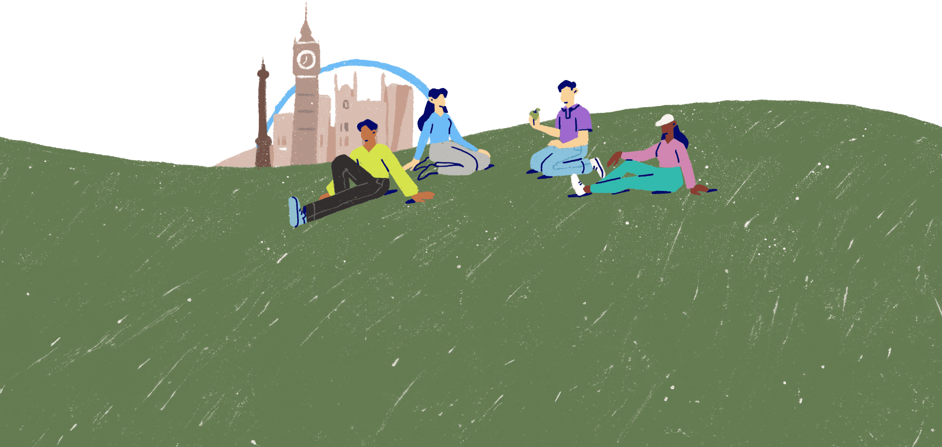
Recharging our batteries
Lesson 8

Slide 2



What our bodies need
Feeling tired
Feeling hungry
Feeling poorly
Lacking protein in our diet
Having an ache or pain
Consuming too much sugar
Dehydration
Lacking essential vitamins
Feeling too hot or too cold
Sensory overload
Having a chronic illness
We know that our physical health and wellbeing are linked to our mental health and wellbeing.
Let's take a look at all the aspects of our physical health that might impact our mood and emotions.

Slide 3


Take a break
“Almost everything will work again if you unplug it for a few minutes, including you.” - Anne Lamott
The school day includes break times between lessons.
At work, employees have scheduled breaks, or are encouraged to take breaks.
And drivers will notice signs on the road reminding them to take a break on long drives.
Why is it strongly recommended that you take regular breaks when studying, working and driving?

Slide 4


True or false?
Taking frequent breaks from work or study can help reduce stress.
True – breaks help us to decompress, feel calmer and to deal with pressure better.
A break disrupts focus and hinders concentration.
False – when locked into a task for too long, our brains become accustomed and lose focus, so taking breaks actually helps us to refocus on the task.
It's best to do a stimulating activity when you take a break from study or work.
False – a break should be relaxing and a chance to unwind.
Taking regular breaks when studying can aid memory.
True – breaks give our brains a chance to process and store the information we've learned.
Regular breaks from screens helps reduce eye strain and headaches.
True – there has been a lot of research to show how prolonged screen use can strain our eyes and cause headaches, as well as prevent us from getting to sleep when we use screens late at night.

Slide 5
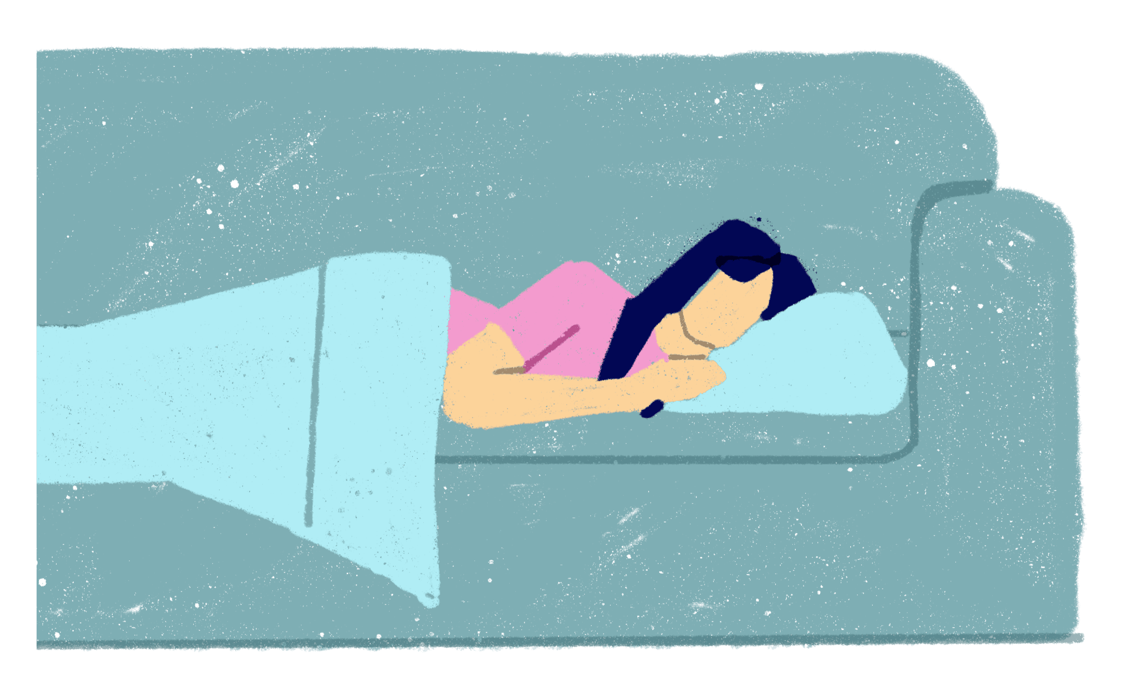
A good night's sleep?
Many people have issues with their sleep and some people have diagnosed sleep disorders.
Some people find it hard to get to sleep, some have bad dreams that disturb their sleep, and some find themselves waking up far too early.
What do you think the signs might be that a person isn't getting enough sleep or that they aren't getting good quality sleep?

Slide 6













Feeling sleepy?
Feeling irritable and snappy
Headaches
Feeling tearful
Trouble seeing clearly
Impulsiveness and difficulty making decisions
Yawning
Falling asleep during the day
Using stimulants like caffeine to stay awake
Problems with motor skills
Increased appetite and weight gain
Poor memory
Difficulty concentrating
Picking up viruses (due to a weakened immune system)

Slide 7

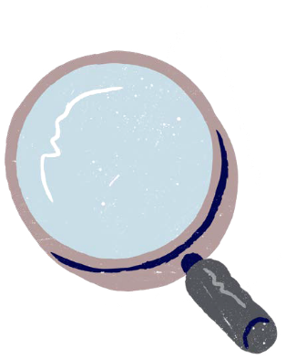

Getting enough sleep
Getting enough good quality sleep each night also helps to lower stress and improve concentration.
Research shows it can help reduce the risk of certain medical conditions (such as diabetes and heart disease), too.
Do you know the amount of sleep each night that's recommended for someone your age?
7 - 12-year-olds need 10 - 11 hours of sleep each night.
12 - 18-year-olds need around 8 - 9 hours.

Slide 8
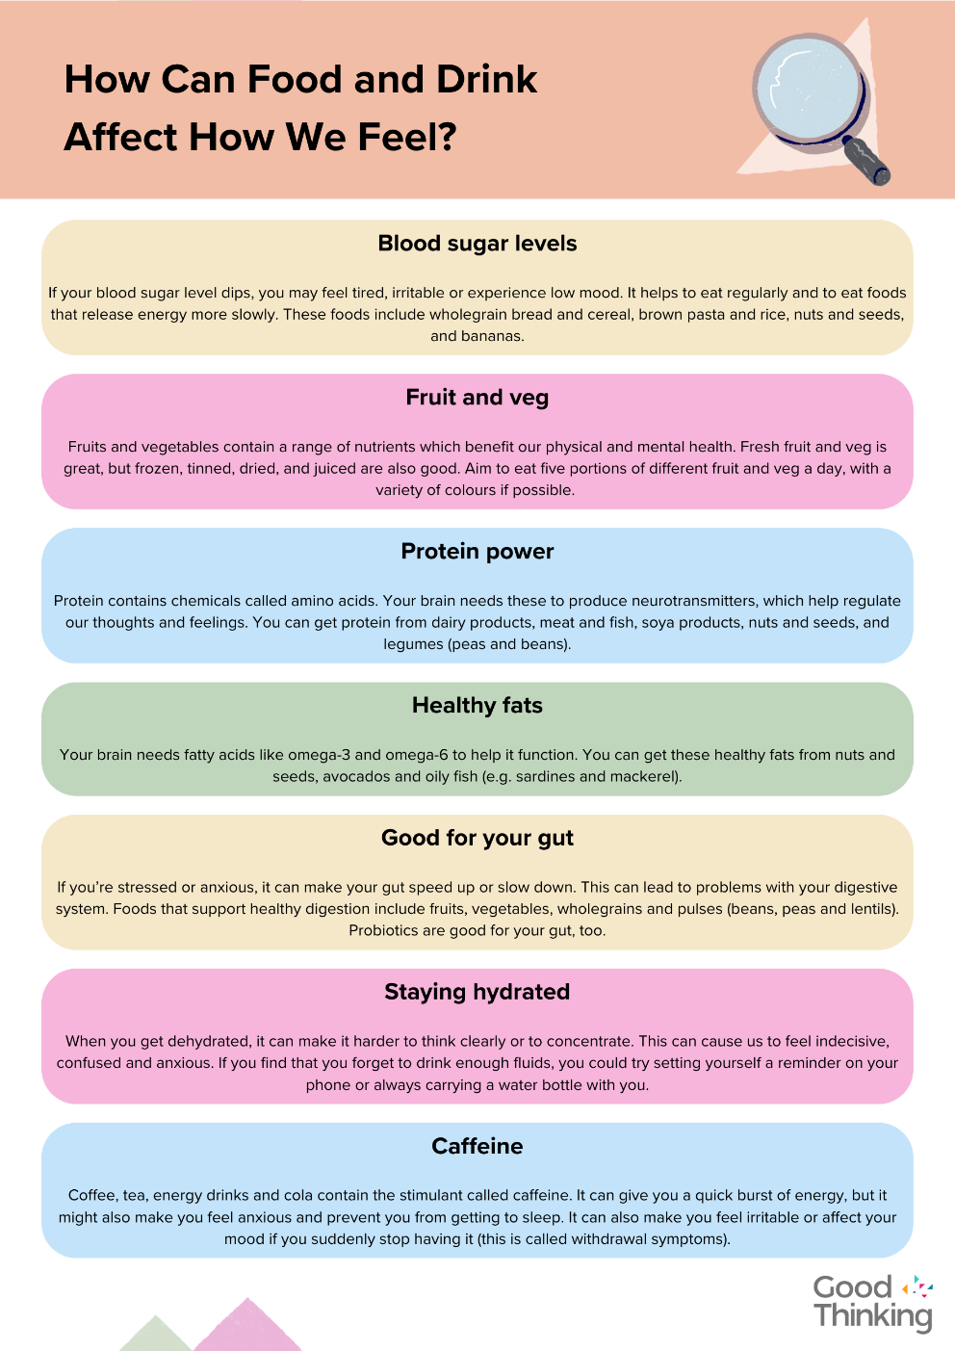
The right kind of fuel
Eating a healthy diet and staying hydrated are essential for taking care of our bodies and minds.
Did you know...
a food intolerance or allergy might affect a person mentally as well as physically?
some foods have been linked to boosting mood?
Different things work for different people, but it may be useful to learn about how different food groups or certain vitamins and minerals can positively impact our mental wellbeing.

Slide 9

Every Body
Taking breaks, getting enough sleep and diet can help everybody with protecting their mental health. But as individuals, our bodies are all different and our needs can vary.
For some people with a mental health difficulty or diagnosed condition, medication may be prescribed by a health professional.
So, along with working on protective factors to support good mental wellbeing and looking after their physical health, they take medication to help them manage the symptoms of their condition.
Photo from Canva

Slide 10

"Find some quiet, private time. Allow yourself to slow down and relax. Find nature, meditate, or do nothing. Take a mental break. You'll gain the benefits of a quiet mind."
Tom Giaquinto
Photo by Simon WIlkes on Unsplash

Slide 11


