Slide 1



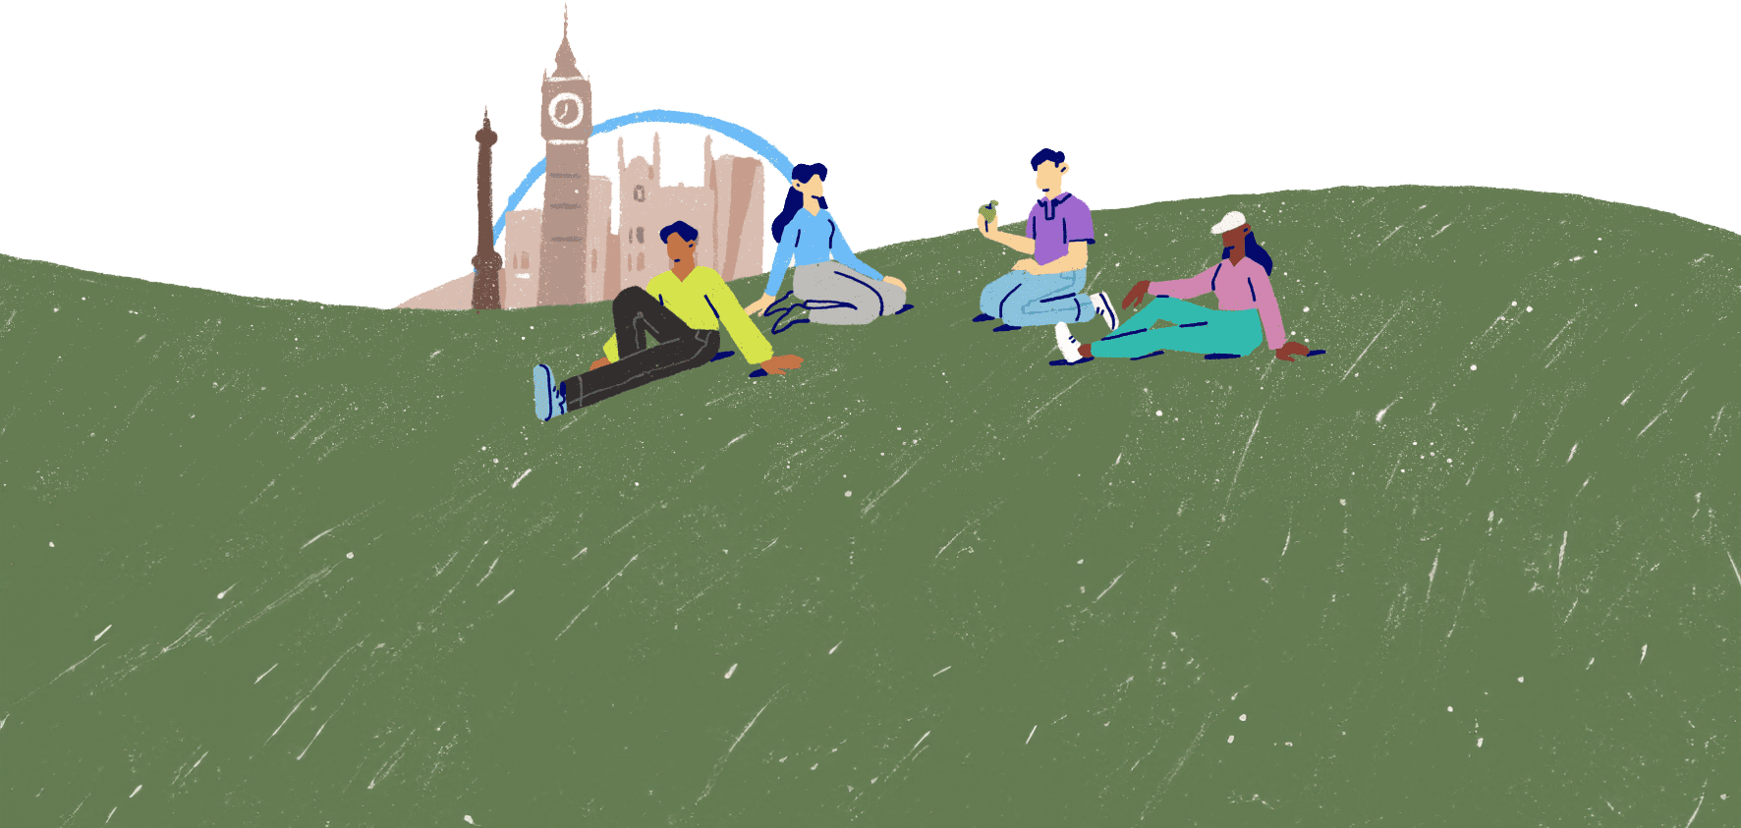
What is mental wellbeing?
Lesson 1

Slide 2
A definition of mental health and wellbeing
We hear the term mental health and wellbeing a lot. But what do you think the term actually means?
On your piece of paper or sticky note, write down your definition of mental health and wellbeing.
There is no right or wrong answer here – we're just gathering ideas.

Slide 3
Official definitions
"Mental health is a part of our overall health, alongside our physical health. It is what we experience every day, and like physical health, it ebbs and flows daily. Good mental health means we can realise our full potential and feel safe and secure. It also means we thrive in everyday life."
"Mental wellbeing is our internal positive view that we are coping well psychologically with the everyday stresses of life and can work productively and fruitfully. We feel happy and live our lives the way we choose."
Scottish Government
"Mental health is a state of mental wellbeing that enables people to cope with the stresses of life, realise their abilities, learn well and work well, and contribute to their community. It is an integral component of health and wellbeing that underpins our individual and collective abilities to make decisions, build relationships and shape the world we live in."
The World Health Organisation (WHO)

Slide 4
Mental health vs mental wellbeing
We hear and use the terms mental health and mental wellbeing. They are often used to mean the same thing – to describe a person's emotional, psychological and social state. While the two terms are directly linked, it is important to know that...
A person may live with a diagnosed or undiagnosed mental health condition but effectively manage it, and they may have good general mental wellbeing, meaning they cope well day-to-day.
Another person may not have a mental health condition, but they could be struggling with their mental wellbeing at any given time – perhaps because of an experience they have been through.​

Slide 5
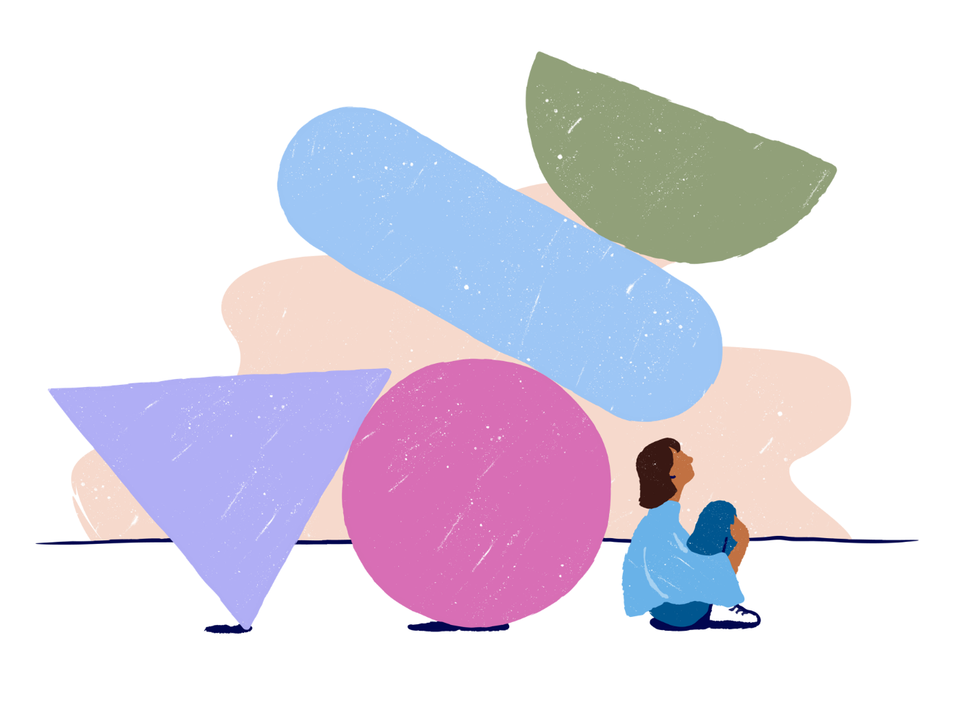
Good mental wellbeing
It's important to understand that having good mental wellbeing doesn't mean you're happy all the time or that you never feel upset, frustrated, disappointed or angry.
Having good mental wellbeing doesn't mean that challenges and experiences don't affect you.
Do you think good mental wellbeing looks and feels the same for everyone?

Slide 6
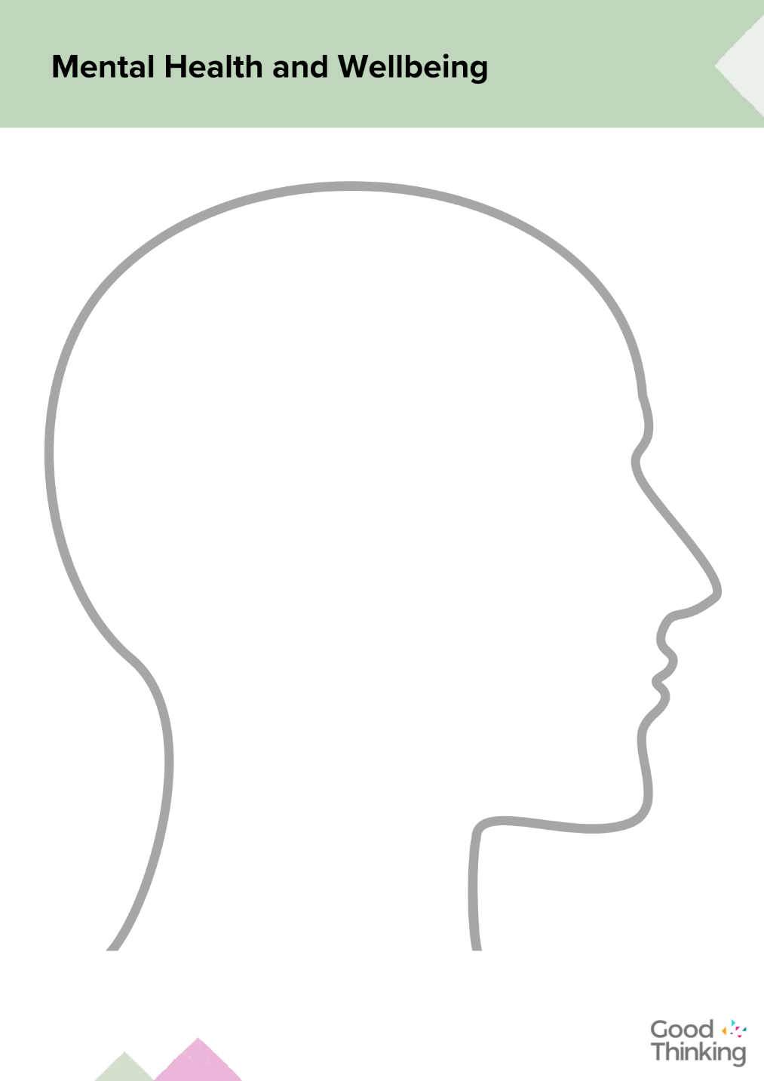
My mental health and wellbeing
Consider what mental health and wellbeing means to you and what good mental wellbeing looks and feels like for you.
Use words or pictures (or both) to illustrate and annotate your Mental Health and Wellbeing activity sheet.

Slide 7

"'Positive vibes only' isn't a thing. Humans have a wide range of emotions and that's OK."
Molly Bahr
Photo by Craig Melville on Unsplash

Slide 8


