Slide 1



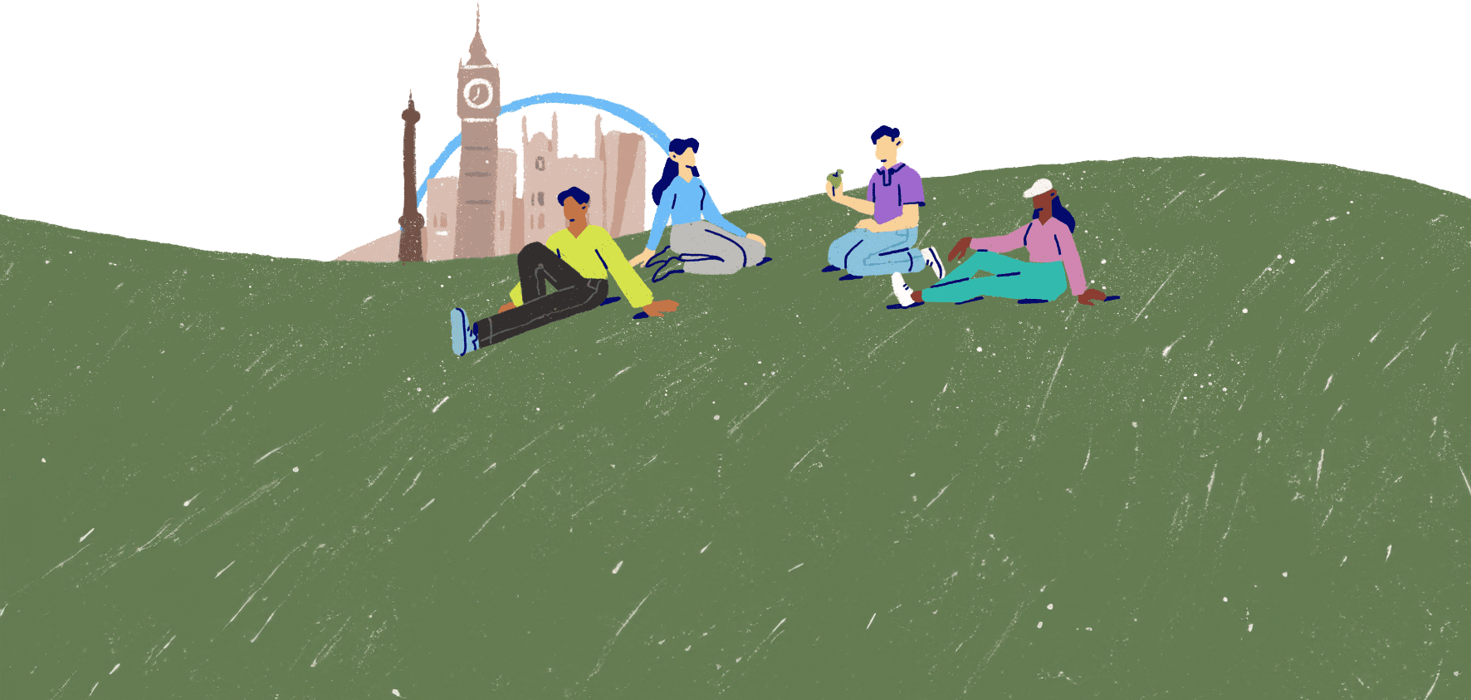
The five ways to wellbeing
Lesson 5

Slide 2

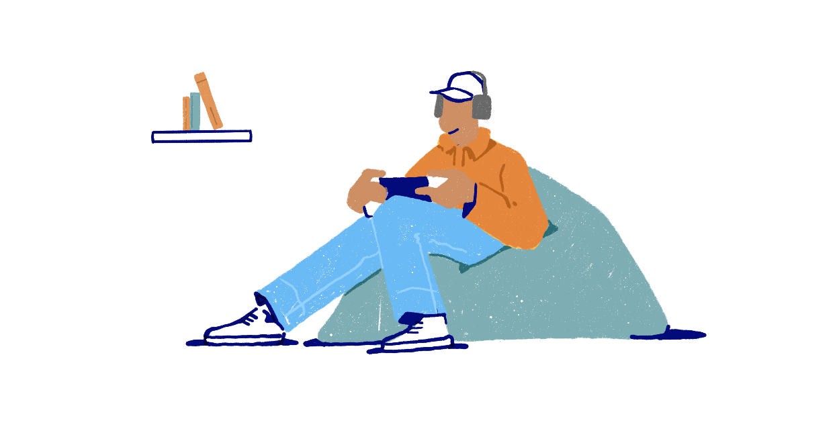

Protecting our wellbeing
Looking after our mental wellbeing is just as important as looking after our physical wellbeing.
There are some key things we can do to support good mental wellbeing and having these protective factors in place will help us cope better when we face challenging situations.
Can you think of five things people can do that might support good mental wellbeing?​

Slide 3
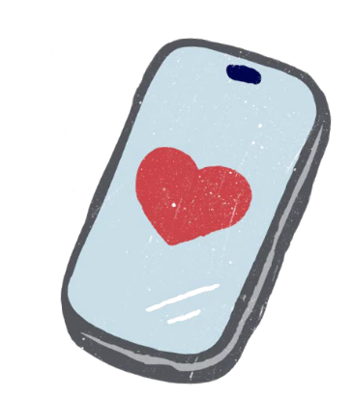


1. Connect with others
Examples of meaningful human connections include:
Emotional conversations (openly sharing feelings)
Giving or receiving support and advice
Sharing a joke and laughing
Expressing gratitude
Sharing positive memories
Giving or receiving praise or compliments
Gaining others' perspectives on important issues
Who do you enjoy spending time with? Why? How do you connect?
Humans are naturally social creatures. Research has shown that meaningful connections with others promote positive mental wellbeing.
We often have different relationships with different people, and we might enjoy those connections for different reasons.

Slide 4


2. Stay active
Physical activity has huge benefits for our bodies and minds.
Can you name a physical activity for every letter of the alphabet?
For each activity you name, consider whether it is low, moderate or high intensity.
Do you know the recommended amount of physical activity per day for children and young people?
The NHS recommends children and young people to aim for an average of at least 60 minutes of moderate or vigorous activity a day.

Slide 5


3. Keep learning
Hands up if you consider learning to be good for your mental wellbeing.
Learning may not always seem like it's boosting your mood. However, research has shown that learning new things we find interesting or developing new skills can actually support our wellbeing.
It can boost self-confidence and raise self-esteem. It can give us a sense of purpose. And it's also a way of connecting with others.
If you could learn any new skill, what would it be?

Slide 6


4. Be present
Noticing our current surroundings and bringing our focus to the 'here and now' can also support mental wellbeing. It can help us enjoy the moment.
Being present also allows us to stop and notice our thoughts and feelings.
Being present is often referred to as mindfulness. Practicing mindfulness can be particularly helpful when we're feeling anxious.
The 3, 3, 3 technique​
When something triggers you to feel anxious, you can try using the 3,3,3 rule to help you feel grounded.
Let's try now:
Identify 3 objects around you​
Listen for 3 sounds​​
Touch 3 things or move 3 body parts

Slide 7

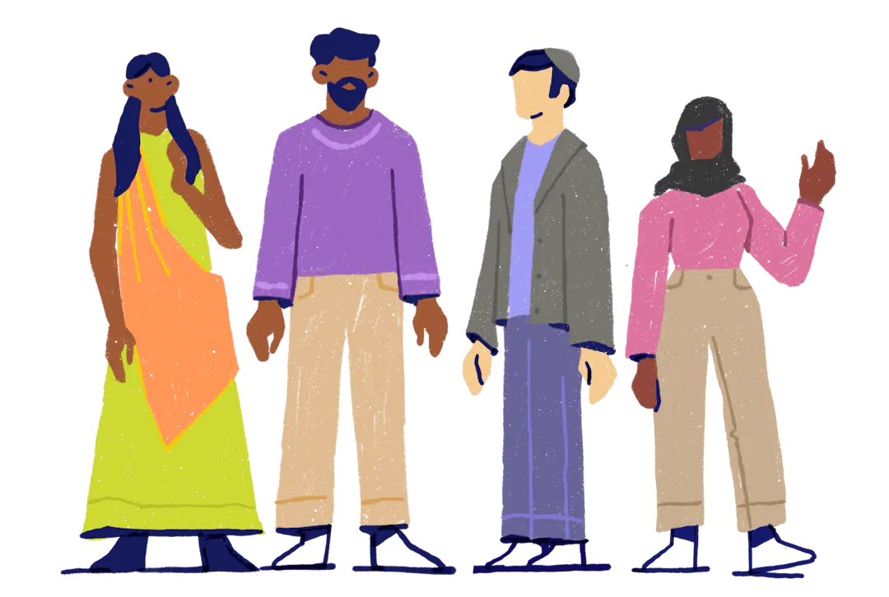
5. Give to others
Can you think of three examples of giving to others?
This could be an act of kindness, volunteering or supporting others in various ways.
Giving to others has been scientifically proven to activate the reward centre of our brains.
When we give to others, our brain releases endorphins ('feel good' chemicals) which can reduce stress and make us feel happier.
Generosity has even been linked to lower blood pressure and a longer lifespan!

Slide 8
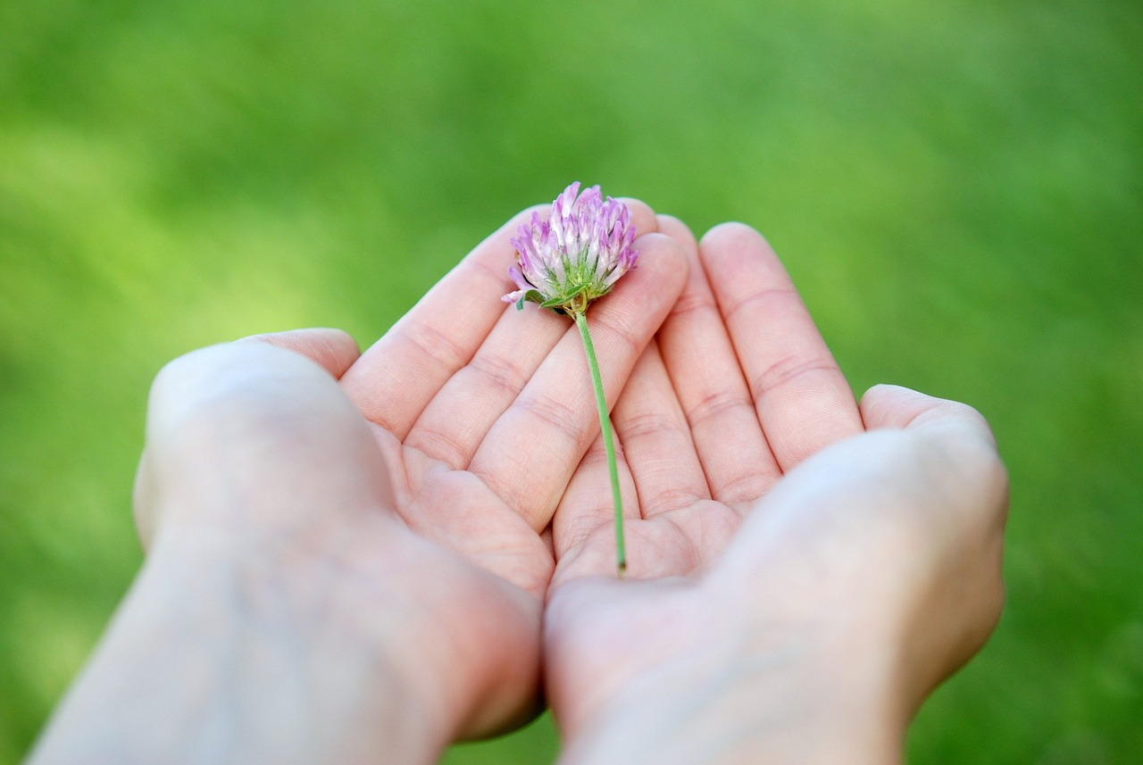
"Allow yourself the things you need right now, whether that's space, rest, support or something else. Know that you are not a burden for taking care of yourself.”
Twloha
Photo by GLady on Pixabay

Slide 9


