Slide 1
Introduction: Tailwind Responsive Grid
Why is it Used?
✅ Mobile-Friendly Design
✅ Faster Development
✅ Clean and Maintainable Code
✅ Better User Experience
Topic Demonstration
Project: College Analytics Dashboard
Objective: Build a 6-card responsive dashboard.
Features:
6 Responsive Cards
Hover Effects
Animated Statistics
Mobile, Tablet & Desktop Support
Project: College Analytics Dashboard (6 Cards)
What is Tailwind CSS?
Utility-first CSS framework
Provides ready-to-use CSS classes
Helps create responsive websites quickly
What is a Responsive Grid?
Arranges content in rows and columns
Automatically adjusts layout based on screen size

Slide 2
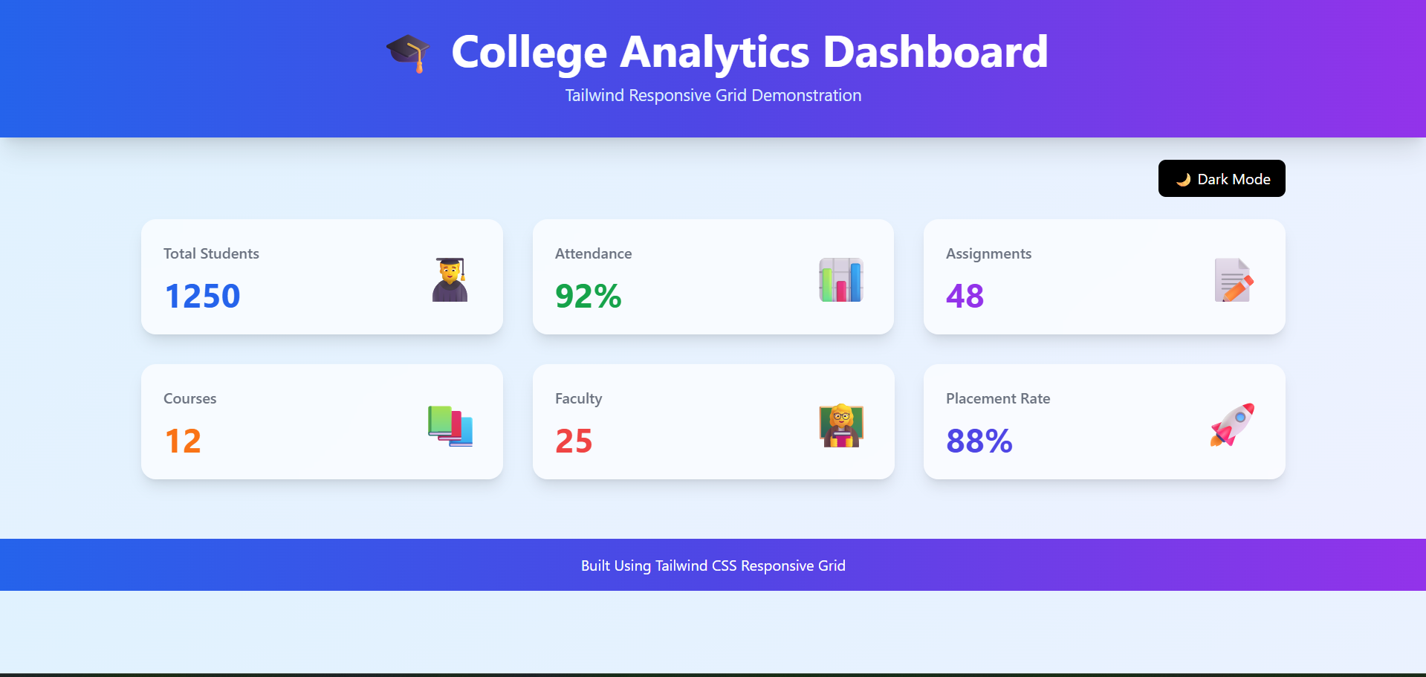
Live Demonstration & Code Explanation
Dashboard Preview
Tailwind Grid Code
<div class="grid grid-cols-1 md:grid-cols-2 lg:grid-cols-3 gap-8">
Explanation: Dashboard Cards
Total Students
Attendance
Assignments
Courses
Faculty
Placement Rate
Additional Features
Gradient Header
Glass morphism Cards
Hover Animation
Animated Counter

Slide 3
Additional Information: Tailwind Responsive CSS Grid
Key Tailwind Grid Classes:
grid
grid-cols-1
md:grid-cols-2
lg:grid-cols-3
gap-8
Class | Function
grid | Creates grid layout
grid-cols-1 | 1 column on mobile
md:grid-cols-2 | 2 columns on tablet
lg:grid-cols-3 | 3 columns on desktop
gap-8 | Adds spacing between cards

Slide 4
Real-World Usage & Conclusion
Real-World Applications
Education Portals
Student Management Systems
Learning Management Systems
Business Dashboards
Analytics Dashboards
Sales Reports
Other Applications
Banking Dashboards
E-Commerce Websites
Hospital Management Systems

