Slide 1
A Model To Compute Degree of Polarity of Review
Santanu Modak , Sohom Ghosh and Abhoy Chand Mondal
Presented By- Santanu Modak

Slide 2
Sentiment Analysis and Opinion Mining
Field of study that analyzes people’s opinions, sentiments, and emotions towards entities such as products, services, organizations, individuals, issues, events, topics, and their attributes

Slide 3
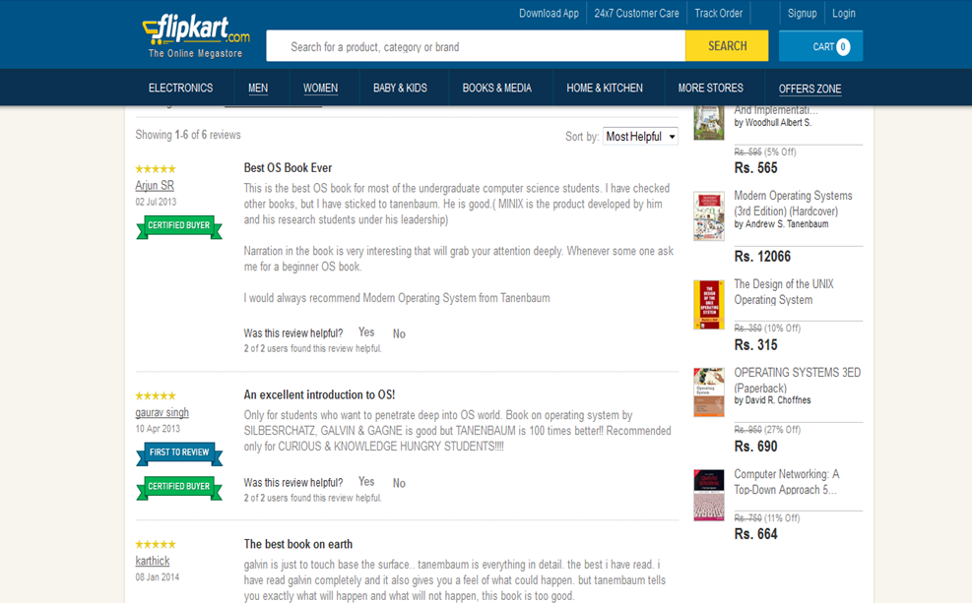

Slide 4
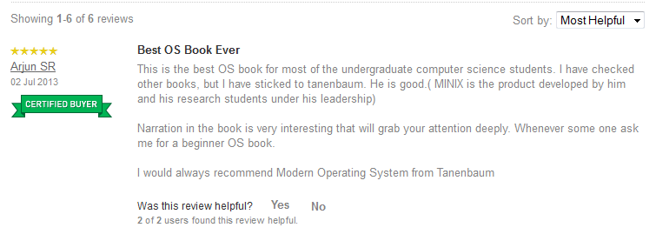

Slide 5
Basis of Sentiment Analysis
Interrelated field of
MATHEMATICS/STATS
COMPUTER SCIENCE
MANAGEMENT

Slide 6
TYPES OF PROBLEM
CLASSIFICATION
REVIEW IS POSITIVE/ NEGATIVE/ NEUTRAL
REGRESSION
SCALE TO FIT REVIEW LIKE Star Rating

Slide 7
OUR PROBLEM
Automatically generates the scores by analyzing the review title
The score vary from -5 to +5, proposed a fixed discrete rating scale (-5,+5).
A score of -5 or near to -5 indicates that the review is extremely negative
A score of +5 or close to +5 , indicates that review is highly affirmative

Slide 8
DATASET
COLLECTED FROM :- www.flipkart.com
Review titles of electronic products
LIKE:-
“A Good Budget Android Dual SIM Phone by Samsung.”

Slide 9
DATASET
TOTAL DATASET CONTAINS 1250 REVIEW TITLES. 1000 MANUALLY CLASSIFIED
500 POSITIVE REVIEWS
500 NEGATIVE REVIEWS
250 MIXED REVIEWS (for testing)

Slide 10
CORPORA
SENTIMENT WORD CORPUS….collected from
http://www.enchantedlearning.com/wordlist/positivewords.shtml
http://www.enchantedlearning.com/wordlist/negativewords.shtml
Internet
Added some sentiment symbol also
Like 'X-D', 'LOL', '(lol)', '(LOL)', ":'D", ":'-D", 'LMAO', '(lmao)', - out of dictionary word..

Slide 11
Preprocessing
Tokenization
Stop word removal
Stemming

Slide 12
Experiments and Results after preprocessing
Dataset: Samsung Galaxy S Duos 2 Loses The Game With Slow Apps And Bad Battery
Dataset after preprocessing: Samsung Galaxi S Duo 2 Lose Game Slow App Bad Batteri

Slide 13
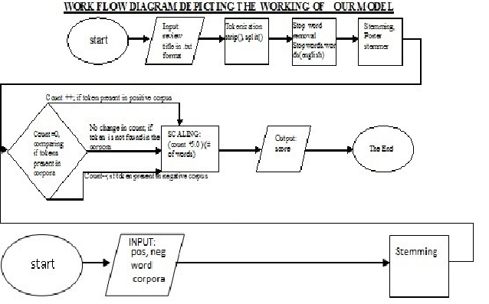
The Model

Slide 14
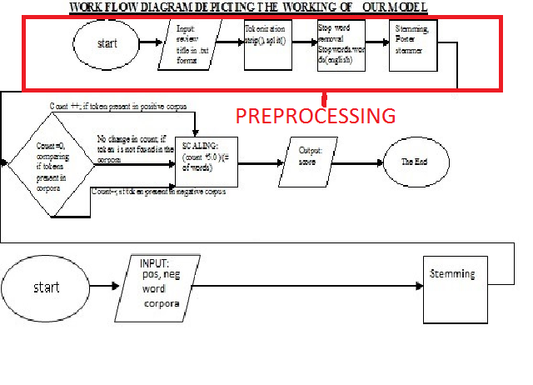

Slide 15
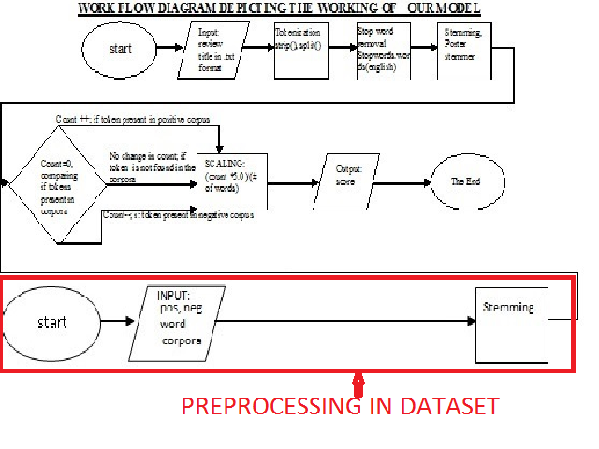

Slide 16
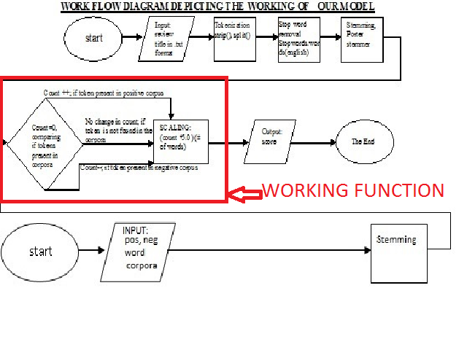

Slide 17
Result Analysis
Dataset: Samsung Galaxy S Duos 2 Loses The Game With Slow Apps And Bad Battery
Dataset after preprocessing: Samsung Galaxi S Duo 2 Lose Game Slow App Bad Batteri

Slide 18
Result Analysis
Dataset: Samsung Galaxy S Duos 2 Loses The Game With Slow Apps And Bad Battery
Dataset after preprocessing: Samsung Galaxi S Duo 2 Lose Game Slow App Bad Batteri

Slide 19
Result Analysis
Dataset: Samsung Galaxy S Duos 2 Loses The Game With Slow Apps And Bad Battery
Dataset after preprocessing: Samsung Galaxi S Duo 2 Lose Game Slow App Bad Batteri
Score: -3
P.S. : - For Better Experimental Results, in these examples we have omitted the scaling process. The scaling process works well if review title are ideal i.e. contains 1-5 words

Slide 20
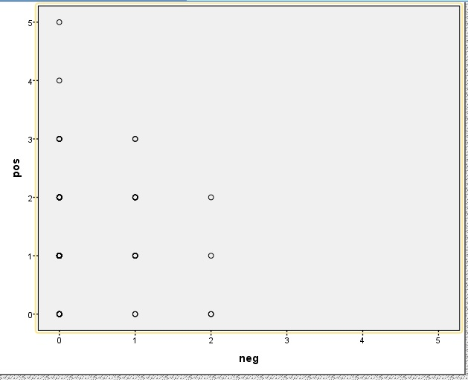
Graph Based Analysis
Shows the distribution of positive and negative words per title. X-axis represents the # of negative words while the Y-axis represents the # of positive words per title.

Slide 21
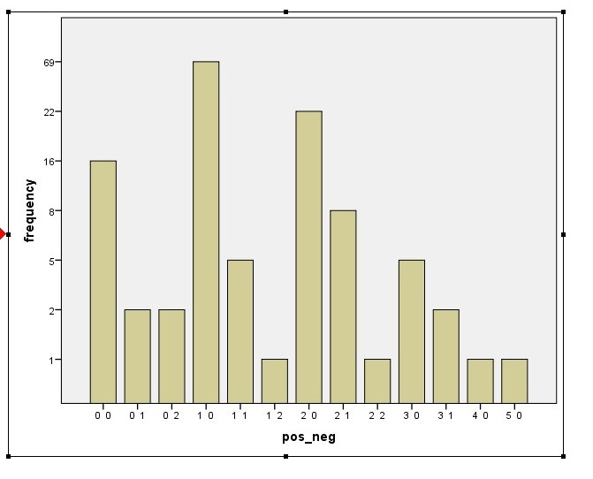
Graph Based Analysis
We plot the # of times the combinations are occurring. A combination 0 1 represents 0 positive word and 1 negative word per title

Slide 22
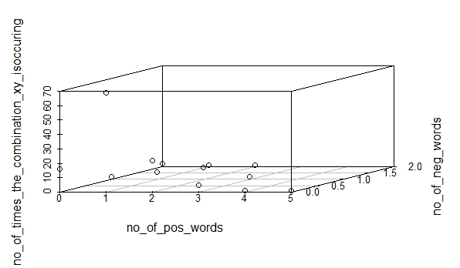
Graph Based Analysis
We observe that number of titles with one positive word and one negative word are more

Slide 23
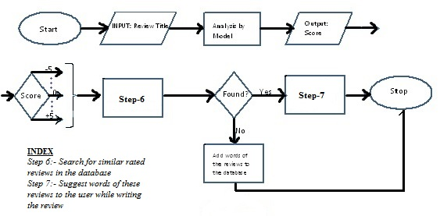
Future Work
Recommendation System and Word prediction

Slide 24
REFERENCES
Jacob Perkins, “Python Text Processing with NLTK 2.0 Cookbook”, PACKT publishing I
Bird, Steven, Edward Loper and Ewan Klein (2009), Natural Language Processing with Python. O‟Reilly Media Inc.
http://www.enchantedlearning.com/wordlist/positivewords.shtml, http://www.enchantedlearning.com/wordlist/negativewords.shtml; List of positive and negative words.
http://computer-ease.com/emotposi.htm, http://computer-ease.com/emotneg.htm List of positive and negative emoticons.
Modak, S., & Mondal, A. C “A Model of Structured Opinion Format” International Journal of Advanced Research in Computer Science and Software Engineering, ISSN (Online): 2277 128X, ISSN (Print): 2277 6451, Volume 4, Issue 5, May 2014. Page 147-151
Ali Harb, Michel Plantié, Gerard Dray, Mathieu Roche, François Trousset, Pascal.Poncelet Web Opinion Mining: How to extract opinions from blogs? Published in "CSTST'08: International Conference on Soft Computing as Transdisciplinary Science and Technology,.
Ritesh Agarwal, T. V. Prabhakar, Sugato Chakrabarty. “I Know What You Feel”:Analyzing the Role of Conjunctions in Automatic Sentiment Analysis,6th International Conference, GoTAL 2008 Gothenburg, Sweden, August 25-27, 2008 Proceedings pp 28-39
Jusoh, S.; Alfawareh, H.M., “Applying fuzzy sets for opinion mining,” Computer Applications Technology (ICCAT), 2013 International Conference on , vol., no., pp.1,5, 20-22 Jan. 2013 doi: 10.1109/ICCAT.2013.6521965
Srivastava, Ritesh, et al. “Exploiting grammatical dependencies for fine-grained opinion mining.” Computer and Communication Technology (ICCCT), 2010 International Conference on. IEEE, 2010.
Bing Liu, “Sentiment Analysis and Opinion Mining”, Morgan and Claypool Publishers, May 2012.

Slide 25
THANK YOU

