Slide 1
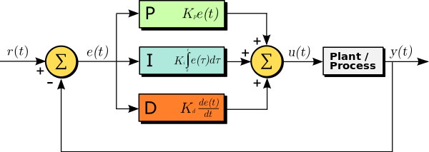
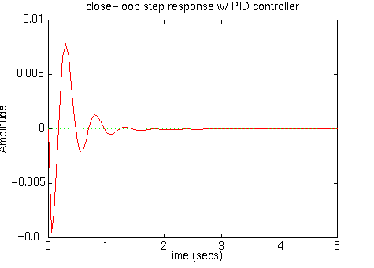
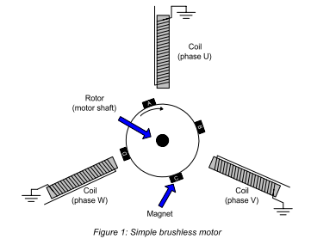
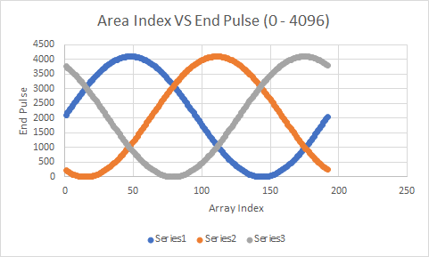
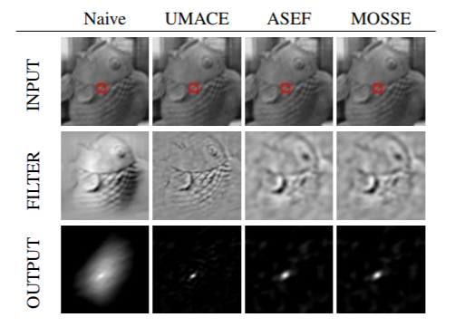
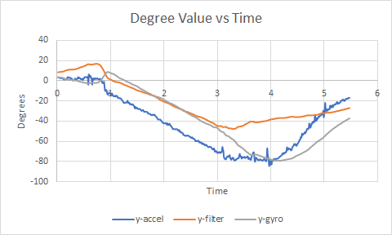
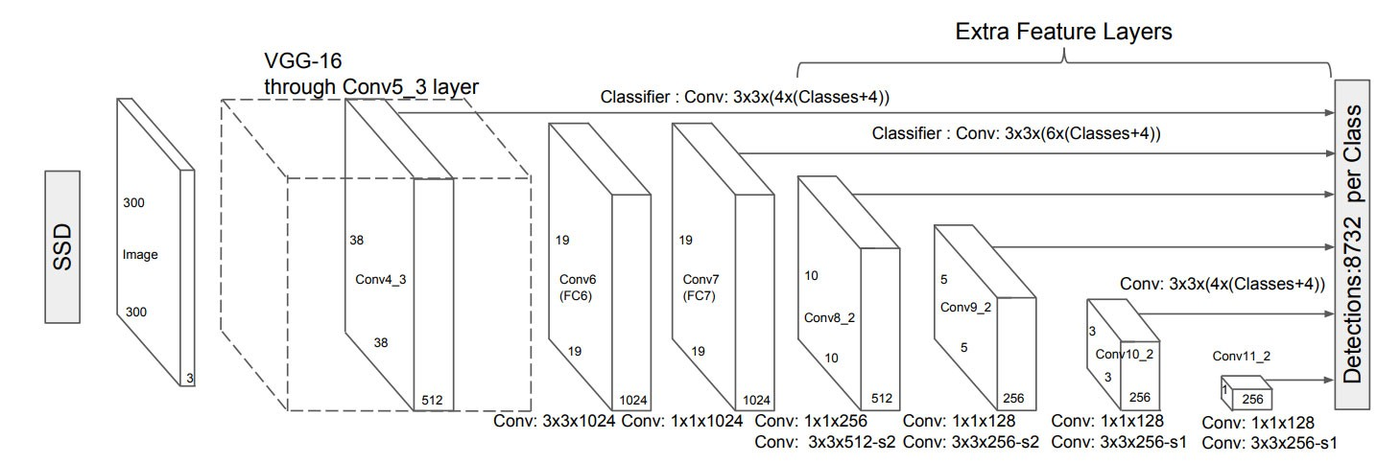
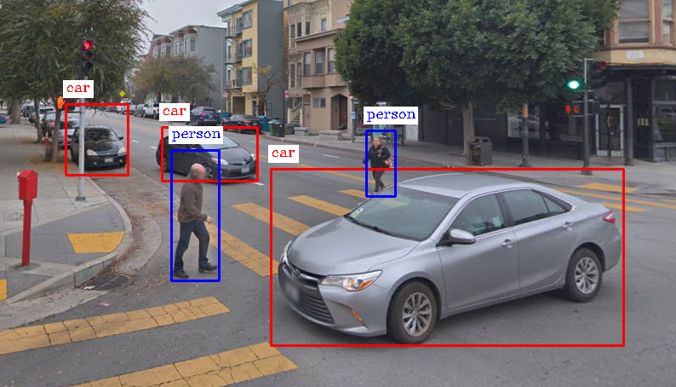

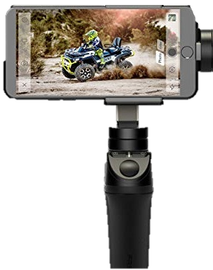
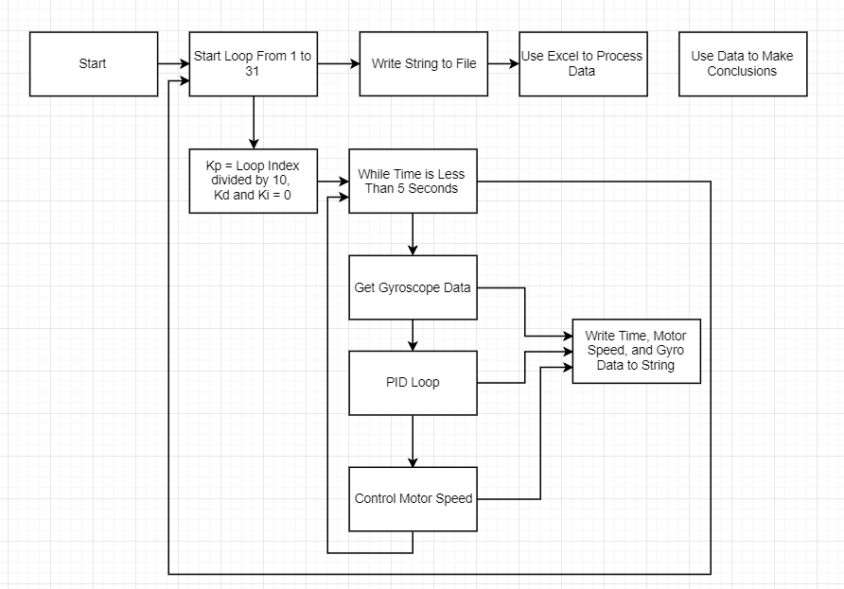
Gyroscopic Based System to provide Camera Stabilization and Object Detection/Tracking in Real Time
Statement of Purpose
The goal of this project was to design a system that can stabilize a camera in the x, y, and z-axis in addition to tracking the subject of a frame or providing information related to the movement and speed of common objects in relation to the operator.
The system will use three brushless, directly driven motors to stabilize a camera along with a 3 axis acceleration sensor, 3 axis gyroscope, and magnetometer. In addition to stabilizing the camera, the system will use a computer program to track an object specified before the program is run, or convert the movement of objects surrounding the user into useful sound reports, helping those who are visually impaired navigate their environments more easily.
This system has applications in videography and assistance of the visually impaired. It will make it significantly easier for videographers and presenters to make professional videos themselves, as they will not need to employ others to control the movement of a camera. It can follow people as they walk around and talk to an audience, or film a person participating in athletic activities, without the need of someone to pan and tilt the camera.
Application for the visually impaired are the tracking and identification of common objects moving around the environment, allowing people who cannot see to know when people are approaching, cars are passing by, or when the path in front of them is clear.
Interpretation of Data
Interpretation of PID Data
After completing this project I have made multiple conclusions about PID tuning. After collecting multiple types of data on the system I was using, including time information, gyroscope and accelerometer readouts, and pid output, I was able to graph these values and see correlations in data. My main focus was identifying Ku, or the ultimate gain of the system. The ultimate gain of the system is when the proportional gain of a pid loop is such that the system oscillates about the setpoint, with oscillations neither becoming too large, or going to 0. The reason we are interested in finding Ku is because Ku makes it easier to find optimal PID values by way of the Ziegler-Nichols heuristic formulas. Once Ku is found, the period of oscillation at these values can be used to calculate close to optimal PID gain values, with some manual fine tuning by hand if needed.
Through my project I found ways to identify Ku faster than pure guess and check. Most methods on the internet require a human operator to slowly increase Kp until Ku is found, checking the data constantly. I performed this a couple of times for one motor, and noticed a trend where Ku almost always occurred at the local extrema of a plot of Ku and the average period of oscillations. This graph can easily be generated by recording gyroscope values for a large amount of Kp values automatically, over a given amount of time. Once a suitably large amount of data is found, the period of oscillations can be found by noting the number of times the gyroscope crosses the set point and dividing the time by this number. Once you plot the period of oscillation against the values for Ku you found, you can find the relative extrema. Using the data for the relative extrema, you can use the Ziegler-Nichols formulas to get a good starting point for PID values. You can then optimize those values slightly depending on how you want the system to act, such as increasing the integral gain for less overshoot, or increasing the derivative gain to make the system move fast, as you move it faster away from the setpoint.
The reason this works is that local extrema of the plot are areas where the oscillations do not subsidize too quickly, or get out of control, the exact characteristics that we search for when identifying Ku. Oscillations occurring too quickly then diminiting lead to low lying, flat parts on the curve, and oscillations that are too large create large un bounded maximums in the curv, as shown by how the graphs approach infinite has Kp increases after a certain point. The relative extreme represent a point where oscillations do not grow too quickly, nor too slowly and are balanced, meaning they are close to Ku. This property of the relative extrema allows us to identify possible Kp’s that might be Ku’s more quickly and with less work.
Interpretation of Tracking Comparisons
After performing tests on multiple different tracking algorithms and reading an analysis of the different tracking algorithms, I have found that although GOTURN is superior in tracking objects, it is very slow compared to other, worse tracking algorithms. I found that the MOSSE tracking algorithm is suitable for the task as it is fast, and mostly reliable. In addition it is able to identify when it has lost sight of the object it needs to track, allowing a object detection algorithm to re identify a region of interest.
Interpretation of Object Detection
I found that common object detection algorithms relying on neural networks are too slow to operate on a Raspberry Pi, but work very well on a laptop. Increased gains can be made by optimizing the software to use the gpu processor instead of just the CPU. In addition, neural networks can be run of smartphones efficiently now, so a suitable app could be written to work with the hardware and provide tracking and detection data.
Background Research
Held, David, et al. “Learning to Track at 100 FPS with Deep Regression Networks.” Department of Computer Science Stanford University. Department of Computer Science Stanford University
Huang, Jonathan, et al. “Speed/Accuracy Trade-Offs for Modern Convolutional Object Detectors.” Open Access, Computer Vision Foundation, openaccess.thecvf.com/content_cvpr_2017/papers/Huang_SpeedAccuracy_Trade-Offs_for_CVPR_2017_paper.pdf.
Janju, Peter, et al. “Comparison of Tracking Algorithms Implemented in OpenCV.” MATEC Conferences, 2016, www.matec-conferences.org/articles/matecconf/pdf/2016/39/matecconf_cscc2016_04031.pdf.
Microstar Laboratories, Inc. “Ziegler-Nichols Tuning Rules for PID.” Ziegler-Nichols Tuning Rules for PID, www.mstarlabs.com/control/znrule.html.
Yu, Cheng-Ching. Autotuning of PID Controllers: a Relay Feedback Approach. Springer-Verlag UK., 2006.
.
Engineering Goal
The end goal of this project is to create a system that can stabilize a camera in three separate axis and track objects or provide information on their movement
The engineering goals of this project included
Developing heuristics to autotune PID loops, either completely automatically or partially automatically, with some human interpretation of the data.
Detection of a variety of things commonly seen in an urban environment (cars, people, dogs, motorbikes) and their movement relative to the person operating the device.
Adequate Stabilization of a Camera
Adequate Tracking of a moving object
Portability and Ease of Use
The exact criteria I wanted the project to meet are listed here
.
Conclusion and Discussion
PID Constants can be tuned quickly and effectively with careful analysis of data from test trials of the system and some human analysis of the data along with PID tuning heuristics. I observed a correlation between stabilization performance and the relative maximums of graphs plotted of various values of Kp (Proportional Gain) against the period of oscillations of the system. I also analyzed multiple tracking algorithms and object detection algorithms on constrained, low cost systems like the Raspberry Pi. The final system was able to adequately stabilize a system (< 5 degree oscillation from setpoint) when encountering rotations of different speeds and in different directions (max angular velocity of 1 rad/sec). In addition, along with the assistance of the computing power of a laptop the system was able to track people quickly (>100 fps) and perform object detection adequately quickly (>15 fps)
I found that although tracking works at acceptable frame rates (>15 fps) when allowed to utilize 100 percent of resources, it slows down too much as other tasks are added, such as stabilization of a system (>2 fps). I also found that object detection using neural networks will not perform adequately (>1 fps) and feature recognition using Haar Cascade Filters will not perform adequately (>2 fps).
The final system was able to adequately stabilize a system (< 5 degree oscillation from setpoint) when encountering rotations of different speeds and in different directions (max angular velocity of 1 rad/sec). In addition, along with the assistance of the computing power of a laptop the system was able to track people quickly (>100 fps) and perform object detection adequately quickly (>15 fps)
Although the entire system was not portable due to the electronics I was using, the system could meet size and weight constraints by utilizing purpose built hardware and a smartphone to handle the intense computations of object tracking and detection and a small microprocessor to enable stabilization and hardware control, with a Lithium Polymer battery to power the device.
Further Research
Further research will need to be performed on controlling brushless motors without excess heat being built up due to the inefficient way I am driving motors. By employing an 8 bit motor driver chip, like the TI-DRV8301 3 phase motor driver, more efficient control can be used. This chip enables gains in efficiency by measuring the back EMF produced by the motor to control it once it has built up enough speed. By using a chip like this, the large motor controllers I currently use would not be required, in addition to the PWM signal generator. These chips allow more fine control over the motor and allow it to reach greater speed and torque ranges. In addition, they are very small, and can be bought in surface mount packaging.
In addition further gains can be achieved by switching to a smartphone instead of a webcam. With a smartphone a Raspberry Pi wouldn’t be needed to process and track data. In addition, smartphones are much faster than the Raspberry Pi, allowing better object detection and tracking to occur. Another benefit is that by using a smartphone, you could take advantage of the gyroscope, accelerometer, and compass built into it, eliminating the need for all the sensors on the robot. A necessary component would be a small bluetooth low energy device to communicate with the phone and the motor controllers.
By moving all processing to the smartphone and relying on its own battery, the system could be lightened significantly. A small battery pack could provide power to the entire device for multiple hours, increasing portability and ease of use for the intended demographic, the visually impaired and amateur videographers.
The largest area of improvement that can be achieved is in tuning the PID loops. Although I was able to find pretty good values for the PID gains, they aren’t perfect, and large improvements can be made. The best way to proceed with making these improvements is to collect large amounts of data on how the system responds to changes, then use that data to create a model of the system. Once a model of the system that accurately captures the way the system works is created, optimal PID values can be found. Unfortunately, creating a complete model of the system is very complex, as there are multiple variables that influence the way it works, and they interact in unexpected ways. With new advancements in machine learning however, it might be possible to feed large amounts of automatically collected data into a machine learning model and have it optimize PID values itself. Advancement in this area has been limited for a very long time, but as more research occurs and with new tools available, large leaps and bounds can be made in this field.
Goal | Status | Explanation
Stabilize Camera with < 10 degree deviation from setpoint | Achieved | <10 degree deviation from midpoint
Stabilize Camera against rotation of 3 rad / second | Not Achieved | 2 rad / second maximum stabilization speed
Track Objects in Changing Lighting Conditions | Achieved | Achieved using a MOSSE tracker
Track Objects at >10 fps on Raspberry Pi | Achieved | Achieved using a MOSSE tracker
Perform Object Detection at >10 fps on Raspberry Pi | Not Achieved | Raspberry Pi achieved 1-2 fps
Perform Text to Speech on Recognitions and Movement | Achieved | Achieved with Laptop and Text to Speech library
Auto Tune PID Loops Automatically | Not Achieved | Only Partial Automation was Achieved
Tune PID Loops with Minimal Human Assistance | Achieved | Achieved by automatically collecting data on the systems response to changes, along with some human analysis of this data followed with using the Ziegler-Nichols tuning heuristics and formulas
Track Objects at >10 fps on Laptop | Exceeded | Laptop used MOSSE filter to track at >100 fps
Perform Object Detection at >10 fps on Laptop | Exceeded | Laptop used Mobile Net SSD v2 to perform object detection at 15-16 fps
Portable System < 6 pounds | Not Achieved | Entire system relied on laptop

