Slide 1
HCI – Understanding Hand Gestures and Virtual Reality

Slide 2
APPROACH
What is HCI?
HCI Infographic
Basic HCI model
Let’s get some perspective - Hand Gesture Recognition and Virtual Reality
Hand Gestures– Input block
Hand Gestures – Process block
Hand Gestures – Output block
VR – Input block
VR – Process block
VR – Output block
References
Questions?

Slide 3
WHAT IS HCI?
An area of research and practice that emerged in the early 1980s, initially as a specialty area in computer science embracing cognitive science and human factors engineering.
Until the late 1970s, the only humans who interacted with computers were information technology professionals and dedicated hobbyists. This changed disruptively with the emergence of personal computing in the later 1970s.
HCI has now become an integral part of our day to day activities with some interaction with a computing device as given below:
Set up ‘Wake Up’ alarm – HCI
Go to the bathroom – Not so HCI
Check Emails – HCI
Book a taxi – HCI
Pay taxi bill – HCI
Spend at least 9 hours on a computer – HCI
Have food – Not so HCI but occasional logging into Facebook, Newstand, Whatsapp, etc.
Workout – HCI (Well, you want to monitor the calories!)
Sleep with some good music – HCI
That accounts for surprising 88% (8/9) HCI!

Slide 4
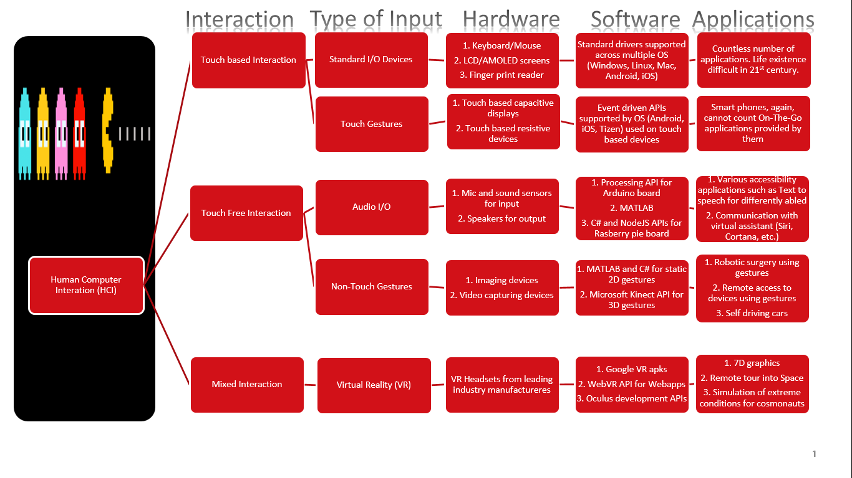
HCI INFOGRAPHIC

Slide 5
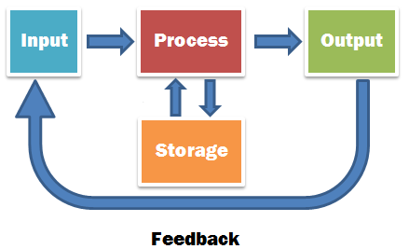
BASIC HCI MODEL
HCI works on basic Input-Process-Output model with storage being an optional element
Storage model is usually involved when using Machine Learning algorithms for creation of training data

Slide 6
LET’S GET SOME PERSPECTIVE – HAND GESTURE RECOGNITION AND VIRTUAL REALITY
HCI has now become a vast area of research and development. In this deck, we will limit our discussion to Hand Gesture Recognition (HGR) and Virtual Reality (VR)
What is HGR and where is it used?
Human hand is a complex articulated object consisting of many connected parts and joints. Considering the global hand pose and each finger joint, the human hand motion has roughly 27 Degrees Of Freedom (DOFs).
HGR is all about communication through interpretation of static and dynamic hand postures
Widely used in medical applications such as remote communication, sign language depiction, control of robotic equipment for complicated surgeries, etc.
What is VR and where is it used?
The use of computer technology to create the effect of an interactive three-dimensional world in which the objects have a sense of spatial presence
See it, Feel it, Make your dream a reality!
Widely used in military, automotive and entertainment field for simulating multi dimensional experience.

Slide 7
HAND GESTURES – INPUT BLOCK
For 2D gestures:
Input taken via Webcam, camera on a smartphone, digital camera
Stored in standard formats such as JPEG, PNG, for static images and AVI, MOV, MPEG, etc. for dynamic gestures
For 3D gestures:
Input taken via 3D camera; a camera which also measures depth or distance of an object from its location; such as Microsoft Kinect, Intel Real Sense, etc.
Stored in 3D video formats such as 3D Blu-ray/AVCHD

Slide 8
HAND GESTURES – PROCESS BLOCK
For 2D gestures following algorithms are used:
Illumination correction: Uses skin color models and gray world lighting compensation to improve the image quality
Palm Segmentation: Features are usually generated by orientation and count of fingers. To reduce the computational weight and errors, palm is segmented from the image.
Feature Extraction: For matching the features of input image with training data and recognizing gestures. Eg: SIFT, Lowe’s transform
For 3D gestures:
Video Processing: Uses SimpleOpenNI, NiTe and Processing libraries. Software code usually comprises of implementation in C, C++
Segmentation: Common algorithms used are range based segmentation and finger detection
Feature Extraction: Uses centroid extraction and finger tracking

Slide 9
HAND GESTURES – OUTPUT BLOCK
On recognition of 2D gestures, output is provided depends on application. Few examples include:
Electrical and mechanical output to robotic instruments. Includes Internet of Things (IoT) applications
Haptic feedback to users
Software output to for storing and improving training data
As in the case of 2D gestures, output from 3D gestures also depends on application:
Software output to Gaming applications
Configuration parameters to 3D printing devices

Slide 10
VR – INPUT BLOCK
Recent developments in the field of Virtual and Augmented Reality have resulted in use of readily available sensors present in smart phones. Essential sensors include:
Microphone – For capturing audio inputs
Accelerometer – For capturing direction and orientation. Includes 3 axis and 6 axis accelerometer
Magnetometer and Gyroscope – For detecting depth and stability (vibrations) in user input
Image and Video stream – For capturing real time nature and scenery objects

Slide 11
VR – PROCESS BLOCK
Raw data from sensors is processed by via I/O libraries for filtering sensible data. Processing algorithms depends on applications given below:
Simulation based VR – Localization and PID control algorithms used in simulation environments
Avatar based VR - Spectral Compensation, Facial Action Coding System (FACS), Stochastic Pruning, Tissue simulation system, etc.
Gaming based VR - 3D sense, waypoint based navigation, localization, etc.

Slide 12
VR – OUTPUT BLOCK
Based on application, output is channelized as follows:
High definition video output – 4K (2160p) video stream for real life like user experience
Audio output – High definition audio output provided via stereo speakers
Haptic feedback – Vibrational feedback for incorporating 4th dimension to user experience

Slide 13
References
Dawid Lowe, Distinctive Image Features from Scale-Invariant Keypoints In: International Journal of Computer Vision 60(2), 91–110, 2004, 2004 Kluwer Academic Publishers
Luo Juan and Oubong Gwun: A Comparison of SIFT, PCA-SIFT and SURF In: International Journal of Image Processing (IJIP) Volume(3), Issue(4), (2009), pp. 143- 152
Guan-Feng He, Real-time gesture recognition using 3D depth camera, 2011 IEEE 2nd International Conference on Software Engineering and Service Science (ICSESS), 15-17 July 2011, Page: 187 – 190
http://www.vrs.org.uk/virtual-reality-gear/motion-tracking/sensors.html
http://stackoverflow.com/questions/26792526/google-cardboard-vr-sensors

Slide 14
QUESTIONS?
We are happy to help you!
Please mail us your queries to Saurabh Sohoni or Ramya Sudarshan and we will get back to you at the earliest!

Slide 15
THANK YOU

