Slide 1
JavaScript Debugging, Remote Debugging & Ardiuno Graph Visualization

Slide 2
INTRODUCTION TO DEBUGGING

Slide 3
INTRODUCTION & LOGGING METHODS
“The first time you try something, you probably won’t get it completely right”
Prior to the advent of modern day browsers, alert(“”) used to be the breakpoint for developers. But, it was a mess
The “debugger;” command
console.log(“”) – the most frequently used developer command
Modern day browsers are equipped with very powerful debugging tools (apart from console.log) which are very useful to debug the day to day development issues

Slide 4
DEBUGGING TECHNIQUES
02

Slide 5
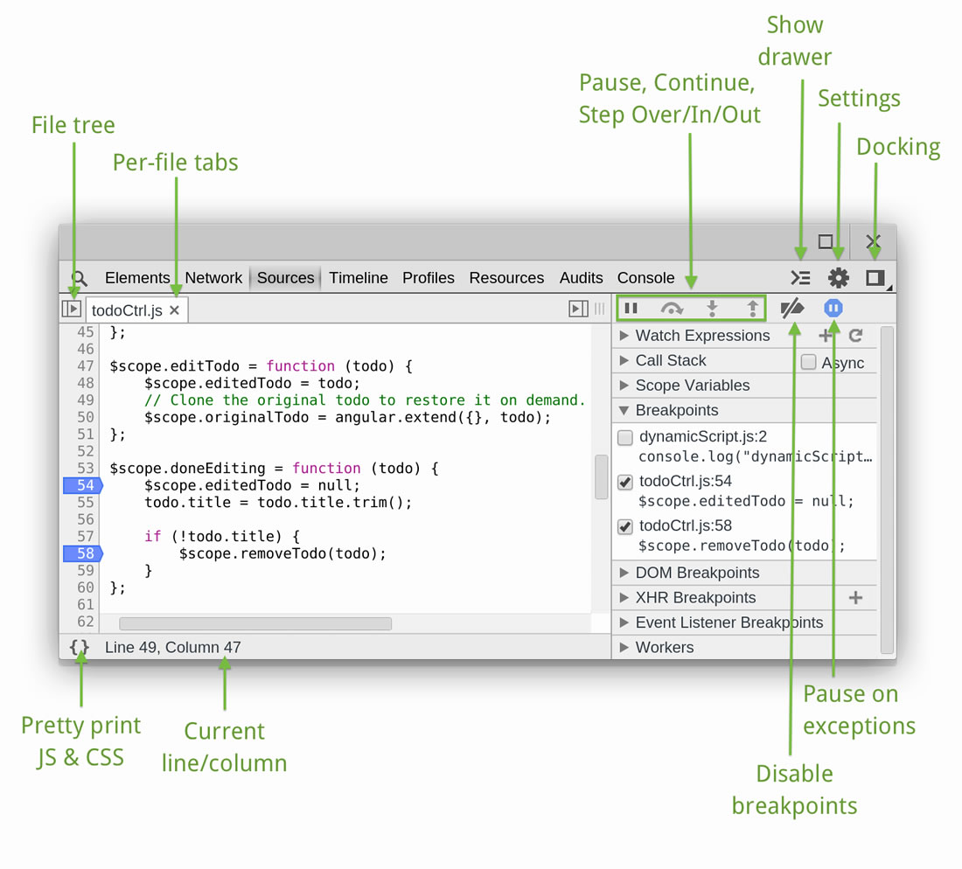

Slide 6
TYPES OF BREAKPOINTS
JS Breakpoints
Add
Remove
Edit
Disable
DOM Breakpoints
XHR Breakpoints
Event Listener Breakpoints
PAUSED BREAKPOINTS
Execution Controls
Call Stack Panel
Asynchronous call stacks
Watch expressions
BlackBoxing
Console drawer / Hover
Pause On exceptions (caught/uncaught)

Slide 7
PAUSED BREAKPOINTS
Execution Controls
Call Stack Panel
Asynchronous call stacks
Watch expressions
BlackBoxing
Console drawer / Hover
Pause On exceptions (caught/uncaught)

Slide 8
EXECUTION CONTROLS
Continue (/long press): Continues code execution until next breakpoint
Step Over: Step through code line-by-line
Step Into: Execution moves to the first line of function definition
Step Out: Moves execution to its parent function
Toggle breakpoints: Toggles breakpoints on/off leaving their state intact

Slide 9
OTHER FEATURES
Live Editing
History Logs
JS Source Maps
Watching Scopes
Snippets
Persistent Authoring – Add folder to workspace
Map network files to local resource
Throttling

Slide 10
COMMANDLINE API
log() / warn() / error() / info()
assert()
group() / groupCollapsed() / groupEnd()
time() / timeEnd() / timeStamp()
keys() / values()
table() / dir() / dirXML()
copy()
debug() / undebug()
monitor() / unmonitor()
inspect()
trace()
profile() / profileEnd()

Slide 11
PERFORMANCE
04

Slide 12
YES YOU CAN
Well, chrome toolbar provides 4 very powerful features which can help you:
Analyze network performance
Analyze code optimizations
Analyze rendering performance
Analyze your page, JS and CSS performance
Help you to narrow down on performance bottlenecks
These are
Network panel
Audits panel
Timeline panel
Profile panel

Slide 13
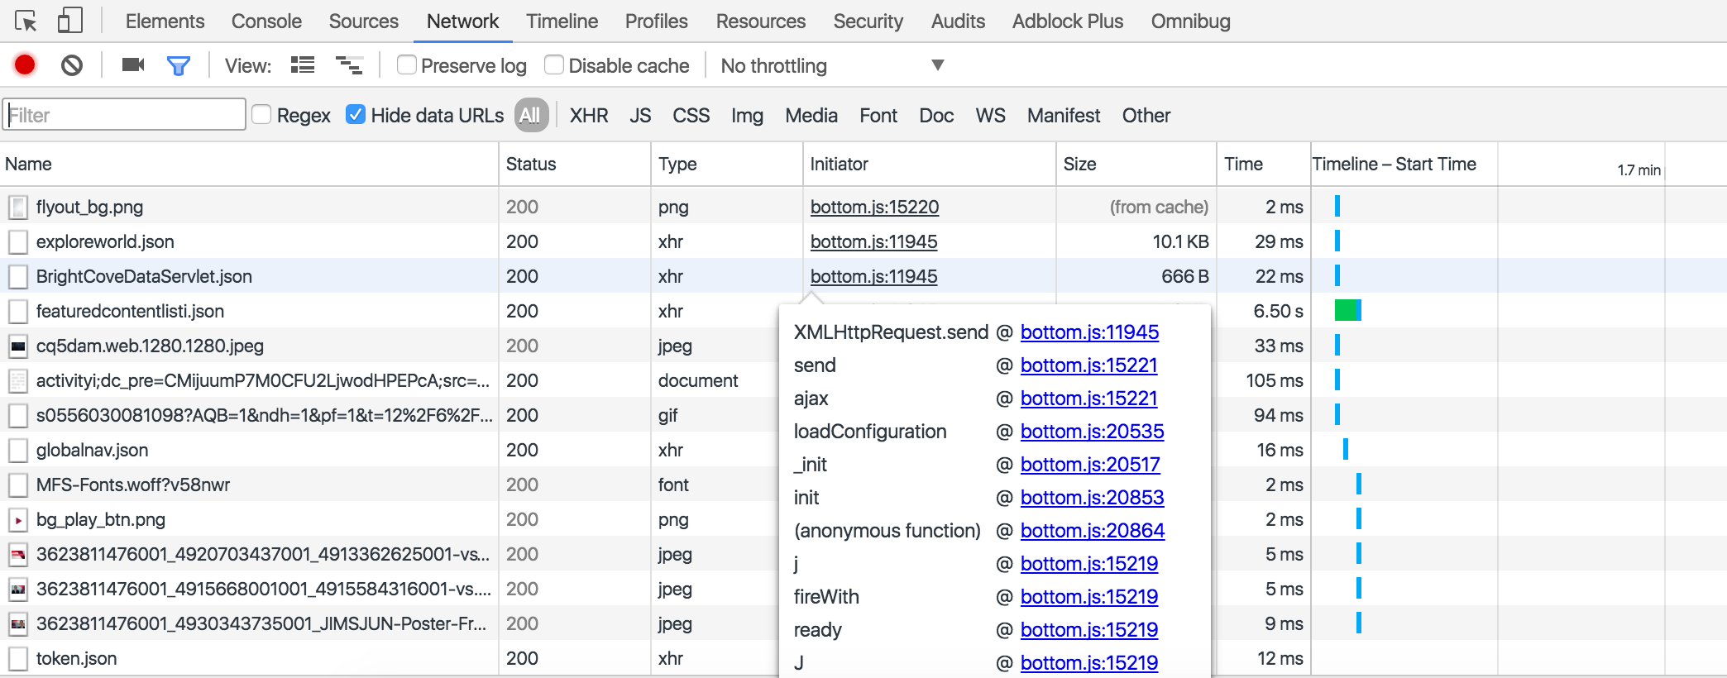
NETWORK PANEL - OVERVIEW

Slide 14
AUDITS PANEL - OVERVIEW
Get suggestions on how to improve your page performance
Optimization for decreasing load time
Audit
Present state
Reload and audit on load performance

Slide 15
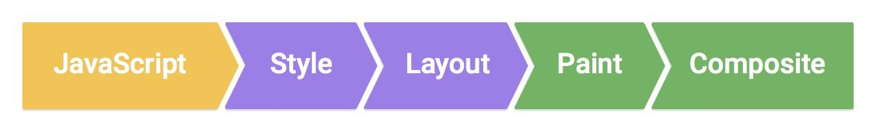
THE PIXEL PIPELINE

Slide 16
TIMELINE PANEL - OVERVIEW
RAIL model
Use the timeline panel to record and analyze all activity in your application.
The timeline panel consists of 4 panes:
Controls
Overview
FPS (Frames per second)
CPU resources
NET requests
Flame chart
Details
Zoom in on a timeline section
Jank
Make a recording
Capture screenshots during recording
Profile JavaScript/memory

Slide 17
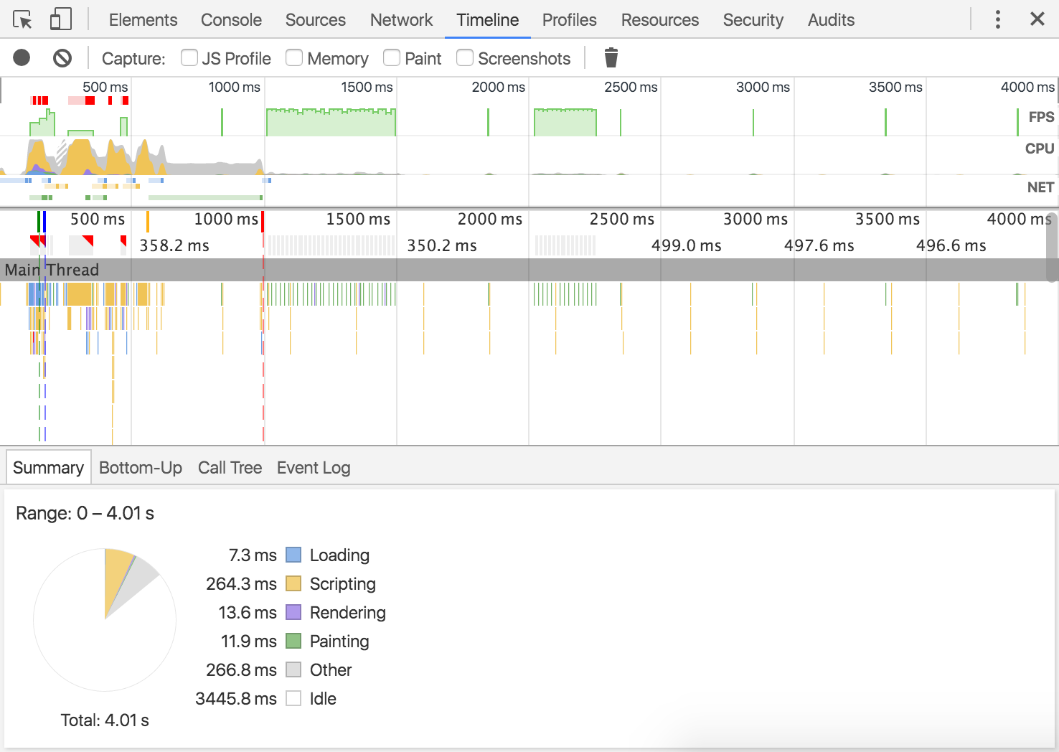

Slide 18
PROFILE PANEL - OVERVIEW
Memory loss occurs when a program repeatedly fails to return memory it has obtained for temporary use
CPU profiling
Heap profiling
Memory diagnosis

Slide 19
DATA VISUALIZER
Arduino Graph

Slide 20
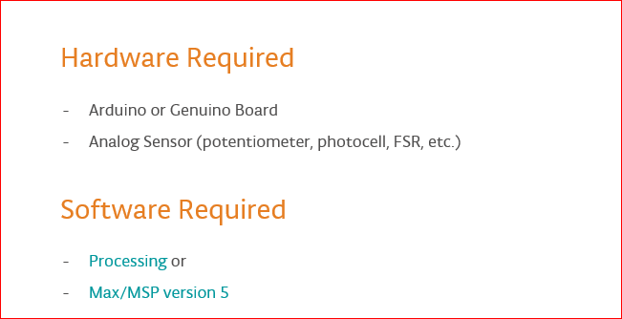
REQUIREMENTS

Slide 21
OVERVIEW
Graph shows how to send a byte of data from the Arduino or Genuino to a personal computer and graph the result. This is called serial communication because the connection appears to both the board and the computer as a serial port, even though it may actually use a USB cable, a serial to USB and a USB to serial converter.
we can use the serial monitor of the Arduino Software (IDE) to view the sent data, or it can be read by Processing (see code below), Flash, PD, Max/MSP, etc.

Slide 22
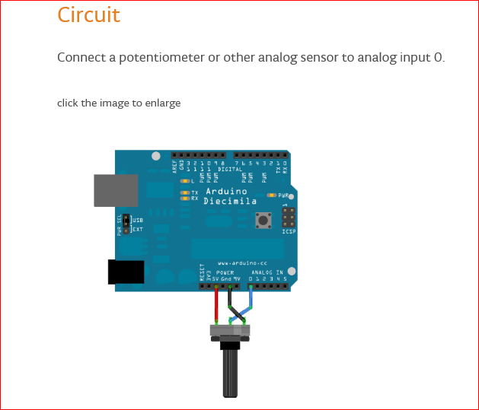
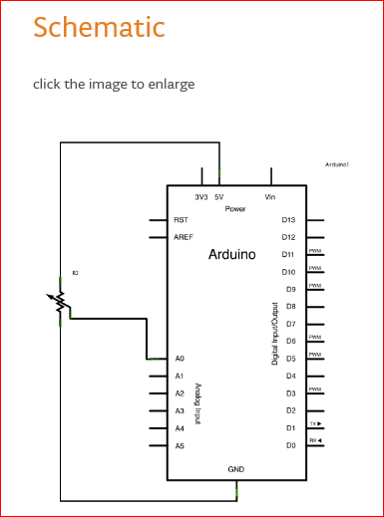
CIRCUIT DIAGRAM

Slide 23
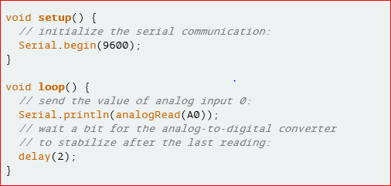
SAMPLE CODE

Slide 24
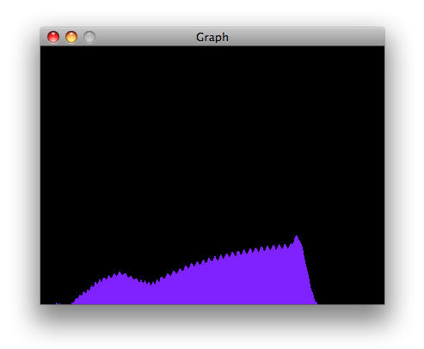
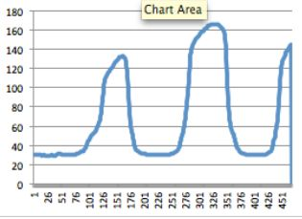
GRAPH PLOTTED

Slide 25
Remote Debugging Android Devices

Slide 26
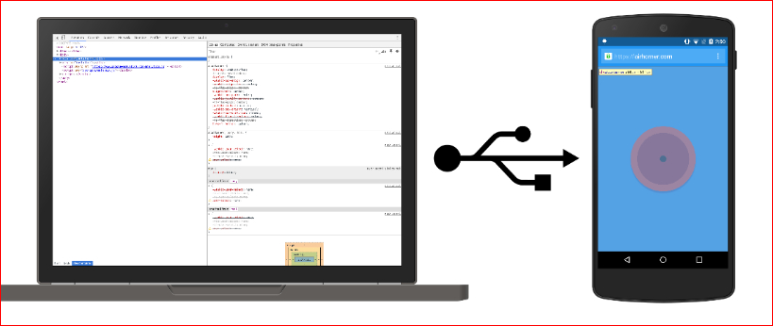

SETUP

Slide 27
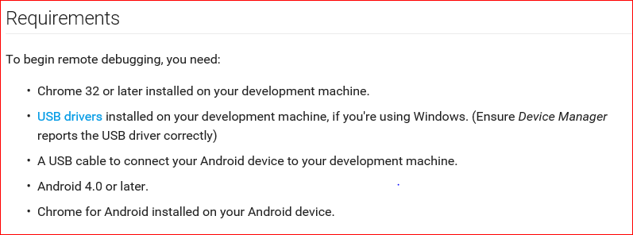
SETUP

Slide 28
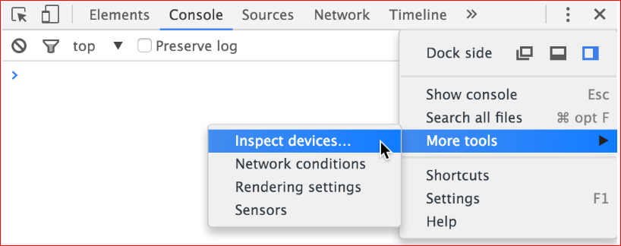
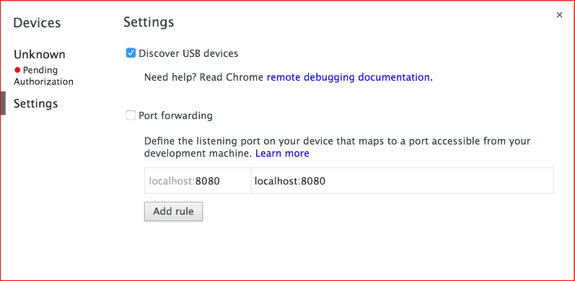
SETUP

Slide 29
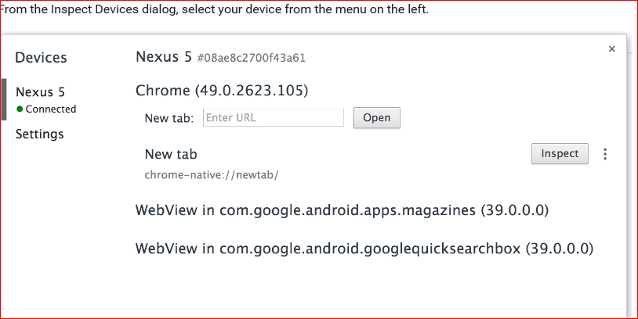
Debug content on Android device from development machine

Slide 30
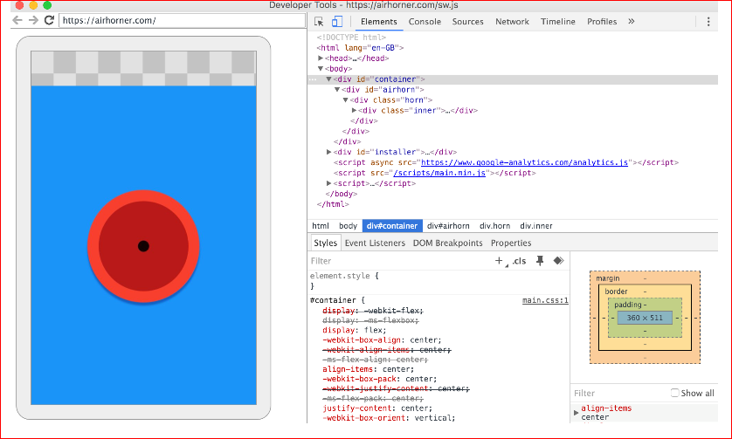
Screencast from Android device to development machine

Slide 31
THANK YOU

