Slide 1

Compiler Design Sohrab Namazinia
Iran University of Science & Technology
School of Computer Engineering
Spring 2021

Slide 2
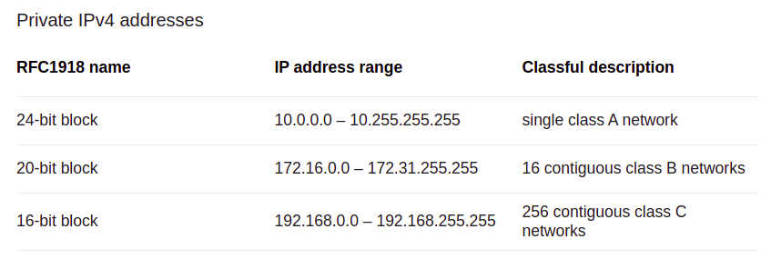
Assignment Details
1- Write a regular expression for a simple network Router: router's in computer network must validate ipv4 and drop all packet with private ipv4 address. Write a anrlr4 grammar to validate IP addresses for a router.
Requirment:
A) An ip address consists of 3 numbers, separated with two dots. The value of each number is 0-255 For example: 255.189.10.37 Correct and 256.189.89.9 is error.
B) private ip address range:

Slide 3
Assignment Details
2- Write a Python program, using ANTLR regular expression, over the alphabet {a, b, c}:
a) length of input is at least 2 and at most 4
b) number of 'a's is a multiple of 3
c) contains at least three consecutive 'b's
3- Depict a DFA to accept all the binary strings, that do not include the substring “1101”. write a lexer function pseudocode to determine these strings. (code implementation in any language is optional and have extra credit)

Slide 4
Assignment Details
4- Write a function with lexical analyzer of anrlr4 that undo comments from a Java program. assume that: a- we previously comment some piece of program and we know that piece of commented code has no error. b- we know in this program all comments are piece of correct Java code. and have not any discretional comment. Use antlr4 lexical analyzer and Java grammar in previous assignment. There is an example in next slide.

Slide 5
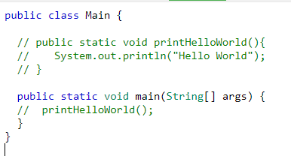
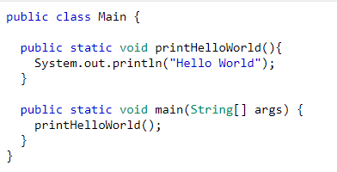
Assignment Details
Input:
Output:
Note that real compiler remove all comment in lexical analyzer step. So that in syntax analyzer step you don't have access to comments. So you must work in lexical analyzer step.

Slide 6
Assignment Details
Write and explain all question completely in your report (use screenshot)
And attach your code please.
Your report must be in end of this slide.
Good Luck!

Slide 7
Solutions
A1.
the corresponding grammar file in my code is q1.g4. what I did was to divide the answer domain into separate regions that must be accepted. Also I used two simple lex rules Octet and Dot for simplicity. So it contains the ip addresses that are:
1. before class A: from 0.0.0.0 to 9.255.255.255 2. between A and B: from 11.0.0.0 to 172.15.255.255
3. Between B and C: from 172.32.0.0 to 192.167.255.255
4. After C: from 192.169.0.0 to 255.255.255.255
Each of these intervals then are divided to subintervals that their regex can be defined easily. Above of each regex, there is comment that specifies the corresponding interval which that regex covers.
Totally I have defined 20 lex rules and 1 parse rule for defining the regex of this question.

Slide 8
Solutions
A2.
I defined a ‘Char’ that must be repeated at least 2 times and at most 4 times. The Char is a, b or c. (q2_a.g4) here is the corresponding regex:
(a + b + c) (a + b + c) + (a + b + c) (a + b + c) (a + b + c) + (a + b + c) (a + b + c) (a + b + c) (a + b + c)
b) I implemented the corresponding regex for that in q2_b.g4:
((b + c)* a (b + c)* a (b + c)* a (b + c)* )*
c) ) I implemented the corresponding regex for that in q2_c.g4:
(a + c)* bbb (a + b + c)*
So finally there are 3 grammar files for this question in my project.

Slide 9
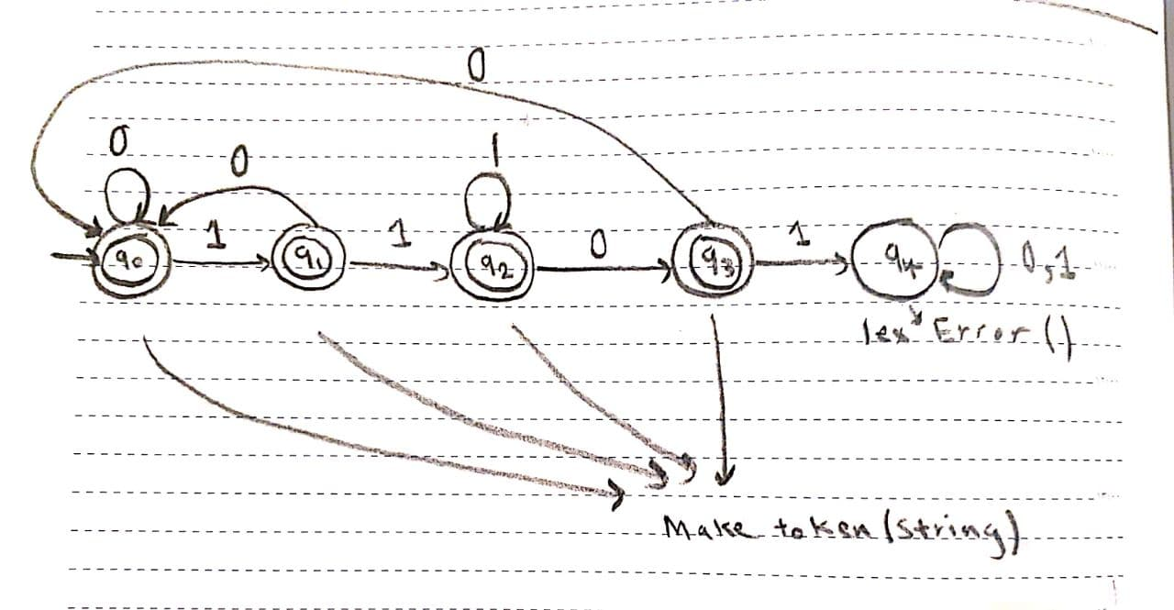
Solutions
A3. first I have implemented the dfa here.

Slide 10
Solutions
A3. then, according to what TAs said, if you code it (extra credit), there is no need to pseudocode. But I have done both! Here is the pseudocode,
Next slide is the pseudocode
I have uploaded in lms too. My code consists if a very clear definition for dfa, then constructing the dfa for this question. You can easily run and test it. If it causes lex error, it prints rejected, otherwise, it prints the details of reading the input and switching between the states step by step. (FSA folder)

Slide 11
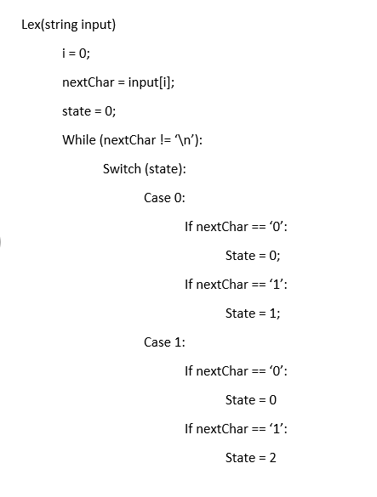
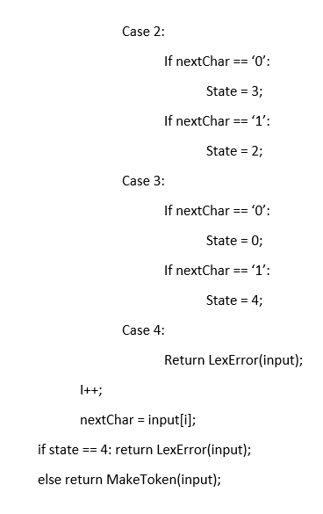
Solutions

Slide 12
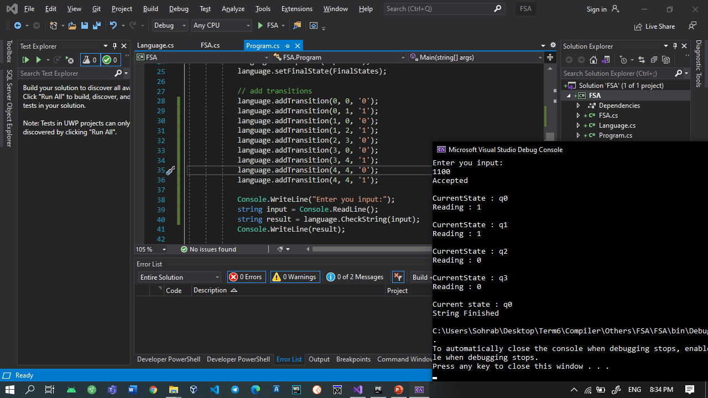
Solutions
Here is an example I ran with my code:

Slide 13
Solutions
A4. first, I explain the directory structure of my code. In A3, in grammar folder, I have put my grammars for q1, q2_a, q2_b and q2_c. also I have put JavaLexer and JavaParserLabled from the TA Class. I generated the lexer / parser (parser is not needed) python files in gen folder and imported them in src folder in a new python file called undo_comment.py where my code for q4 is in. in this file I have just run my main method which reads the input, converts it to fileStream and pass it to lexer. Then I iterate on tokens and wrote the result in the following way in a new file. both my input and output files are in IO directory.
There are two types of tokens in java grammar:
Comment
Line Comment
For each token:
if it is comment with length n, I have written the token from index 2 to index n – 3 which means ignoring the first 2 and last 2 chars of comment tokens.
If it is line comment, I have written it from index 2 which means just ignoring the first two chars.
Finally otherwise, I have just written the token.
Altogether, after running my code, the result is written in output.java in IO folder. In the next slide, you can see my main method. In the next two slides, there is an example I ran with my code. (input and out).

Slide 14
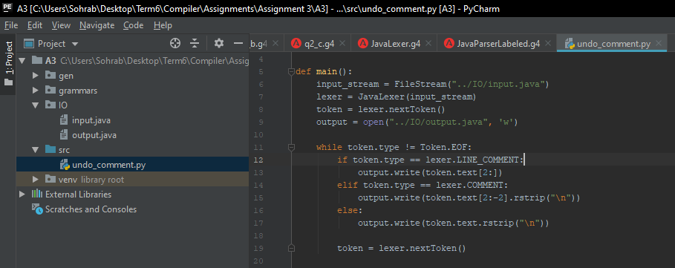
Solutions

Slide 15
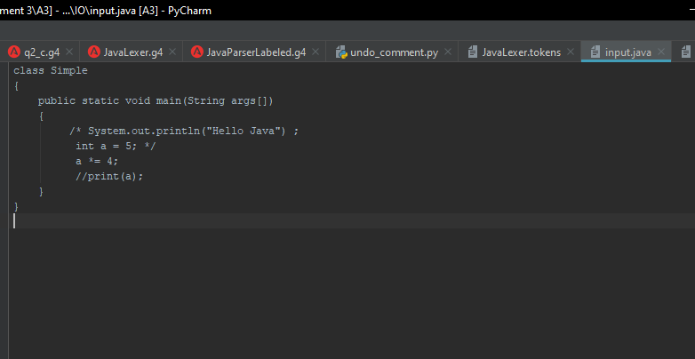
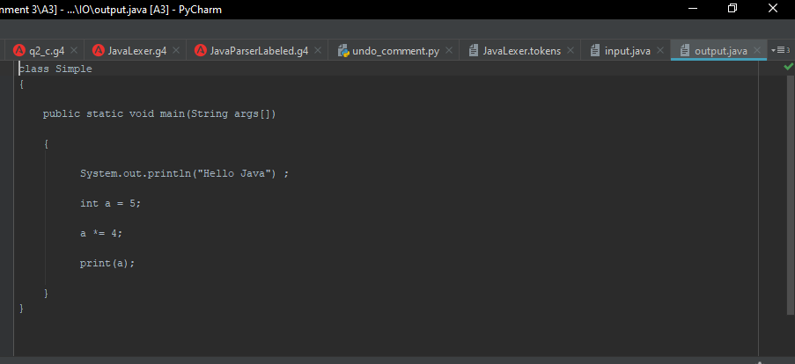
Solutions

