Slide 1
Turing & FA
By: Sohrab Namazinia

Slide 2
Automata (Logic)
In the PDF File attached to this project, you can read the logic behind the design of each of the machines (L1 to L5).
Then, you will see how you can give input to test the program, so that you get the clear result of that.

Slide 3
Input and Structure
The code is completely Object-Oriented :
Interface Q has the method “CheckString(w)” and all “Q” classes implement it.
The OOP Structure of the classes is shown in the next slide.

Slide 4
Interface Q : class L1:
CLASS FA CLASS State CLASS Edge class L2:
CLASS FA CLASS State CLASS Edge class L3:
CLASS PDA CLASS State CLASS Edge class L4: CLASS PDA CLASS State CLASS Edge class L5:
CLASS TuringMachine
CLASS State
CLASS Edge
CLASS Tape
ENUM Movement

Slide 5
Input and Structure
The project structure has been designed in such a way that you really do not need to read this documentation!
You just need to run the main file of the project!
Then everything will be asked from you.
An example is shown in the next slides.

Slide 6
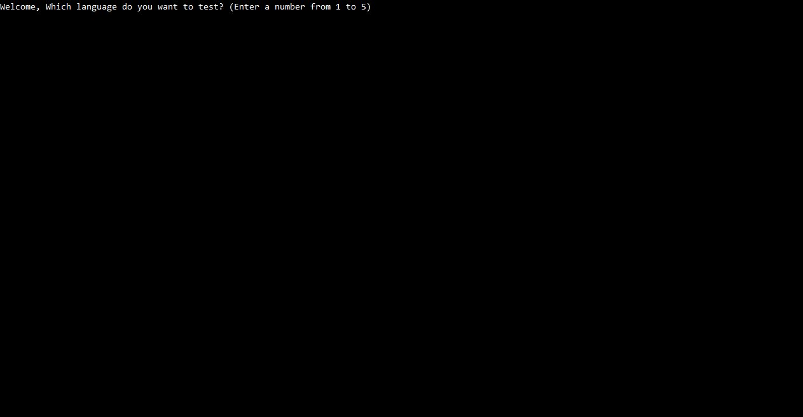

Slide 7
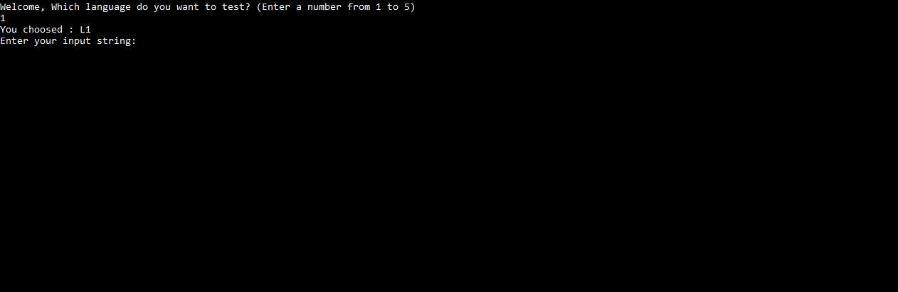

Slide 8
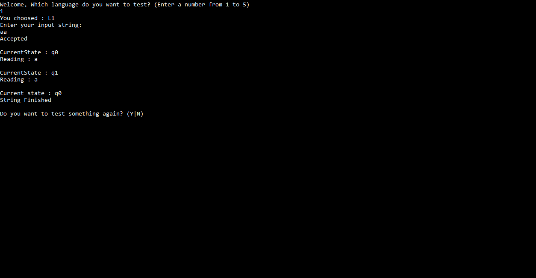

Slide 9
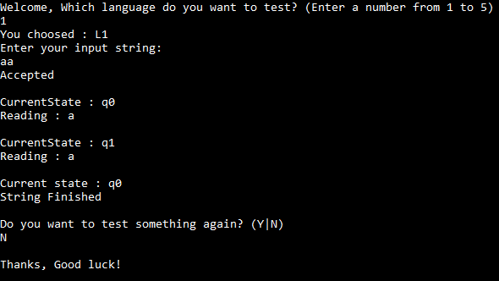

Slide 10
“THE END”

