Slide 1
DFS
(DEPTH-FIRST SEARCH)
Sohrab Namazi

Slide 2
CONTENT

Slide 3
CONTENT
What is algorithm? (briefly)
Graph and traversal (briefly)
DFS algorithm
DFS applications
Graphical visualization of DFS (code)

Slide 4
algorithm

Slide 5
ALGORITHM

Slide 6
ALGORITHM
In our daily life, we confront with many different problems. For solving them, we start to make a plan that is a step by step list of commands and works that we should do to complete a job so that the problem be solved.
In computer science, algorithm refers to a step by step process that a computer accomplishes to do a task. These days, algorithms have many applications. Because of the versatility of some algorithms, they been called via specific names.
For example, for computing the salary of a employee by a computer, many factors should be combined with a specific order so that the salary be computed correctly. This specific order is the algorithm for this problem.

Slide 7
An example of an algorithm for sorting numbers (called “merge sort”)

Slide 8
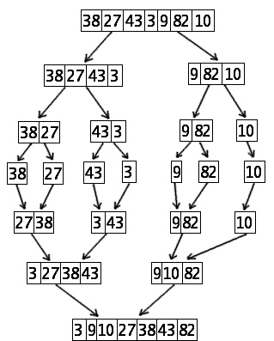
An example of an algorithm for sorting numbers (called “merge sort”)

Slide 9
Graph & traversal

Slide 10
Graph & traversal
Graph is a diagram for visualizing relation of objects of almost a same group. Graphs have to parts :

Slide 11
Graph & traversal
Graph is a diagram for visualizing relation of objects of almost a same group. Graphs have to parts :
Graph
Node : almost refer to objects
Edge : almost refer to a specific relation between the objects

Slide 12
This is a graph for a social network. The nodes refer to users and the edges refer to the act of following

Slide 13
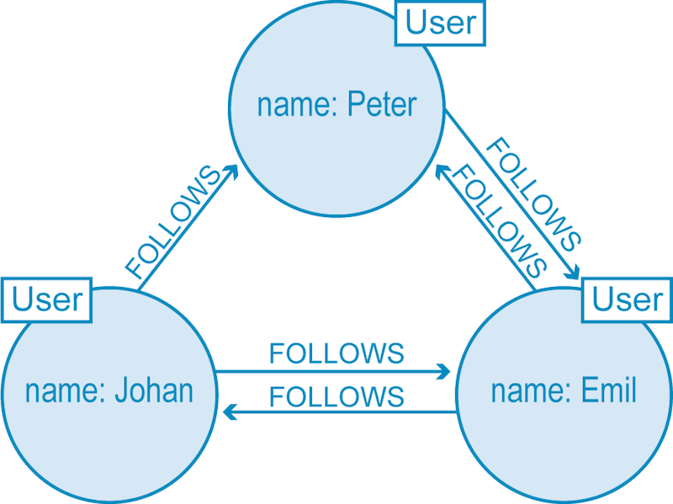
This is a graph for a social network. The nodes refer to users and the edges refer to the act of following

Slide 14
Graph & traversal
So graph is a way of showing database and in every database, many times we want to seek some distinct objects and their relations with others or relation of two objects, etc. for such these tasks, we have to traverse the graph. For traversing a graph, there are many algorithms. Graph traversal helps us to find out if there is a connection between two nodes or not, also it helps us to know how far we can go in a graph if we start from an arbitrary point.
One of the famous algorithms for graph traversal, is called DFS that stands for Depth-First Search. In this presentation, we are going to cover this algorithm, its implementation and applications.

Slide 15
DFS

Slide 16
Depth-first search (dfs)
DFS (which stands for Depth-First Search) is an algorithm mostly for traversing through a graph. With DFS, the algorithm starts from a point and it will visit all possible nodes with that origin. But the order that it visits nodes, is recursive.
It goes deeply in a branch and after exploring it, goes back to the intersection and enters the other branch. It will continue until not being able to visit new nodes.
We will explain it on a graph in next slide.

Slide 17

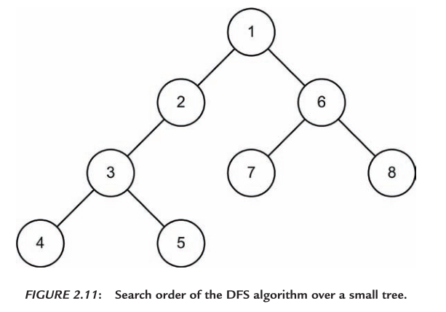
Dfs example
Imagine we want to run DFS on this graph. We start from an arbitrary node like 1. from one we can go into 2 branches that are 2 & 6. we first go deep in 2 (we can first choose 6 too), so after 2 we should go to cell 3, then we can go either in 4 or 5, we choose 4, then there is no way, so we backtrack and come back to 3, from 3 still we can visit new nodes, so we go to 5, then again come back to 3, back to 2, back to 1, now we do the same way for the second branch, first go to 6, then to 7, then backtrack to 6, go to 8, back to 6, and finally back to the origin. There is no new nodes from the origin to see, so the DFS has been finishes.

Slide 18
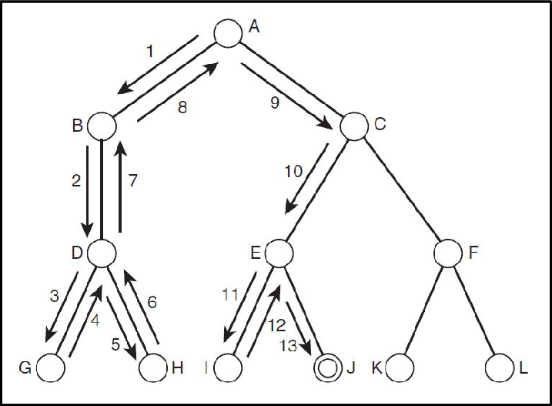
A pictorial example
now, we want to run DFS on this graph, step by step by image(the numbers are showing the order of steps) :

Slide 19
Marked list
for implementing DFS in code, a list is created called Marked list or visited list. In this list, we assign a Boolean value to every node. At first, all the nodes are false. At the time that we visit a node, we mark its value as true so that next time e are doing DFS, we ignore it.
In a connected component graph, finally all the nodes will have true value. But the important point is that :
With starting from a node, and running DFS, finally, we some nodes have true value and some false. Those having true, are called reachable nodes from the origin node. Those having false, are called unreachable nodes from the origin. Therefore :
One application for DFS is checking reachability

Slide 20
“Edge TO” list
another list sometimes is created for DFS that is called “EdgeTo” list. This list assigns a node to every node that is the adjacent node of the current node that we have gotten to. For example if we go from node A to node B, edgeTo of B will be A. it is obvious that the origin node wont have any edgeTo. But writing this list helps us to find the path from origin to that. Imagine that we have covered the path we have passed with a string. So following back that string, will help us to do the backtracking that is the necessary part of DFS. It means that it will help us to find the path that is reaches the origin node to any arbitrary reachable node from the origin. Therefore :
Another application for DFS is path finding (through EdgeTo list).

Slide 21
DFS Applications

Slide 22
Dfs applications
DFS has many applications in different partitions. But first we should divide its applications in two parts :
1( Speculative applications : how DFS helps us in more details
2) Practical applications : how DFS helps us in the real world.

Slide 23
speculative applications
As we mentioned in the explanation part of the presentation, dfs has two important speculative applications :

Slide 24
speculative applications
As we mentioned in the explanation part of the presentation, dfs has two important speculative applications :
It determines with starting an arbitrary node in a graph, how far we can go and which nodes we can visit. That is called reachability

Slide 25
speculative applications
As we mentioned in the explanation part of the presentation, DFS has two important speculative applications :
It determines with starting an arbitrary node in a graph, how far we can go and which nodes we can visit.
- That is called reachability
2) it also gives us the path from an arbitrary origin to every reachable nodes around. In other words, it tells us how to go to a reachable node by starting from the origin.
This application is called path finding.
3) Topological sort : topological sort is another subject for projects by itself. therefore we are not going to explain it.

Slide 26
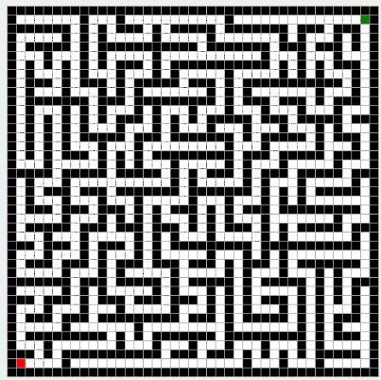
Path finding through DFS

Slide 27
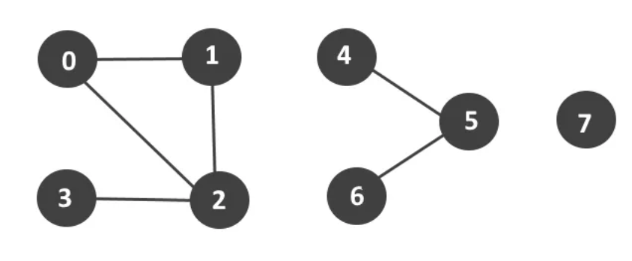
DFS reachability states that from 0, 3 is reachable, but 4 isn’t!

Slide 28
Dfs practical applications
Now, its time to mention the practical applications of DFS :
1) maze exploration
2) Data clustering
3) Maps : since there are much more powerful algorithms in this field like Dijkstra and so on, we are not going to explain this part. Because using those algorithms is much more versatile. Also A* algorithm is even better than Dijkstra in some fields of map exploring.

Slide 29
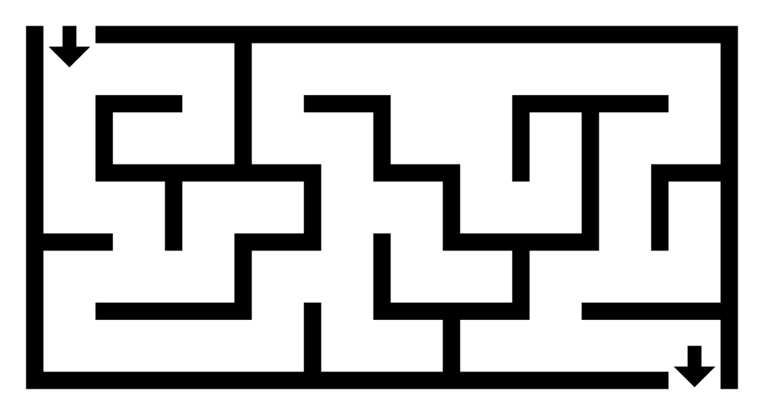
maze
Imagine some thing has gotten stuck in a maze or some thing that has an identical structure to that. for finding the path out, you just need to run a DFS that the origin is your current location and your destination is the terminal of the maze. If a way exists, DFS is able to give you the path.

Slide 30
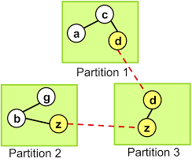
Data clustering
Imagine we have some data that we want to divide it into some partitions based on some properties. First of all, we need to convert the structure to a graph that 2 nodes are adjacent if they tend to be in a single component. That will be the way to divide the data into partitions. With running DFS from node a (in the picture), a, c and d will be visited. So we will give them the same id as a single unit. Then, we will run DFS from an unvisited node and give the same id (different with the former group) to the connected nodes to that. We do this until not having any edges unvisited. Then, the number of different ids will show the number of our portions or connected components. So it has lots of applications in data clustering.

Slide 31
Graphical visualization of DFS (code)

Slide 32
Graphical visualization of DFS
We have prepared a code project with this presentation that is written in python (via module pygame). This code presents DFS algorithm step by step in graphical structure for understanding better.
Here we will explain the code a bit to realize how it works.

Slide 33
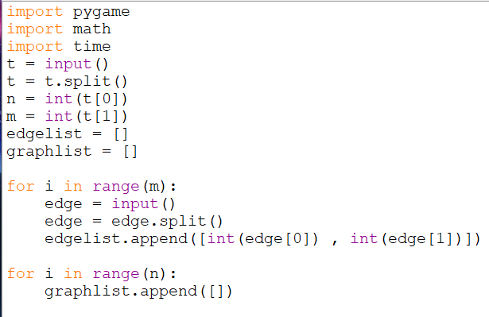
User input
In this part the program takes input from the use and convert it to the list of edges.

Slide 34
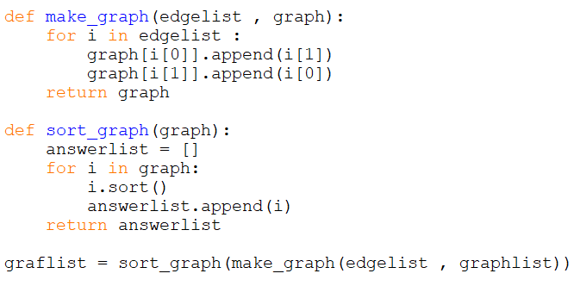
Making Graph
Here the graph is built and the numbers inside the list of edges be sorted.

Slide 35
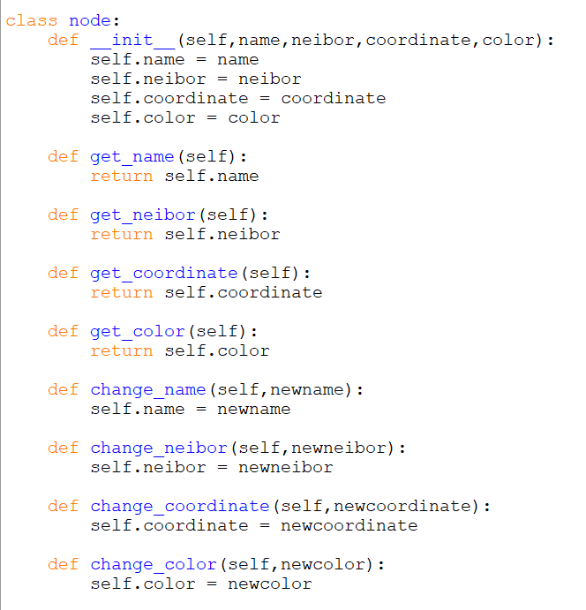
Node class
Here is the node class with its methods.

Slide 36
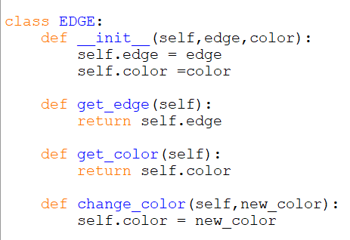
edge class
Here is the edge class with its methods.

Slide 37
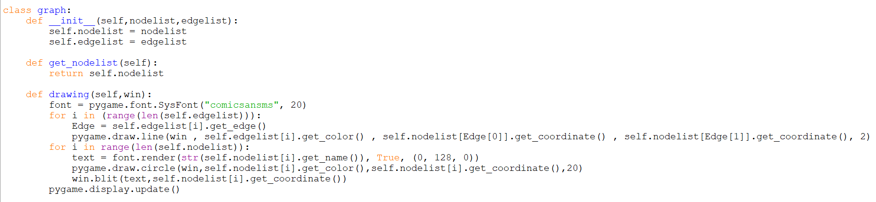
graph class
Here is the graph class with its methods.

Slide 38
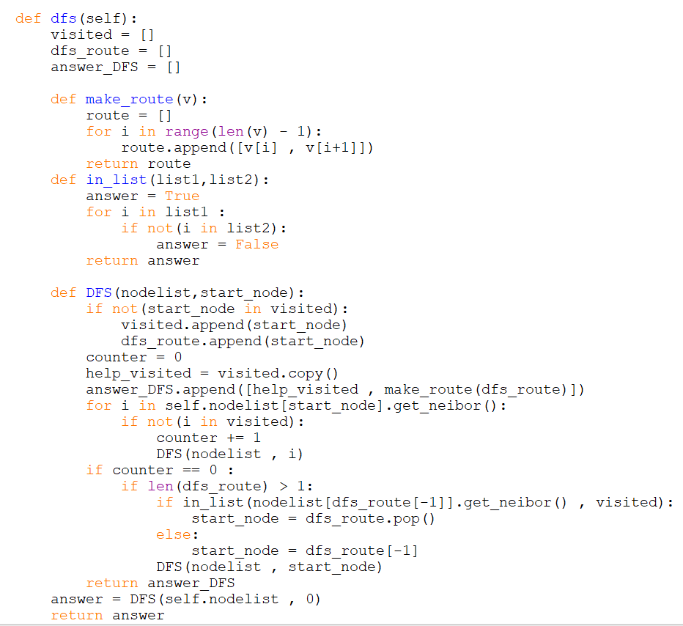
DFS method
Here is somehow the core of the project where DFS has been defined as a method for the Graph class.

Slide 39
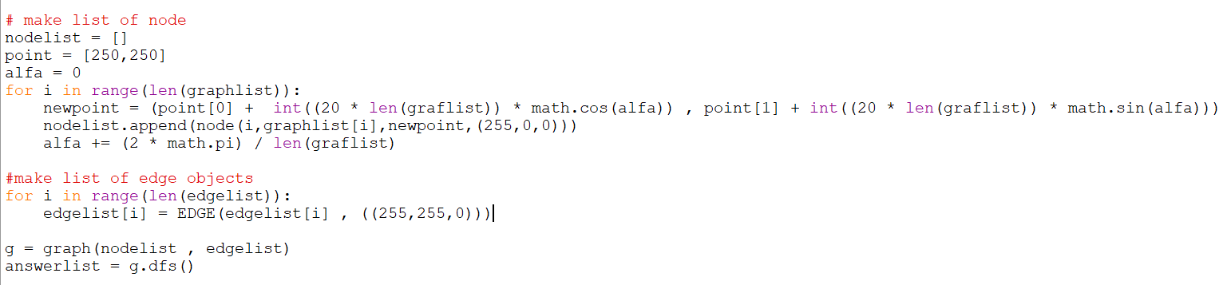
Making lists for nodes and edges separately
Here from the edges and nodes that we have, two lists will be created.

Slide 40
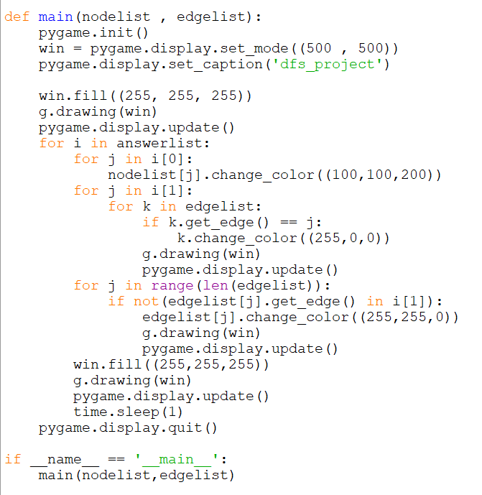
Main method
We run a loop on the lists that are existing in the answer list. What the screen displays will be updated in the loop to continue showing the steps of DFS. - here the code is finished.

Slide 41
summary
There are many algorithms for graph traversal that one of them is called DFS. DFS stands for Depth-First Search and is a recursive method to go deep in a graph and for traversing it. DFS has many applications such as path finding, reachability, etc. There is also a code project about DFS visualization that has been attached to this presentation in one folder. (the code has been written in python)

Slide 42
the last word
Since even not 1 line of this project and presentation has been copied, so much time has been taken for this. Hope you enjoy it. If you have any criticisms about the project, you can tell us :
sohrabsn7@yahoo.com
Thank you, good luck.

Slide 43
the end

