Slide 1
Ranking with LLMs
Inputs: a set of unstructured documents
A scoring function (e.g., MMR)
Output k documents with the highest MMR score.
LLMs (perhaps langchain.. I am not sure)
Similarity LLM - Inputs to LLM (a query, and a document), output its relevance or similarity score
Diversity LLM – Inputs to LLM (two documents), output is the diversity score between two documents
Algorithmic computations – computing MMR score of a set of k documents.

Slide 2
Technical problem
Example
Total number of documents – 4
K=2
Asking minimum number of questions to LLM
Two kinds of question
Relevance question Rel(q, di)?
Diversity question Div(di,dj)?
Inputs – Relevance Vector Diversity matrix
 | d1 | d2 | d3 | d4
query | x | x | x | x
 | d1 | d2 | d3 | d4
d1 | x | x | x | x
d2 | x | x | x | x
d3 | x | x | x | x
d4 | x | x | x | x

Slide 3
Core technical problem
Decide the next best question
Infer a probability distribution function over the possible set of top-k sets
Decide how a question is helpful in reducing the entropy of the solution
N1-n100 (entities) – k=5
Number of possible solution set = 100C5
Minimum(LB) MMR score to each set, Maximum (UB) MMR score to each set
When you get an answer to a question – LB and MB scores of some candidate sets get readjusted.

Slide 4
A running example
N=6, k=3
How to add LB and UB score
What is the uncertainty in the current candidate set?
How do you decide the question that reduces it maximally?
DIV(a,b), DIV(b,c) – how one is better than the other?

Slide 5
A running example

Slide 6
Example Definition
N=4, k=3
d1 = the price is fair, d2 = This camera has very high quality
d3 = The quality of this camera is great, d4 = The quality of the camera is normal
query: I’m looking for a good camera
Candidate set = {{d1, d2, d3}, {d1, d2, d4}, {d1, d3, d4}, {d2, d3, d4}}
Scoring function (MMR)
MMR(candidate_set) = 1 * R(candidate_set) + 1 * D(candidate_set)
R(candidate_set) = Sum(R(query, d) for d in candidate set) / k
D(candidate_set) = Sum(D(d_i, d_j) for (d_i, d_j) in candidate_set) / kC2
 | d1 | d2 | d3 | d4
d1
d2 | 0.9
d3 | 0.9 | 0.3
d4 | 0.9 | 0.6 | 0.6
 | d1 | d2 | d3 | d4
query | 0.3 | 0.9 | 0.9 | 0.7

Slide 7
Relevance score
Current Candidate set = {{d1, d2, d3}:(0, 2), {d1, d2, d4} }:(0, 2), {d1, d3, d4} }:(0, 2), {d2, d3, d4} }:(0, 2)}
First, we assume we have called LLM for the whole Relevance (R) table since the number of calls is still linear.
Current Candidate set = {{d1, d2, d3}: (0.7, 1.7), {d1, d2, d4}: (0.6, 1.6), {d1, d3, d4}: (0.6, 1.6), {d2, d3, d4}: (0.8, 1.8)}
R({d1, d2, d3}) = 0.7
R({d1, d2, d4}) = 0.6
R({d1, d3, d4}) = 0.6
R({d2, d3, d4}) = 0.8
 | d1 | d2 | d3 | d4
d1
d2
d3
d4
 | d1 | d2 | d3 | d4
query | 0.3 | 0.9 | 0.9 | 0.7

Slide 8
Uncertainty Metric
Next best question: LLM(d1, d2) OR LLM(d2, d3)?
Whatever that results in higher uncertainty reduction
How to measure uncertainty
U1: Min(UBs) – Max(LBs)
Conceptually, equivalent to Length of intersection of common intervals
U2: Sum of the length of common intervals between each candidate pair
Conceptually, equivalent to Length of union of common intervals
U3: Entropy
Sum(PlogP)
P: chance of each candidate set to have the maximum score
P = Integral(x) for x in [LB, UP] / (UB – LB)
P needs to be normalized then
 | d1 | d2 | d3 | d4
d1
d2
d3
d4
 | d1 | d2 | d3 | d4
query | 0.3 | 0.9 | 0.9 | 0.7

Slide 9
Current Candidate set = {{d1, d2, d3}: (0.7, 1.7), {d1, d2, d4}: (0.6, 1.6), {d1, d3, d4}: (0.6, 1.6), {d2, d3, d4}: (0.8, 1.8)}
U1 = 0.8 , U2 = 5.3
If we Call LLM for (d1, d2): 0.9
Current Candidate set = {{d1, d2, d3}: (1.0, 1.66), {d1, d2, d4}: (0.9, 1.56), {d1, d3, d4}: (0.6, 1.6), {d2, d3, d4}: (0.8, 1.8)}
U1 = 0.56, U2 = 3.94
If we Call LLM for (d2, d3): 0.3
 | d1 | d2 | d3 | d4
d1
d2 | 0.9
d3
d4
 | d1 | d2 | d3 | d4
query | 0.3 | 0.9 | 0.9 | 0.7
 | d1 | d2 | d3 | d4
d1
d2
d3 |  | 0.3
d4
 | d1 | d2 | d3 | d4
query | 0.3 | 0.9 | 0.9 | 0.7
Current Candidate set = {{d1, d2, d3}: (0.8, 1.46), {d1, d2, d4}: (0.6, 1.6), {d1, d3, d4}: (0.6, 1.6), {d2, d3, d4}: (0.9, 1.56)}
U1 = 0.56, U2 = 4.2
Hence, Different uncertainty metrics give different results, but U2 is the accurate version of U1

Slide 10
Given a partially filled D, How to decide the next best question?
 | d1 | d2 | d3 | d4 | d5 | d6
query | 1 | 0.9 | 0.8 | 0.2 | 0.3 | 0.1
 | d1 | d2 | d3 | d4 | d5 | d6
d1
d2 | 0.9
d3 | 0.8 | 0.4
d4 | 0.6 | 0.5 | 0.2
d5 | 0.4 | 0.6 | 0.4 | 0.1
d6 | 0.7 | 0.1 | 0.3 | 0.4 | 0.7
Analysis: what LLM(tuple) to choose?
If the tuple does not exist in any candidate set, it is useless
Each tuple’s overall effect is fixed
always increasing lower bound(s), always decreasing upper bound(s)
Hence, How much a tuple reduces uncertainty depends on two factors
How many times the tuple is involved in the candidate sets totally
What are the corresponding (lower, upper) bounds of those candidate sets that this tuple is involved in
Hence, we should choose the tuple that has the highest share in the total uncertainty of the candidate list. However, this is not a guarantee that it is going to maximally reduce uncertainty since we do not know the value of that cell before calling the LLM

Slide 11
Given a partially filled D, How to decide the next best question?
 | d1 | d2 | d3 | d4 | d5 | d6
d1
d2 | 0.9
d3 | 0.8 | 0.4
d4 | 0.6 | 0.5 | 0.2
d5 | 0.4 | 0.6 | 0.4 | 0.1
d6 | 0.7 | 0.1 | 0.3 | 0.4 | 0.7
 | d1 | d2 | d3 | d4 | d5 | d6
query | 1 | 0.9 | 0.8 | 0.2 | 0.3 | 0.1
Uncertainty types
LLM response: Make LLMs vote/refine (computation)
candidate set (already described): reducing with the following approach
X – amount of computation – y – uncertainty reduction
Algorithm
Candidates_list = list of all possible candidate sets (initially nCk candidates)
While len(candidates_list) > 1:
Tuples_list = all possible tuples by considering the remaining candidate sets
tuple <= choose that tuple from tuple list such that it has the maximum share in the total uncertainty of the candidate list
Call LLM(tuple)
Update LB and UB of candidate sets including tuple
removing_candidate_sets = Check new intervals of candidate sets and choose the ones that are eligible for being pruned
candidates_list <= remove removing_candidate_sets from Candidates_list

Slide 12
Given a partially filled D, How to decide the next best question?
Example
(N = 6, K = 3)
 | d1 | d2 | d3 | d4 | d5 | d6
d1
d2 | 0.9
d3 | 0.8 | 0.4
d4 | 0.6 | 0.5 | 0.2
d5 | 0.4 | 0.6 | 0.4 | 0.1
d6 | 0.7 | 0.1 | 0.3 | 0.4 | 0.7
 | d1 | d2 | d3 | d4 | d5 | d6
query | 1 | 0.9 | 0.8 | 0.2 | 0.3 | 0.1
A simplified example of the iterative behavior of the algorithm
(For simplicity, the chosen tuples are not necessarily the ones with the highest share in uncertainty)
The initial candidate set does not contain all possible candidates. WLOG, We can assume they have already been pruned.
Current Candidate set = {{d1, d2, d3}: (0.9, 1.9), {d2, d4, d6}: (0.4, 1.4), {d4, d5, d6}: (0.2, 1.2)} --- U2 = 1.6
LLM(d1, d2) = 0.9
Current Candidate set = {{d1, d2, d3}: (1.2, 1.9), {d2, d4, d6}: (0.4, 1.4), {d4, d5, d6}: (0.2, 1.2)}
REMOVING {d4, d5, d6}
Current Candidate set = {{d1, d2, d3}: (1.2, 1.9), {d2, d4, d6}: (0.4, 1.4)} --- U2 = 0.6
LLM(d2, d6) = 0.1
Current Candidate set = {{d1, d2, d3}: (1.2, 1.9), {d2, d4, d6}: (0.4, 1.1)}}
REMOVING {d2, d4, d6}
Current Candidate set = {{d1, d2, d3}: (1.2, 1.9)} => Top-3 = (d1, d2, d3) --- U2 = 0

Slide 13
Implementation

Slide 14
Description
Algorithms
Exact baseline: does all LLM calls, computes exact scores and select the max
Naïve: does all LLM calls, uses them one by one to adjust bounds, and selects the remaining one
Min Uncertainty: In an iterative process, decides which LLM call to do next, updates bounds, and repeats it till the winner is clear.
LLM calls
Actual calls using Langchain
Mocked tables (test purposes)
Metrics
Time (duration)
Cost (LLM calls)
Quality (correct solution)

Slide 15
Results
Cost
Min_Uncertainty < Naïve = Baseline
Time
Mocked tables
Min Uncertainty > Baseline > Naïve
Actual LLMs
Min Uncertainty < Naive < Baseline
Quality
Mocked tables
Min Uncertainty = Baseline = Naïve
Actual LLMs
No guarantee, but we expect to be still equal
Second type of uncertainty
Make use of Langchain to reduce that
preference questions – categorized values

Slide 16
Uncertainty

Slide 17
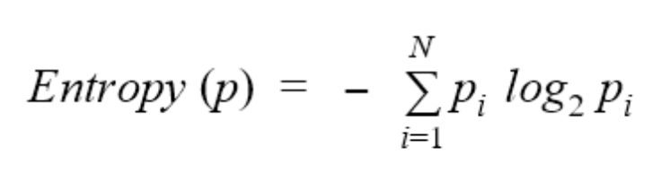
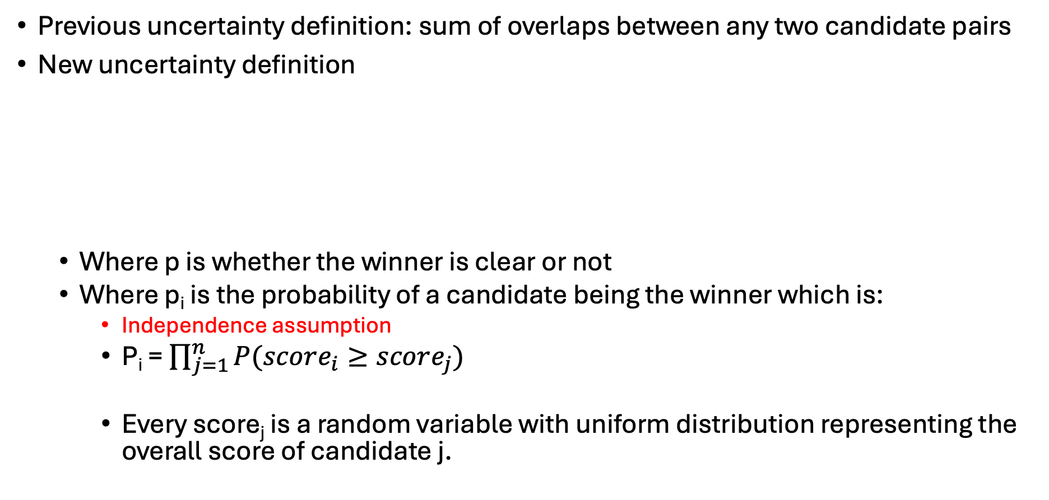
Entropy
Previous uncertainty definition: sum of overlaps between any two candidate pairs
New uncertainty definition
Where p is whether the winner is clear or not
Where p_{i} is the probability of a candidate being the winner which is:
Independence assumption
P_{i} = $\prod_{j=1}^{n}{P(score_{i}≥score_{j})}$
Every score_{j} is a random variable with uniform distribution representing the overall score of candidate j.

Slide 18
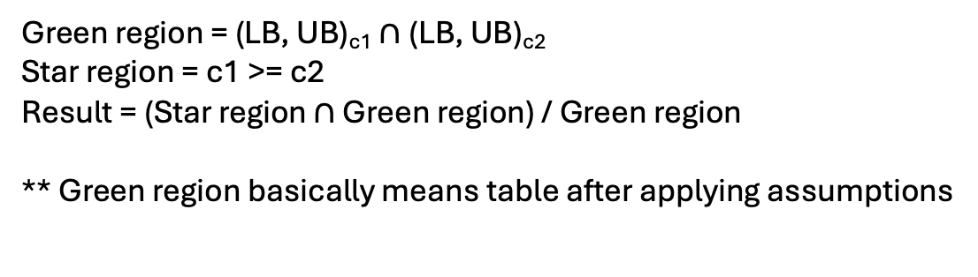
Entropy - Example
Continuous
c1: (lb, ub) = (1, 2)
c2 : (lb, ub) = (0.5, 1.5)
P(c1 >= c2) =
p(1.5 < c1 < 2) +
p(1 < c1 < 1.5) * p(1 < c2 < 1.5) * ½ +
p(1 < c1 < 1.5) * p(0.5 < c2 < 1)
= ½ +
½ * ½ * ½ +
½ * ½ =
0.875
P(c1 < c2) = 1 – 0.875 = 0.125
Discrete
C2
C1
 | 0.5 | 1 | 1.5 | 2
0.5 | *
1 | * | *
1.5 | * | * | *
2 | * | * | * | *
Green region = (LB, UB)_{c1} $∩$(LB, UB)_{c2}
Star region = c1 >= c2
Result = (Star region $∩$ Green region) / Green region
** Green region basically means table after applying assumptions

Slide 19
Entropy
Choosing an LLM call that most likely reduces entropy
minimizing the entropy
minimizing uncertainty
Let’s say we have 2 candidates:
C1 = (0, 2), C2 = (0, 2)
P(c3) = ½ , P(c1) = ½ => worst-case probability distribution => entropy = maximum
C1 = (1.5, 2), C2 = (0.25, 0.75)
P(c1) = 1, P(c2) = 0=> best-case probability distribution => entropy = 0

Slide 20
heuristic to minimize entropy
How to choose the LLM call that most likely reduces the entropy?
Heuristic 1) Choosing the llm call that most likely reduces the sum of common intervals between candidates (previously discussed)
←----------------→
←-----→
←------------------------------→
←--------------------------------→
Tries to diverge the intervals as much as possible

Slide 21
heuristic to minimize entropy
Heuristic 2) Choose a candidate where LB has the lowest overlap with the UB of others + largest non-overlapping area
It means choosing the candidate that is currently most likely the winner
After we choose the candidate (let’s say {d1, d2, d3}), we need to decide which tuple we should choose from that. (d1 vs d2 OR d1 vs d3 OR d2 VS d3)
Choose any
We can use heuristic one to make this decision
We can use the document tuple that is in the 2nd potential winner
←----------------→ C1
←-----→ C2
←------------------------------→ C3
←--------------------------------→ C4
←----------------------→ C5
←--------------------------------------------→ C6

Slide 22
Next implementation steps
Uncertainty of a candidate set (Entropy)
The probability of a candidate winner
Heuristic 2
No. calls heuristic vs baseline

Slide 23
Entropy – No independence assumption

Slide 24
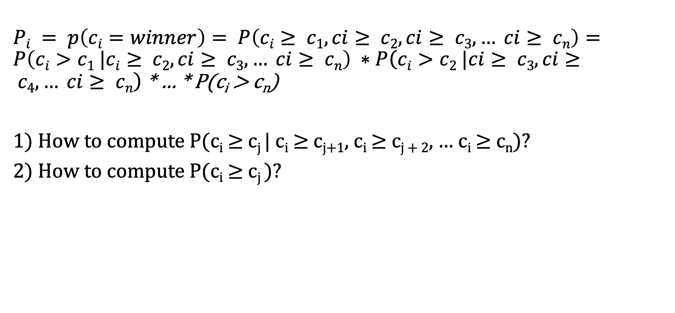
Probability modeling
$Pi = p\left(ci=winner\right)= P\left(ci≥ c1, ci≥ c2, ci≥ c3, … ci≥ cn\right)=P\left(ci>c1 |ci≥ c2, ci≥ c3, … ci≥ cn\right) ∗P\left(ci>c2 |ci≥ c3, ci≥ c4, … ci≥ cn\right)$ * … * P(c_{i} > c_{n})
1) How to compute P(c_{i} $≥$ c_{j} | c_{i} $≥$ c_{j+1}, c_{i} $≥$ c_{j + 2}, … c_{i} $≥$ c_{n})?
2) How to compute P(c_{i} $≥$ c_{j} )?

Slide 25
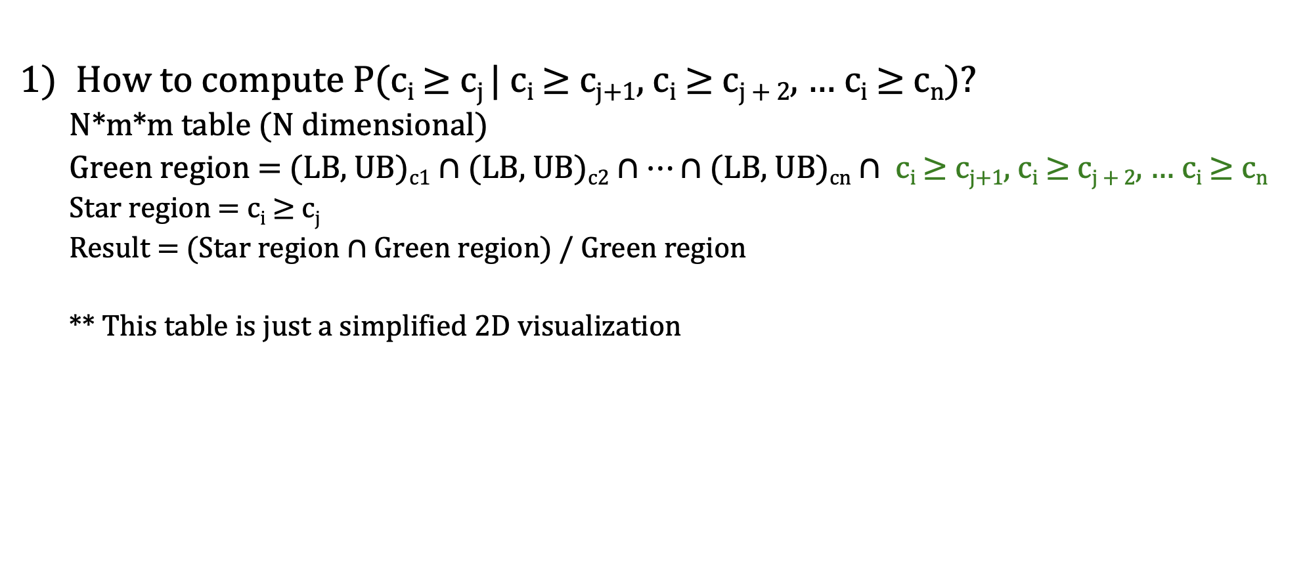
Entropy
How to compute P(c_{i} $≥$ c_{j} | c_{i} $≥$ c_{j+1}, c_{i} $≥$ c_{j + 2}, … c_{i} $≥$ c_{n})?
N*m*m table (N dimensional)
Green region = (LB, UB)_{c1} $∩$(LB, UB)_{c2} $∩…∩\text{(}\text{LB}\text{, }\text{UB}\text{)}\text{c}\text{n}$ $∩$ c_{i} $≥$ c_{j+1}, c_{i} $≥$ c_{j + 2}, … c_{i} $≥$ c_{n}
Star region = c_{i} $≥$ c_{j}
Result = (Star region $∩$ Green region) / Green region
** This table is just a simplified 2D visualization
C2
C1
 | 0.5 | 1 | 1.5 | 2
0.5 | *
1 | * | *
1.5 | * | * | *
2 | * | * | * | *
P = 0.88

Slide 26
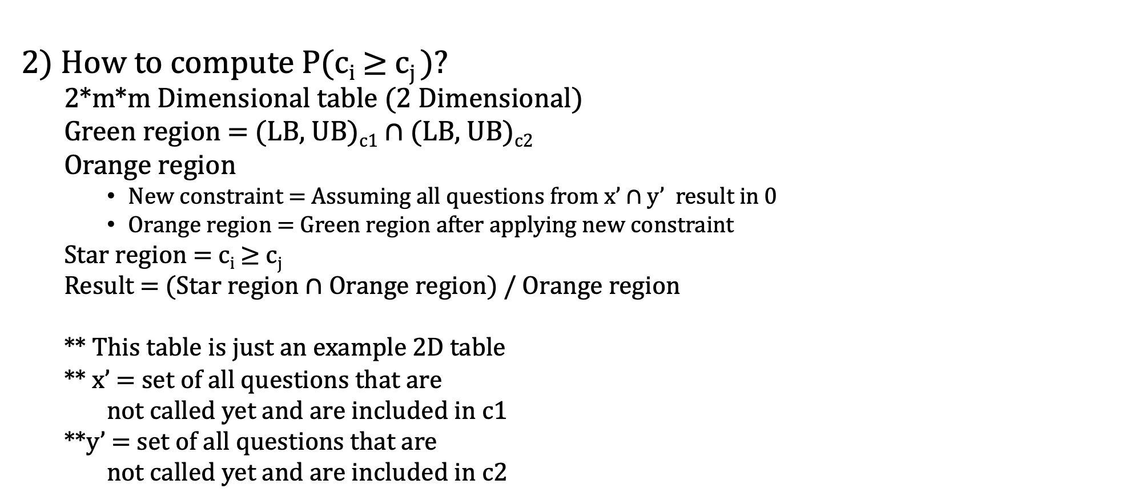
Entropy
2) How to compute P(c_{i} $≥$ c_{j} )?
2*m*m Dimensional table (2 Dimensional)
Green region = (LB, UB)_{c1} $∩$(LB, UB)_{c2}
Orange region
New constraint = Assuming all questions from x’ $∩$ y’ result in 0
Orange region = Green region after applying new constraint
Star region = c_{i} $≥$ c_{j}
Result = (Star region $∩$ Orange region) / Orange region
** This table is just an example 2D table
** x’ = set of all questions that are
not called yet and are included in c1
**y’ = set of all questions that are
not called yet and are included in c2
C2
P = 1
C1
 | 0.5 | 1 | 1.5 | 2
0.5 | *
1 | * | *
1.5 | * | * | *
2 | * | * | * | *

Slide 27
Results

Slide 28

Description
Algorithms
Exact baseline: does all LLM calls, computes exact scores and select the max
Naïve: does all LLM calls, uses them one by one to adjust bounds, and selects the remaining one
Min Uncertainty: In an iterative process, decides which LLM call to do next, updates bounds, and repeats it till the winner is clear.
Lowest Overlap: Choose a candidate where LB has the lowest overlap with the UB of others + largest non-overlapping area
Inside a candidate, it chooses the tuple based on Min Uncertainty approach (Heuristic 1)
LLM calls
Actual calls using Langchain
Mocked tables (test purposes)
Metrics
Time (duration)
Cost (LLM calls)
Quality (correct solution)
Entropy
Dataset
Hotel reviews (code implemented – not executed yet)
Mocked api calls

Slide 29
Cost
Lowest overlap < Min_Uncertainty < Naïve = Baseline
10 < 20 < 28 < 28 24 < 25 < 28 < 28
8 < 18 < 28 < 28
Time
Mocked tables
Lowest overlap > Min Uncertainty > Baseline > Naïve
Actual LLMs
Min Uncertainty = Lowest overlap < Naive < Baseline
Entropy
The entropy over time ends with zero for all Lowest overlap, min uncertainty, and naïve
The entropy over time is not monotonic for any of them
Quality
Mocked tables
Min Uncertainty = Baseline = Naïve = Lowest Overlap
Actual LLMs
No guarantee, but we expect to be still equal
Second type of uncertainty
Make use of Langchain to reduce that

Slide 30
Next steps:
Probability implementation
Discrete with the independence assumption
Generate discrete values for LLM/fake APIs
Actual dataset
Be able to run with hotel dataset
Implement a few ranking functions
Ranking functions:
MMR
GMM https://link.springer.com/article/10.1007/s00778-022-00770-0

Slide 31
Meeting September 23

Slide 32
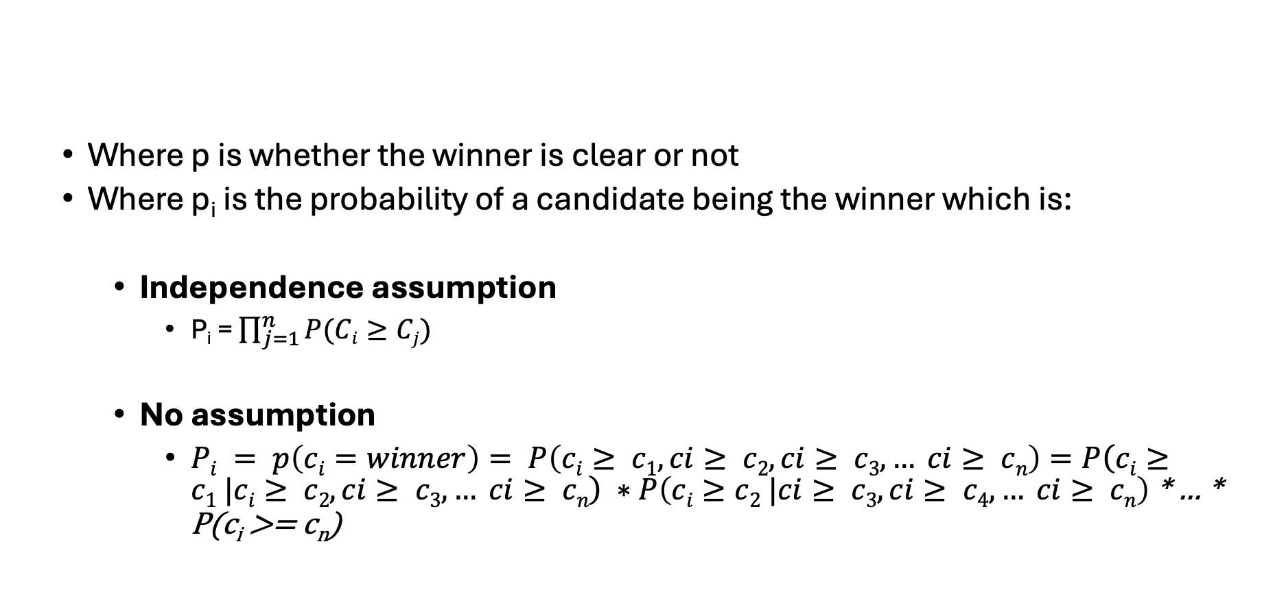
Uncertainty
Where p is whether the winner is clear or not
Where p_{i} is the probability of a candidate being the winner which is:
Independence assumption
P_{i} = $\prod_{j=1}^{n}{P(Ci≥Cj)}$
No assumption
$Pi = p\left(ci=winner\right)= P\left(ci≥ c1, ci≥ c2, ci≥ c3, … ci≥ cn\right)=P\left(ci≥c1 |ci≥ c2, ci≥ c3, … ci≥ cn\right) ∗P\left(ci≥c2 |ci≥ c3, ci≥ c4, … ci≥ cn\right)$ * … * P(c_{i} >= c_{n})

Slide 33
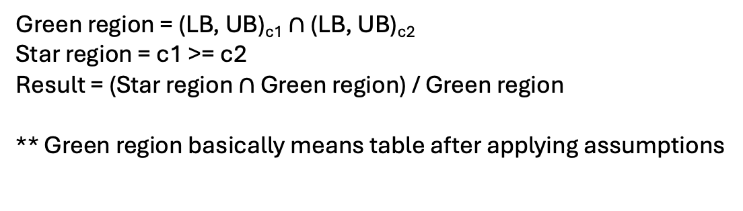
Example: Entropy with Independence assumption
C2 = (0.5, 1.5)
 | 0.5 | 1 | 1.5 | 2
0.5 | *
1 | * | *
1.5 | * | * | *
2 | * | * | * | *
C1 = (1, 2)
P(c1 >= c2) = 8 / 9
Green region = (LB, UB)_{c1} $∩$(LB, UB)_{c2}
Star region = c1 >= c2
Result = (Star region $∩$ Green region) / Green region
** Green region basically means table after applying assumptions

Slide 34
Example – Entropy with no assumption
How to compute P(c_{i} $≥$ c_{j} | c_{i} $≥$ c_{j+1}, c_{i} $≥$ c_{j + 2}, … c_{i} $≥$ c_{n})?
N*m*m table (N dimensional)
Green region = (LB, UB)_{c1} $∩$(LB, UB)_{c2} $∩…∩\text{(}\text{LB}\text{, }\text{UB}\text{)}\text{c}\text{n}$ $∩$ c_{i} $≥$ c_{j+1}, c_{i} $≥$ c_{j + 2}, … c_{i} $≥$ c_{n}
Star region = c_{i} $≥$ c_{j}
Result = (Star region $∩$ Green region) / Green region
** This table is just a simplified 2D visualization
C2
C1
 | 0.5 | 1 | 1.5 | 2
0.5 | *
1 | * | *
1.5 | * | * | *
2 | * | * | * | *

Slide 35
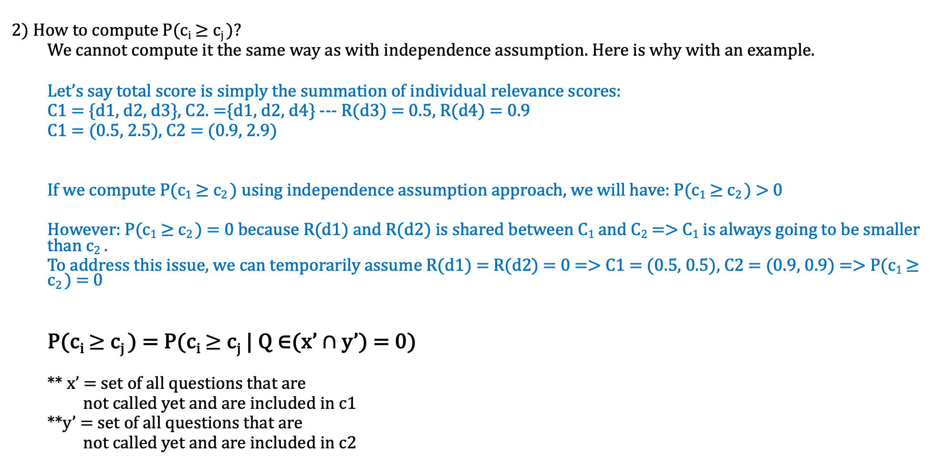
Example - Entropy with no assumption
2) How to compute P(c_{i} $≥$ c_{j} )?
We cannot compute it the same way as with independence assumption. Here is why with an example.
Let’s say total score is simply the summation of individual relevance scores:
C1 = {d1, d2, d3}, C2. ={d1, d2, d4} --- R(d3) = 0.5, R(d4) = 0.9
C1 = (0.5, 2.5), C2 = (0.9, 2.9)
If we compute P(c₁ $≥$ c₂ ) using independence assumption approach, we will have: P(c₁ $≥$ c₂ ) > 0
However: P(c₁ $≥$ c₂ ) = 0 because R(d1) and R(d2) is shared between C₁ and C₂ => C₁ is always going to be smaller than c₂ .
To address this issue, we can temporarily assume R(d1) = R(d2) = 0 => C1 = (0.5, 0.5), C2 = (0.9, 0.9) => P(c₁ $≥$ c₂ ) = 0
P(c_{i} $≥$ c_{j} ) = P(c_{i} $≥$ c_{j} | Q ∈(x’ $∩$ y’) = 0)
** x’ = set of all questions that are
not called yet and are included in c1
**y’ = set of all questions that are
not called yet and are included in c2

Slide 36
Example - Entropy with no assumption
2) How to compute P(c_{i} $≥$ c_{j} )?
2*m*m Dimensional table (2 Dimensional)
Green region = (LB, UB)_{c1} $∩$(LB, UB)_{c2}
Orange region
New constraint = Assuming all questions from x’ $∩$ y’ result in 0
Orange region = Green region after applying new constraint
Star region = c_{i} $≥$ c_{j}
Result = (Star region $∩$ Orange region) / Orange region
** This table is just an example 2D table
** x’ = set of all questions that are
not called yet and are included in c1
**y’ = set of all questions that are
not called yet and are included in c2
C2
P = 1
C1
 | 0.5 | 1 | 1.5 | 2
0.5 | *
1 | * | *
1.5 | * | * | *
2 | * | * | * | *

Slide 37

Algorithms
T = set of all possible questions = set of all cells in all tables (R and D)
Exact baseline: does all LLM calls, computes exact scores and select the max
$∀Q∈T$=> LLM(Q)
$winner = argmaxc$ $Compute_exact_score(c)$
Naïve: does all LLM calls, uses them one by one to adjust bounds, and selects the remaining one
$∀Q∈T:$
$result=LLM(Q)$
$bounds=update_bounds(bounds, result)$
$winner = argmaxc$ $bounds$
3-4. Heuristics: In an iterative process, decides which LLM call to do next, updates bounds, prunes, and repeats it till the winner is clear.
$repeat until winner is clear:$
$Q=select_next_question(T)$
$result=LLM(Q)$
$bounds=update_bounds(bounds, result)$
$C= prune_candidate(C, bounds)$
$$return winner$$

Slide 38
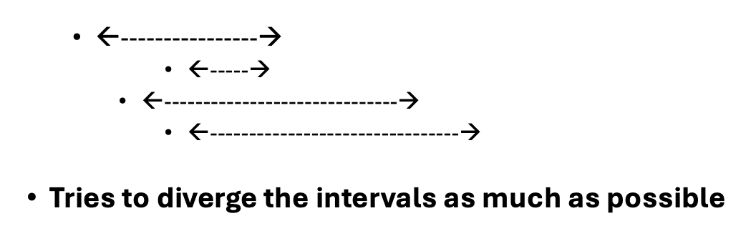

Algorithms
Min Uncertainty: chooses the question that has the most participation in the overlapping intervals of the candidates
$for each Q∈T:$
$for each candidate c that has Q:$
$ScoreQ+=\sum_{c′}{overlap(c, c^{′})}$
$chosen candidate=argmaxQ Score$

Slide 39
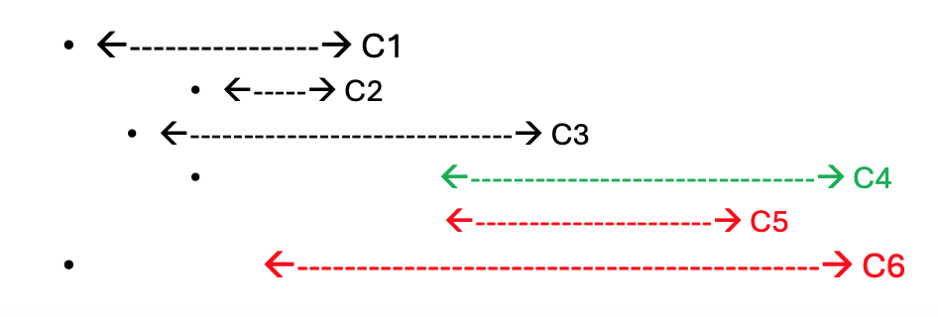

Algorithms
Lowest Overlap:
Choose a candidate where LB_{c} has the lowest overlap with the UB of others + largest non-overlapping area
After choosing a candidate, it chooses a tuple of that candidate based on Min Uncertainty approach (Algorithm 3)
$c= argmaxc \left(UBc −\max\left(UBC^{′}\right)\right)+(\left(LBc −\max\left(UBC^{′}\right)\right)$
$$for each Q∈C:$$
$for each candidate c′ that has Q:$
$ScoreQ+= \sum_{c′′}{overlap(c′, c^{′′})}$
$$chosen candidate=argmaxQ Score$$

Slide 40
Implementation
LLM calls
Actual calls using Langchain
Mocked tables (test purposes)
Metrics
Time (duration)
Cost (LLM calls)
Quality (correct solution)
Entropy
Dataset
Hotel reviews
Mocked API calls
NOTE1: We have assumed the scores obtained by LLMS (or fake APIs) are discrete values. This helps us to be able to use the probability computation of our slides in our code.
NOTE2: The entropy (probabilities) computation is not used in any of the algorithms directly, and the entropy is just being reported. Hence, for efficiency purposes, we might want to skip it on actual datasets?

Slide 41
Cost
Lowest overlap < Min_Uncertainty < Naïve = Baseline --- No. LLM Calls (n = 8, k = 3):
10 < 20 < 28 < 28 24 < 25 < 28 < 28
8 < 18 < 28 < 28
Time
Mocked tables
Lowest overlap > Min Uncertainty > Baseline > Naïve
Actual LLMs
Lowest overlap <= Lowest overlap < Naive < Baseline
Entropy
The entropy over time ends with zero for all Lowest overlap, min uncertainty, and naïve
The entropy over time is not monotonic for any of them
Quality
Mocked tables
Min Uncertainty = Baseline = Naïve = Lowest Overlap
Actual LLMs
No guarantee, but we expect to be still equal
Second type of uncertainty
Make use of Langchain to reduce that

Slide 42
Experiment – Hotel reviews dataset
N = 6, k = 3 | Best candidate | Time (s) | API Calls
Exact Baseline | 0, 1, 2 | 41 | 15
Naive | 0, 1, 5 | 38 | 15
Min Uncertainty | 0, 1, 5 | 14 | 11
Lowest Overlap | 0, 2, 5 | 10 | 8

Slide 43
Top-K Set vs Top-K Ranking
So far, we are doing top-k Set
Top-k Ranking:
Challenge
In top-k set => nCk candidates
In top-k ranking => (nCk)! Which is extremely numerous
Solution
Keep nCk candidates
Find top-k set
Use LLM to sort them
Use new type of question from LLM (d1 vs d2)
We need further assumptions (e.g. Transitivity: if d1 > d2 and d2 > d3 => d1 > 3 doesn’t need to be asked)

Slide 44
Write Paper
Leverage llms to retrieve answers
What is a question to the llm?
Data model: records + documents + query + scoring function
Top-k set vs top-k ranking
Interaction model
llm returns exact score to question
Given two pairs to llm, which one is better?
LLM return score a score range
Goal: calls to llm is expensive, and goal is to take a ranking function and use oracles s.t they return same answer with the case of naïve approach calling all questions
Which question to ask?
Next single question VS Next K quesitons

Slide 45
Next steps:
Probability implementation
Discrete with the independence assumption
Generate discrete values for LLM/fake APIs
Actual dataset
Be able to run with hotel dataset
Implement a few ranking functions
Ranking functions:
MMR
GMM https://link.springer.com/article/10.1007/s00778-022-00770-0

