Slide 1
Kdump
Kernel-Dump: A crash dump mechanism for Linux
Sohum Shah
121056

Slide 2
Overview
A “new” kernel, is booted after the previous kernel crashes.
Previous kernel's memory is preserved.
Kernel-to-kernel boot loader enables booting a new kernel after a crash.
Kexec is the currently used boot loader.
Dump is exported as an Executable and Linkable Format (ELF) object, which can be accessed though /proc/vmcore
It can be automatically saved to a locally accessible file system or any other devices attached to the OS.

Slide 3
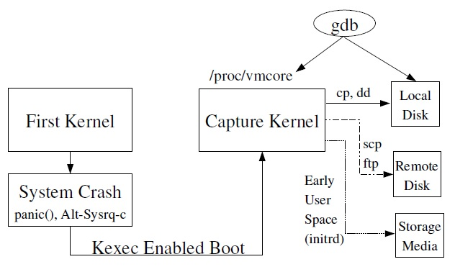
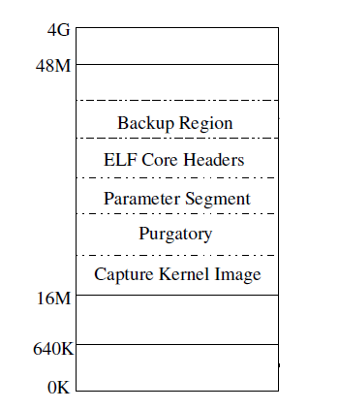
Overview
Currently available on i386, x86_64 and ppc64 platforms.
Fixed memory for storing Capture kernel and for booting as shown in figure:
First 640K of memory is required for booting SMP capture kernel (i386)
Contents of first 640K of memory are backed up in Backup Region
Purgatory contains the code for backing up first 640K of memory after crash.
ELF core headers stores the ELF object headers and parameters.

Slide 4
Kexec
Running kernel acts as a loader for the new kernel
System directly jumps from one kernel to another: Skips BIOS or Firmware stage
Reboots are extremely fast (33% reduction in time)
Memory can be preserved across reboots: Since BIOS is skipped, it is left to the OS to retain or erase memory.
Load a new kernel : kexec -l <kernelimage> append=<options>
Execute: kexec -e

Slide 5
Panic()
Enables booting a new kernel after system crash
Devices are not shutdown
New kernel runs from a reserved memory location: Protection against ongoing DMA at the time of crash.
Loading capture kernel: kexec p <kernelimage> append=<options>
Execution of capture kernel: panic() ( or AltSysrqc)

Slide 6
Advantages
Limitations
Increased reliability:
Dump is captured from a newly booted kernel
Enhanced flexibility:
Dump image can be saved to virtually any storage media supported by kernel.
Ease of use:
Standard utilities can be used to save the dump image either locally or remotely.
Standard analysis tools like gdb can be directly used for limited debugging.
Devices are not shutdown/reset after a crash which might result in a driver initialization failure in capture kernel
Non-disruptive dumping is not possible.

Slide 7
Current Scenario
Kdump functionality, together with kexec, was merged into the Linux kernel mainline (2.6.13)
Driver initialization issues are being addressed
Various patches have been updated to this functionality, various add-on services appended.
Analysis tools
GDB : Virtual view of memory dump
Debugfs – a Linux kernel's RAM-based file system specifically designed for debugging purposes
Crash: Physical view of memory

Slide 8
References
http://en.wikipedia.org/wiki/Kdump_(Linux)
http://en.wikipedia.org/wiki/Kernel_panic
http://lse.sourceforge.net/kdump/documentation/ols2005-kdump-presentation.pdf
http://www.dedoimedo.com/computers/kdump.html#mozTocId967714
http://lse.sourceforge.net/kdump/

