Slide 1
Page Replacement Algorithm (Linux kernel 2.4.23)
-Rujuta Shah(121044)
Sohum Shah (121056)

Slide 2
Why Page Replacement
Page Fault
Main memory Full

Slide 3
Existing Algorithms
First in First out
Least Recently Used
Not frequently used
Clock Policy
Optimal

Slide 4
Performance measures of Algorithm
Efficiency
Allocating a fixed memory to each process
Limiting a fixed memory to each process

Slide 5
Page replacement to Page frame Reclamation
To reduce I/O read and write times.
To prevent CPU from wasting time behind I/O
To ensure a fixed number of free pages in RAM.

Slide 6
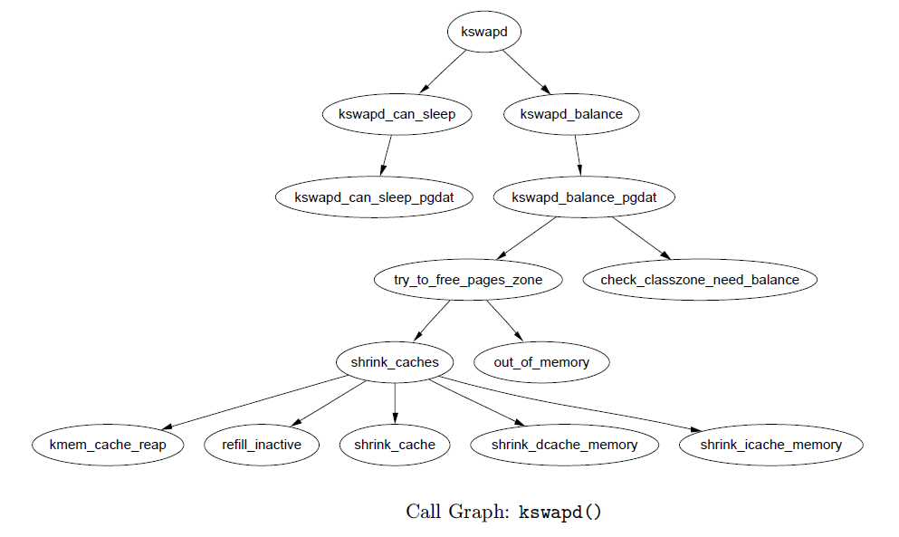
Kswapd
A kernel thread: initialized on boot.
Sleeps when number of free pages are high
If nr_pages > nr_ high : kswapd wakes up
Checks zones in memory to free pages.

Slide 7
Other important functions
add_to_page_cache
lru_cache_add
lru_cache_del
mark_page_accessed
activate_page

Slide 8
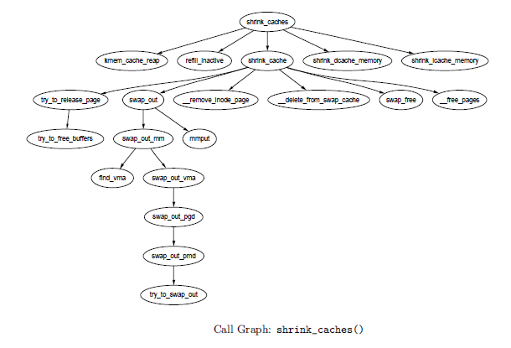
Shrink_cache

Slide 9
Analysis

Slide 10
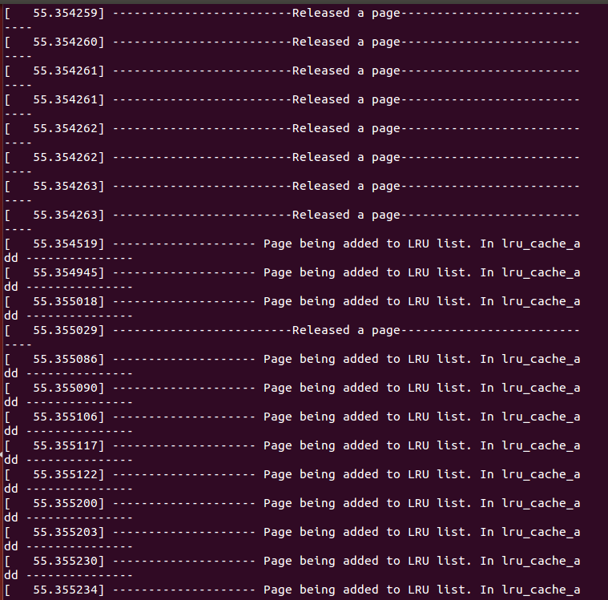
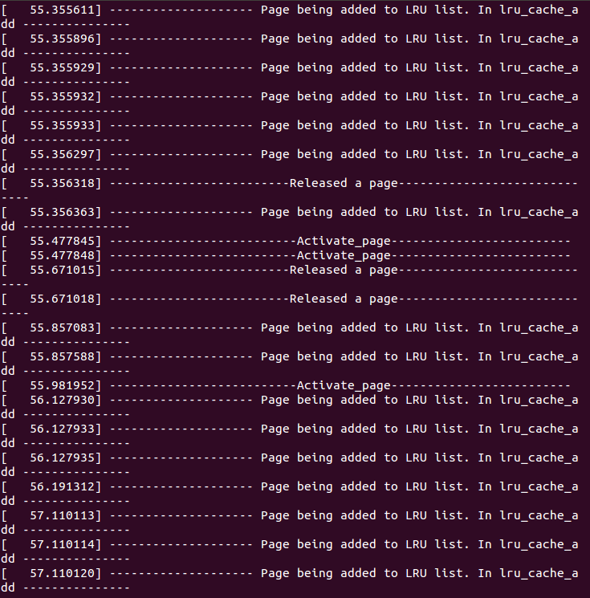
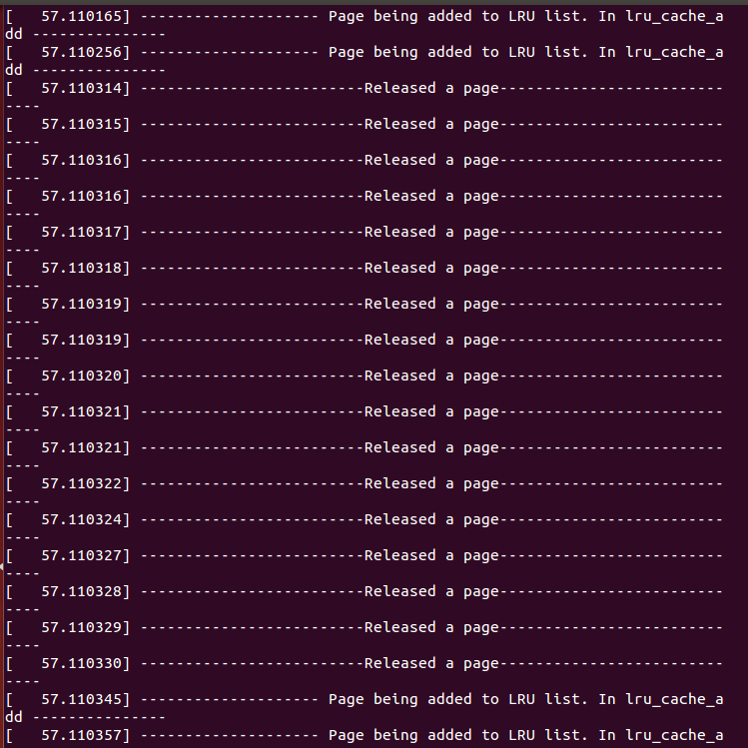

Slide 11
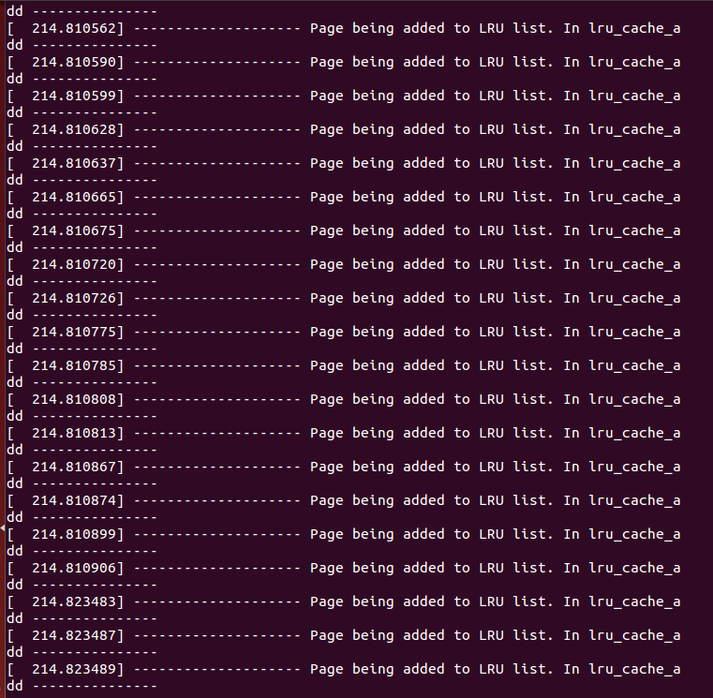
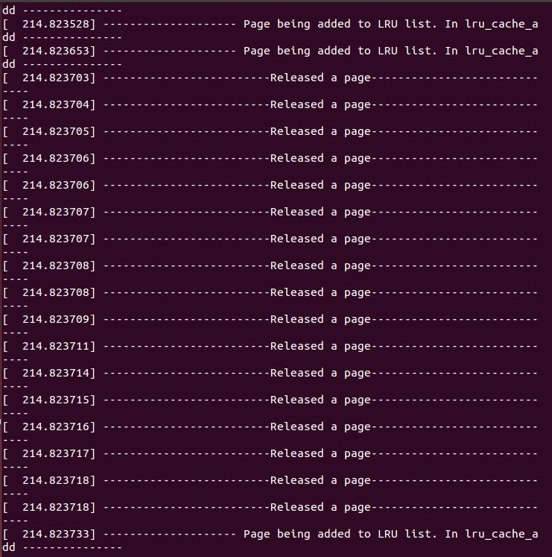
Libre Office Writer

Slide 12
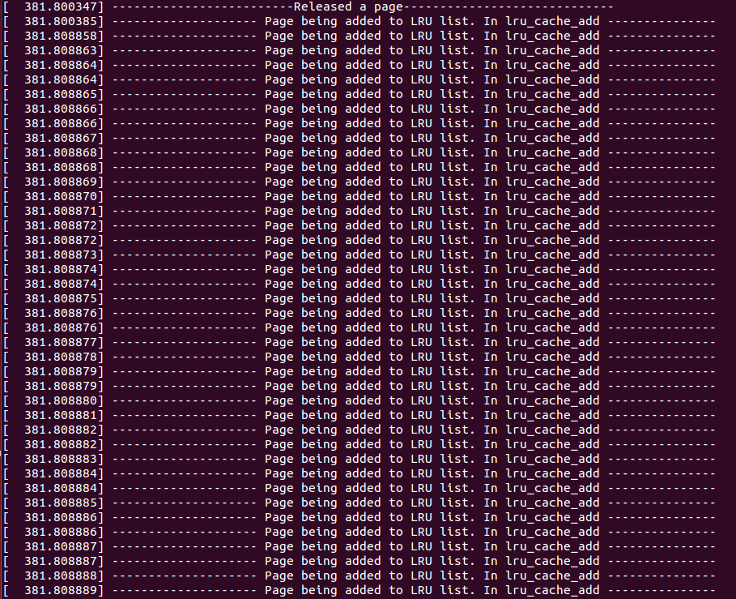
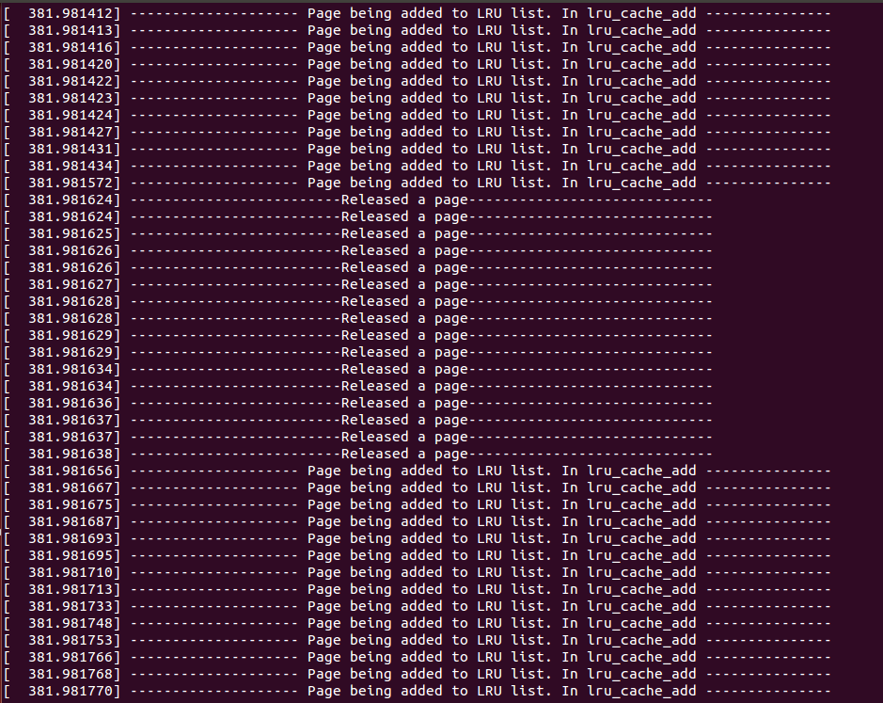
Mozilla Firefox

Slide 13
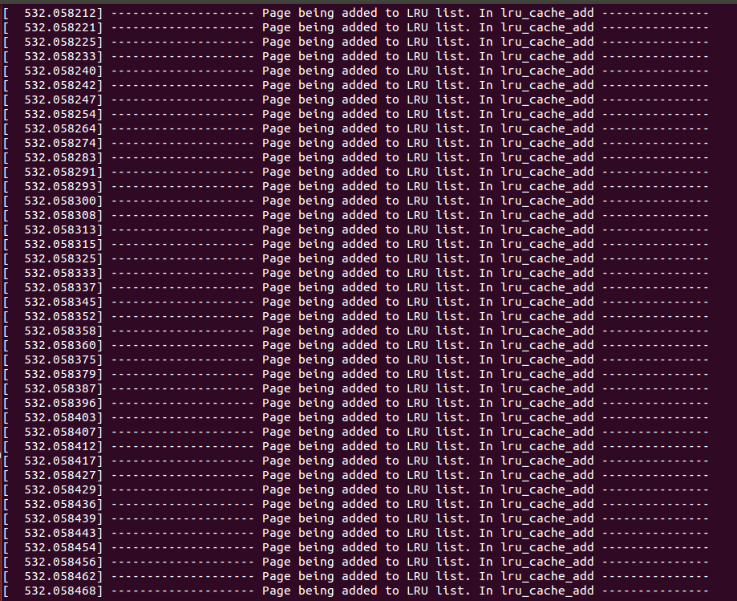
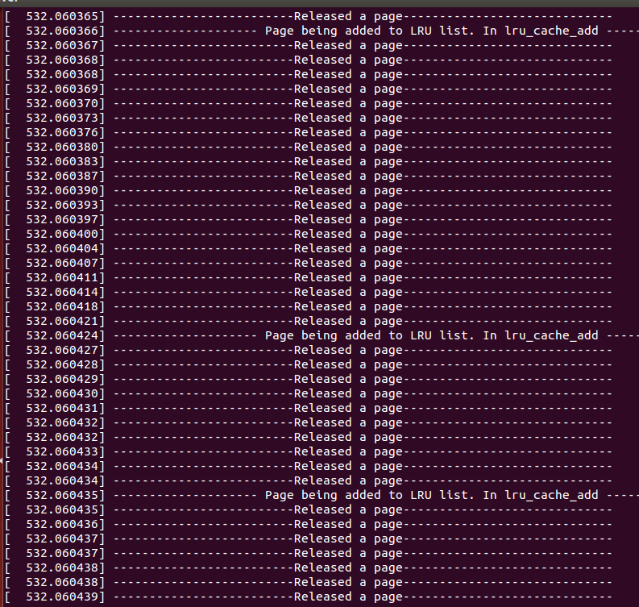
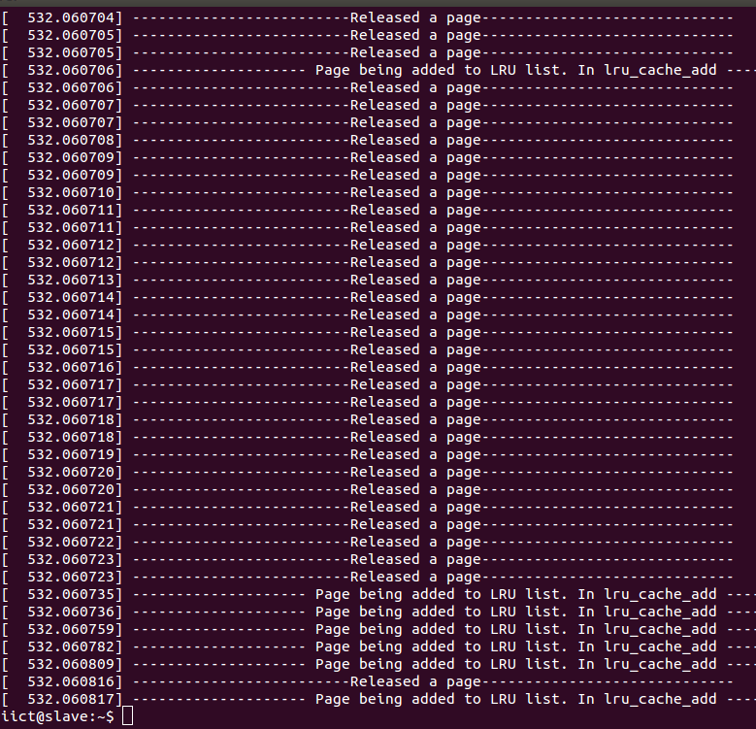
Ubuntu Software Centre

Slide 14
Thank You

