Slide 1
QuickShip: A Smart Courier Management System
Submitted by
Bibusa Shrestha
Soichchha Khadka

Slide 2
Introduction
QuickShip is a web-based courier management system.
It connects customers, delivery staff, and administrators.
It manages parcel booking, payment, tracking, delivery, and reports

Slide 3
Problem Statement
Manual courier processes are time-consuming.
Customers have limited parcel tracking visibility.
Staff assignment and delivery updates are difficult to manage.
Payment and delivery records may be scattered

Slide 4
Objectives
Automate parcel booking and delivery management.
Calculate delivery cost automatically.
Provide QR-based parcel tracking.
Support online payment and cash on delivery.
Improve staff assignment and delivery monitoring.

Slide 5
Technology Used
Frontend: React.js, Vite, Tailwind CSS
Backend: Node.js and Express.js
Database: MySQL with Sequelize
Payment: eSewa and COD
Algorithms: Haversine, Weighted Scoring and Random Forest Algorithm

Slide 6
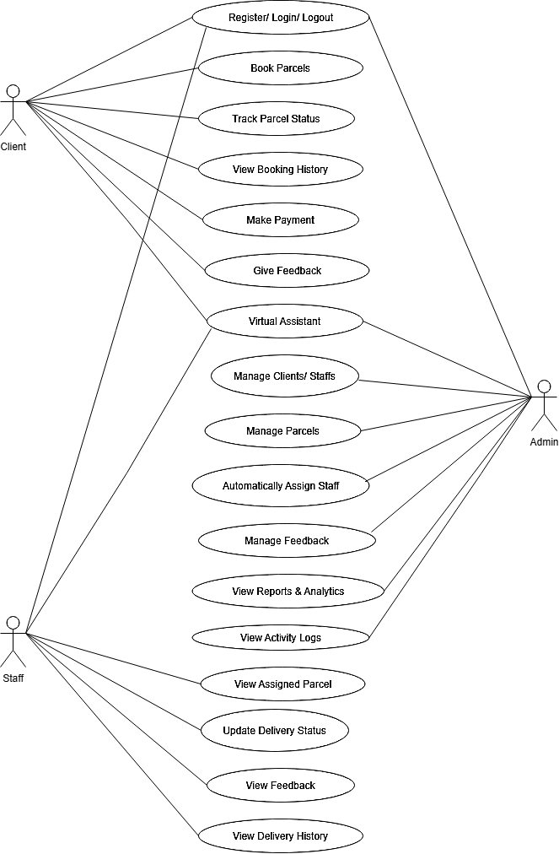
Case diagram

Slide 7
Algorithms Used
Haversine Formula: Calculates distance between locations.
Weighted Scoring Algorithm: Recommends suitable delivery staff.
Random Forest Algorithm: Predicts estimated delivery time.

Slide 8
Conclusion
QuickShip digitizes courier operations in one platform.
It improves booking, payment, tracking, and delivery monitoring.
It combines web technologies, QR tracking, and machine learning.
The system can be extended with real-time logistics features.

Slide 9
Future Enhancements
Real-time GPS tracking
Route optimization
SMS and push notifications
Improved ML accuracy with more data
Mobile application

Slide 10
Thank You !

