Slide 1


IMPACT OF INFLATION ON GOVERNMENT SPENDING IN BANGLADESH ECONOMY
CAUSE
IMPACT
TYPES
ABOUT
STRATEGIES
MEASURING
PRESENTED BY-
MD. Khaled Mahmud Saoun- 201002096
MD. Soikot Hossain -201002182
MD. Golam Mostafa-201002183
Obaydullah Khan-201002093

Slide 2
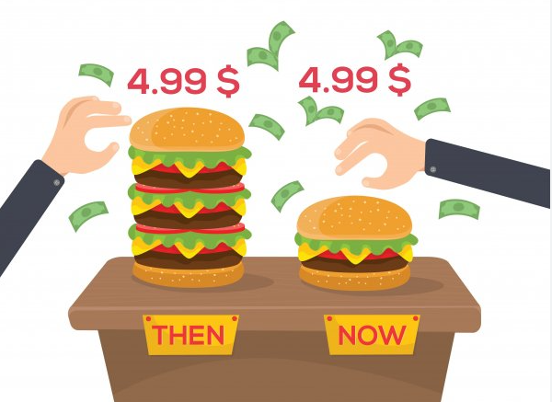
CAUSE
TYPES
IMPACT
ABOUT
STRATEGIES
MEASURING
WHAT IS INFLATION?

Slide 3



1
2
3
IMPACT
TYPES
INCREASE OF MONEY SUPPLY
RISING OF PRODUCTION COST
INCREASE IN GLOBAL COMMODITY PRICES
CAUSE
STRATEGIES
ABOUT
MEASURING

Slide 4


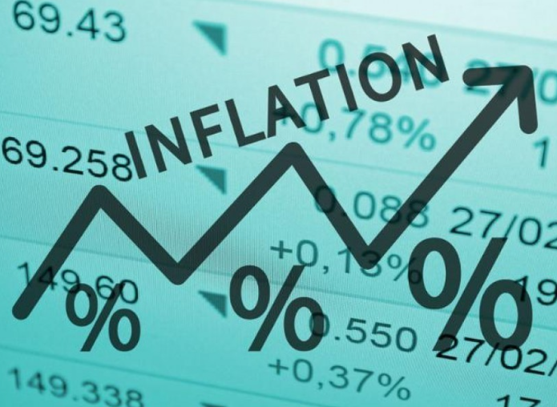
DEMAND PULL
COST-PUSH
STRUCTURAL
IMPACT
CAUSE
STRATEGIES
TYPES
ABOUT
MEASURING
12.5 Billion
34.13 Billion

Slide 5
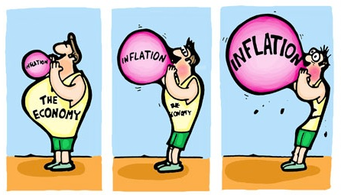
STRATEGIES
CAUSE
IMPACT
TYPES
ABOUT
MEASURING
MEASURING INFLATION

Slide 6


Reducing purchasing power
Economic instability
This Strategy will make our products more competitive in the world’s ready-made garments market.
The competitors of Bangladesh have regularly expanded their markets and keep changing their products by using fashion.
STRATEGIES
Difficult to save and invest
Slowing economic Growth
This Strategy will make our products more competitive in the world’s ready-made garments market.
IMPACT
HISTORY
TYPES
ABOUT
To survive in the world’s most competitive RMG market, we have to develop new product items with a lot of variations.
MEASURING
Affecting the distribution of wealth
Product Diversification Strategy is an important factor to keep the place in the world’s ready made garments market. Different types of products should be produced by applying fashion.

Slide 7
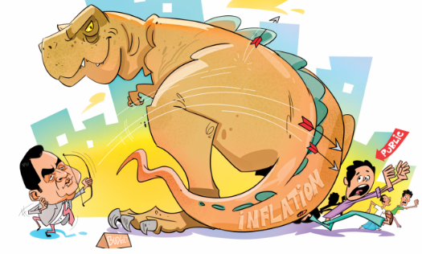
CAUSE
Top key
TYPES
ABOUT
MEASURING
STRATEGIES
STRATEGIES TO MANAGE INFLATION

Slide 8


