Slide 1

Employee Management System

Slide 2




TEAM UNITY
Md. Arafat Rahman
CSE06307434
Rishad Istiak Sachcha
CSE06307451
Saikat Hussain
CSE06307459

Slide 3
Objectives
interview questions
case diagram
data flow diagram
Information Gathering & Interview

Slide 4
For information gathering we have chosen three methods.
Interview
Questionnaires
Investigation

Slide 5
Interview Structure
Interview structure was Funnel type
6 open ended question in beginning.
3 close ended question after that.

Slide 6
Selection Of Interviewe
Interviewee

Slide 7
1.What kind of employees do you have in your company?
Ans: Many kinds of employees.like for consultancy,training,reception,cleaning.
2. How did you manage the Employees Management System at the beginning of the company?
Ans:
3. How do you currently manage the employees management system of the company?
Ans: Manage through an web app.
management system you have now?
Ans:
5. What features do you currently have with your software running the Employee
management System?
Ans: Attendance tracking,loan apply,salary withdrawal
6.Which adding key features will make your employee management system more convenient?
Ans: Its a private matter & businesss policy.so i can't reveal it.

Slide 8
Interview Question
8. Can the employee get the current information of the activity through the web?
Answer: No, currently we do not have that.
9. What method is used by the main branch to collect the information from the local branches?
Answer: It is an automated process. We collect the information on a monthly basis.
10. Which program of (company name) has the most employee?
Answer: Training

Slide 9
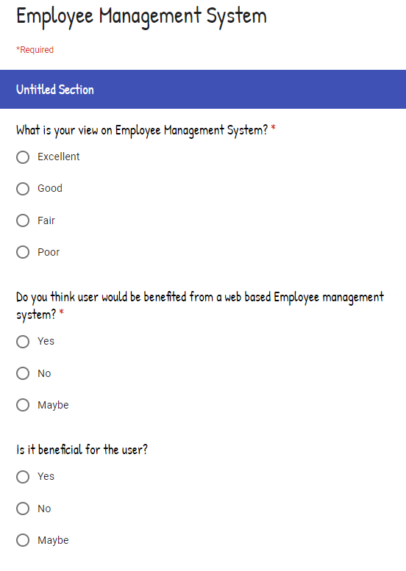
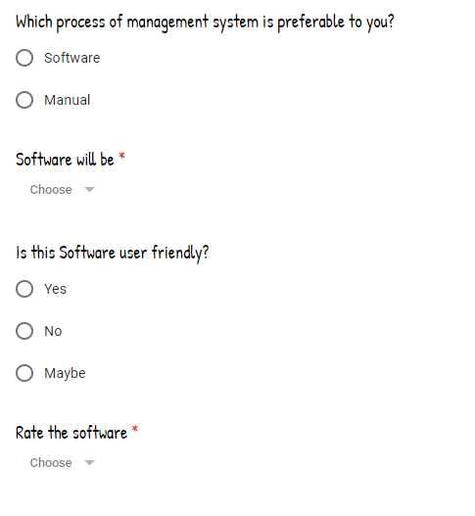
Questionnaires

Slide 10
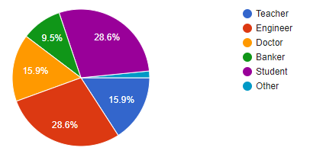
Count of Occupation
Questionnaires

Slide 11
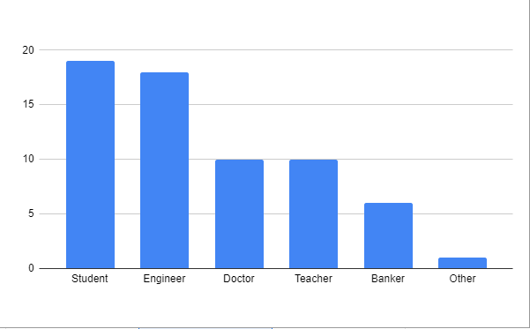
Count of Occupation
Questionnaires

Slide 12
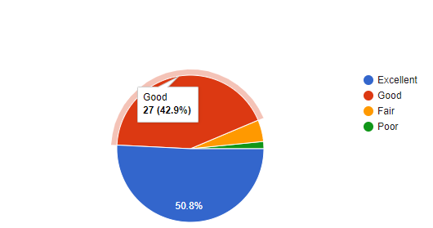
view on Employee Management System
Questionnaires

Slide 13
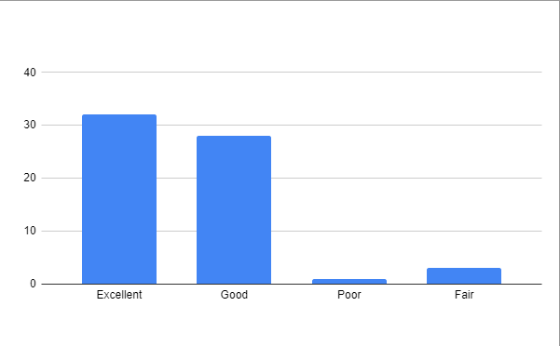
Count of view on employee management system
Questionnaires

Slide 14
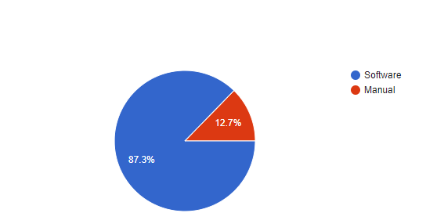
Which process of management system is preferable
Questionnaires

Slide 15
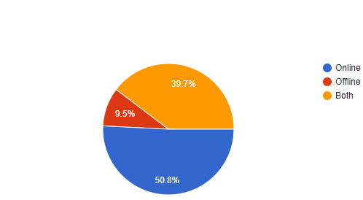
View on software will be
Questionnaires

Slide 16
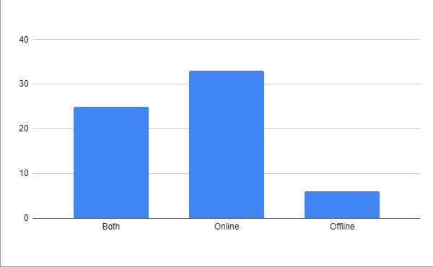
Count of software will be
Questionnaires

Slide 17
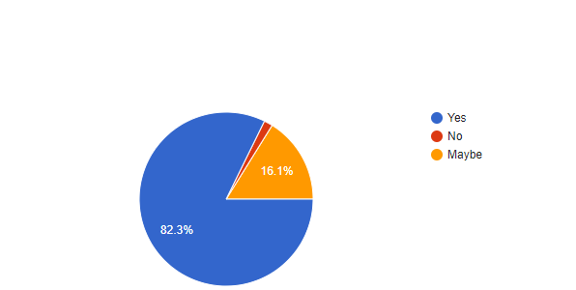
Benefite of Web Based Employee Management System
Questionnaires

Slide 18
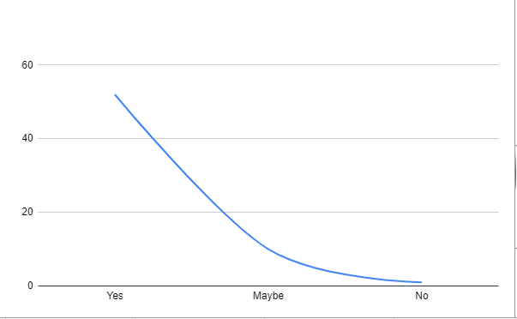
Count of Web Based Employee Management System
Questionnaires

Slide 19
Investigation
Top use of employee management system -
Business company
School
College
Hospital
93.5% agree that software base employee management system is effective.
87.3% agree that online base software management.

Slide 20




THANK YOU!
TEAM_UNITY
team_unity@example.com
678-555-0100

