Slide 1
(Zachos et al. 2008)
Notes:
Figure 1. Cores of ocean sediments offer a continuous record of indicators related to global climate. Here, the indicator is the ratio of two isotopes of oxygen found in the shells of ocean dwelling organisms. The wider the ratio, the cooler the temperature when the shells were formed. The y-axis on the left is that ratio, which is translated into relative temperature (on the right). The x-axis is time before present in millions of years. The global temperature was relatively high 50 million years ago and has become much cooler and more variable in the last 4 million years.
Zachos, J.C., G.R. Dickens and R.E. Zeebe 2008. An early Cenozoic perspective on greenhouse warming and carbon-cycle dynamics. Nature. 451:279-283.

Slide 2
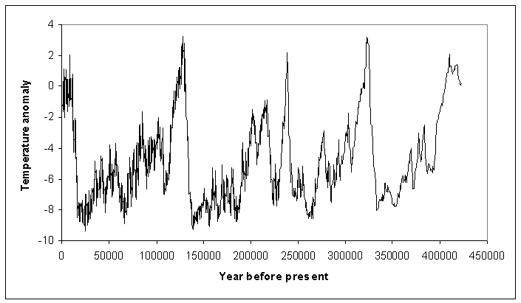
Figure 2. Last 4 glacial-interglacial cycles.
https://agwobserver.wordpress.com/2009/08/24/rising-carbon-dioxide-concentration-stops-the-glacialinterglacial-cycle/
Notes:
The data is from an ice core in Antarctica. The variation (degrees C) is an indicator of global climate change over the last 4 glacial-interglacial cycles.

Slide 3
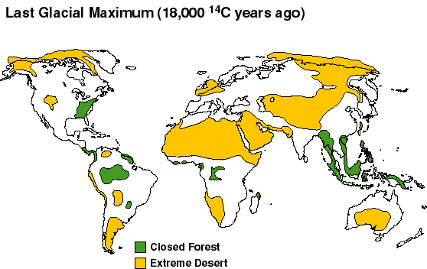
Figure 3. Simulated distribution of forests at the last glacial maximum.
http://www.esd.ornl.gov/projects/qen/lastgla.gif
Notes:
The reduction in forest area during the last glacial maximum period.

Slide 4
Figure 4. Indication of tree line shifts associated with cooling trend since the height of the current interglacial period(Lamb 1974).
Lamb 1974

