Slide 1
Leveraging Open-Source Data for Precision Agriculture Applications
Instructor: Andres Patrignani – Associate Professor in Soil Water Processes – Kansas State University
Teaching Assistant: Gabriel da Rocha Hintz – Graduate Research Assistant in Cropping Systems – Kansas State University
Precision Agriculture Systems Community
ASA-CSSA-SSSA Annual Meeting 2024 – San Antonio, TX

Slide 2
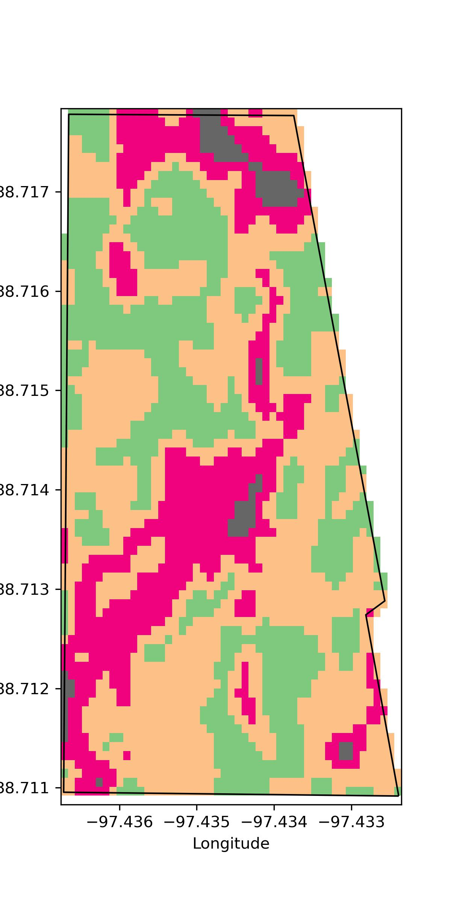
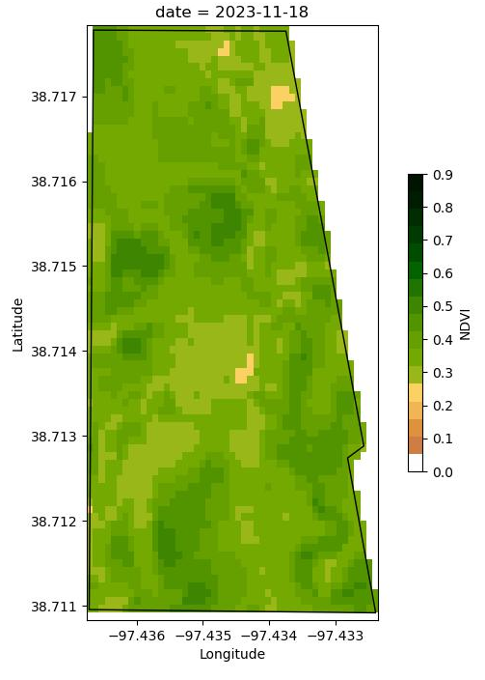
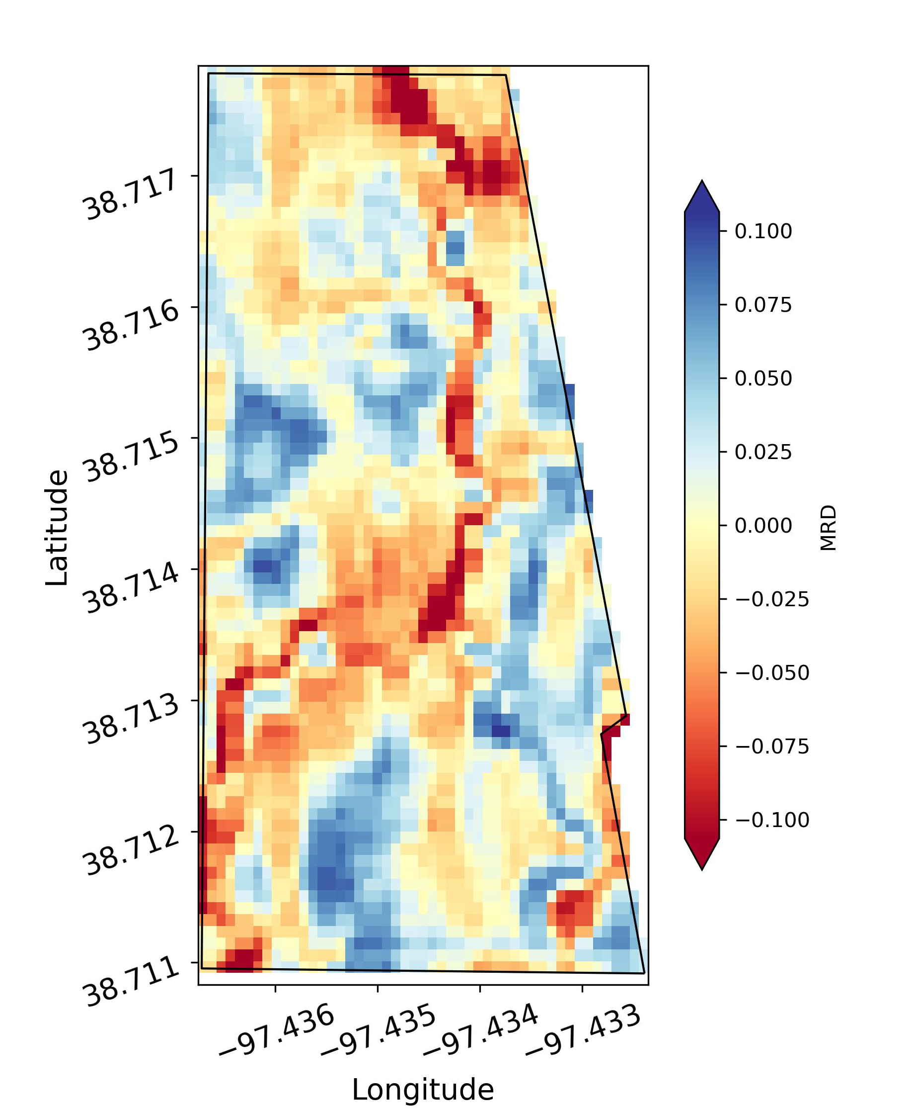
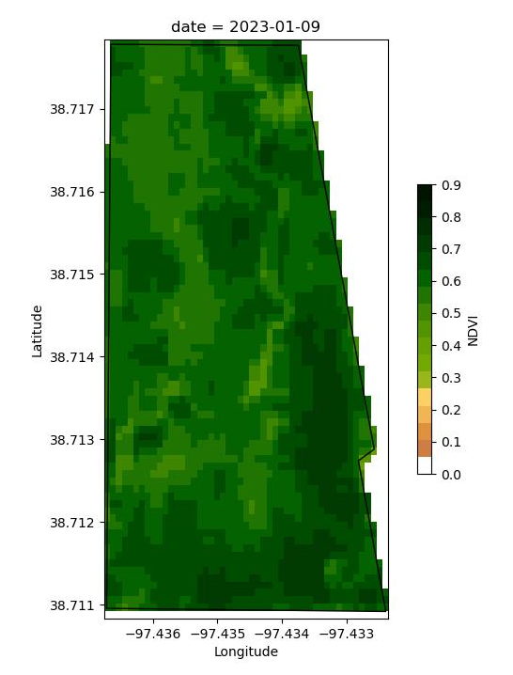
Roadmap for today
NDVI image from Sentinel 2
Normalize using the relative difference
Stack normalized images
Compute mean relative difference
Cluster using bisecting K-Means

