Slide 1
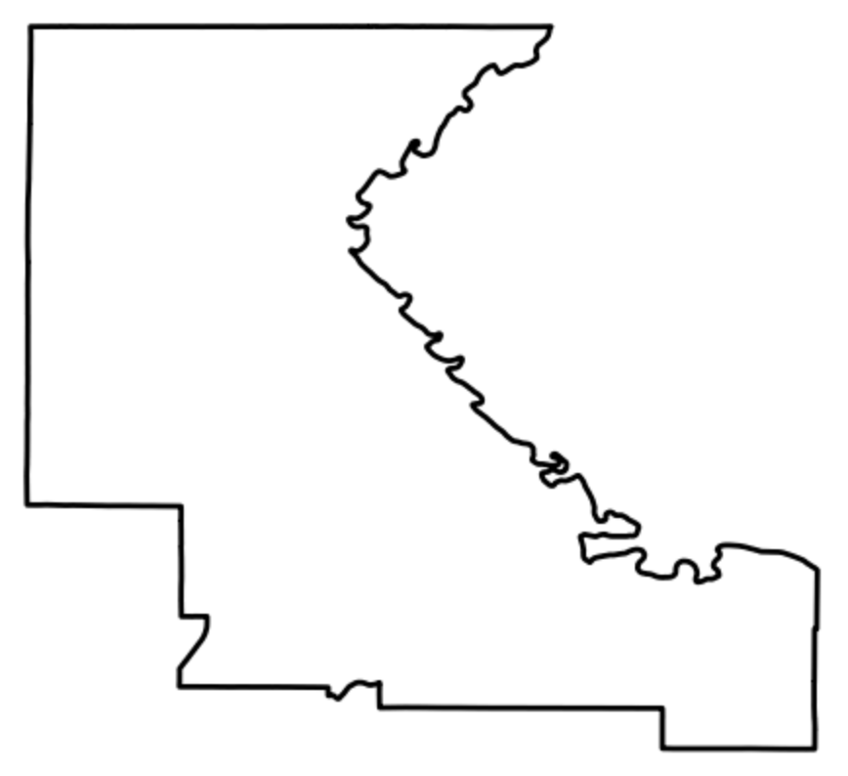
Riley County, KS
Geometry
{'type': 'Polygon',
'coordinates': [[[96.9617, 39.241],
[-96.961, 39.240], …
[-96.961, 39.238]]]
}
Feature
{'type': 'Feature'
'geometry': {'type': 'Polygon',
'coordinates': [[[96.9617, 39.241],
[-96.961, 39.240], …
[-96.961, 39.238]]]
},
'id': '09b1',
'properties': {'ALAND': 1579325910,
'AWATER': 31529484,
'COUNTYFP': '161',
'NAME': 'Riley',
'STATEFP': '20'}
}

Slide 2
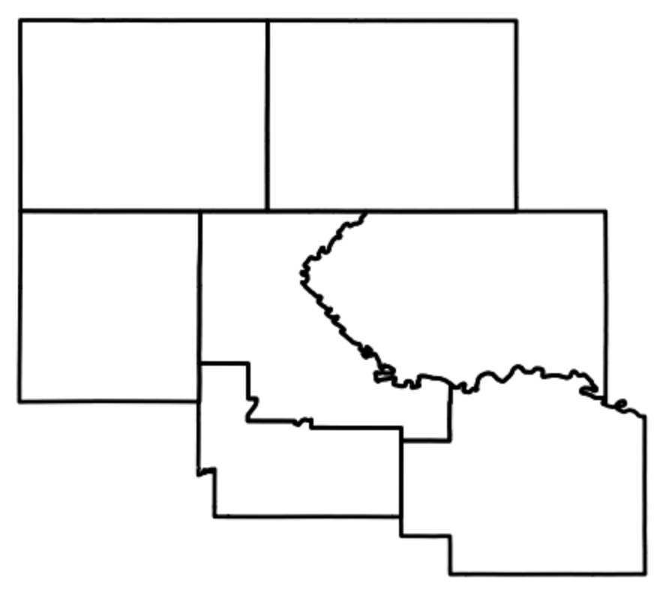
Riley County and surrounding counties
FeatureCollection
{'type': 'FeatureCollection',
'version': 1566851207937615,
'id': 'TIGER/2016/Counties',
'properties': {'description': 'Boundaries for primary
U.S. legal divisions.'
},
'features':[ {'type': 'Feature'
'geometry': {'type': 'Polygon',
'coordinates': [[[96.9617, 39.241],
[-96.961, 39.240], …
[-96.961, 39.238]]]
},
'id': '09b1',
'properties': {'ALAND': 1579325910,
'AWATER': 31529484,
'COUNTYFP': '161',
'NAME': 'Riley',
'STATEFP': '20'},
},
{ …. data for other counties }
]
}

Slide 3
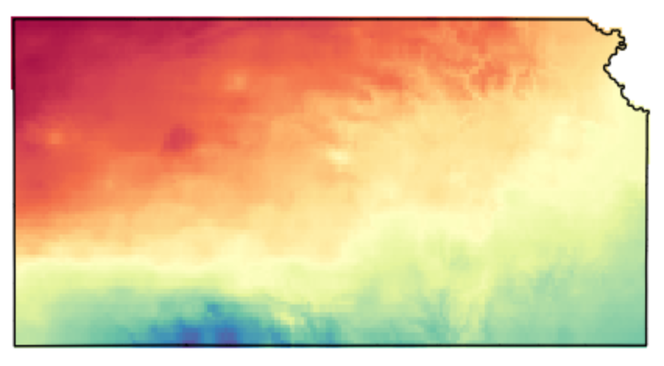
Kansas temperature on 2022-05-02
Image
{'type': 'Image',
'bands': [{'id': 'tmean',
'data_type': {'type': 'PixelType',
'precision': 'float'},
'dimensions': [1405, 621],
'crs': 'NAD83'},
'version': 1685653354797949,
'id': 'PRISM/AN81d/20220502'
]
}

Slide 4
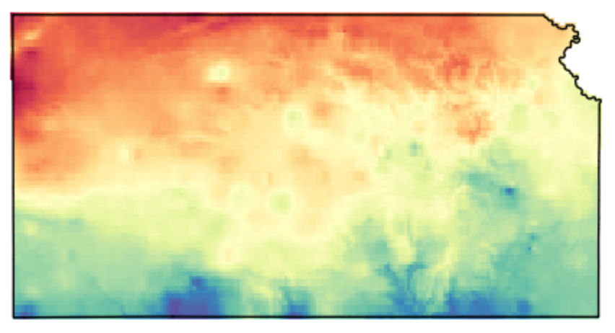
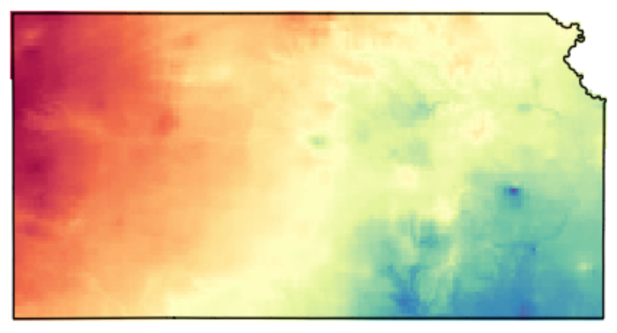
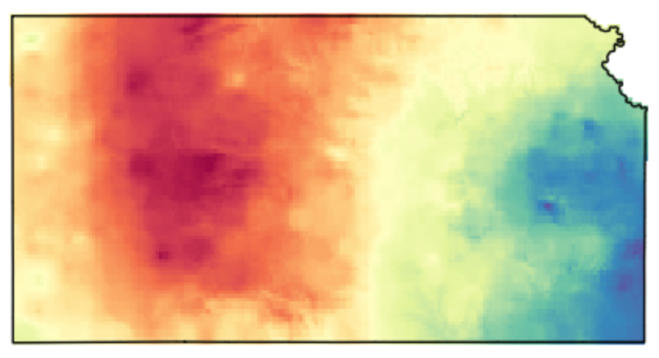
Kansas temperature from 2023-05-02 to 2023-05-05
ImageCollection
{'type': 'ImageCollection',
'bands': [],
'version': 1711112196093221,
'id': 'OREGONSTATE/PRISM/AN81d',
'features': [{'type': 'Image',
'bands': [{'id': 'tmean',
'data_type': {'type': 'PixelType',
'precision': 'float'},
'dimensions': [1405,621],
'crs': 'NAD83'},
'version': 1685653354797949,
'id': 'PRISM/AN81d/20220502'},
{'type': 'Image',
'bands': [{'id': 'tmean',
'data_type': {'type': 'PixelType',
'precision': 'float'},
'dimensions': [1405,621],
'crs': 'NAD83'},
'version': 1685653379099214,
'id': 'PRISM/AN81d/20220503'},
{ …. tmean data for other days },
]
}

