Slide 1

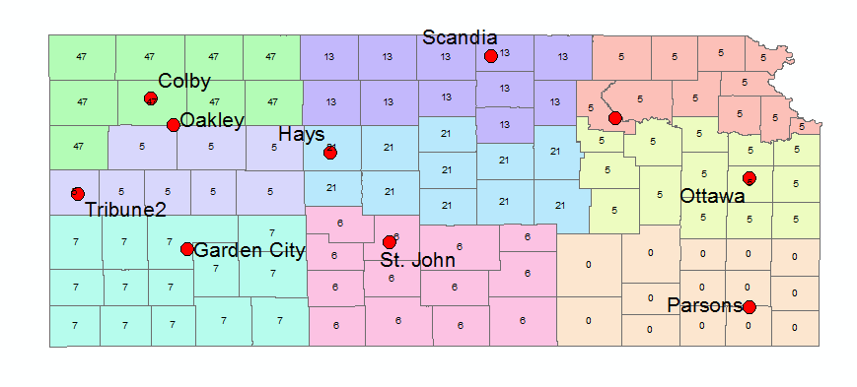

Determining the Zero-Degree Isotherm of Kansas Climate Divisions
Jacob Zortman², Jeremy Davidson¹, Andres Patrignani¹
¹Department of Agronomy, ²Department of Biological & Agricultural Engineering, Kansas State University
Background
Results
Discussion
The goal of this model is to help determine a better value of freezing depth that can be used throughout the state of Kansas. The current option is over estimated and can cost contractors more money.
Soil temperature is constantly changing. We can assume that the temperature at various depths in the soil oscillates according to a sinusoidal function in time around an average value [1].
Figure 2: Model at Three Kansas Mesonet locations
With this data model, excel was used to establish a well rounded temperature flux throughout each soil profile. In order to model each location the same, solver was used to calculate each parameter for temperature. While doing this we encountered error throughout the models due to temperature variations and due to data loss.
Another problem we ran into was the data accuracy leading to over exaggerations of freezing depths due to the inaccuracy of data collection. Some of these stations are old and their infrastructure is questionable.
Our model was limited by the ability to predict seasonal changes which led to an underestimation of soil freezing depth at many locations.
Objective
Determine the depth of the zero-degree isotherm for Kansas climate divisions using a sinusoidal function that describes the annual variations of soil temperature with depth.
Methodology
Model:
$T\left(z,t\right)=T_{ave}+A_{0} sin\left(ωt−\frac{z}{d}−φ_{0 }\right)e^{−z/d}$ [1]
Datasets
Daily air and soil temperatures, to a depth of 1m, were obtained from the weather stations of the National Oceanic and Atmospheric Administration (NOAA) in Manhattan, Kansas and Oakley, Kansas from 2009-2016.
For the climate divisions of Kansas, we obtained datasets from a Kansas mesonet station in each climate division of Kansas.
Development of the model was done using the datasets obtained from the NOAA stations. This allowed us to compare our model to observed data sets.
Figure 4: Model limitations: our model showed the average soil freezing depth of Parsons, Kansas to be 0cm. This is due to our limitations in accurately estimating seasonal changes.
Table 1: Model Parameters at Each Location
Division | Station ID | t0 | Tair ave | A0 | Dh | 5cm Error in ℃ | 10cm Error in ℃ | 20cm error | 50cm error | 100 cm error | depth cm | depth ft
1 | Colby | 49 | 11.11 | 13.64 | 0.045 | 3.4 | 3.3 | N/A | N/A | N/A | 47 | 1.542
1 | Oakley | 14.43 | 12.95 | 15.4 | 0.019 | N/A | 2.4 | 2.05 | 1.49 | 2.13 | 19 | 0.623
2 | Scandia | 49.4 | 11.60 | 14.43 | 0.004 | 4.4 | 3.5 | N/A | N/A | N/A | 13 | 0.426
3 | Manhattan | 6.3 | 13.27 | 13.88 | 0.013 | 3.1 | 2.8 | N/A | N/A | N/A | 5 | 0.164
4 | Tribune 6NE | 6.3 | 11.87 | 12.94 | 0.004 | 4.3 | 3.9 | N/A | N/A | N/A | 5 | 0.164
5 | Hays | 6.3 | 12.51 | 14.12 | 0.027 | 3.2 | 2.87 | N/A | N/A | N/A | 21 | 0.689
6 | Ottawa | 6.3 | 13.22 | 13.75 | 0.017 | 4 | 3.74 | N/A | N/A | N/A | 5 | 0.164
7 | Garden City | 6.4 | 12.29 | 12.72 | 0.040 | 4.8 | 4.7 | N/A | N/A | N/A | 7 | 0.230
8 | St. John | 6.3 | 13.21 | 13.87 | 0.016 | 2.8 | 2.6 | N/A | N/A | N/A | 6 | 0.197
9 | Parsons | 6.3 | 13.93 | 13.13 | 0.016 | 3 | 2.75 | N/A | N/A | N/A | 0 | 0.000
3 | NOAA MHK | 14.43 | 13.71 | 14.75 | 0.005 | N/A | 2.48 | 2.12 | 3.3 | 4.15 | 5 | 0.164
Conclusion
With this model, the zero degree isotherm of the Kansas climate divisions is being overestimated.
More data is needed to conduct a more comprehensive study to determine the zero degree isotherm.
Figure 1: How the model was developed:
Using data from NOAA, we could depict temperature modeled at deeper depths and compare them with temperature observations at those depths
Acknowledgments
Figure 3: Graphical representation of locations, and how freezing depth changes with climate division
Mary C. Knapp – Kansas State Climatologist
Kansas Mesonet
US Climate Reference Network (USCRN)
References
Introduction to Environmental Soil Physics by Daniel Hillel, Elsevier-Academic Press, New York, 2005. ISBN: 0-12-348655-6.
Nofziger and Wu. 2003. Soil temperature variations with time and depth. Available at: http://soilphysics.okstate.edu/software/SoilTemperature/document.pdf
deVries, D. A., 1963. Thermal Properties of Soils. In W.R. van Wijk (ed.) Physics of Plant Environment. North-Holland Publishing Company, Amsterdam.
Wu, J. and Nofziger, D.L., 1999. Incorporating temperature effects on pesticide degradation into a management model. Journal of Environmental Quality, 28(1), pp.92-100.

