Slide 1
Tracking with Online Appearance Model
Bohyung Han
bhhan@cs.umd.edu

Slide 2
Introduction
Tracking algorithm
  Deterministic: mean-shift
  Probabilistic: Condensation algorithm
Model template
  Fixed in most of tracking algorithms
  Requires to be updated for the robust tracking
  But, how?
Reference
  [1] A. Jepson, D. Fleet, T. El-Maraghi, “Robust Online Appearance Models for Visual Tracking,” CVPR 2001
  [2] S. Zhou, R. Chellappa, B. Moghaddam, “Appearance Tracking Using Adaptive Models in A Particle Filter,” ACCV 2004

Slide 3
Related Work
Adaptive color feature selection
  Stern and Efros
    choose 5 feature spaces (RG, rg, HS, YQ, CbCr) and switch amongst them in each frame
  Collins and Liu
    build ranking system for the feature selection
Feature value weighting
  Comaniciu
    assigns different weight for each pixel considering the background
Target model update
Adaptive process model in particle filter

Slide 4
Basic Idea
Three components
  Stable: learned with a long-term course
  Wandering: 2-frame transient component
  Lost (outlier) [1] or Fixed [2]
Idea
  By identifying stable properties of appearance, we can weight them more heavily for motion estimation.
  On-line EM algorithm for the parameter estimation

Slide 5
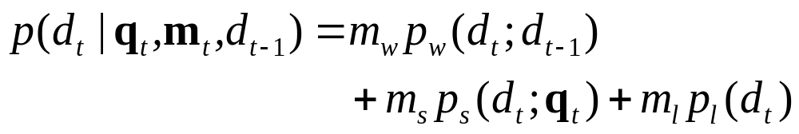


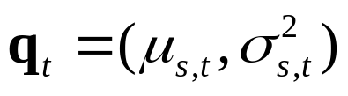
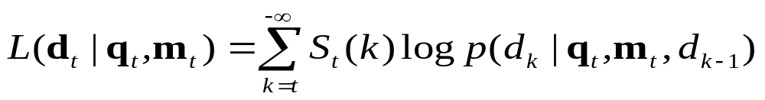
WSL Appearance Model
Probabilistic mixture [1]
  : observation
  : mixing probabilities
  : mean and covariance of stable component
Log-likelihood of observation history

Slide 6
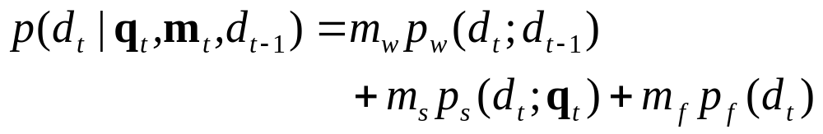
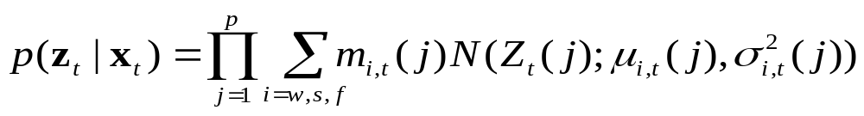
WSF Appearance Model
Probabilistic mixture [2]
  Every component is modeled with Gaussian.
Observation likelihood

Slide 7
EM Algorithm
Purpose & methodology
  Need to estimate parameters mixing probabilities and Gaussian parameters for stable component
  Online approximate EM algorithm
Sketch of estimation process
  Parameters in previous step
  new mixing probabilities by computing the posterior responsibility probabilities
  S: using the first- and second-moment images
  W, F: very simple
  L: no parameter (uniform distribution)

Slide 8






EM Algorithm
Batch step
Incremental modification

Slide 9
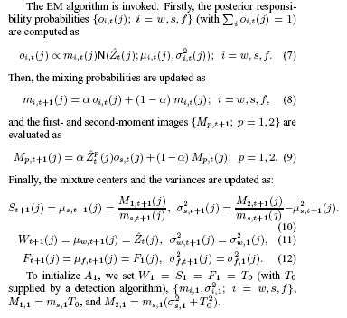
EM Algorithm

Slide 10
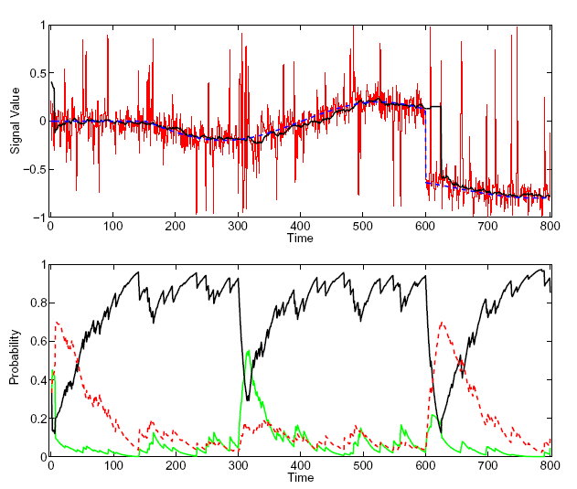
Parameter Estimation

Slide 11
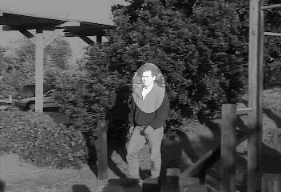
Tracking [1]
Motion-based Tracking
  Wavelet-based appearance model
  Maximizes the sum of data log likelihood and log prior by EM algorithm

Slide 12
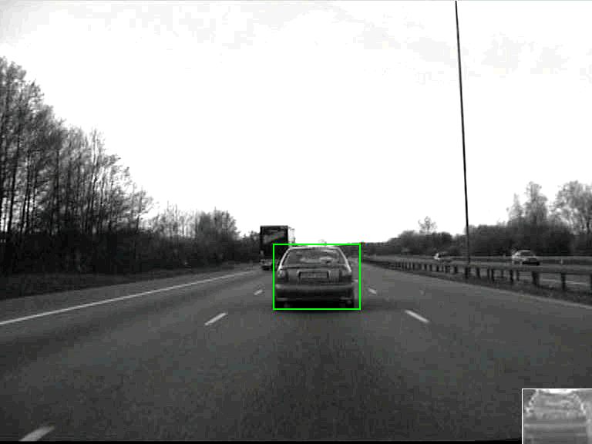
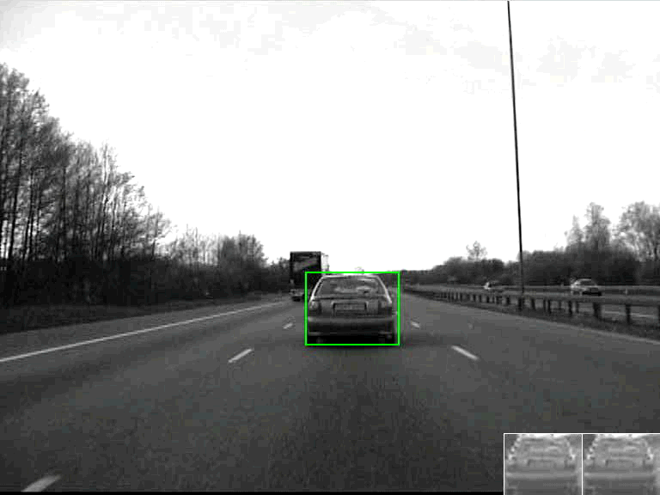
Tracking [2]
Appearance-based Tracking [2]
  Particle filter
  Adaptive process model
  Variable number of particles
  Online target model update

