Slide 1
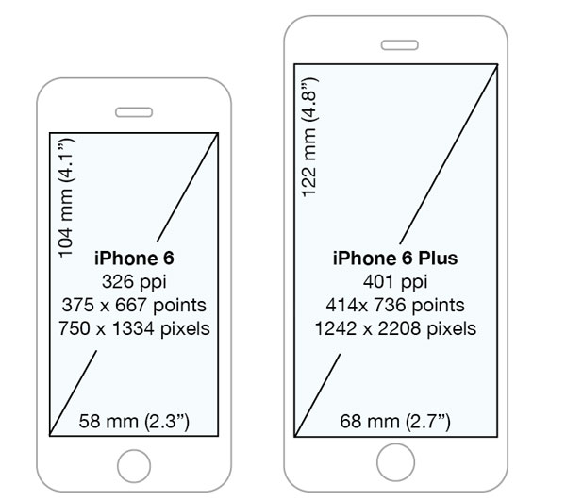

Stock
recipe
First page
Add stock
Add recipe
scroll view
First page
Press to back to stock page
stock
logo
v
Press to back to add stock page
add stock
Press to back to recipe page
recipe
Press to back to add recipe page
add recipe

Slide 2

Stock
Press to select
back
sort by quantity
back to stock
back to first page
sort by expired date
back
stock
Press list to open
the note in that list
note
delete list
delete
press to go to
add stock page
Are you sure to delete ?
add
cancel
confirm
back to stock page
back
logo
add stock
ingredient name
text input
amount
unit
dropdown
milligram
reminder on
gram
kilogram
expired Date
tablespoon
Add stock
save & add
note
save and add list to the stock

Slide 3
Recipe
back
back to first page
back
back to recipe page
recipe
Press menu
to see detail
ingredients
Press done for
cook this menu
& subtract stock
done
recipe
Are you sure to delete ?
delete
cancel
confirm
Delete this
recipe
back to recipe page
Add recipe
back
logo
add recipe
recipe name
recipe name
text input
ingredient
ingredient
amount
amount
unit
press to add
other ingredient
ingredient
unit
add
ingredient
amount
recipe
unit
save & add
save and add
to the recipe page
recipe

