Slide 1
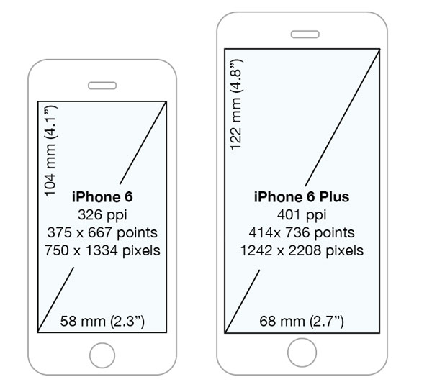

Ingredient
recipe
First page
Add ingredient
Add recipe
scroll view
First page
Press to go to ingredient page
ingredient
logo
v
Press to go to add ingredient page
add ingredient
Press to go to recipe page
recipe
Press to go to add recipe page
add recipe

Slide 2

Ingredient
Press to select
back
sort by quantity
back to ingredient
back to first page
sort by expired date
back
ingredient
Press list to open
the note in that list
note
delete list
delete
press to go to
add ingredient page
Are you sure to delete ?
add
cancel
confirm
back to ingredient page
back
logo
add ingredient
ingredient name
text input
amount
unit
dropdown
milligram
reminder on
gram
kilogram
expired Date
tablespoon
Add ingredient
save & add
note
save and add list to the ingredient

Slide 3
Recipe
back
back to first page
back
back to recipe page
recipe
Press menu
to see detail
ingredients
Press cook for
cook this menu
& subtract stock
cook
recipe
Are you sure to delete ?
delete
cancel
confirm
Delete this
recipe
back to recipe page
Add recipe
back
logo
add recipe
recipe name
recipe name
text input
ingredient
ingredient
amount
amount
unit
press to add
other ingredient
ingredient
unit
add
ingredient
amount
recipe
unit
save & add
save and add
to the recipe page
recipe

