Slide 1
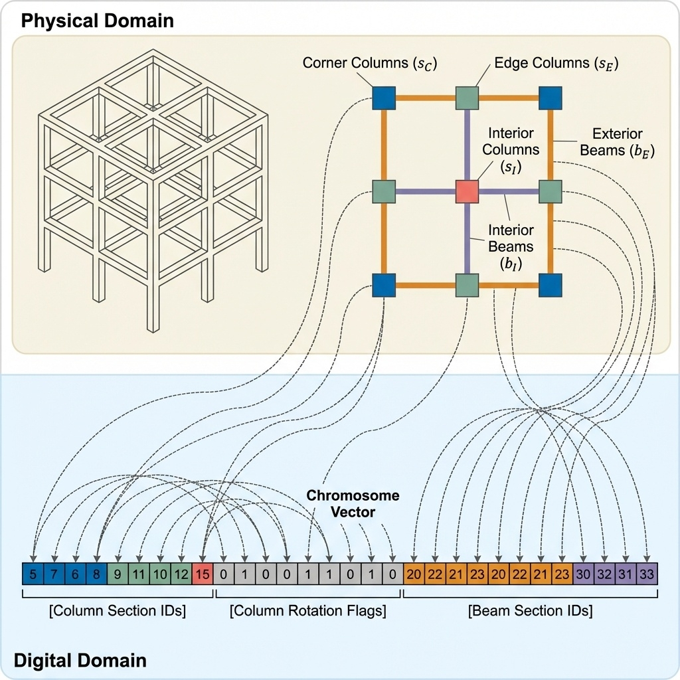
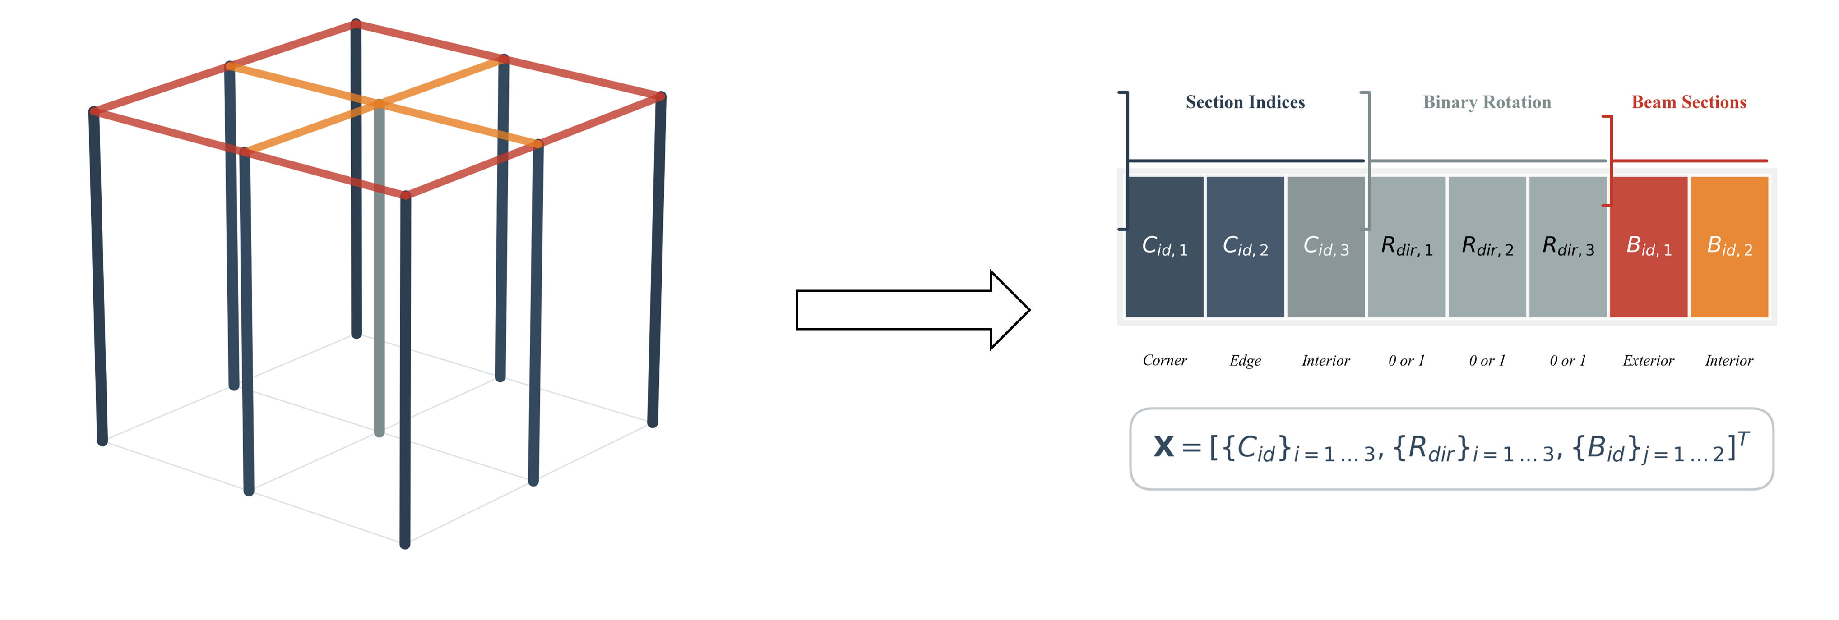





Corner Columns ($C_{id, 1}$)
Edge Columns ($C_{id, 2}$)
Interior
Columns
($C_{id, 3}$)
Exterior
Beams ($B_{id, 1}$)
5
11
15
…
0
1
0
…
23
4
…
Interior
Beams
($B_{id, 2}$)
1F
Column Section IDs
Column Rotation Flags
Beam Section IDs
Chromosome Vector

