Slide 1
AWS
Group 5
Sojess T Sojan
Sanjana Rachel Ninan
Dijal Tom
Sandra Marya
Neethu Chandran K

Slide 2
AWS
AWS is an abbreviation for Amazon Web Services.
It's actually a subsidiary of Amazon. With AWS, Amazon provides on-demand infrastructure, various managed services and cloud computing platform to organizations, governments or individuals on pay-as-you-go basis.
It was launched in March 2006.

Slide 3
Amazon S3
Amazon S3 is also called as Amazon Simple Storage Service
It is an object storage service that offers industry-leading scalability, data availability, security, and performance.
It is used to store and retrieve any amount of data using highly scalable, reliable, fast, and inexpensive data storage.
It stores data as objects within buckets.
In S3 bucket you can store unlimited volume of data and number of objects. A single Amazon S3 objects can be a size of range 0 bytes to 5 terabytes

Slide 4
Amazon S3
Steps to create S3 bucket
Sign in to the preview version of the AWS Management Console.
Under Storage & Content Delivery, choose S3 to open the Amazon S3 console.
From the Amazon S3 console dashboard, choose Create Bucket.
In Create a Bucket, type a bucket name in Bucket Name. The bucket name you choose must be globally unique across all existing bucket names in Amazon S3
Choose Region.
Choose Create.

Slide 5
Amazon S3
Here are steps to delete an S3 bucket:-
Step1: Login to AWS Management Console.
Step2: Select S3 from services.
Step3: Check the bucket you want to delete.
Step4: Click on the delete button. As confirmation Aws ask you to type the bucket name to delete.
Step5: Type bucket name and click on the Confirm button.

Slide 6
Amazon VPC
VPC stands for virtual private cloud
The AWS VPC enables you to launch all the AWS resources into the VPC that one have defined
The VPC resembles the network that you operate in your data center with the benefit of using the scalable infrastructure provided by AWS
The VPC is a large network which is divided into smaller chunks called as subnets
Why a VPC is required?
For large organizations the most important concern is privacy, security and the security of their data
While using the public networks of a cloud service like AWS the constraints are compromised
While using VPC they can create their own network. While providing the extra layer of security VPC also provides ease of connecting to their instances or services
When the AWS account is created a default VPC is created. But at production level we need to customize the VPC
For this the AWS also provides various tools required to customize VPC. Where we can explicitly create Subnets, NAT, security groups , internet gateways etc.

Slide 7
Key Components of VPC
Internet Gateway & NAT: It logically enables routing of the public network i.e. It provides a gateway for the VPC to connect to the Internet
DNS: Standards which resolve the names used over the Internet into IP Address
Elastic IP: It’s a static IP which never changes
VPC Endpoints: Private connecting between your VPC and other AWS services(i.e. without using services)
Egress only IG: Allows only outstanding communication from EC2 over IPV6
Route Tables: It defines how traffic is routed between each subnet
VPC Peering: Connection between VPC's

Slide 8
Here are the steps for creating a VPC
Login to AWS Management console https://aws.amazon.com/
Search for VPC in the search bar or Select All services from the AWS Services section
Scroll down to Networking and Content delivery service
Select VPC
In the sidebar select Your VPC's
Select Create VPC
Configure you VPC

Slide 9
Amazon EC2
Amazon Elastic Compute Cloud (Amazon EC2) is a web service that provides secure, resizable compute capacity in the cloud.
Designed to make web-scale cloud computing easier for developers.
It's simple web service interface allows you to obtain and configure capacity with minimal friction
Eliminates your need to invest in hardware up front, so you can develop and deploy applications faster.
Offers the broadest and deepest compute platform with choice of processor, storage, networking, operating system, and purchase model.
Virtual computing environments, known as instances
Pay for what you use

Slide 10
Features of EC2
Elastic web-scale computing - Amazon EC2 enables you to increase or decrease capacity within minutes, not hours or days.
Completely controlled - You have complete control of your instances. You have root access to each one, and you can interact with them as you would any machine.
Flexible cloud hosting services - Amazon EC2 allows you to select a configuration of memory, CPU, instance storage, and the boot partition size that is optimal for your choice of operating system and application.
Designed for use with other amazon web services
Reliable - Amazon EC2 offers a highly reliable environment where replacement instances can be rapidly and predictably commissioned.
Secure - Amazon EC2 works in conjunction with Amazon VPC to provide security and robust networking functionality for your compute resources.

Slide 11
Set up to use Amazon EC2
Create an AWS Account - To create AWS acoount open https://portal.aws.amazon.com/billing/signup. .Follow the online instructions.
Choosing an AMI - Preconfigured templates for your instances that package the bits you need for your server (including the operating system and additional software)
Choose instance type- Instance type that you specify determines the hardware of the host computer used for your instance.
Configure instance - You have to specify number of instances, purchasing options , kind of network, the subnet , assigning a public IP, the IAM role, the shutdown behavior etc.
Adding storage - Amazon EC2 provides you with flexible, cost effective, and easy-to-use data storage options for your instances.
Adding tags - To help you manage your instances, images, and other Amazon EC2 resources, you can assign your own metadata to each resource in the form of tags.
Configure Security group - A security group acts as a virtual firewall for your EC2 instances to control incoming and outgoing traffic
Review - Finally we review all configurations that we have made. Launch EC2 instance

Slide 12
Amazon Cloud Testing
The main goal of cloud testing is to verify an application’s performance and stability using cloud computing that provides more scalability and flexibility.
The cloud allows developers to test functional and non-functional features of the software in less time and with fewer resources.
Three vital AWS testing services :
AWS Inspector — Security testing tool
AWS Device Farm — Automated testing tool
AWS Fault Injection Simulator — Infrastructure testing tool
AWS Inspector — Security testing tool
* Amazon Inspector detects security loopholes in the deployment phase.
* Evaluating and prioritizing the identified vulnerabilities,
* AWS Inspector generates automatic reports with explicit data.
* This Amazon Web testing service offers an easy-to-understand overview of the potential bottlenecks and weaknesses that need to be addressed as early as possible.

Slide 13
AWS Device Farm — Automated testing tool
* Device Farm is another automated AWS testing tool that allows mass testing across various devices.
* These AWS services can be used for testers and to set up automated test cases.
* The service helps to execute tests concurrently on numerous devices and browsers and immediately receive test results and logs to identify issues.
AWS Fault Injection Simulator — Infrastructure testing tool
* Built for running fault injection experiments, this testing service helps you drive up the performance and stability of your application.
* Fault injection is technique commonly used in testing that checks how the system will behave in a stressful and out-of-the-ordinary situation.
* Fault injections are achieved by creating and running a disrupting scenario that will put the application under stress, such as a rapid spike in user traffic or memory consumption. The created real-world conditions help you uncover hidden bottlenecks that have gone unnoticed with other testing types.
* Fault injection provides testers with ready-made templates that cause the desired disruptions and guarantee the results.
The automation that Amazon testing tools deliver allows QA teams to delegate some monitoring tasks as the service provides automatic rollbacks in case of failure.

Slide 14
Amazon IAM
AWS Identity and Access Management (IAM) is a web service that helps you securely control access to AWS resources. You use IAM to control who is authenticated (signed in) and authorized (has permissions) to use resources.
When you first create an AWS account, you begin with a single sign-in identity that has complete access to all AWS services and resources in the account. This identity is called the AWS account root user and is accessed by signing in with the email address and password that you used to create the account. We strongly recommend that you do not use the root user for your everyday tasks, even the administrative ones. Instead, adhere to the best practice of using the root user only to create your first IAM user. Then securely lock away the root user credentials and use them to perform only a few account and service management tasks.
If we want to create IAM users or groups in root account then go to Services --> Security, Identity & compliance --> IAM

Slide 15
And there are 4 basic concepts,
Users: Users are identifiable individuals, and with IAM, you can give each one login and password so they can access the AWS console on their own. However, they’ll have a restricted set of permissions that you specify. Users have secret keys and secret access keys, which are used as inputs in your application-level code when setting up clients.
Groups: Then there are groups, which essentially apply to a collection of users that share a mutual interest. Permissions are different for different groups. Specific users of a group are subject to the same permissions and policies that are defined for the group as a whole.
Roles: Then we have roles, which are similar to user accounts in AWS. We attach policies to roles as we do for the users. In AWS IAM, we provide the access permissions to roles instead of a user. If an instance wants to access an AWS account, we’ll make it a role so that it can access the account without a login id and password. Roles can also be used by an AWS service to access another resources.(eg.: instance->actions->Security->Modify IAM role)
Policies: Finally, there are policies, which is an AWS object that determines the permissions of identity or resource when it is connected with it. When an IAM principal (user or role) makes a request, AWS evaluates these policies. They come in two variations: allow or deny. The policy permissions decide whether the request is allowed or denied.

Slide 16
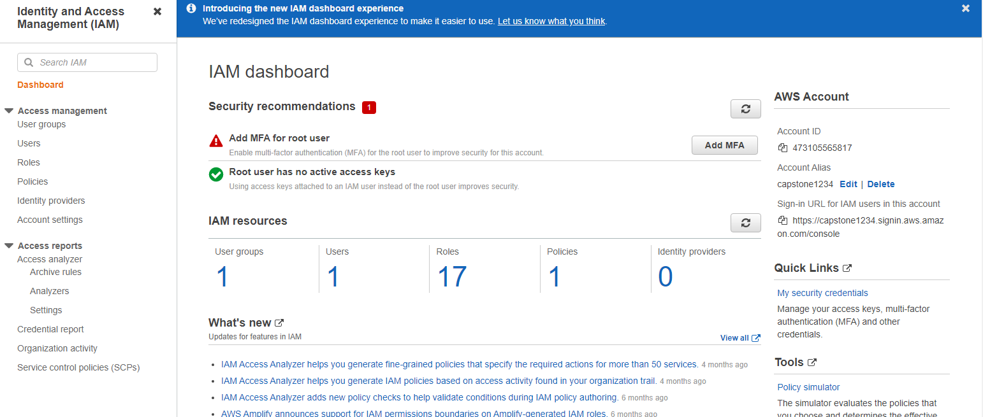
Homepage of IAM

Slide 17
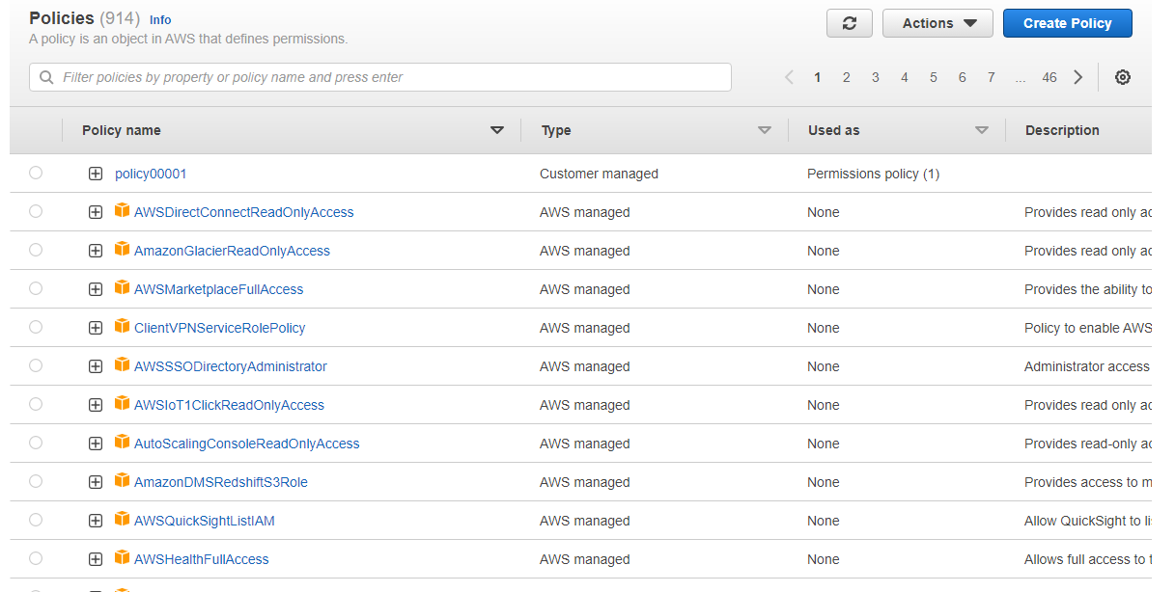
Policies

Slide 18
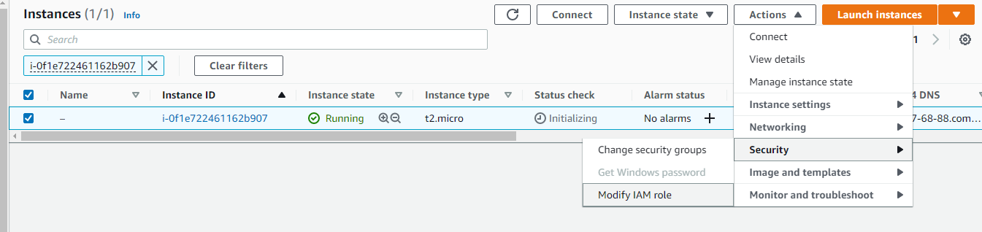
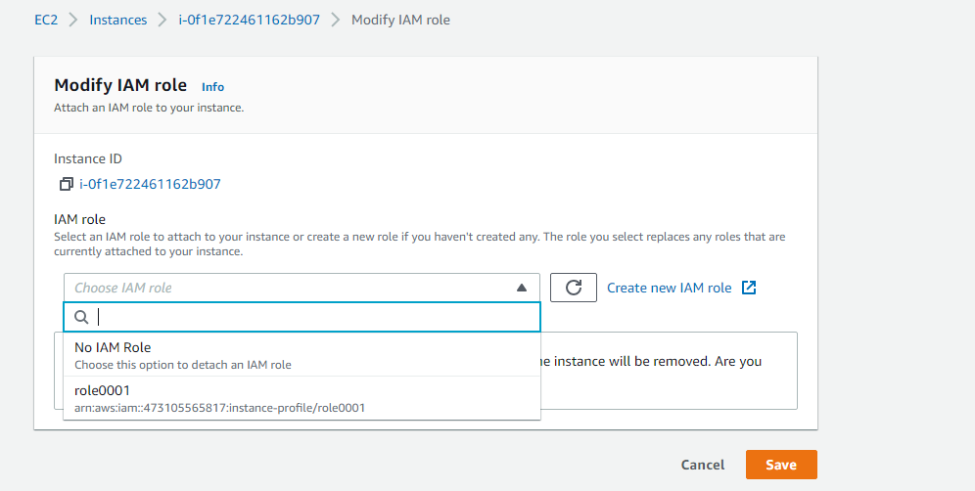
Steps for adding roles to the EC2 instance
Steps 1 :
Steps 2 :

Slide 19
IAM Features
Shared access to your AWS account
You can grant other people permission to administer and use resources in your AWS account without having to share your password or access key.
Granular permissions
You can grant different permissions to different people for different resources. For example, you might allow some users complete access to Amazon Elastic Compute Cloud (Amazon EC2), Amazon Simple Storage Service (Amazon S3), Amazon DynamoDB, Amazon Redshift, and other AWS services. For other users, you can allow read-only access to just some S3 buckets, or permission to administer just some EC2 instances, or to access your billing information but nothing else.
Secure access to AWS resources for applications that run on Amazon EC2
You can use IAM features to securely provide credentials for applications that run on EC2 instances. These credentials provide permissions for your application to access other AWS resources.

Slide 20
Multi-factor authentication (MFA)
You can add two-factor authentication to your account and to individual users for extra security. With MFA you or your users must provide not only a password or access key to work with your account, but also a code from a specially configured device.
Identity federation
You can allow users who already have passwords elsewhere—for example, in your corporate network or with an internet identity provider—to get temporary access to your AWS account.
Free to use
AWS Identity and Access Management (IAM) of your AWS account offered at no additional charge. You are charged only when you access other AWS services using your IAM users or AWS STS temporary security credentials.

Slide 21
Thank you

