Slide 1
Stratospheric Aerosol Injection Emulation for Controller Design
Jared Farley and Benjamin Wagman
August 5, 2025

Slide 2
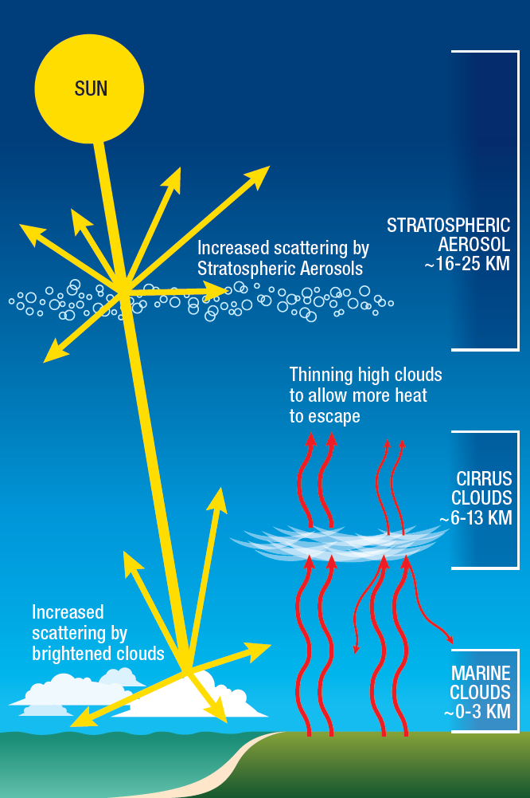
Background Information
Stratospheric Aerosol Injection (SAI) injects aerosols, or a precursor gas such as SO₂, to the lower stratosphere to increase the reflectivity of the stratosphere.
This reflectivity increase can reduce global surface temperatures.
SAI is studied using Earth System Models like the DOE’s Energy Exascale Earth System Model (E3SM) (Xie et al., 2025; Golaz et al., 2025)
(National Academy of Sciences, 2021)

Slide 3
Problem Statement
The Problem
E3SM is computationally expensive to run (~1.2 million core hours per simulated year).
The climate system is uncertain.
SAI deployment algorithms (controllers) tuned for different earth system models may not work on E3SM.
Creation of novel controllers and simulation of new scenarios may involve (costly) prototyping.
The Question
Can we develop a cheaper, simpler model that mimics E3SM behavior well enough for rapid controller design and prototyping?

Slide 4
Prior Work
Assessing Responses and Impacts of Solar climate intervention on the Earth system (ARISE) (Richter et al., 2022)
Uses a multi-latitude control strategy (MacMartin et al., 2017; Kravitz et al., 2017) that takes in a global map of temperature and outputs SO₂ injection, maintaining:
Global mean temperature
N-S temperature gradient
Equator-to-pole temperature gradient
Simulated in NCAR’s Community Earth System Model Version 2
Climate Intervention Dynamical EmulatoR (CIDER) (Farley et al., 2025, preprint)
Reduced order model that takes in multiple latitudes of injection and outputs a global map of the resultant temperature
Trained to mimic NCAR’s Community Earth System Model Version 2 (CESM2), but can be trained on any climate model with the prerequisite system identification

Slide 5
Current Approach: Overview
ARISE takes in Temperature and outputs SO₂ Injection
CIDER outputs Temperature and takes in SO₂ Injection

Slide 6
Current Approach: Step-by-step
ARISE’s controller and CIDER downloaded from respective GitHub repositories
CIDER trained on E3SM system identification simulations
CIDER learns the patterns, magnitudes, and rates of cooling that occur when a SAI deployer injects SO₂ at various parts of the world
ARISE controller and CIDER linked together in a closed-loop system
Climate targets are specified and all parameters (both controller and earth system) can be changed from outside the loop.

Slide 7
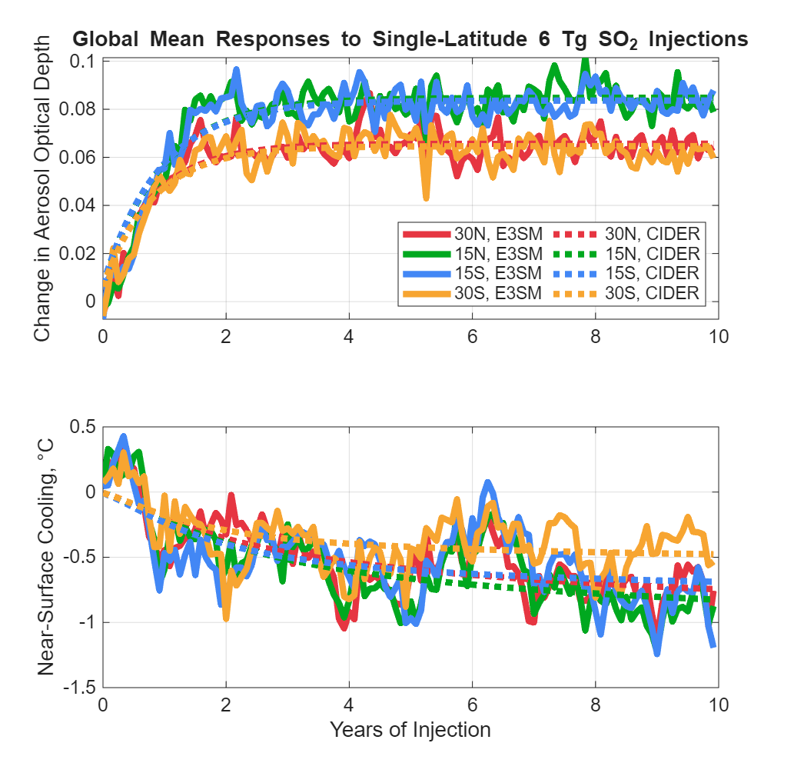
Data (slide 1 of 3): CIDER performance emulating E3SM
CIDER can estimate E3SM’s response of global mean aerosol optical depth and temperature with respect to different latitudes of SAI deployment.
CIDER achieves this estimate at a percentage of E3SM’s computational cost.
E3SM Cost per Simulated Year
E3SM Cost per Simulated Year
1.2 million core hours
E3SM Cost per Simulated Year | CIDER Cost per Simulated Year
1.2 million core hours | 11 core seconds
E3SM Cost per Simulated Year | CIDER Cost per Simulated Year
1.2 million core hours

Slide 8
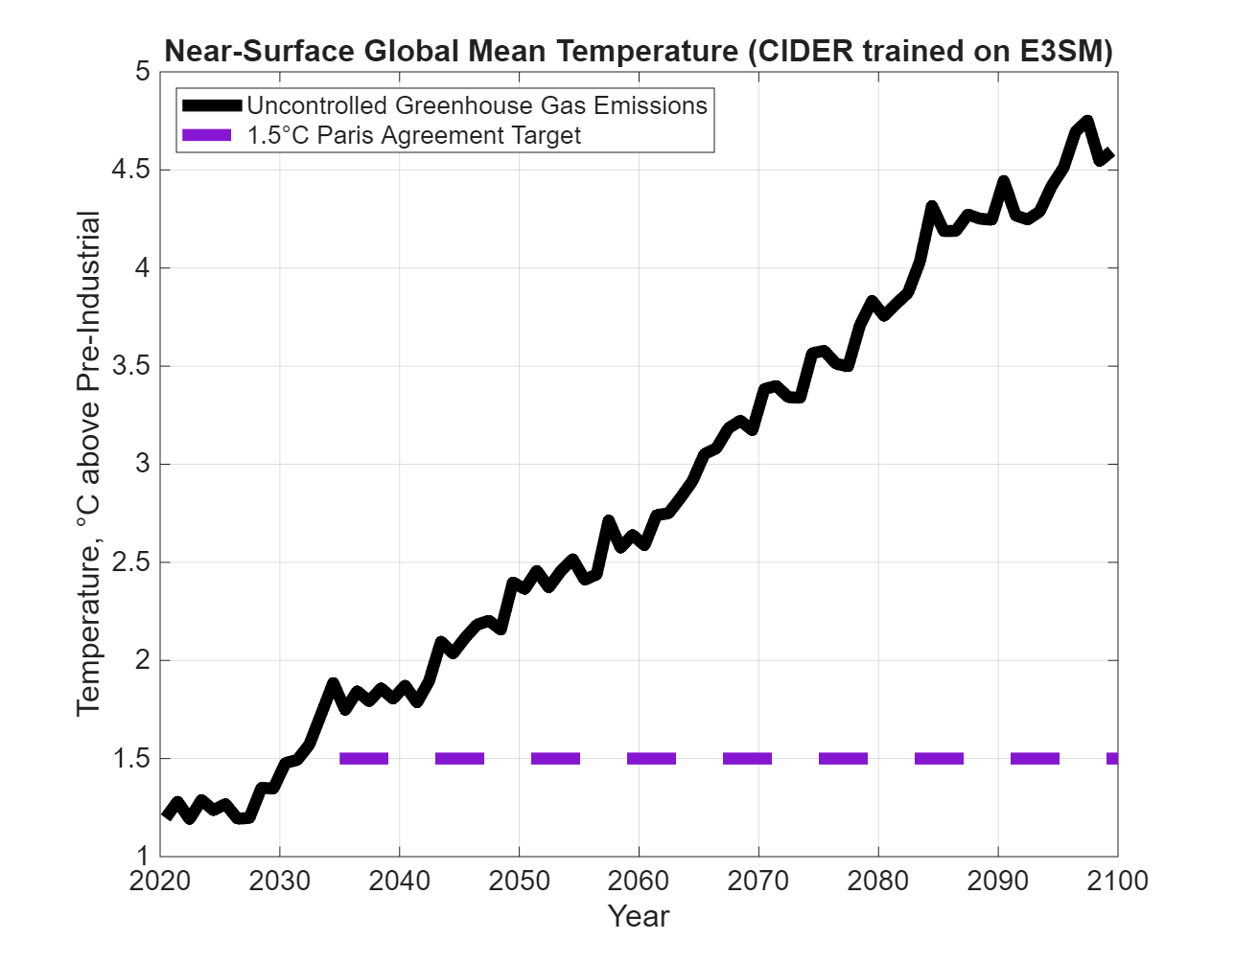
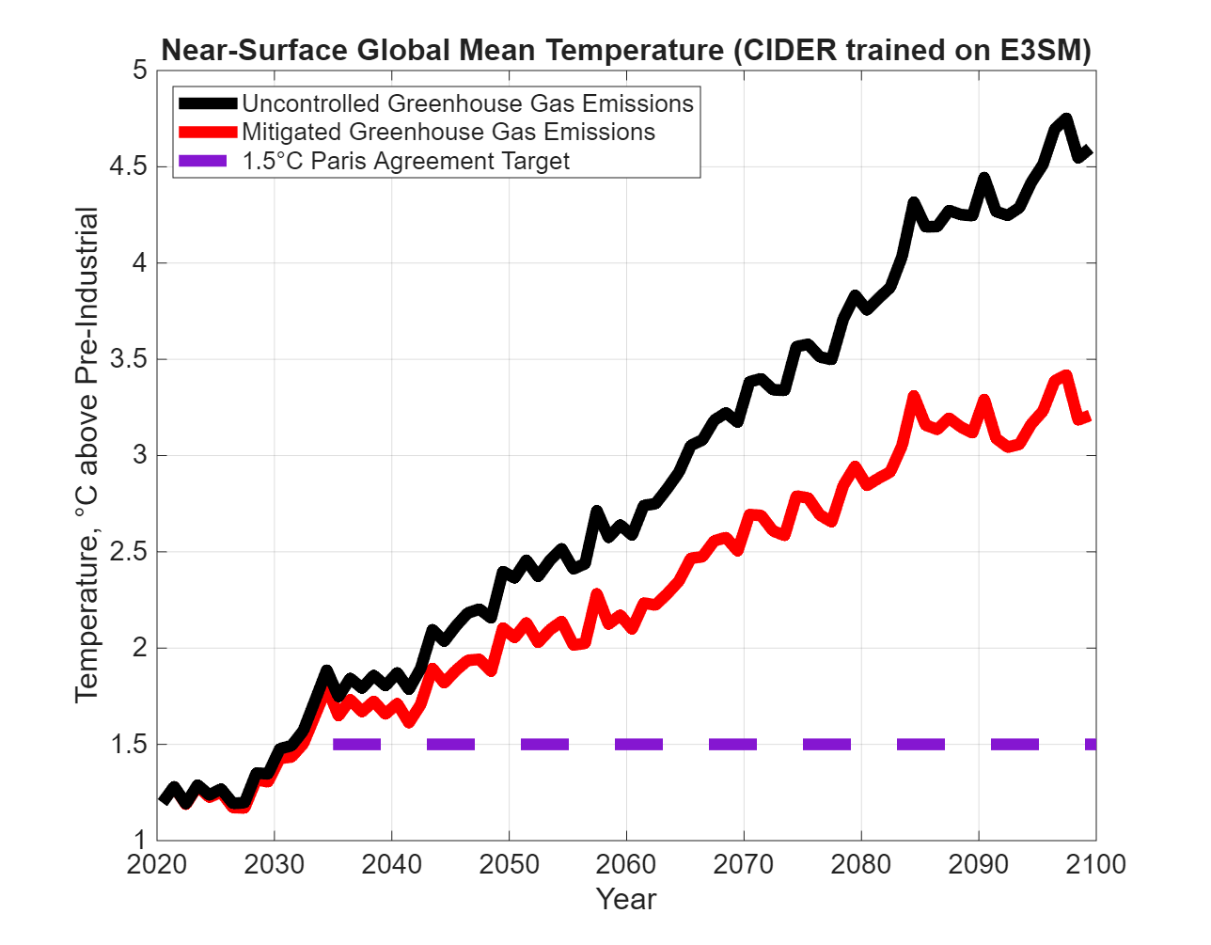
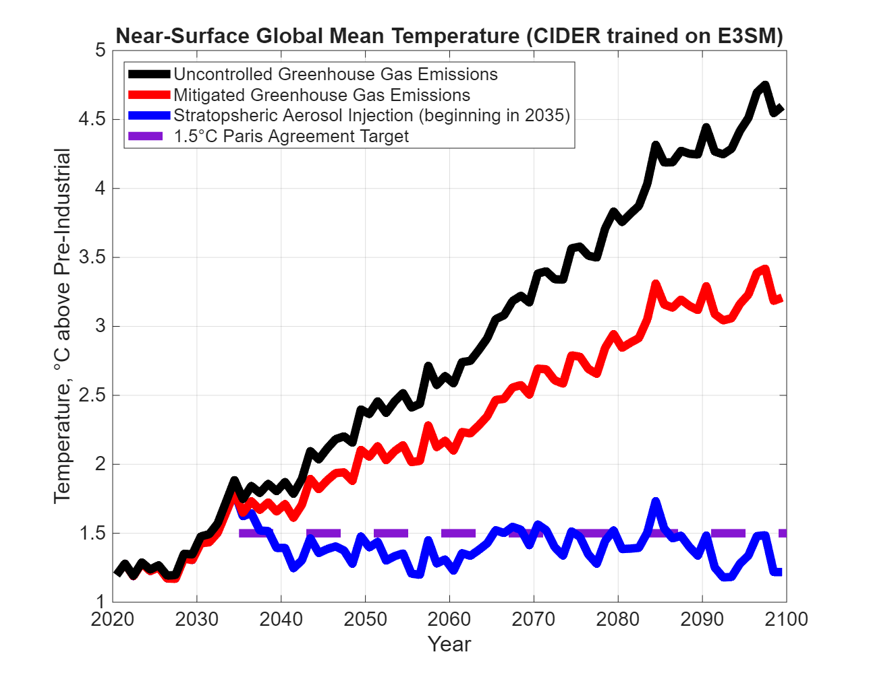
Data (slide 2 of 3): CIDER + ARISE Example
Emissions Mitigation
ARISE-like SAI

Slide 9
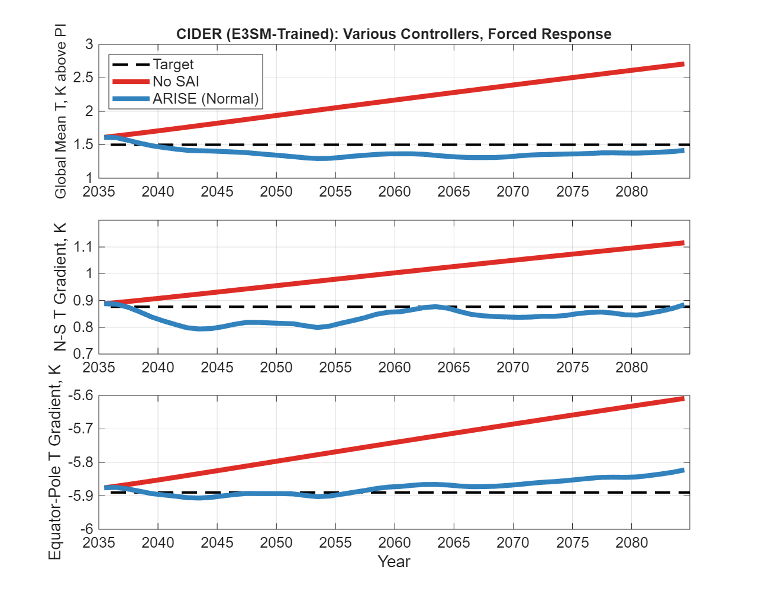
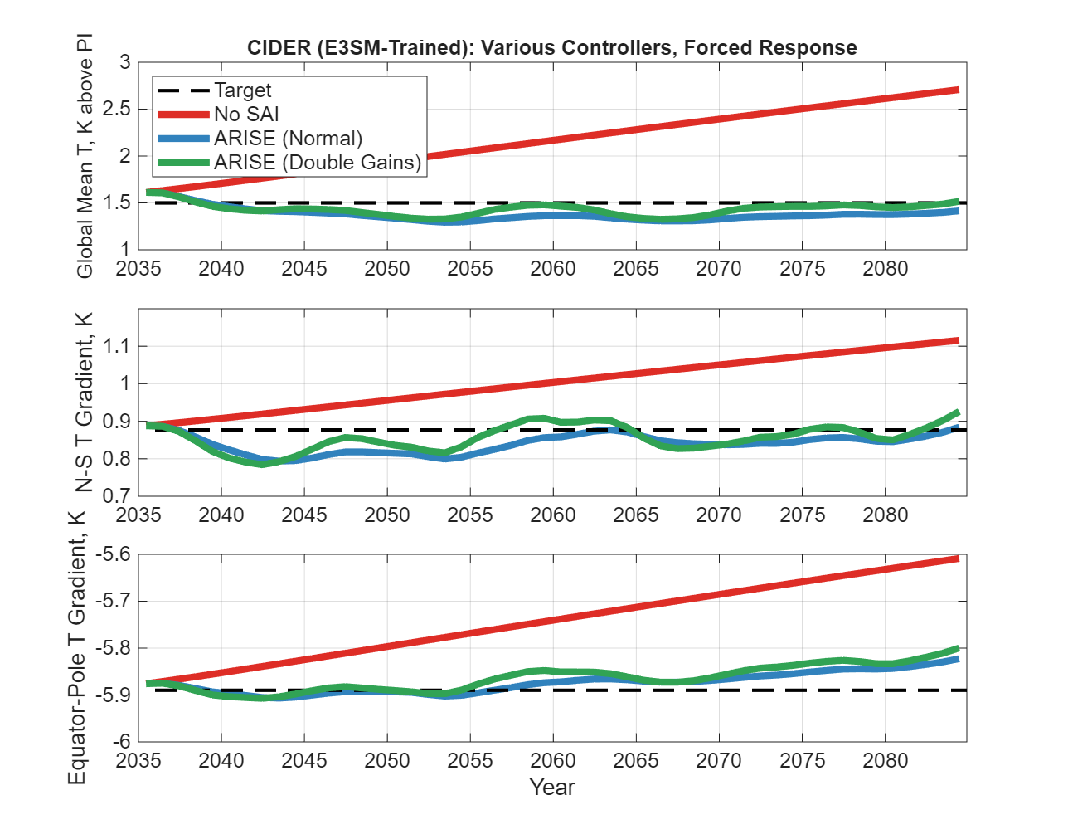
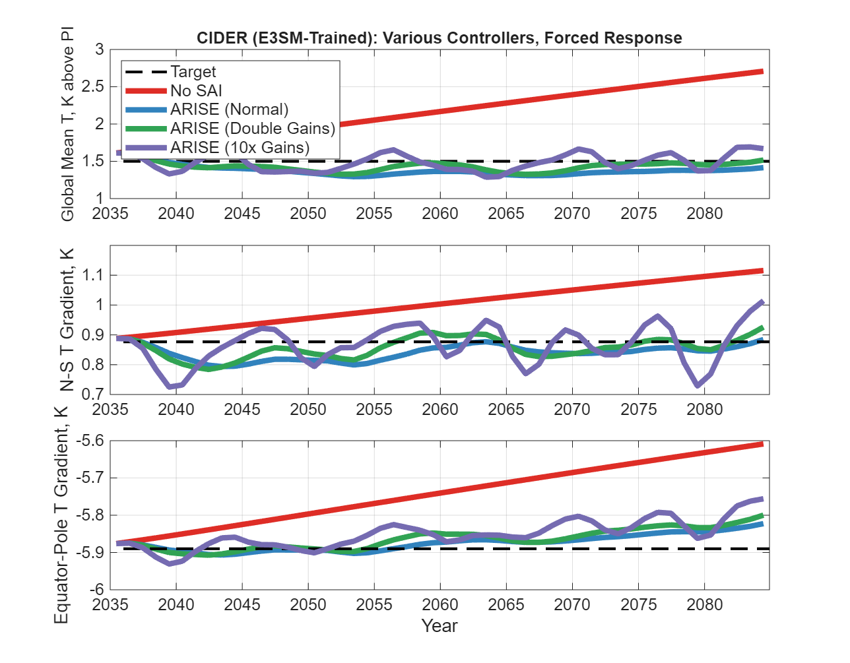
Data (slide 3 of 3): CIDER + New Controllers
E3SM-Trained CIDER can run different controllers than standard ARISE
ARISE calculates its SAI by finding the error between where we are and where we want to be, and multiplying by some gain
(And same for the integral – it’s a proportional-integral controller)
Example: How does naively increasing the gains affect controller performance?

Slide 10
Impact of these data to the Problem Statement
The Original Question
Can we develop a cheaper, simpler model that mimics E3SM behavior well enough for rapid controller design and prototyping?
Answer
Yes! Training CIDER on E3SM results in a low-cost estimate of the response of the full climate model to SAI.
This model is usable with the current state-of-the-art controller, the one used with ARISE.
Caveats
CIDER works with (mostly) linear pattern scaling.
CIDER currently fits the annual dynamics.
CIDER can never be more accurate than the model on which it is trained.

Slide 11
Conclusions and Potential Future Work
Conclusions
CIDER can be (and is now) trained to mimic E3SM.
ARISE works with CIDER (whether CESM2 or E3SM).
Potential Future Work
Getting good seasonal AOD dynamics with CIDER may require an upgrade to its aerosol module (a 2-box model seems to be good enough).
CIDER doesn’t include variability in its dynamics
Pro: adding/removing variability is easy, including isolating particular modes of variability
Con: SAI’s effect on that variability is not captured
Once the E3SM simulations of ARISE are complete, CIDER’s predictions should be compared against them

Slide 12
Acknowledgements
This work was funded through Sandia's Laboratory Directed Research and Development program.
Thanks to the SCTR LDRD team!
Thank you for your attention!
Questions? Email me at jcfarle@sandia.gov or jf678@cornell.edu

Slide 13
References
Jean-Christophe Golaz, Wuyin Lin, Xue Zheng, et al. The Energy Exascale Earth System Model version 3. Part II: Overview of the coupled system. ESS Open Archive. https://doi.org/10.22541/essoar.175097464.44666291/v1 June 26, 2025.
Farley, J., MacMartin, D. G., Visioni, D., Kravitz, B., Bednarz, E., Duffey, A., and Henry, M.: A Climate Intervention Dynamical Emulator (CIDER) for Scenario Space Exploration, EGUsphere [preprint], https://doi.org/10.5194/egusphere-2025-1830, 2025.
Kravitz, B., MacMartin, D. G., Mills, M. J., Richter, J. H., Tilmes, S., Lamarque, J.-F., Tribbia, J. J., and Vitt, F.: First simulations of designing stratospheric sulfate aerosol geoengineering to meet multiple simultaneous climate objectives, J. Geophys. Res.-Atmos., 122, 12616–12634, https://doi.org/10.1002/2017JD026874, 2017.
MacMartin, D. G., B. Kravitz, S. Tilmes, J. H. Richter, M. J. Mills, J.-F. Lamarque, J. J. Tribbia, and F. Vitt,: The climate response to stratospheric aerosol geoengineering can be tailored using multiple injection locations. J. Geophys. Res. Atmos., 122, 12 574–12 590, https://doi.org/10.1002/2017JD026868, 2017.
Richter, J. H., Visioni, D., MacMartin, D. G., Bailey, D. A., Rosenbloom, N., Dobbins, B., Lee, W. R., Tye, M., and Lamarque, J.-F.: Assessing Responses and Impacts of Solar climate intervention on the Earth system with stratospheric aerosol injection (ARISE-SAI): protocol and initial results from the first simulations, Geosci. Model Dev., 15, 8221–8243, https://doi.org/10.5194/gmd-15-8221-2022, 2022.
Shaocheng Xie, Christopher Ryutaro Terai, Hailong Wang, et al. The Energy Exascale Earth System Model Version 3. Part I: Overview of the Atmospheric Component. ESS Open Archive. https://doi.org/10.22541/essoar.174456922.21825772/v1, April 13, 2025.

