Slide 1
BED Format

Slide 2
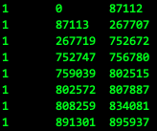
Browser Extensible Data .bed
https://en.wikipedia.org/wiki/BED_(file_format)
File containing Genomic Regions
0-base coordinates (more on this later!)
Tab \t delimited
BEDtools command line tool
https://bedtools.readthedocs.io/en/latest/
Fast AF

Slide 3
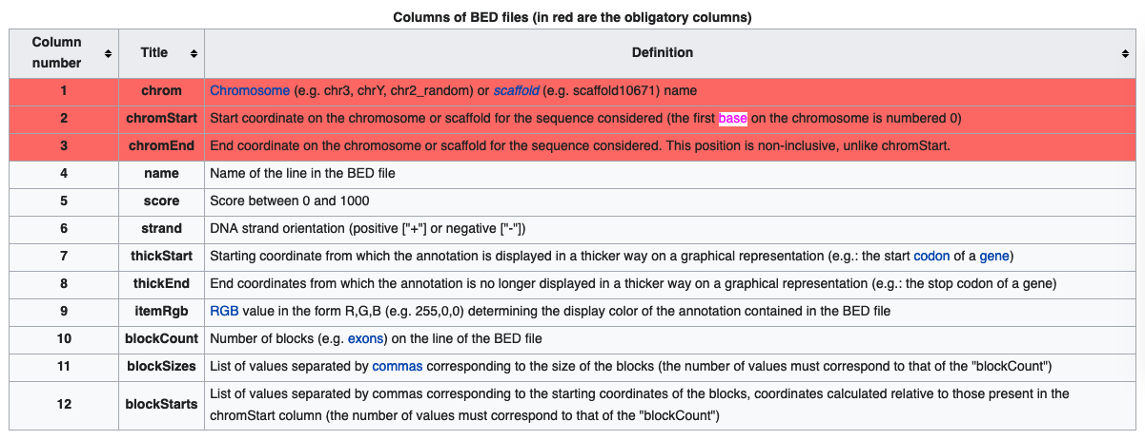
BED requires chrom start end
2 flavors of BED file
UCSC BED for Genome Browser
Everything else
Append information to a genomic position!
chr1 0 100 GeneX ScoreY …
UCSC BED assumes col4 will always contain a name entry

Slide 4
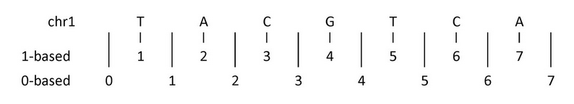
0-base: chrom. begins with 0 not 1
Convert 0-base to 1-base
start1 = start0+1;
end1 = end0;

Slide 5
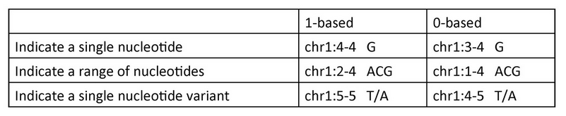

Slide 6
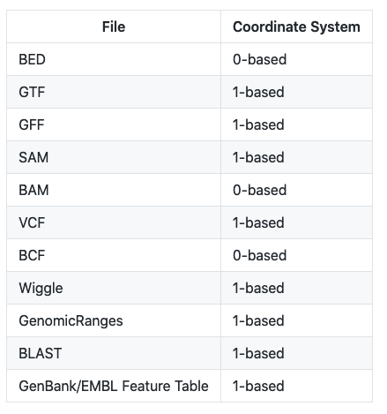
BED 0-Base. VCF 1-Base.
Bad rule of thumb: if you can read it, it’s 1-base

Slide 7
Convert VCF -> BED with AWK
Print SNPs into a BED file
grep -v "#" 1000G_omni2.5.b37.sites.vcf | \ awk '{ print $1"\t"$2-1"\t"$2"\t"$3 }’ >1kgp_omni2.5.hg19.bed
Why?
Intersect to regions of interest (blacklisted regions, genes, etc.)
BEDtools can take VCF as input BUT
Only considers the POS not the END if SV

Slide 8
BEDtools 💚 sorted BED files
sort –k1,1 –k2,2n in.bed >in.sorted.bed
Many commands require sorted files
intersectBed –sorted … much faster
bgzip in.bed; tabix –p bed in.bed.gz
Compress and index a BED file
Naming convention
dataset.reference.bed
gnomad_sv.hg38.bed

Slide 9
Split BED by chromosome with awk
zcat in.bed.gz | awk ‘{ print $0 >>”in.”$1”.bed” }’
Note: >> is the append operator
Delete files if you need to run again!

Slide 10
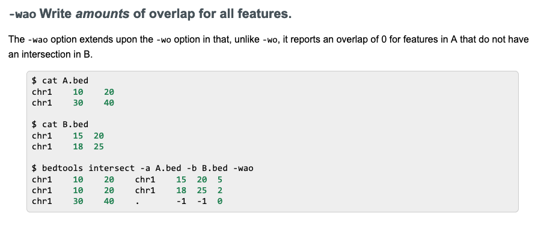
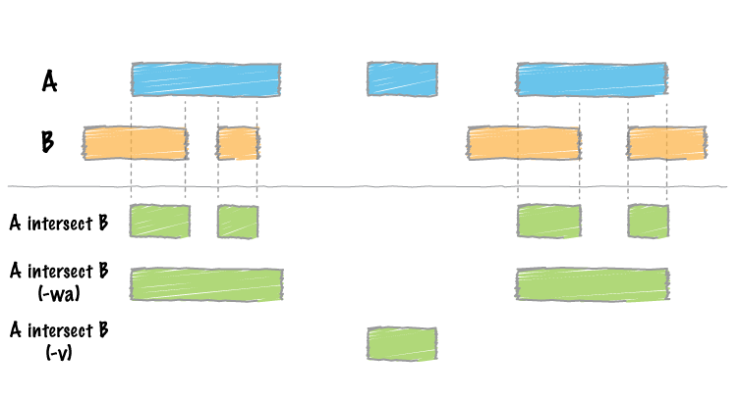
Check the Docs! 📗
Search online ”bedtools <subcommand>”
https://bedtools.readthedocs.io/en/latest/content/tools/intersect.html
Great visual examples
bedtools intersect

Slide 11
Filter variants in Bad regions
intersectBed –a in.bed \
–b mask.bed \
–wa –v \
>in.filtered.bed
-wa : write original entry in A
-v : report the opposite (variants that do NOT overlap B)

Slide 12
GTF -> BED: making a BED file of exons
zcat gencode.gtf.gz | \
grep “protein_coding” | \
awk ‘{ if($3 == “exon”) { print $1”\t”$4-1”\t”$5”\t”$0 }’ | \
cut –f 1-3,12 >gencode_exons.bed
***** WARNING: File gencode_exons.hg19.bed has inconsistent naming convention for record:
If this happens likely one file has “chr1” and the other has “1”

Slide 13
Perl one-liners to fix “chr” problems
perl –pi –e ‘s/^chr//g’ in.bed
Remove “chr” from the beginning of each line
perl –pi –e ‘s/^/chr/g’ in.bed
Add “chr” to the beginning of each line

Slide 14
Report overlap to unique genes
intersectBed –a in.bed –b exons.bed –wa –wb >in.exons.bed
Write both the A and B entry if they overlap
Then write a script to parse out the gene name (if needed)
Dictionary of dictionaries example

