Slide 1
Dps-100 (Guru library management system)
Soji pi
Roll No:52

Slide 2
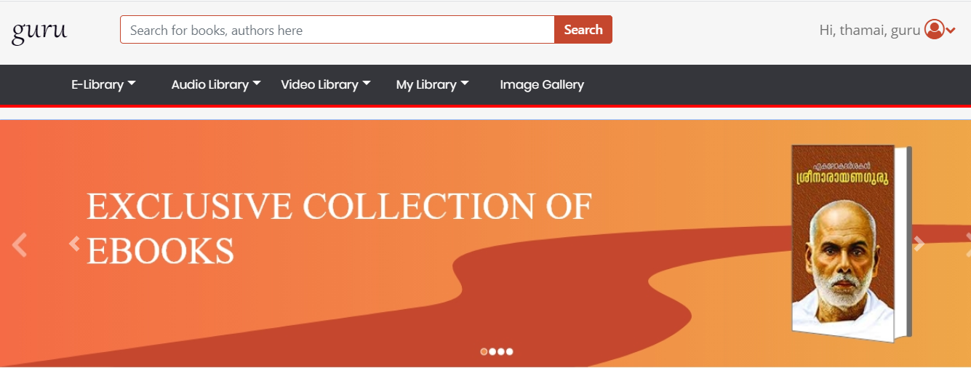
1.Home page

Slide 3
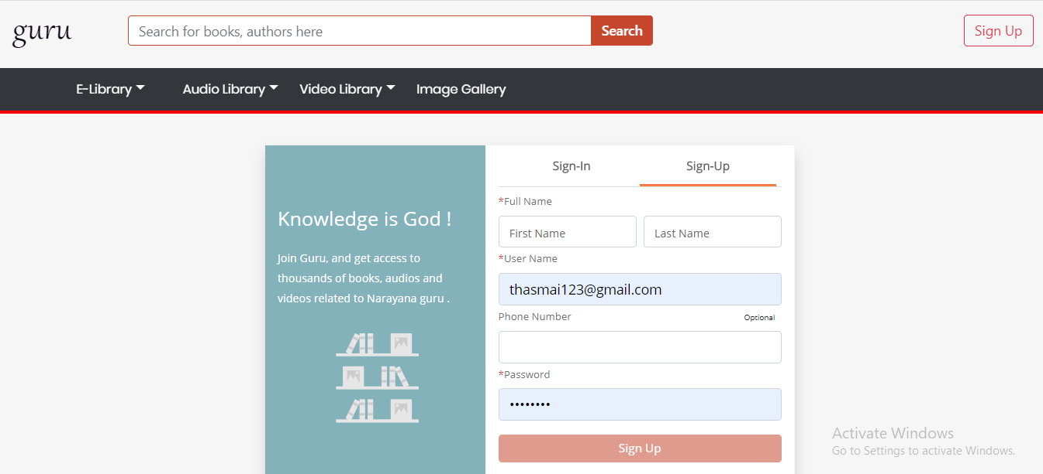
2.Sign up

Slide 4
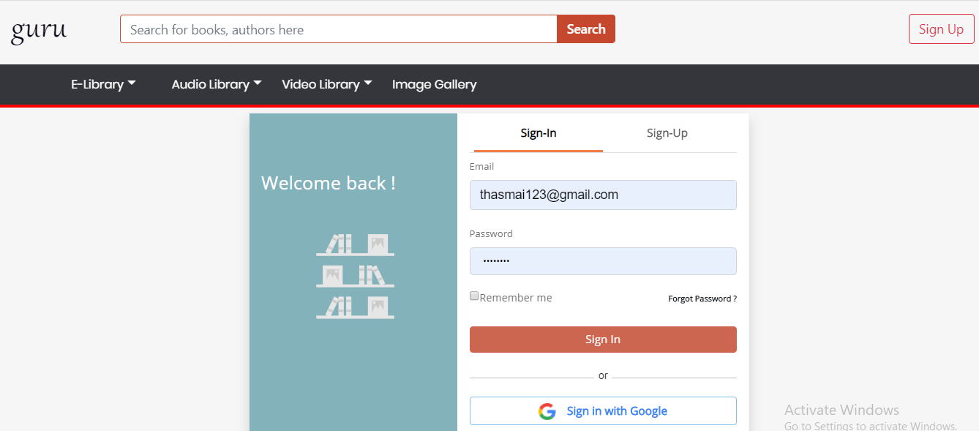
3.Sign in

Slide 5
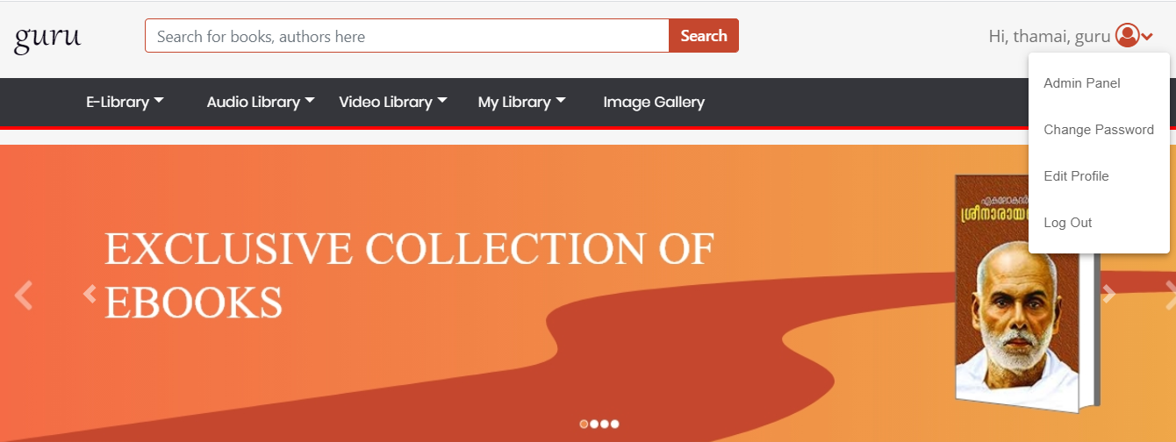
4.Admin panel

Slide 6
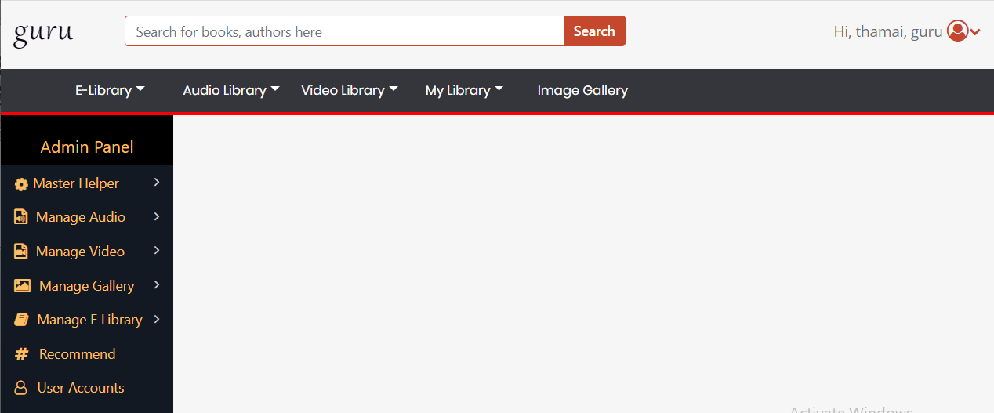
5.Admin panel

Slide 7
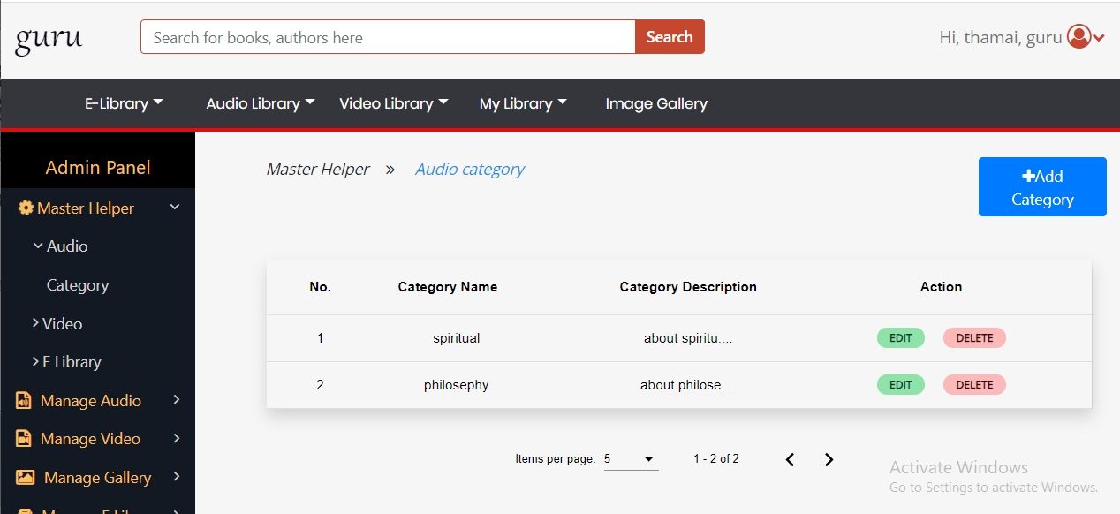
6.Add audio category

Slide 8
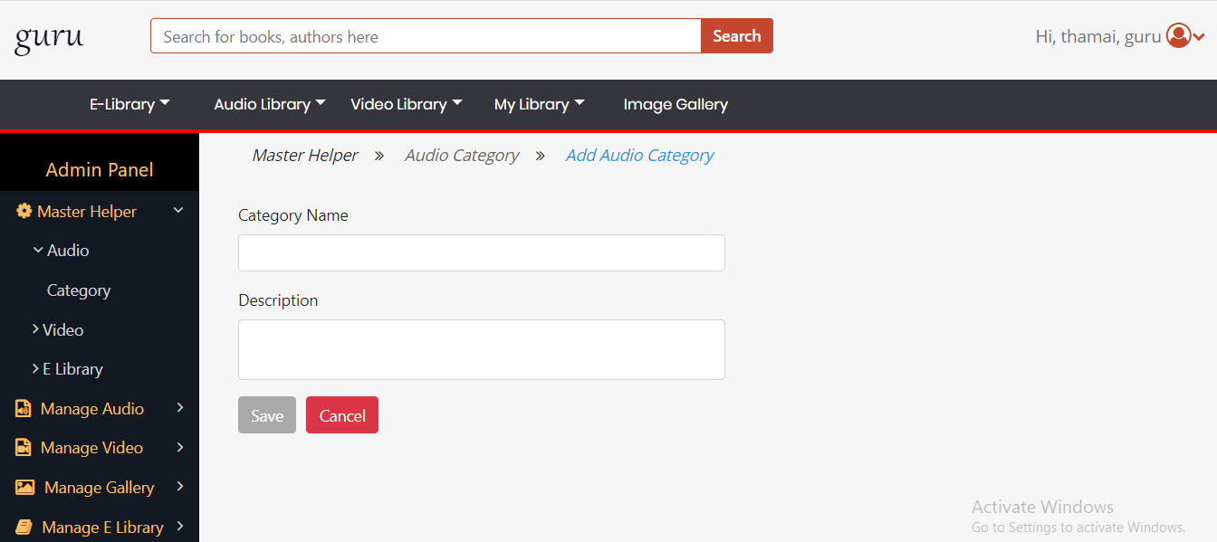
7.Add category form

Slide 9
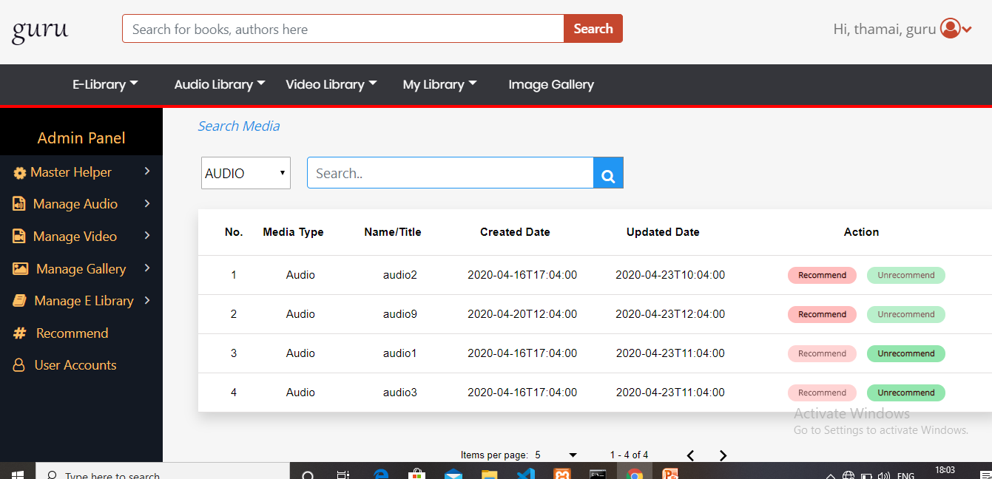
8.Recommend

Slide 10
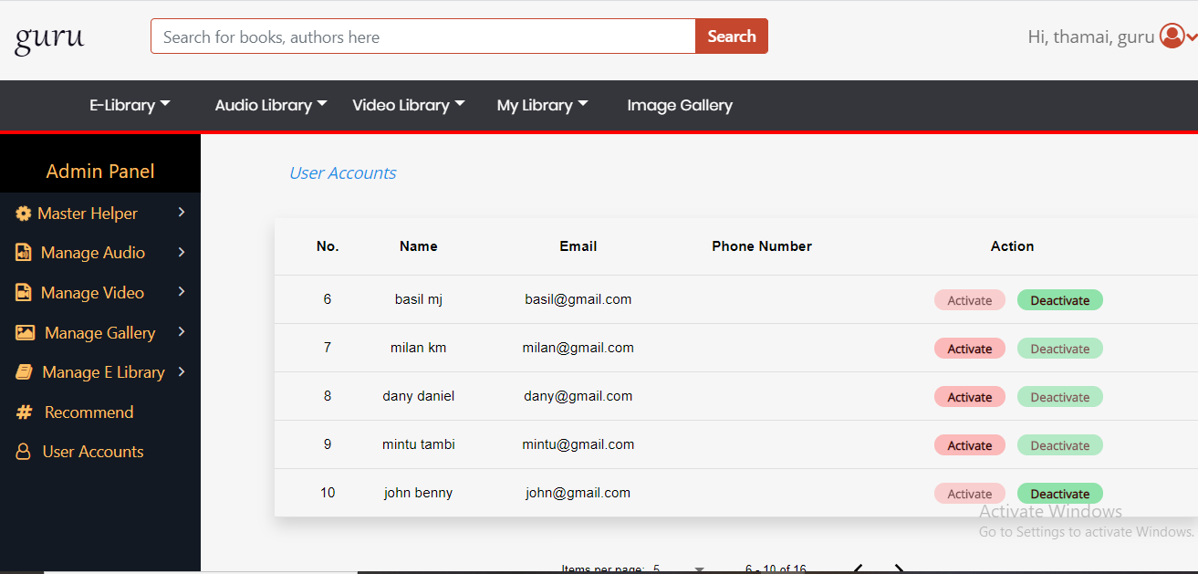
9.User accounts

Slide 11
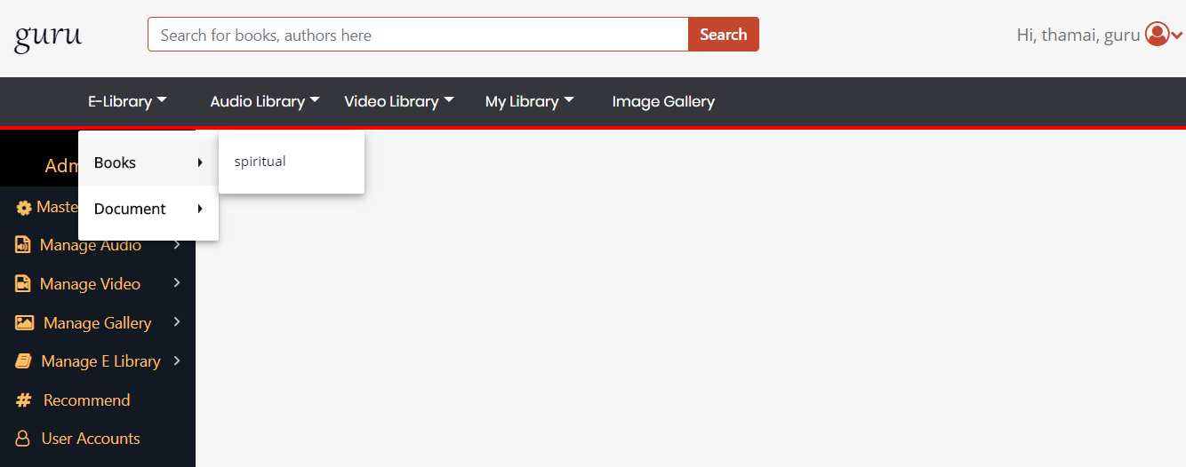
10.E-library

Slide 12
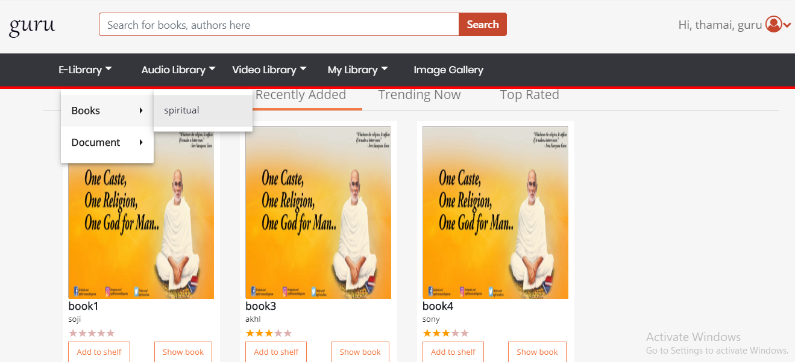
11.Books

Slide 13
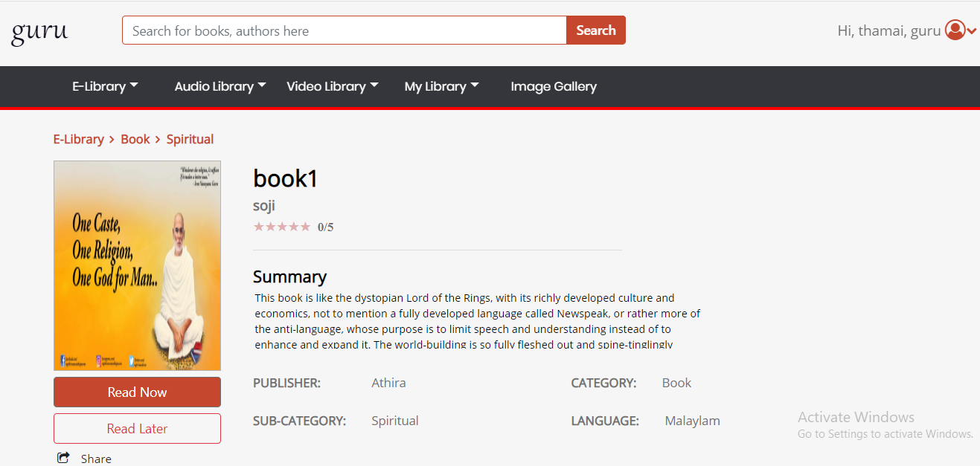
12.Read book

Slide 14
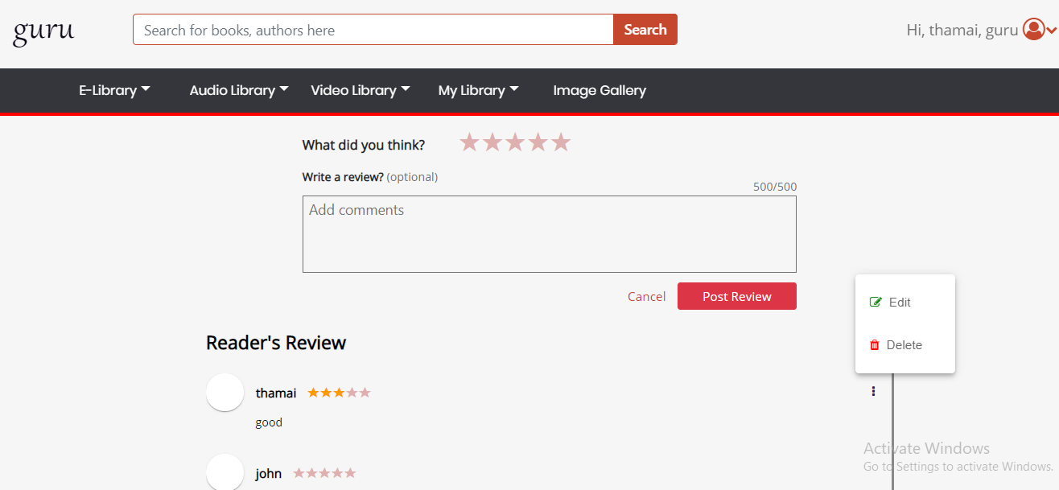
13.Book continue….

Slide 15
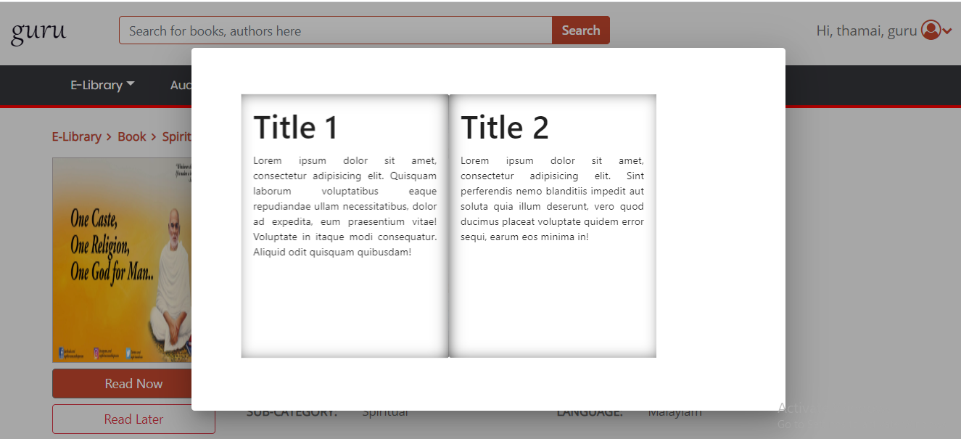
14.Book reading

Slide 16
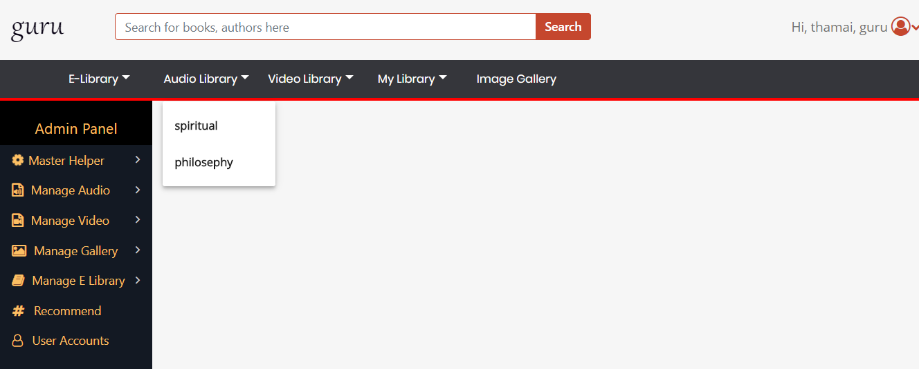
15.Audio library

Slide 17
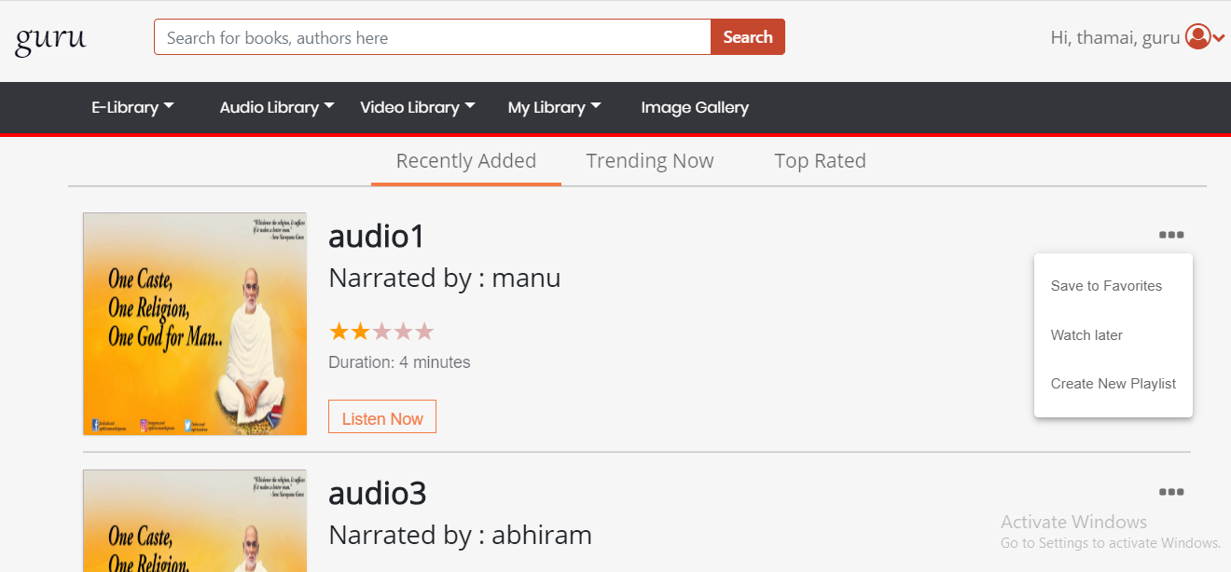
16.Audio

Slide 18
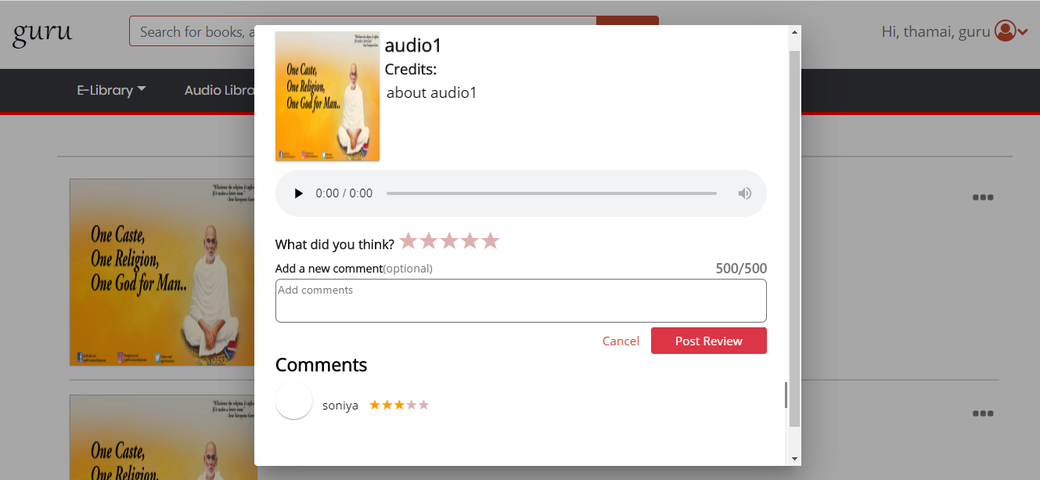
17.Lisen now

Slide 19
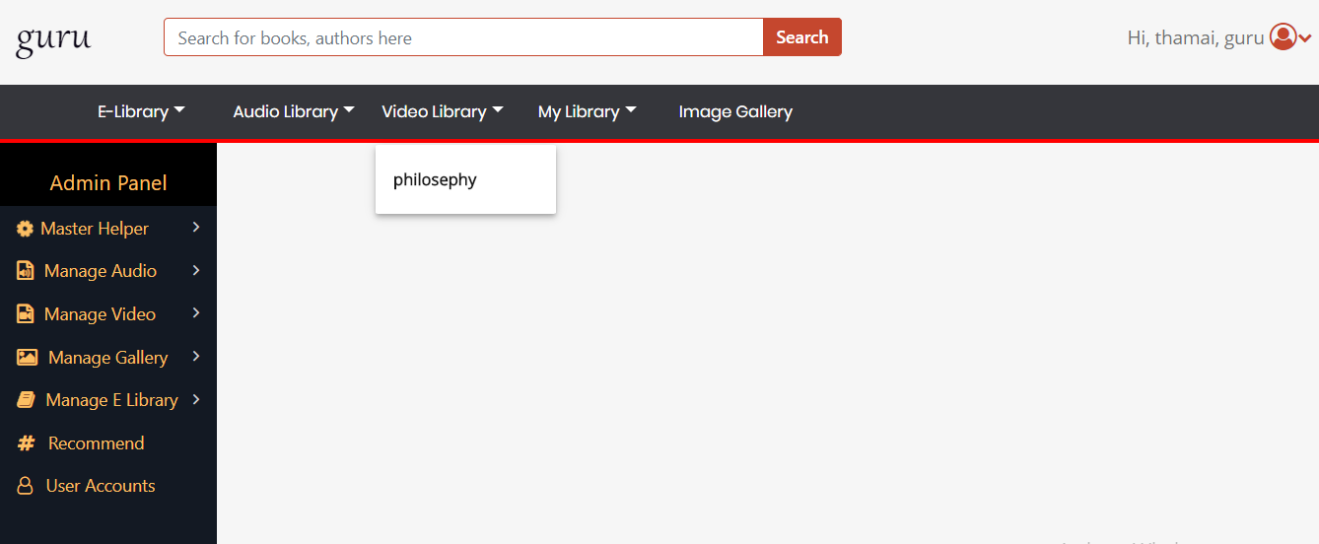
18.Video library

Slide 20
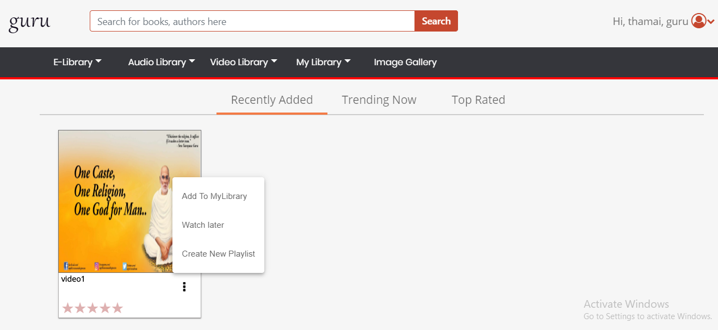
19.Video

Slide 21
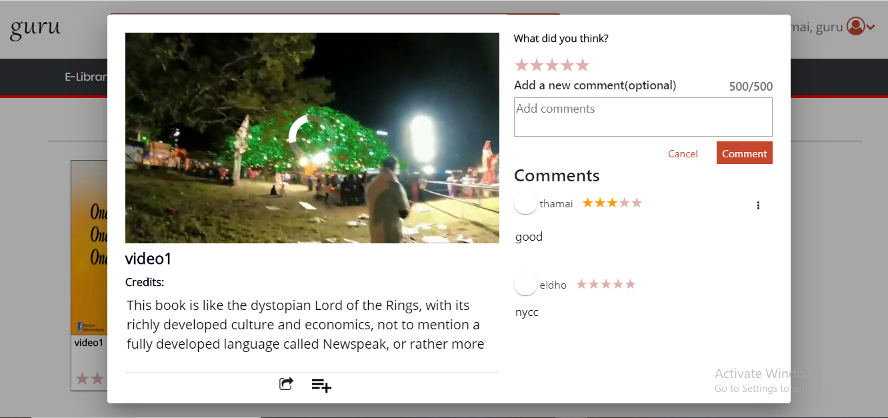
20.Playing audio

Slide 22
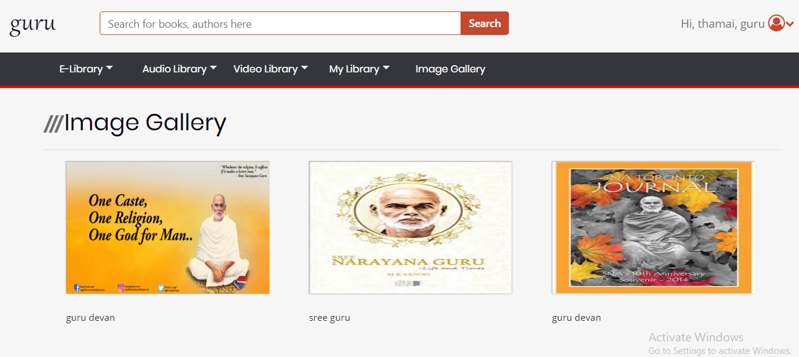
21.Image gallery

Slide 23
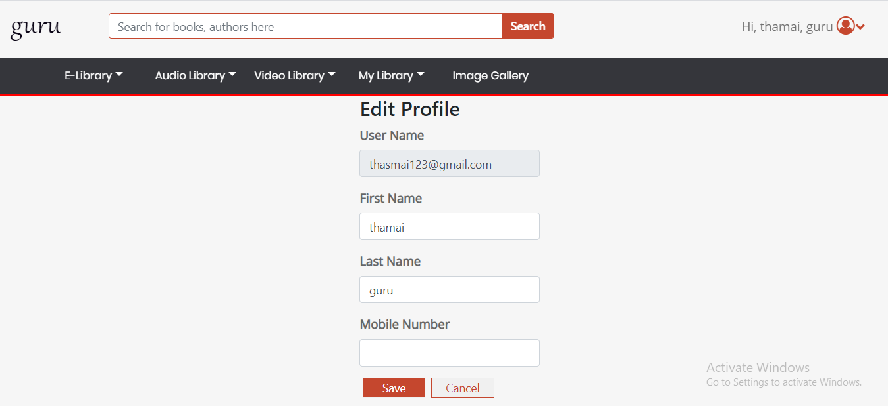
22.Edit profile

Slide 24
Thank you……..

