Slide 1
Attendance Management System
By Monis Pathan and Urvish Sojitra

Slide 2
1.Introduction

Slide 3
1.1 Problem Definition
By maintaining the attendance manually efficient reports cannot be generated. As the attendance is maintained in registers it is a tough task for admin and staff to maintain. Also older record keeping methods are outdated and inefficient.

Slide 4
1.2 Project Objective
This project aims to make an effective student attendance management system for teachers,and to
To reduce the cost of operation
To Reduce time consumption
To Reduce human error
To reduce paperwork
To make report generation easy
To improve efficiency
To Improve data security

Slide 5
1.3 Project Scope
The scope of the system is confined to one college in one department containing multiple courses ,which is an internet-based system and it only contains required functionality of the attendance system and not external modules like student grade management or marksheet generation. This system does not consist of the role of Director and does not consist of leave management.The system also does not contain elective subjects.

Slide 6
2.System Specific Requirements

Slide 7
2.1 Functional Requirement
Manage Login/Registration
Manage Profile
Manage academic details
Academic year
Course
Semester_Division
Subject

Slide 8
4.Manage Faculty
5.Manage Student
6.Assign academic detail
Academic year
Course
Semester_Division
Subject
7. Manage Counselor

Slide 9
8.Manage Class Schedule
9..Manage Attendance
10.Generate reports

Slide 10
1.Manage Login/Registration
RN | Description | Comments (operation)
FR1 | System shall allow Admin to register Students and Faculty either manually or using csv file | Add student page, Add Faculty page
FR2 | System shall validate Admin ,Student and faculty with username, password, role and status and only then allow them to login into the system. | Login page
FR3 | System shall provide ‘forget password’ functionality to valid Students,faculty and who have forgotten their password. Password shall be reset by sending a confirmation email | Forget password page (OTP by mail)

Slide 11
FR4 | To manage this module the following operations shall be performed by the: Admin: Shall be able to Add Student and Faculty details Shall be able to view Student and Faculty details Shall be able to Update Student and faculty details Shall be able to assign counselor role to faculty shall be able to set status as active or inactive | Add Student page Add Faculty page Assign counselor page

Slide 12
2. Manage Profile
RN | Description | Comments
FR1 | After successful registration by Admin,Student and Faculty shall be able to view their profile | profile page
FR2 | Valid admin,students and faculty shall be able to update their passwords using ‘change password’ | profile page ‘change password
FR3 | If student and Faculty wants to update their profile details ,they have to file a written application and and give it to admin | student page faculty page

Slide 13
3. Manage academic details
RN | Description | Comments
FR1 | In this module admin shall manage: academic year course semester division subject | pages involved: Add academic year Add course Add semester Add division Add subject
FR2 | To manage this module Admin shall: Add new details like academic year, course, semester, division and subject Update existing details View existing Details | pages involved: Add academic year Add course Add semester Add division Add subject

Slide 14
4.Manage Faculty
RN | Description | Comments
FR1 | In this module admin shall be able to: Add new faculty details Update existing faculty details View and search existing Faculty details Set faculty status as active or inactive Assign subject to Faculty Assign counselor role to faculty set class schedule | Add faculty page Assign Counselor page Class Schedule page

Slide 15
FR2 | Inactive faculty can not access the system | login denied
FR3 | Faculty shall be able to view details assigned by admin academic year course semester division subject add attendance view attendance update attendance Class Schedule | Faculty page attendance page Class Schedule page

Slide 16
5.Manage Students
RN | Description | Comments
FR1 | In this module admin shall be able to: Add new student details Update existing students details View and search existing students details Set student status as active or inactive | Add student page
FR2 | Inactive Students cannot access the system | login denied
FR3 | After Allocation Students shall be able to view details assigned by admin. academic year course semester division | student page

Slide 17
6.Assign academic detail
RN | Description | Comments
FR1 | After adding academic details and faculty Admin shall allocate these details to faculty: academic year course semester division subject Faculty shall be able to view details assigned by admin | Dashboard and Faculty profile
FR2 | After adding academic details and Student Admin shall allocate these details to Student: academic year course semester division Students shall be able to view details assigned by the admin. | Dashboard and student profile

Slide 18
7.Manage Counselor
RN | Description | Comments
FR1 | Admin shall assign counselor role to faculty | Assign Counselor
FR2 | Admin shall assign students to counselors | Assign Counselor
FR3 | Admin shall view number of active or inactive counselors | Dashboard Assign Counselor
FR4 | Counselor can see the students assigned to them and their reports | Counselor page

Slide 19
8.Manage Class Schedule
RN | Description | Comments
FR1 | To manage this module the following operations shall be performed by the Admin: Schedule the lecture in the Class Schedule update the lectures in Class Schedule | Class Schedule
FR2 | Admin shall assign subject division and course to faculty and make the Class Schedule based on these parameters. | Assign subject Class Schedule page
FR3 | After lectures have been assigned Faculty shall be able to see their Class Schedule | Class Schedule page
FR4 | This module will contain: subject semester Start time of lecture End time of lecture | Class Schedule page

Slide 20
9.Manage Attendance
RN | Description | Comments
FR1 | After allocation of academic details faculty can take attendance Academic details: academic year course semester division subject | Attendance
FR2 | Faculty can set whether the student was present or absent during their assigned lectures. Faculty can enter attendance by the subject assigned to them | Attendance page
FR3 | After taking attendance Faculty shall be able to view and update attendance till end of week | Attendance page

Slide 21
10. Generate reports
RN | Description | Comments
FR1 | System shall generate reports based on the attendance taken by faculty | Report page
FR2 | Faculty can view reports based on their subject and role like counselor | Report page

Slide 22
FR3 | Reports shall be generated on: The percentage of present and absent days by subject and lectures of a student The most absent student ,by lectures. Average Daily Attendance Average Attendance by Day Attendance Chart Absence Summary Attendance for given duration Subject wise absent report Student wise absent report Admin can view all the reports | Report page

Slide 23
FR4 | Admin and Faculty can download the required reports in pdf form | Report page
FR5 | To manage this module the following operations shall be performed by the Faculty and admin: View the reports appropriate to them Faculty can see reports on the students assigned to them Counselor shall be able to see the reports of students assigned to them | Report page

Slide 24
4.2 Non-Functional Requirements
1)Performance
Easy tracking of records and updating can be done due to:
This software uses an underlying database which shall be on a central server while the frontend shall be available to Administrative staff ,faculty and students.
The Software can handle many users at the same time.
2)Reliability
This software shall not be able to connect to the centralized database in the event that the Server is down due to hardware or software failure.
3)Availability
The software shall be only available to authorized users of the college like Teachers who shall mark the attendance of students,Students to check their leave and Admin to maintain the system.

Slide 25
3.System Design

Slide 26
3.1 Database Design
Database Design Consists of:
3.1.1.Database Schema
3.1.2.Data Dictionary

Slide 27
3.1.1.Database Schema
6.1.1.1 tbl_academicYear:-
tbl_academicYear(AcademicYearID[PK],AcademicYear,AcademicYearCreatedAt,AcademicYearEndAt)
FD:AcademicYearID→ {AcademicYear,AcademicYearCreatedAt,AcademicYearEndAt}

Slide 28
6.1.1.2 tbl_course
tbl_course(CourseID[PK],CourseName,CourseDescription,CourseCreatedAt)
FD:CourseID→ {CourseName,CourseDescription,CourseCreatedAt}

Slide 29
6.1.1.3 tbl_semester_division
tbl_semester_division(SemesterDivisionID[PK],SemesterName,DivisionName)
FD: SemesterDivisionID→{SemesterName,DivisionName}

Slide 30
6.1.1.4 tbl_subject
tbl_subject(SubjectID[PK],SubjectName)
FD:SubjectID→{SubjectName}

Slide 31
6.1.1.5 tbl_user
tbl_user(UserID[PK],UserName,Password,Usertype,UserStatus,UserCreaetedAt,UserDeletedAt)
FD:UserID→{UserName,UserPassword,Usertype,UserStatus,UserCreaetedAt,UserDeletedAt}

Slide 32
6.1.6 tbl_state
tbl_state(StateID[PK],StateName)
FD:StateID->{StateName}
6.1.7 tbl_city
tbl_city(CityID[PK],CityName,SateID[FK])
FD:CityID->{SateID[FK]}

Slide 33
6.1.1.8 tbl_admin
tbl_admin(AdminID[PK],AdminFname,AdminMname,,AdminLnameAdminPhoto,AdminGender,AdminDOB,AdminlocalAddress,AdminpermanantlAddress,AdminCaste,AdminSubCaste,AdminBloodGroup,AdminEmail,AdminContactNo,AdminCity,AdminState,AdminMaritalStatus,AdminSpouse,AdminDisability,AdminAadharcardno,AdminHighestQualification,UserID[FK])
FD:AdminID→{AdminFname,AdminMname,AdminLnameAdminPhoto,AdminGender,AdminDOB,AdminlocalAddress,AdminpermanantlAddress,AdminCaste,AdminSubCaste,AdminBloodGroup,AdminEmail,AdminContactNo,AdminCity,AdminState,AdminMaritalStatus,AdminSpouse,AdminDisability,AdminAadharcardno,AdminHighestQualification,UserID[FK])

Slide 34
6.1.1.9 tbl_faculty
tbl_faculty(FacultyID[PK],FacultyFname,FacultyMname,FacultyLname,,FacultyPhoto,FacultyGender,FacultyDOB,FacultyLocalAddress,FacultyPermanantAddress,FacultyCaste,FacultySubCaste,FacultyBloodGroup,FacultyEmail,FacultyContactNo,FacultyStateCityID,FacultyMaritalStatus,FacultySpouse,FacultyDisabilty,FacultyAadharcardno,FacultyHighestQualification,AcadmicYearID[FK],FacultyCourseID[FK],UserID[FK])
FD:FacultyID→{FacultyFname,FacultyMname,FacultyLname,,FacultyPhoto,FacultyGender,FacultyDOB,FacultyLocalAddress,FacultyPermanantAddress,FacultyCaste,FacultySubCaste,FacultyBloodGroup,FacultyEmail,FacultyContactNo,FacultyStateCityID,FacultyMaritalStatus,FacultySpouse,FacultyDisabilty,FacultyAadharcardno,FacultyHighestQualification,AcadmicYearID[FK],FacultyCourseID[FK],UserID[FK]}

Slide 35
6.1.1.10 tbl_students
tbl_students_details(StudentID[PK],StudentEnrollmentNo,StudentFname,StudentMname,StudentLname,StudentPhoto,StudentGender,StudentPermanantAddress,StudentLocalAddress,StudentFatherName,StudentFatherContactNo,StudentMotherName,StudentMotherContactNo,StudentCaste,StudentSubCaste,StudentBloodGroup,StudentEmail,StudentContactNo,StudentStateCityID[FK],StudentAadharcardno,StudentHighestQualification,,EnrollYear,AcademicYearID[FK],CourseSemesterID[FK],UserID[FK])
FD:StudentID→{StudentEnrollmentNo,StudentFname,StudentMname,StudentLname,StudentPhoto,StudentGender,StudentPermanantAddress,StudentLocalAddress,StudentFatherName,StudentFatherContactNo,StudentMotherName,StudentMotherContactNo,StudentCaste,StudentSubCaste,StudentBloodGroup,StudentEmail,StudentContactNo,StudentStateCityID[FK],StudentAadharcardno,StudentHighestQualification,,EnrollYear,AcademicYearID[FK],CourseSemesterID[FK],UserID[FK]}

Slide 36
6.1.1.11 tbl_course_semester
tbl_course_semester(CourseSemesterID[PK],AcademicYearID[FK],CourseID[FK],
SemesterDivisionID[FK],SemesterCreatedDate,SemesterEndDate)
FD:CourseSemesterID→{AcademicYearID[FK],CourseID[FK],SemesterDivisionID[FK],SemesterCreatedDate,SemesterEndDate}

Slide 37
6.1.1.12 tbl_semester_subject
tbl_semester_subject(SemesterSubjectID[PK],CourseSemesterID[FK],SubjectID[FK],SubjectCode,SubjectDescription,SubjectType,SubjectCreatedDate,SubjectEndDate)
FD:SemesterSubjectID→{CourseSemesterID[FK],SubjectID[FK],SubjectCode,SubjectDescription,SubjectType,SubjectCreatedDate,SubjectEndDate}

Slide 38
6.1.1.13 tbl_faculty_subject_allocation
tbl_faculty_subject_allocation(FacultyAllocationID[PK],FacultyID[FK],SemesterSubjectID[FK],SemesterCreatedDate,SemesterEndDate)
FD:FacultyAllocationID→{FacultyID[FK],SemesterSubjectID[FK],SemesterCreatedDate,SemesterEndDate}

Slide 39
6.1.1.14 tbl_counselor_allocation:-
tbl_counselor_allocation(CouncelorAllocationI[PK],FacultyID[FK],StudentID[FK],AllocatedDate,DeallocatedFDate)
FD:CouncelorAllocationID→{FacultyID[FK],StudentID[FK],AllocatedDate,DeallocatedFDate}

Slide 40
6.1.1.15 tbl_classschedule:-
tbl_class_schedule(ClassScheduleID[PK],FacultyAllocationID[FK],ClassScheduleDay,LectureFromTime,LectureToTime,ClassScheduleStartedDate,ClassScheduleEndedDate)
FD:ClassScheduleID→{,FacultyAllocationID[FK],ClassScheduleDay,LectureFromTime,LectureToTime,ClassScheduleStartedDate,ClassScheduleEndedDate}

Slide 41
6.1.1.16 tbl_attendancemaster:-
tbl_attendancemaster(AttendanceMasterID[PK],SemesterSubjectID[FK],FacultyID[FK],AttendanceDate,FromTime,ToTime,ClassScheduleID[FK],Topic)
FD:AttendanceMasterID→{SemesterSubjectID[FK],FacultyID[FK],AttendanceDate,FromTime,ToTime,ClassScheduleID[FK],Topic}

Slide 42
6.1.1.17 tbl_attendance:-
tbl_attendance(AttendanceID[PK],StudentID[FK],AttendanceMasterID,AttendanceStatus)
FD:AttendanceID→{StudentID[FK],StudentID[FK],AttendanceMasterID,AttendanceStatus}

Slide 43
3.1.2 Data Dictionary
6.1.2.1 tbl_academicYear:-
Field | Type | Size | Constraint | Description
AcademicyearID | int | 11 | Primary Key | Id for Academic year
Academicyear | varchar | 10 | Not null | Current and previous Academic year
AcademicYearCreatedAt | date | - | Not null | Start of Academic Year
AcademicYearEndAt | date | - | null allowed | End of Academic Year

Slide 44
6.1.2.2 tbl_Course
Field | Type | Size | Constraint | Description
CourseID | int | 11 | Primary Key | Id number of course
CourseName | varchar | 20 | Not null | Name of the course
CourseDescription | varchar | 50 | Not null | Description of the course explaining the contents of the course
CourseCreatedAt | date | - | Not null | Date of the course creation in dd/mm/yyyy format

Slide 45
6.1.2.3 tbl_semester_division
Field | Type | Size | Constraint | Description
SemesterDivisionID | int | 11 | Primary Key | Id number of semester
SemesterName | int | 2 | Not null | Name of semester like ‘5’
DivisionName | varchar | 2 | Not null | Name of divsion like ‘ A’

Slide 46
6.1.2.4 tbl_subject
Field | Type | Size | Constraint | Description
SubjectID | int | 11 | Primary Key | Id number of subject
SubjectName | varchar | 20 | Not null | Name for the subjects

Slide 47
6.1.2.5 tbl_user
Field | Type | Size | Constraint | Description
UserID | int | 11 | Primary Key | Id number
UserName | varchar | 320 | Not null | Username of users provided by admin Enrollment number for Students ex:’201906100110011’ Email address for Faculty ex:jhon@gmail.com
UserPassword | varchar | 255 | Not null | Password is encrypted
Usertype | char | 1 | Not null | User type is faculty,admin or student
UserStatus | tiny int | 1 | Not null | Active or inactive
UserCreatedAt | date | - | Not null | Date of data creation
UserDeletedAt | date | - | Null allowed | Date of inactivating the users

Slide 48
6.1.2.6 tbl_State
Field | Type | Size | Constraint | Description
StateID | int | 11 | Primary Key | Primary key
StateName | varchar | 50 | not null | Sate name

Slide 49
6.1.2.7 tbl_City
Field | Type | Size | Constraint | Description
CityID | int | 11 | Primary | Id of city
CityName | varchar | 255 | not null | Name of City
StateID | int | 11 | Foreign Key | Sate if from tbl_state

Slide 50
6.1.2.8 tbl_admin
Field | Type | Size | Constraint | Description
AdminID | int | 11 | Primary Key | Admin year
AdminFname | varchar | 30 | Not null | First Name of admin
AdminMname | varchar | 30 | Not null | Middle Name of admin
AdminLname | varchar | 30 | Not null | Last Name or surname of admin
AdminPhoto | varchar | 256 | Null allowed | Photo source
AdminGender | char | 1 | Not null | One letter for gender
AdminDOB | date | - | Not null | Date of birth of admin
AdminLocalAddress | varchar | 255 | Null Allowed | Full address of admin
AdminpermanentAddress | varchar | 255 | Not null | Original Full address of admin

Slide 51
AdminCaste | varchar | 10 | Not null | Caste of admin
AdminSubCaste | varchar | 10 | Not null | SubCaste of admin
AdminBloodGroup | varchar | 3 | Not null | Blood group
AdminEmail | varchar | 320 | Not null,Unique | Email of admin
AdminContactNo | bigint | 10 | Not null,Unique | Mobile number
AdminCity | varchar | 255 | Not null | Name of the city
AdminState | varchar | 255 | Not null | Name of State
AdminMaritalStatus | tinyint | 1 | Not null | If Admin is married or not

Slide 52
AdminSpouse | varchar | 70 | Null allowed | Name of spouse if admin is married
AdminDisabilty | varchar | 255 | Null Allowed | If Admin has a disability state what it is and if no then leave it empty
AdminAadharcardno | bigint | 12 | Not null,Unique | Aadhar card number
Admin Highest Qualification | varchar | 70 | Null allowed | Highest Qualification of admin
UserID[FK] | int | 11 | Foreign key | Foreign key Id from tbl_user

Slide 53
6.1.2.7 tbl_faculty
Field | Type | Size | Constraint | Description
FacultyID | int | 11 | Primary key | id number
FacultyFname | varchar | 30 | Not null | First name of faculty
FacultyMname | varchar | 30 | Not null | Middle name of faculty
FacultyLname | varchar | 30 | Not null | Last name of faculty
FacultyPhoto | varchar | 50 | Null allowed | Photo source
FacultyGender | char | 1 | Not null | Gender in one character
FacultyDOB | date | - | Not null | Date of birth
FacultyLocalAddress | varchar | 255 | Not null | Full Local address
FacultyPermanentAddress | varchar | 255 | Not null | Original Full address

Slide 54
FacultyCaste | varchar | 15 | Not null | Caste of faculty
FacultySubCaste | varchar | 20 | Not null | SubCaste of faculty
FacultyBloodGroup | varchar | 3 | Not null | Blood group
FacultyEmail | varchar | 256 | Not null,unique | email
FacultyContactNo | bigint | 10 | Not null,unique | Mobile number of faculty
FacultyStateCityID | int | 11 | Foreign key | City and State id from tbl_state
FacultyMaritalStatus | tinyint | 1 | Not null | if faculty is married or not
FacultySpouse | varchar | 70 | Null allowed | Name of spouse if admin is

Slide 55
FacultyDisability | varchar | 255 | Null allowed | If Faculty has a disability state what it is and if no then leave it empty
FacultyAadharcardNo | bigint | 12 | null allowed,unique | Aadhar card no
FacultyHighestQualification | varchar | 70 | not null | Highest Qualification of faculty
Academic YearID | int | 11 | Foreign key | academic year id
FacultyCourseID | int | 11 | Foreign key | Faculty course id
UserID[FK] | int | 11 | Foreign key | Foreign key form tbl_User

Slide 56
6.1.2.8 tbl_students
Field | Type | Size | Constraint | Description
StudentID | int | 11 | Primary key | Id for student
StudentEnrollment | bigint | 15 | Not null | Enrollment number of student
StudenFname | varchar | 30 | Not null | First name of student
StudenMname | varchar | 30 | Not null | Middle name of student
StudenLname | varchar | 30 | Not null | Last name of student
StudentPhoto | varchar | 256 | Null allowed | Source of photo(location)
StudentGender | char | 1 | Not null | Single character for gender
StudentDOB | date | - | Not null | Date of birth of student
StudentPermanantAddress | varchar | 256 | Not null | Where students originally are from

Slide 57
StudentLocalAddress | varchar | 256 | Not null | Where student currently reside in
StudentFatherName | varchar | 70 | Not null | Full Name of father
StudentFatherContactNo | bigint | 10 | Not null | Father’s mobile number
StudentMotherName | varchar | 35 | Not null | Mothers full name
StudentMotherContactNo | int | - | Not null | Mother’s mobile number
StudentCaste | varchar | 10 | Not null | Caste of student

Slide 58
StudentSubCaste | varchar | 10 | Not null | Sub Caste of student
StudentBloodGroup | varchar | 3 | Not null | Blood group of student
StudentEmail | varchar | 256 | Not null | Email address
StudentContactNo | int | - | Not null | Mobile number of student
StudentStateCityID | int | 11 | Foreign key | State and City where student resides
StudentAadharcardno | bigint | 12 | Not null | Aadhar card no of student
StudentHighestQualification | varchar | 70 | Not null | Highest qualification of student
EnrollYear | varchar | 2 | Not null | Year when student is admitted in college
AcademicYearID | int | 11 | Foreign key | Foreign key id From tbl_academic-year
CourseSemesterID | int | 11 | Foreign key | Foreign key from tbl_course_semester
UserID | int | - | Foreign key | Foreign key id from tbl_users

Slide 59
6.1.2.9 tbl_Course_semester
Field | Type | Size | Constraint | Description
CourseSemesterID | int | 11 | Primary Key | Id number
AcademicYearID | int | 11 | Foreign key | Foreign key Id from tbl_academicYear
CourseID | int | 11 | Foreign key | Foreign key Id from tbl_Course
SemesterDivisionID | int | 11 | Foreign key | Foreign key Id from tbl_semester_division
SemesterCreatedDate | date | - | not null | Creation date Date in dd/mm/yyyy Format
SemesterEndDate | date | - | Null allowed | End date Date in dd/mm/yyyy Format

Slide 60
6.1.2.10 tbl_semester_subject
Field | Type | Size | Constraint | Description
SemesterSubjectID | int | 11 | Primary Key | Id for subject
CourseSemesterID | int | 11 | Foreign Key | Foreign key Id from tbl_Course_semester
SubjectID | int | 11 | Foreign Key | Foreign key Id from tbl_subject
SubjectCode | varchar | 10 | Not null | Subject code assigned for semester
SubjectType | varchar | 3 | Not null | Theory or practical subject types

Slide 61
6.1.2.11 tbl_faculty_subject_allocation
Field | Type | Size | Constraint | Description
FacultyAllocationID | int | 11 | Primary Key | Id number
FacultyID | int | 11 | Foreign Key | Foreign key Id from tbl_faculty_details
SemesterSubjectID | int | 11 | Foreign Key | Foreign key Id from tbl_semester_subject
SemesterCreateddate | date | - | Not null | start of semester
SemesterDatedate | date | - | null allowed | end of semester

Slide 62
6.1.2.12 tbl_counselor_allocation
Field | Type | Size | Constraint | Description
CouncelorAllocationID | int | 11 | Primary Key | Id number for allocating counselor students
FacultyID | int | 11 | Foreign key | Foreign key Id from tbl_faculty
StudentID | int | 11 | Foreign key | Foreign key Id from tbl_student
AllocatedDate | date | - | Not null | Date when information is added
DeallocatedFDate | date | - | Not null | Date when counselor is deallocated I.e counselor no longer is assigned to students

Slide 63
6.1.2.13 tbl_class_schedule
Field | Type | Size | Constraint | Description
ClassScheduleID | int | 11 | Primary Key | Id number
FacultyAllocationID | int | 11 | Foreign key | Foreign key Id from tbl_faculty_subject_allocation
ClassScheduleDay | varchar | 3 | Not null | Day of the week in three letters like sun,mon,tue,wed,thu,fri,sat
LectureFromTime | time | - | Not null | Start time of lectures
LectureToTime | time | - | Not null | End time of lectures
ClassScheduleStartedDate | date | - | Not null | Start time of schedule
ClassScheduleEndedDate | date | - | Null allowed | End time of schedule Ie ster

Slide 64
6.1.2.14 tbl_attendance_master
Field | Type | Size | Constraint | Description
AttendanceMasterID | int | 11 | Primary Key | id number for master attendance table
SemesterID | int | 11 | Foreign Key | foreign key id from tbl_semester
FacultyID | int | 11 | Foreign key | Foreign key Id from tbl_faculty
AttendanceDate | date | - | Not null | Date of attendance taken
FromTime | time | - | not null | lecture start time
ToTime | time | - | not null | Lecture End Time
ClassScheduleID | int | 11 | Foreign Key | forign key id from tbl_classsheduel
Topic | varchar | 70 | not null | What the lecture contained

Slide 65
6.1.2.15 tbl_attendance
Field | Type | Size | Constraint | Description
AttendanceID | int | 11 | Primary Key | Id number of Attendance information
StudentID | int | 11 | Foreign key | Foreign key Id from From tbl_student
Attendance MasterID | int | 11 | Foreign key | Foreign key Id from From tbl_attendancemaster
AttendanceStatus | tinyint | 1 | Not null | Active or inactive

Slide 66
4.System Implementation

Slide 67
4.1 Screenshots

Slide 68
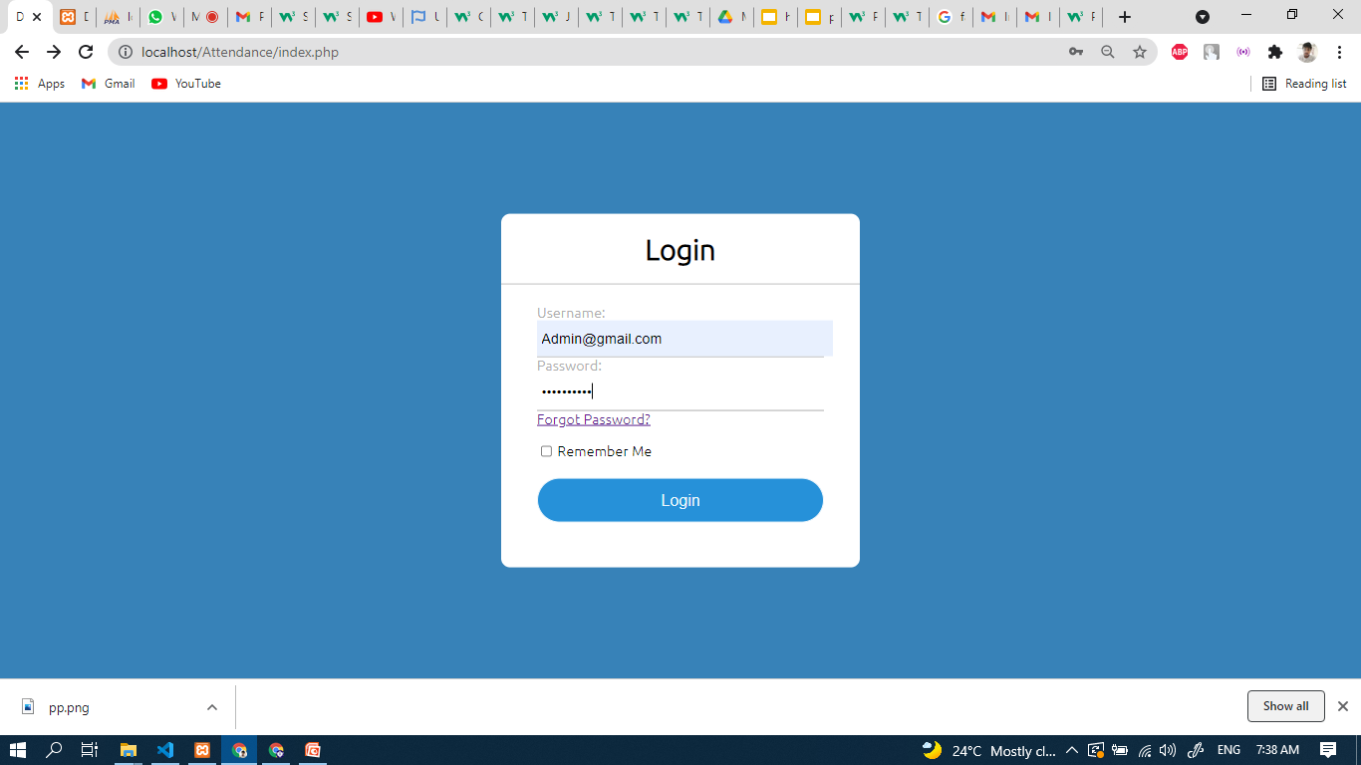

Slide 69
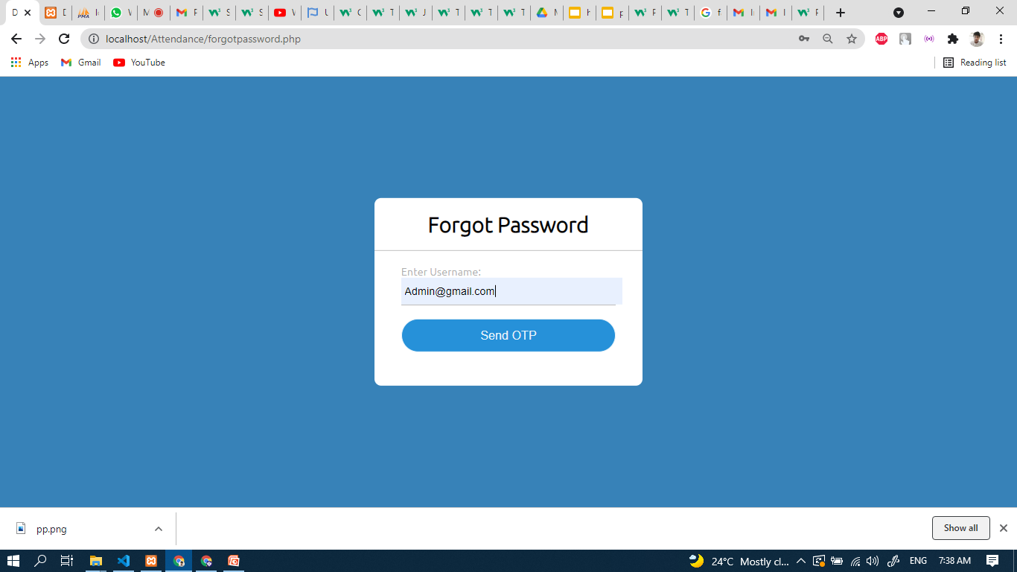

Slide 70
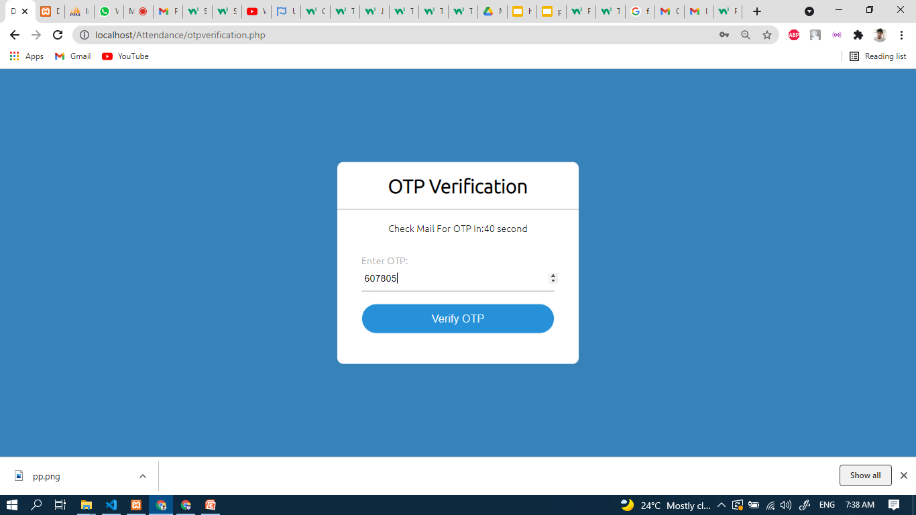

Slide 71
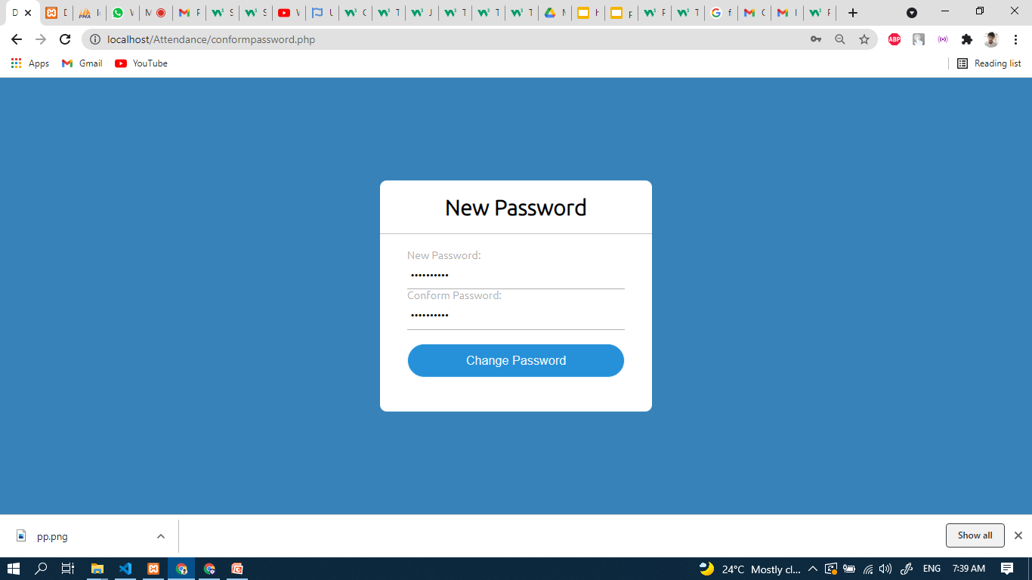

Slide 72
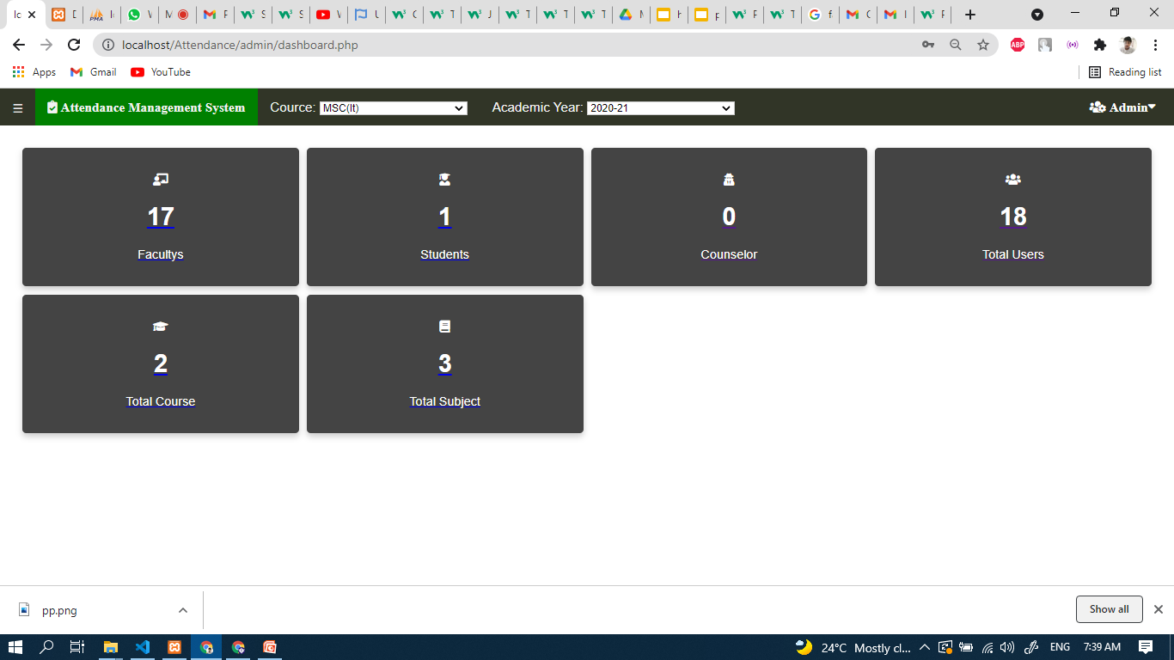

Slide 73
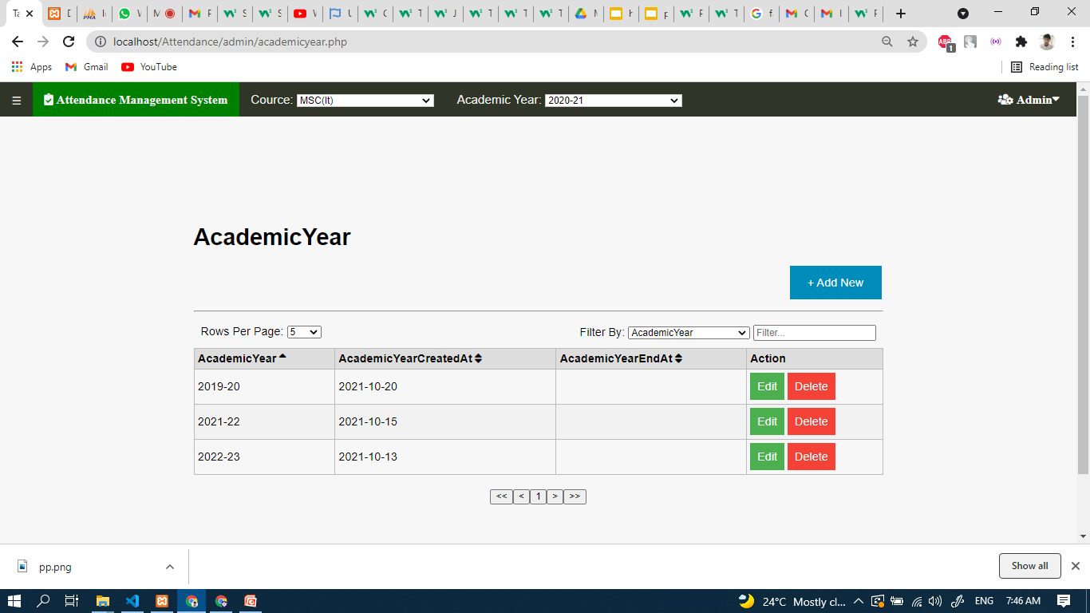

Slide 74
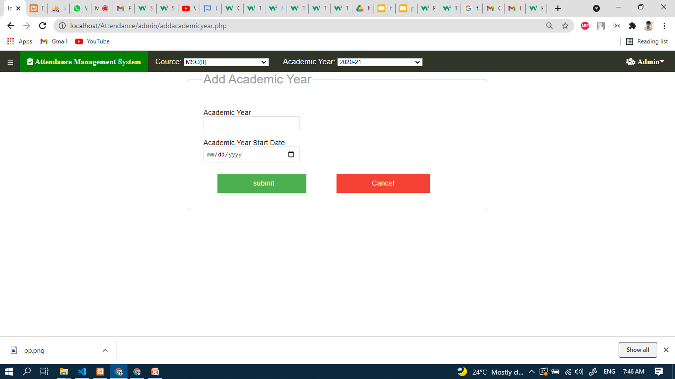

Slide 75


Slide 76
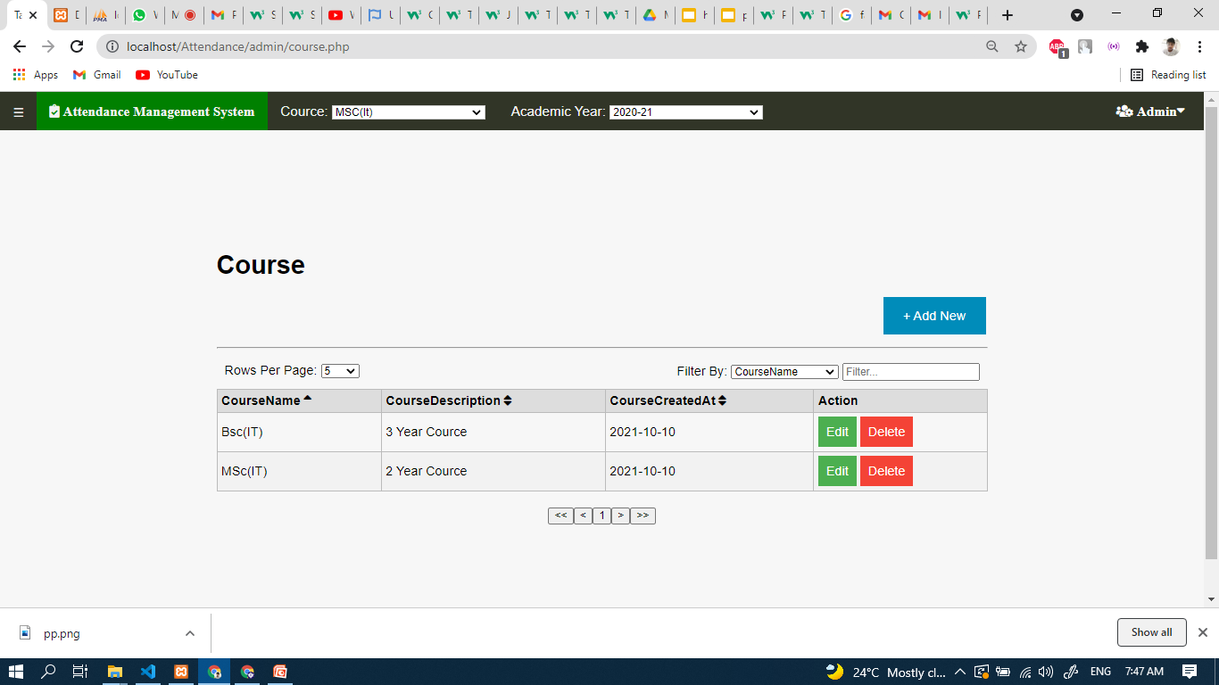

Slide 77
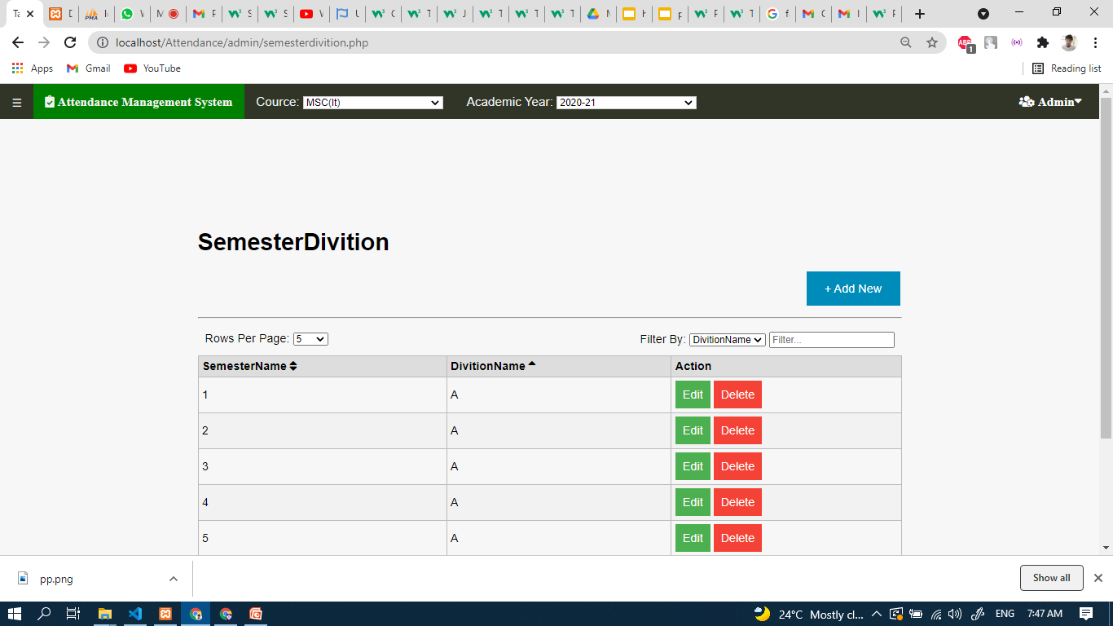

Slide 78
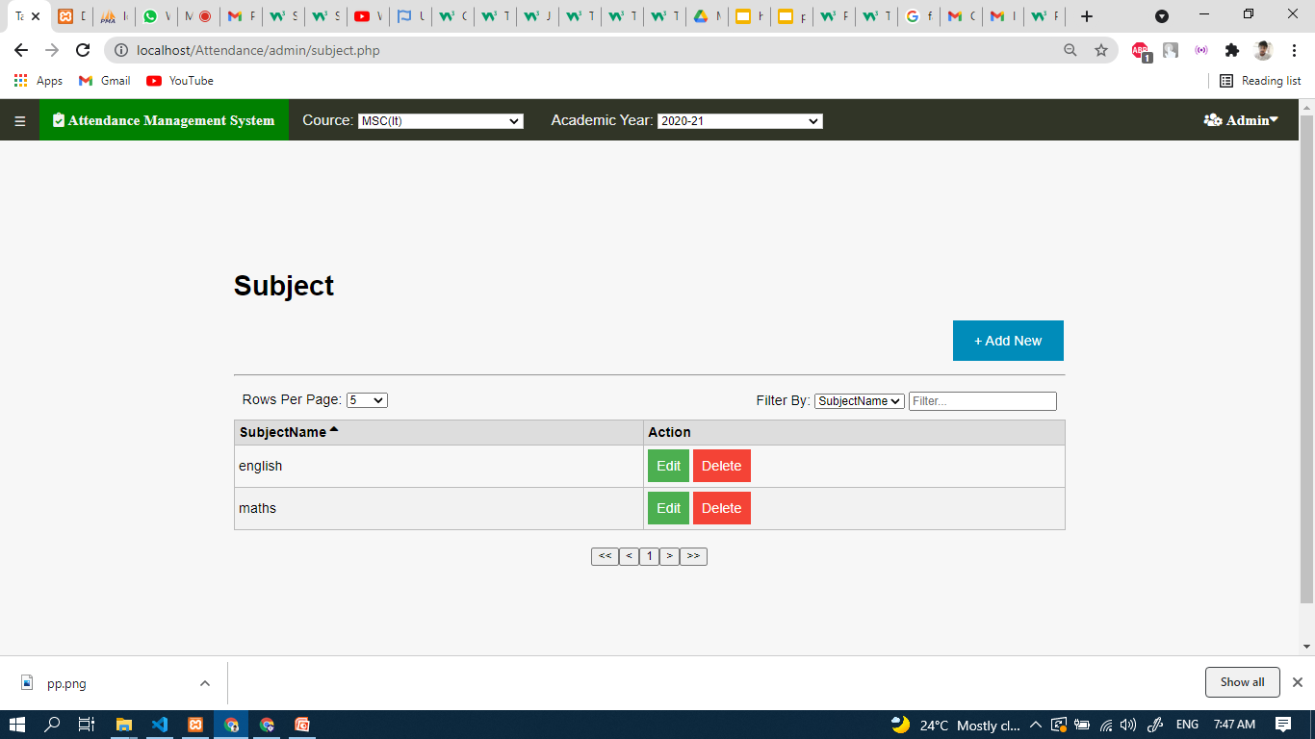

Slide 79
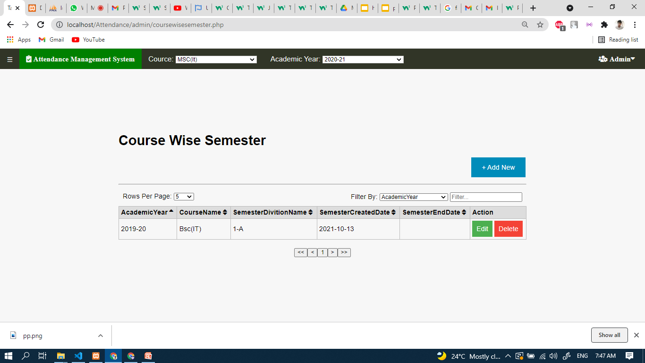

Slide 80
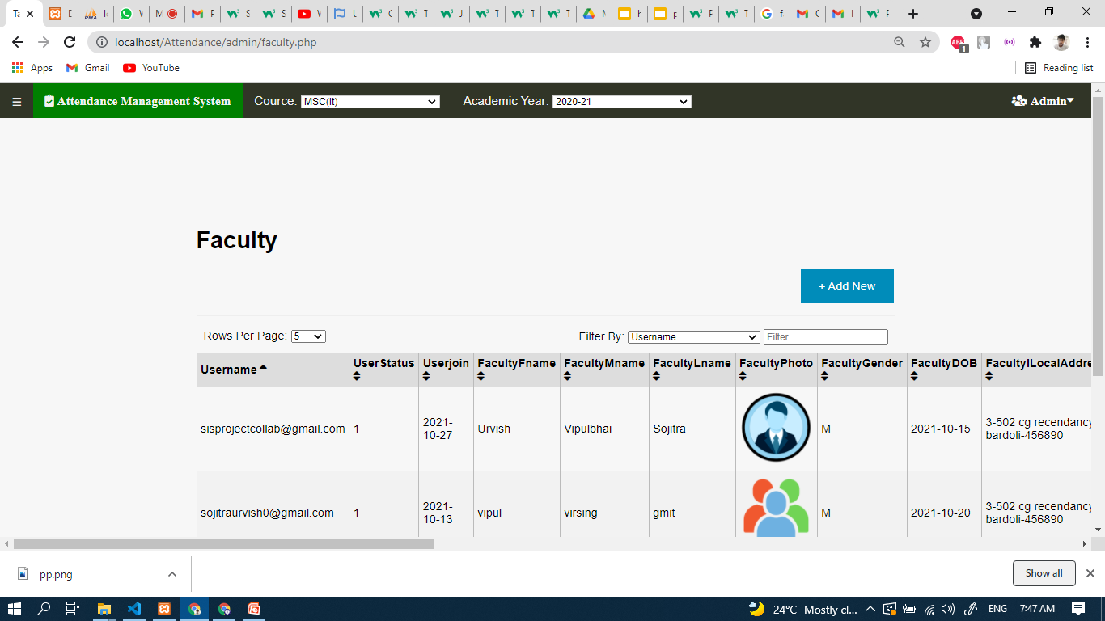

Slide 81
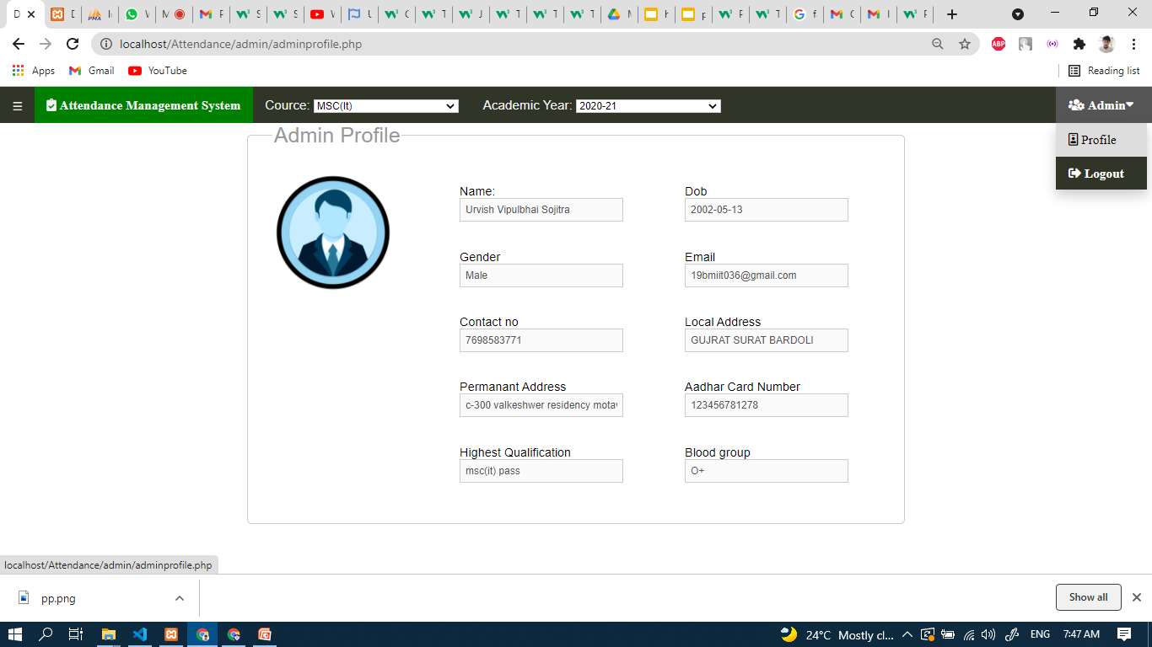

Slide 82
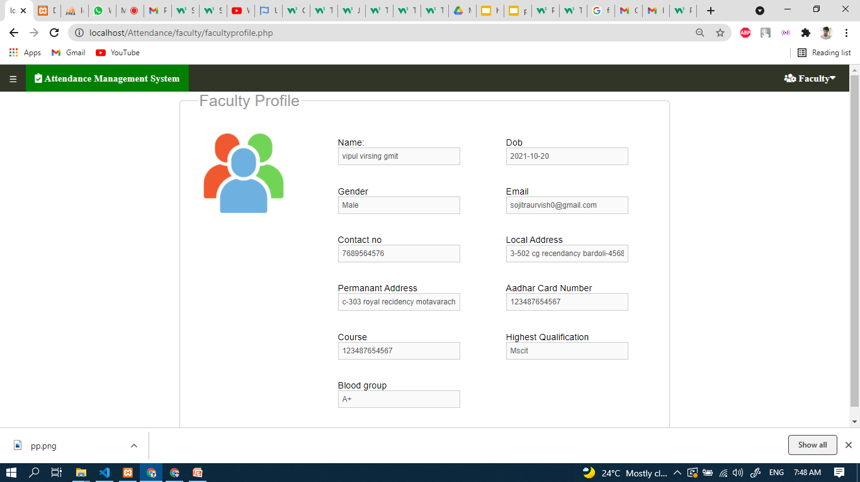

Slide 83
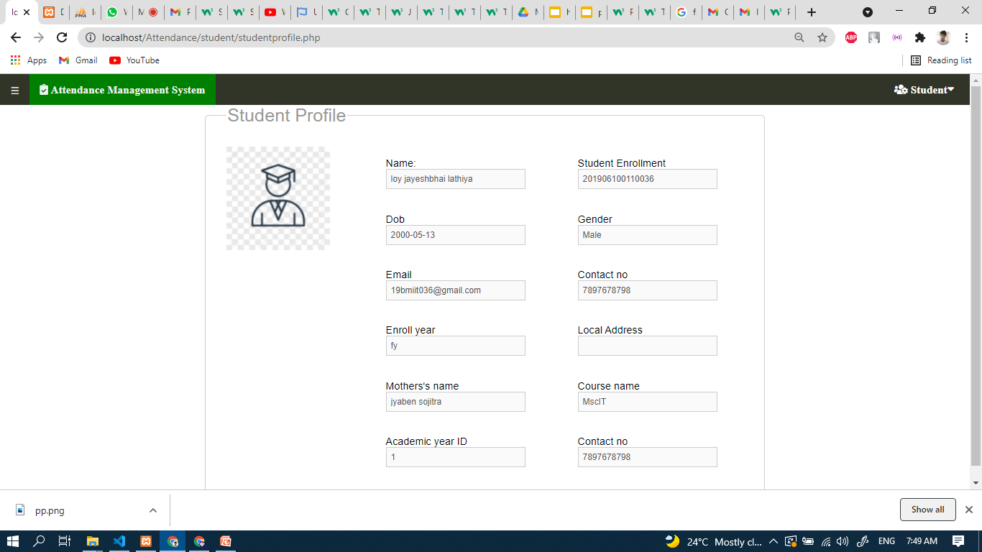

Slide 84
6.Future Enhancement
system shall be available for whole college with multiple departments.
System shall be available worldwide.
System shall have director role.
System shall be able to maintain elective subject attendance differently.

Slide 85
Conclusion
In conclusion,Attendance management system provides a user friendly and efficient manner to maintain attendance of many students.This not only eases the burden on humans but reduces human error in general.

Slide 86
Biblography
www.php.net
www.w3schools.com
www.stackoverflow.com
www.youtube.com

