Slide 1

Image Compression using
Discrete Cosine Transform (DCT)
Course:
MTCS6017 — Digital Signal Processing
Students:
Muhannad Naeem Ahmed AlDabdoub (ID: 2101006)
Khaled Khalil AlHadrami (ID: 2101008)
Basim Nasser AlMafraji (ID: 2101005)
College:
Military Technological College — Systems Engineering Dept.
Notes:
Good morning/afternoon. I am Muhannad, and we are a group of three students presenting our DSP project on image compression using the Discrete Cosine Transform.

Slide 2
Presentation Outline
01
Introduction
02
Project Aim
Why compression? DSP connection
Objectives & research questions
03
DCT Concept
04
Methodology
Transform theory & frequency zones
10-step workflow
05
Thresholding
06
Metrics
Core compression mechanism
PSNR & Compression Ratio
07
MATLAB
08
Results
Implementation details
PSNR & CR graphs + data table
09
Image Analysis
10
Conclusion & Recommendations
Per-image-type findings
Findings & future work
MTCS6017 — Digital Signal Processing | Military Technological College
2 / 25
Notes:
This is our presentation structure. We cover the full pipeline from motivation to conclusion.

Slide 3




Why Image Compression?
Large File Sizes
High Bandwidth Demand
A 4K image can exceed 25 MB. Storing millions of images without compression is impractical.
Streaming, medical imaging, and satellite data all require efficient data transmission.
Preserve Visual Quality
Real-World Applications
Compression must reduce file size while keeping image quality acceptable to the human eye.
JPEG, MPEG, DICOM — all rely on transform-based compression techniques like DCT.
MTCS6017 — Digital Signal Processing | Military Technological College
3 / 25
Notes:
Images are large. Compression is essential for storage and transmission. The goal is to reduce size while maintaining acceptable visual quality.

Slide 4
Project Aim & Objectives
AIM
To study how DCT thresholding affects image quality and compression ratio across different image types.
OBJECTIVES
EXPERIMENT VARIABLES
1
Apply DCT block-based compression in MATLAB
Input
4 image types
2
Test six threshold values: T = 5, 10, 20, 50, 80, 90
Variable
Threshold T
3
Compare four different image types
Output 1
PSNR (dB)
4
Evaluate PSNR and Compression Ratio for each case
5
Identify the best quality-compression trade-off
Output 2
Compression Ratio
MTCS6017 — Digital Signal Processing | Military Technological College
5 / 25
Notes:
Our aim is to study the effect of thresholding on image quality and compression. Five objectives guide the experiment.

Slide 5
DSP Connection
Images are 2D digital signals — each pixel is a discrete sample
SIGNAL PROCESSING PIPELINE
1
2D Image Signal
2
DSP techniques transform signals to reveal frequency information
▼
Apply DCT Block-by-Block
▼
3
DCT is a frequency-domain transform: a core DSP tool
Frequency Coefficients
▼
4
Compression removes redundant or imperceptible frequency components
Apply Thresholding
▼
IDCT — Reconstruct
5
This project applies DSP theory to a real-world engineering problem
MTCS6017 — Digital Signal Processing | Military Technological College
4 / 25
Notes:
Images are 2D digital signals processed using DSP techniques. DCT transforms these signals into frequency components, enabling compression by removing less important data.

Slide 6
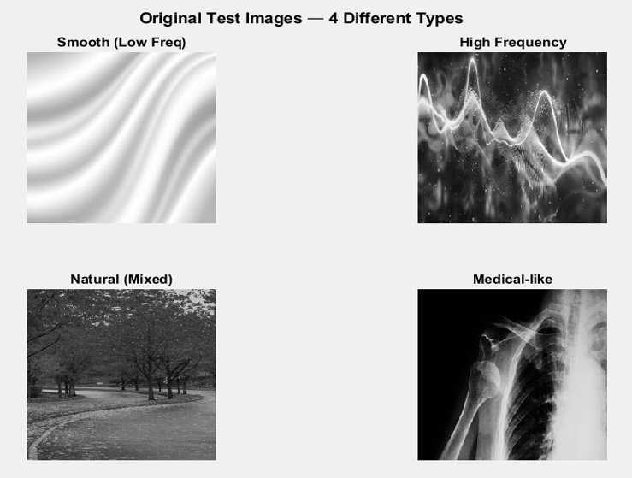
Test Images — Four Different Types (Figure 1)
MTCS6017 — Digital Signal Processing | Military Technological College
6 / 25
Notes:
Four 256×256 grayscale images: smooth/low-frequency, high-frequency edges, natural mixed scene, and medical-like X-ray image.

Slide 7
Test Images — Characteristics
Image 1
Smooth (Low Freq)
Image 2
High Frequency
›
Gradients and uniform regions
›
Sharp edges and rapid changes
›
Minimal edges
›
High-frequency DCT coefficients are important
›
Most energy in low-frequency DCT coefficients
›
Expected: harder to compress
›
Expected: best compression
›
Blurring visible at high threshold
Image 3
Natural (Mixed)
Image 4
Medical-like
›
Combination of smooth and detailed areas
›
Dark smooth background
›
Frequency spread across spectrum
›
Subtle internal structures
›
Expected: moderate compression
›
Compression must be careful
›
Block artefacts appear at high T
›
Quality must be prioritised over CR
MTCS6017 — Digital Signal Processing | Military Technological College
7 / 25
Notes:
Each image type has different frequency characteristics. This affects how well they can be compressed using DCT thresholding.

Slide 8
What is DCT?
Spatial → Frequency Domain
Low-Frequency Coefficients
DCT converts an 8×8 pixel block into 64 frequency coefficients, separating structure from detail.
Located in the top-left of the 8×8 block — store overall brightness, smooth areas, and main structure.
High-Frequency Coefficients
Compression via Thresholding
Located toward the bottom-right — encode sharp edges, fine textures, and noise.
Setting small-magnitude coefficients to zero reduces data with minimal perceptual quality loss.
MTCS6017 — Digital Signal Processing | Military Technological College
8 / 25
Notes:
DCT is the key transform. It separates image content by frequency, allowing us to identify and remove less important data.

Slide 9
Low Frequency vs High Frequency
Low Frequency
High Frequency
Top-left of DCT block — RETAIN
Bottom-right of DCT block — DISCARD
Smooth, uniform areas
Sharp edges and boundaries
Overall image brightness
Fine textures and patterns
Main image structure
Noise components
Essential for visual quality
Less perceptually important
Always retained during compression
Removed at high thresholds
MTCS6017 — Digital Signal Processing | Military Technological College
9 / 25
Notes:
DCT separates image data into low and high frequency zones. Low-frequency coefficients carry the essential image structure and must be preserved. High-frequency ones can be reduced or eliminated.

Slide 10
Research Questions
Q1
How does the threshold value affect image quality (PSNR)?
Q2
How does the threshold value affect the Compression Ratio?
Expected: PSNR decreases as T increases
Expected: CR increases as T increases
Q3
Which image type achieves the best compression performance?
Q4
Which threshold gives the best quality-compression trade-off?
Hypothesis: smooth/low-frequency image
Finding: T = 20 is optimal
MTCS6017 — Digital Signal Processing | Military Technological College
10 / 25
Notes:
These four questions guided the study. All are answered through the PSNR and CR data collected in MATLAB.

Slide 11
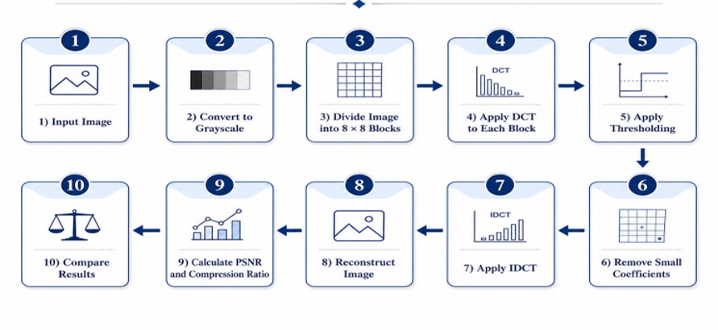
Methodology Workflow (Figure 2)
MTCS6017 — Digital Signal Processing | Military Technological College
11 / 25
Notes:
The 10-step workflow: load image, convert to grayscale, resize to 256×256, divide into 8×8 blocks, apply DCT, apply thresholding, remove small coefficients, apply IDCT, reconstruct image, calculate PSNR and CR.

Slide 12
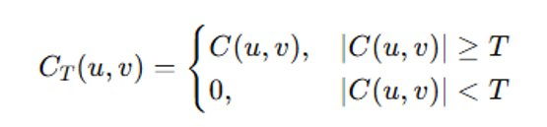
Thresholding Concept
HOW IT WORKS
FORMULA
Six threshold values tested
T = 5, 10, 20, 50, 80, 90
Coefficients below threshold set to zero
if |C(u,v)| < T → set to 0
Higher threshold = more removed
More zeros = higher compression
More removed = lower quality
PSNR decreases as T increases
Key trade-off in this study
CR ↑ vs PSNR ↓
MTCS6017 — Digital Signal Processing | Military Technological College
12 / 25
Notes:
Thresholding is the key step. All DCT coefficients with absolute value less than T are set to zero. As T increases, more coefficients are zeroed, increasing CR but reducing PSNR.

Slide 13
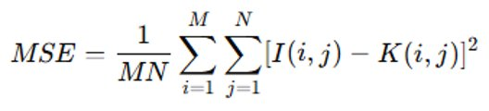
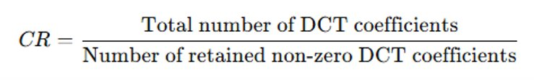

Evaluation Metrics
PSNR — Peak Signal-to-Noise Ratio
CR — Compression Ratio
› Higher CR = stronger compression
› CR = 1:1 → no compression applied
› Higher PSNR = better image quality
› CR = 63:1 → 98% of coefficients removed
› PSNR > 40 dB → Excellent quality
› Inverse relationship with PSNR
Higher CR ↑ ⟺ Lower PSNR ↓
› PSNR > 30 dB → Acceptable quality
› Measured in decibels (dB)
MTCS6017 — Digital Signal Processing | Military Technological College
13 / 25
Notes:
PSNR measures image quality and CR measures compression strength. They have an inverse relationship — as you compress more, quality drops.

Slide 14
MATLAB Implementation
compress_dct.m
KEY PARAMETERS
% === Parameters ===
Block Size
8 × 8 px
blockSize = 8;
thresholds = [5,10,20,50,80,90];
Thresholds
5, 10, 20, 50, 80, 90
% === DCT block-by-block ===
D = dctmtx(blockSize);
fun = @(b) D * b.data * D';
Images
4 types
dct_img = blockproc(img,[8 8],fun);
% === Apply Thresholding ===
Image Size
256 × 256 px
mask = abs(dct_img) > T;
comp = dct_img .* mask;
Colorspace
Grayscale
% === Calculate Metrics ===
psnr_val = psnr(recon, orig);
cr_val = numel(comp)/nnz(comp);
Outputs
PSNR + CR per run
MTCS6017 — Digital Signal Processing | Military Technological College
14 / 25
Notes:
MATLAB uses blockproc to apply DCT to every 8×8 block. The mask zeroes coefficients below the threshold. PSNR is built-in; CR is total over non-zero coefficients.

Slide 15
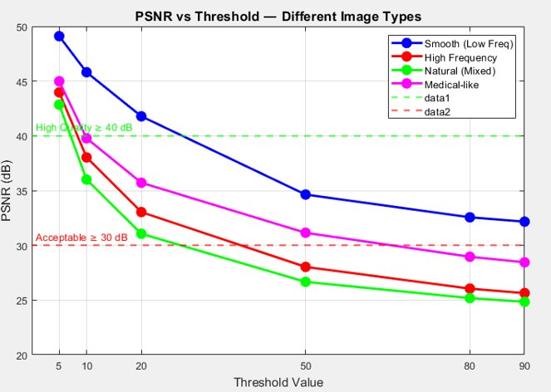
PSNR Results (Figure 3)
KEY FINDINGS
↓
PSNR decreases as T increases
★
Smooth image: highest PSNR at every threshold
●
Medical: moderate — 28.45 dB at T=90
▼
Natural: greatest quality loss overall
✓
T=20: all image types above 31 dB
MTCS6017 — Digital Signal Processing | Military Technological College
15 / 25
Notes:
PSNR decreases as T increases for all image types. The smooth image maintains the highest quality. At T=20, all images remain above 31 dB which is acceptable.

Slide 16
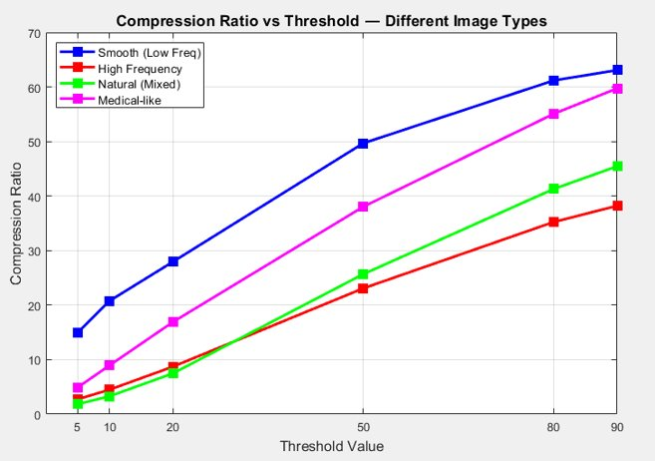
Compression Ratio Results (Figure 4)
KEY FINDINGS
↑
CR increases as T increases
★
Smooth: 63.08:1 at T=90 (best)
◆
Medical: 59.74:1 at T=90
!
High-freq: only 38.21:1 at T=90
↔
Inverse relationship with PSNR
MTCS6017 — Digital Signal Processing | Military Technological College
16 / 25
Notes:
CR curves rise as T increases. The smooth image compresses the most efficiently. High-frequency image reaches only 38.21:1 because its coefficients are harder to remove.

Slide 17
Selected Numerical Results
Image Type | T = 10 | T = 20 | T = 50 | T = 90
Smooth Low-Freq | 45.81 dB / 20.75:1 | 41.78 dB / 27.94:1 | 34.64 dB / 49.69:1 | 32.16 dB / 63.08:1
High-Frequency | 38.03 dB / 4.48:1 | 33.03 dB / 8.70:1 | 28.03 dB / 23.08:1 | 25.64 dB / 38.21:1
Natural Mixed | 36.01 dB / 3.28:1 | 31.06 dB / 7.47:1 | 26.66 dB / 25.68:1 | 24.84 dB / 45.45:1
Medical-like | 39.78 dB / 8.92:1 | 35.72 dB / 16.90:1 | 31.14 dB / 38.04:1 | 28.45 dB / 59.74:1
Format: PSNR (dB) / Compression Ratio · Higher PSNR = better quality · Higher CR = stronger compression
Optimal threshold: T = 20 → all images maintain PSNR ≥ 31 dB with meaningful Compression Ratios
MTCS6017 — Digital Signal Processing | Military Technological College
17 / 25
Notes:
This table clearly shows the trade-off. At T=20, all image types maintain PSNR above 31 dB with significantly improved compression ratios.

Slide 18
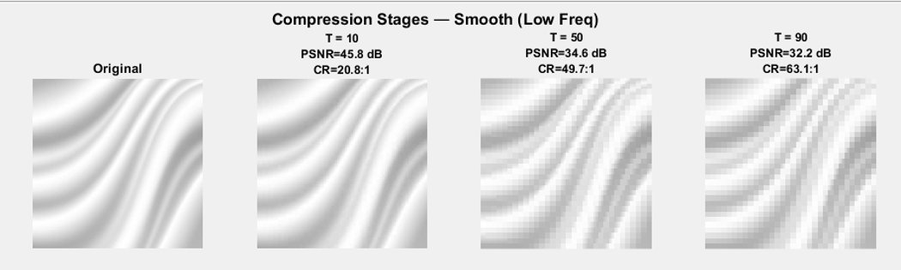
Smooth Image Analysis (Figure 5)
Best Compression
Low-Frequency Energy
Highest CR (63.08:1) and highest PSNR at every threshold.
Most DCT coefficients concentrated in the top-left block — easily retained.
Minimal Distortion
PSNR at T=90: 32.16 dB
Few edges mean removing high-freq coefficients causes little perceptual impact.
Still visually acceptable even at the highest threshold tested.
MTCS6017 — Digital Signal Processing | Military Technological College
18 / 25
Notes:
The smooth image compresses best because almost all its energy is in the low-frequency coefficients. Removing high-frequency coefficients causes minimal visual distortion.

Slide 19
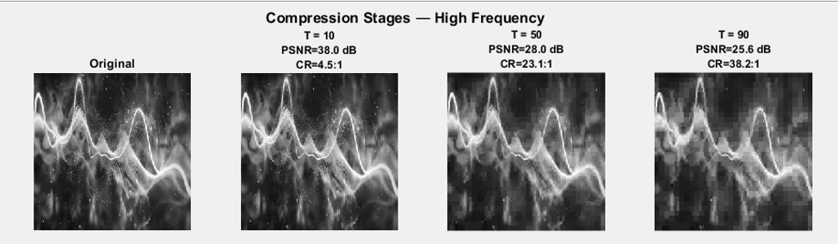
High-Frequency Image Analysis (Figure 6)
Rich Edge Content
High-Freq Coefficients Critical
Rapid intensity changes and sharp edges span the entire image.
Important structural information stored in high-frequency DCT coefficients.
Blurring at T=50+
Weakest CR: 38.21:1
Visible blurring as edge information is discarded at high thresholds.
Fewer removable coefficients compared to smooth image — harder to compress.
MTCS6017 — Digital Signal Processing | Military Technological College
19 / 25
Notes:
The high-frequency image compresses less efficiently. Its important information is in high-frequency coefficients, so removing them causes significant blurring.

Slide 20
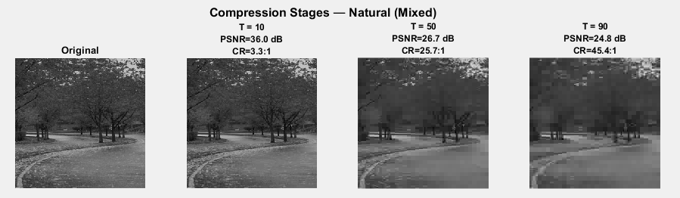
Natural & Medical Image Analysis
Natural (Mixed) Image
Mixed Frequency Content
Block Artefacts at T=50+
Contains both smooth regions and detailed textured areas.
8×8 block boundaries become visible as a grid pattern.
Spread Across Spectrum
Lowest PSNR: 24.84 dB
Important data exists at both low and high frequencies.
Worst quality loss of all image types at T=90.
MTCS6017 — Digital Signal Processing | Military Technological College
20 / 25
Notes:
The natural image compresses poorly due to mixed frequency content. The medical image compresses reasonably but requires careful threshold selection to preserve diagnostic structures.

Slide 21
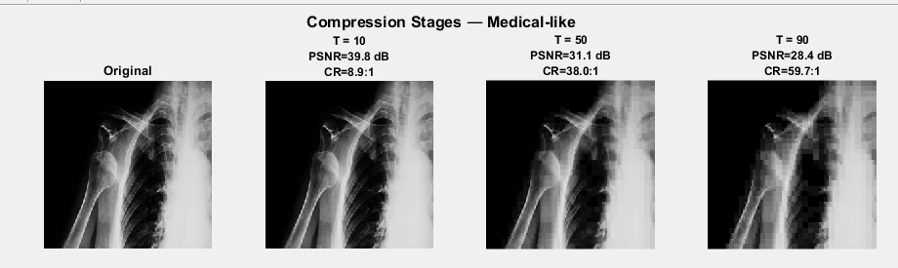
Natural & Medical Image Analysis
Medical-like Image
Quality at T=20: 35.72 dB
Dark Smooth Background
Acceptable quality-compression balance for medical use.
Allows efficient compression — CR reaches 59.74:1 at T=90.
Recommendation: T ≤ 20
Critical Structures at Risk
Prioritise quality over compression in medical imaging.
Diagnostic details (organ edges, lesions) may be lost at T≥50.
⚠ Medical images: always prioritise quality over compression ratio
MTCS6017 — Digital Signal Processing | Military Technological College
20 / 25
Notes:
The natural image compresses poorly due to mixed frequency content. The medical image compresses reasonably but requires careful threshold selection to preserve diagnostic structures.

Slide 22
Summary — Image Type Comparison at T = 20
Smooth (Low-Freq)
PSNR
CR
Best overall — high PSNR, high CR
41.78 dB
27.94:1
Medical-like
PSNR
CR
Good quality — use T≤20 for clinical use
35.72 dB
16.90:1
High-Frequency
PSNR
CR
Moderate — blurring risk at high T
33.03 dB
8.70:1
Natural (Mixed)
PSNR
CR
Hardest to compress — block artefacts at T>20
31.06 dB
7.47:1
MTCS6017 — Digital Signal Processing | Military Technological College
24 / 25
Notes:
This summary shows all four image types at T=20 — the recommended threshold. The smooth image achieves the best combined result.

Slide 23
Conclusion
01
Compression Confirmed
02
Clear Trade-off
DCT thresholding successfully compressed all four image types with varying performance.
Higher threshold increases Compression Ratio but reduces PSNR — quality is sacrificed for size.
03
Smooth Image Best
04
T = 20 is Optimal
The smooth/low-frequency image achieved the highest PSNR and largest CR across all thresholds.
Threshold T=20 provides the best balance: all images maintain PSNR ≥ 31 dB with strong compression.
MTCS6017 — Digital Signal Processing | Military Technological College
21 / 25
Notes:
In conclusion, DCT thresholding is effective for image compression. The smooth image performs best. T=20 is the recommended threshold for the best quality-compression balance.

Slide 24
Recommendations
Full JPEG Pipeline
Implement quantisation matrices, zig-zag scanning, run-length encoding, and Huffman coding.
R1
Colour Space Testing
Extend from grayscale to RGB and YCbCr colour space images for broader applicability.
R2
Additional Quality Metric
Add SSIM (Structural Similarity Index) alongside PSNR for perceptual quality assessment.
R3
Adaptive Thresholding
Investigate image-specific or block-specific adaptive thresholds for improved performance.
R4
MTCS6017 — Digital Signal Processing | Military Technological College
22 / 25
Notes:
Future work includes implementing a full JPEG pipeline, testing colour images, adding SSIM, and exploring adaptive thresholding.

Slide 25
References
[1] K. R. Rao and P. Yip, Discrete Cosine Transform: Algorithms, Advantages, Applications. Academic Press, 1990.
[2] G. K. Wallace, "The JPEG still picture compression standard," IEEE Trans. Consumer Electronics, vol. 38, no. 1, 1992.
[3] R. C. Gonzalez and R. E. Woods, Digital Image Processing, 4th ed. Pearson, 2018.
[4] A. N. Netravali and B. G. Haskell, Digital Pictures: Representation, Compression and Standards. Plenum Press, 1995.
[5] MATLAB Documentation — blockproc, dctmtx, psnr functions. MathWorks, 2024.
MTCS6017 — Digital Signal Processing | Military Technological College
23 / 25
Notes:
These references support the theoretical background and methodology of this project.

Slide 26
Thank You
We are ready for your questions.
Muhannad Naeem Ahmed AlDabdoub
Khaled Khalil AlHadrami
Basim Nasser AlMafraji
ID: 2101006
ID: 2101008
ID: 2101005
MTCS6017 — Digital Signal Processing
Military Technological College | Systems Engineering Department
Key Takeaway: DCT threshold T = 20 gives the best quality-compression trade-off.
Notes:
Thank the panel. Remind them: DCT threshold T=20 is the optimal balance. All team members are ready to answer questions.

