Slide 1
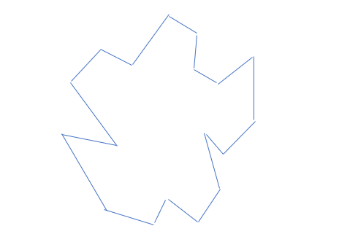
Polygon P with 18 vertices

Slide 2
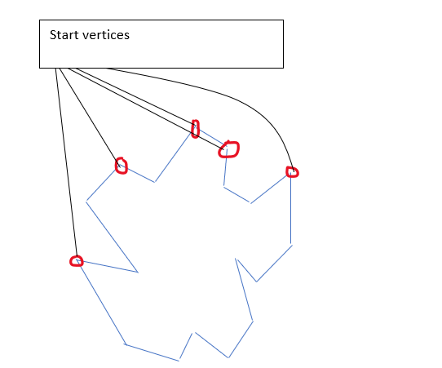
Defining what kind of every vertex

Slide 3
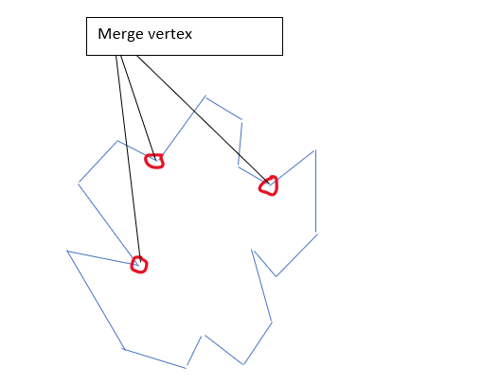

Slide 4
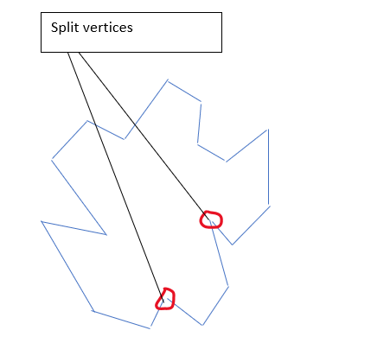

Slide 5
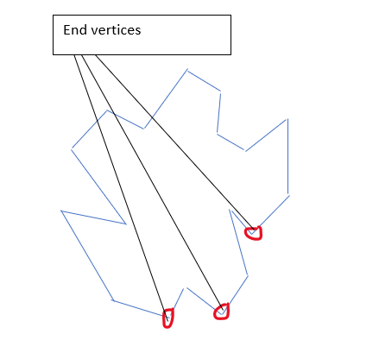

Slide 6
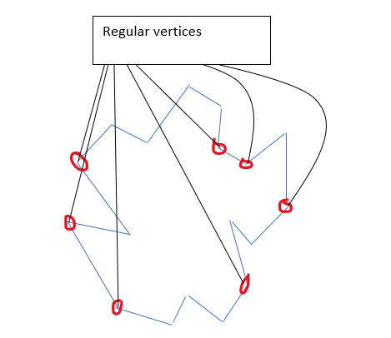

Slide 7
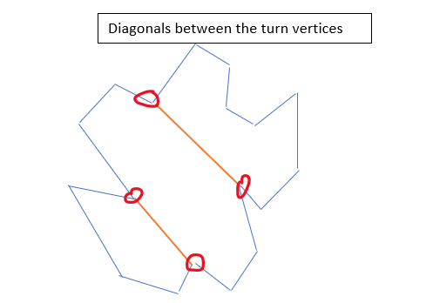
Add diagonals between turn vertices

Slide 8
The MakeMonotone (P) algorithm
Algorithm MakeMonotone(P)
Input :let there be a doubly connected edged list L which stores the polygon P
Output :newly updated list L will store the partitioning of polygon P into y-monotonic polygons
First storing the vertices for polygon P in the priority queue
Initializing the status T
While the priority queue is not empty
Value=remove(priority queue first value entered)
Next is determining what kind of every vertex v in polygon P will be
Applying the handle algorithm

Slide 9
Handle algorithm
Algorithm handle (vertex v,kind of every vertex v,status T)
Input: enter a newly doubly connected edge list L which stores the polygon P,every vertex v,the status T of every vertex and the type of every vertex
Output: get newly list L
If type of vertex is start vertex then algorithm handlestart(L,every vertex,Status)
If type of vertex is split vertex then algorithm handlesplit(L,every vertex,Status)
If type of vertex is regular vertex then algorithm handleregular(L,every vertex,Status)
If type of vertex is merge vertex then algorithm handlemerge(L,every vertex,Status)
If type of vertex is end vertex then algorithm handleend(L,every vertex,Status)

Slide 10
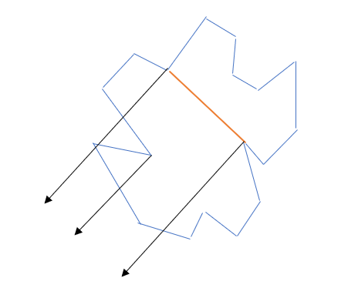
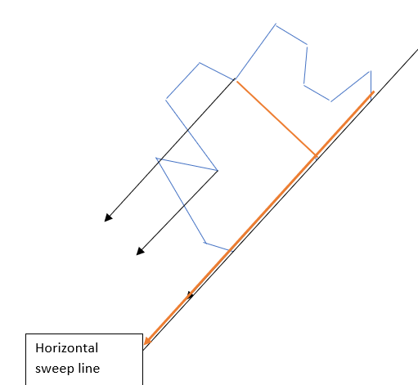
Polygon P triagulation
Diagonals for split vertices
First we compute each vertex v left edge with respect to the horizontal sweep line
We then connect the split vertex v with any near vertex above
Lastly for every edge we save the bottom vertex such that with every left vertex equals each edge

Slide 11
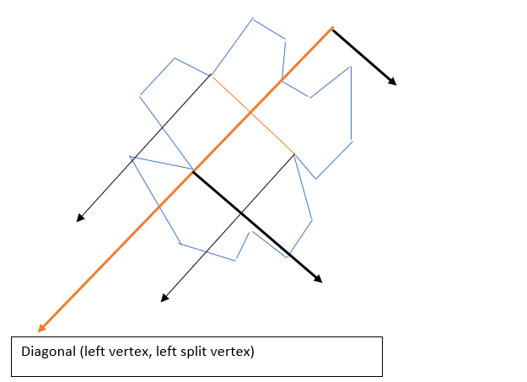
Diagonals for merge vertices
First when the vertex v is reached ,we reset all the left vertices equal to vertex v
After reaching the split vertex in such a way that the left split vertex equals left vertex ,now we introduce the diagonal

Slide 12
In the cases when we get to the regular vertex in a way that the left split vertex is equal to the left vertex then the diagonal is introduced
Lastly if left split vertex is reached ,then we introduce the left vertex,left split vertex diagonal

