Slide 1




Git and github
Maziar Sojoudian
https://maziar.email
http://github.com/sojoudian

Slide 2


What is git?

Slide 3
What is git?
Git is a SCM - Source Control Management System
Management of changes to documents, programs, and other information stored as computer files.
Its first usage have been for Linux and for Git itself.
It is open source and free

Slide 4

More about git
Written by Linus Torvalds
What does the word “git” mean?
Based on git manual page, which is accessible through “man git” command:
git - the stupid content tracker

Slide 5

Git: A Fast Version Control System
Git
Is distributed
Has fast merges
Is controversial
Scales up
Convenient tools still being built
Safeguards against corruption

Slide 6
Source Control Management terminology
Source Control Management (SCM)
Version
Repository
Branch
Merge

Slide 7

Source Control Management (SCM)
A system that tracks changes to source code or other sets of files and directories over time. It allows multiple people to work on a project without stepping on each other's toes. It provides mechanisms to merge changes, track history, and even revert to previous states. Examples of VCS tools are Git, Mercurial, Subversion, and CVS.

Slide 8

Version
A specific state or snapshot of a set of files or directories in a project as recorded by the SCM. Each version captures who made changes, what those changes were, and a timestamp. This allows developers to navigate the history of a project, revert changes, or compare different versions.

Slide 9

Repository
The database or storage where the full history of changes for a project is kept. It contains all versions, branches, tags, and metadata about the project's history. In distributed VCSs like Git, each developer has a complete copy of the repository on their local machine.

Slide 10
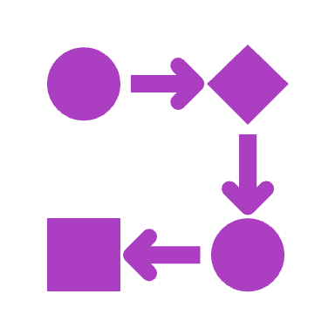
Branch
A parallel line of development. Instead of having a single linear progression of history, SCMs support the creation of branches which allow for diverging from the main line (often called "main" or "master"). This is useful for feature development, bug fixes, or experiments, so they can be worked on in isolation before integrating them back into the main line.

Slide 11
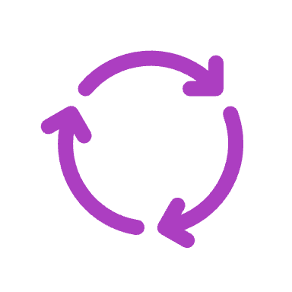
Merge
The process of integrating changes from one branch into another. Merging combines the changes of multiple branches, resolving any conflicts (e.g., two people editing the same line of a file) so that the branches become consistent. After a successful merge, the project should have a unified set of changes from both branches.

Slide 12
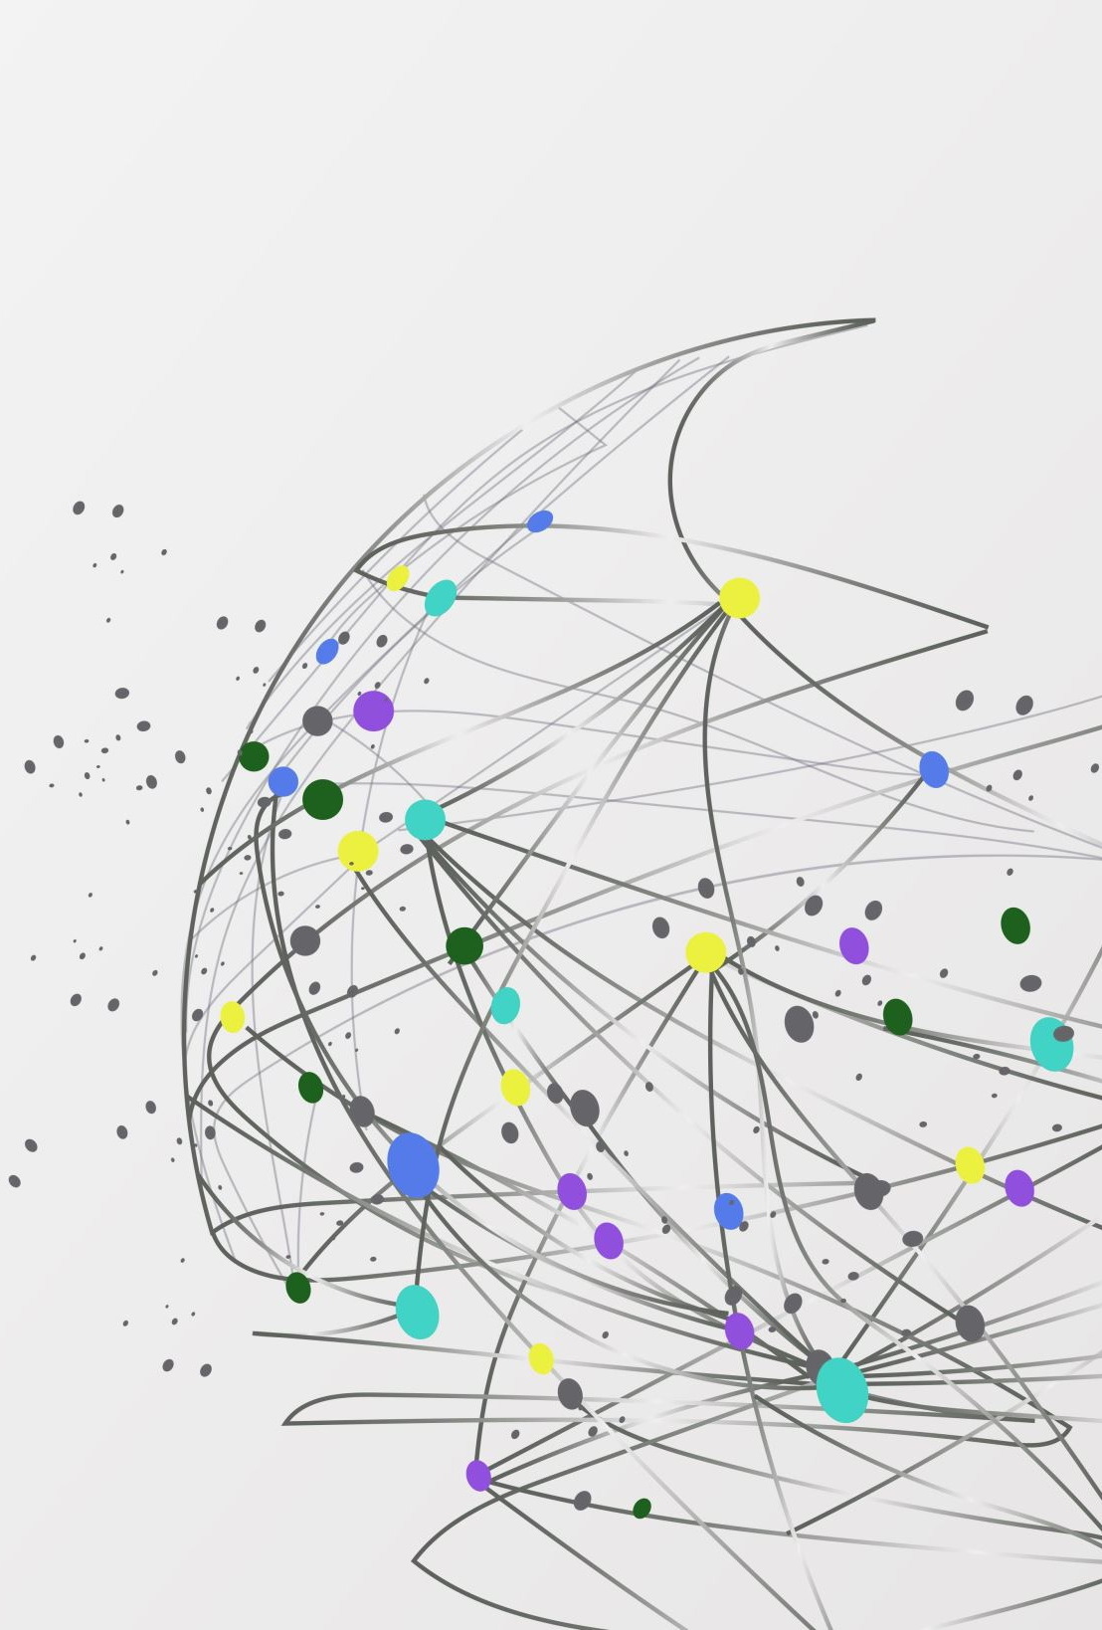
Start with git

Slide 13
Start with Git
To start with Git, we need a few tools.
First, download the appropriate binary for your operating system.
https://git-scm.com/download/

Slide 14
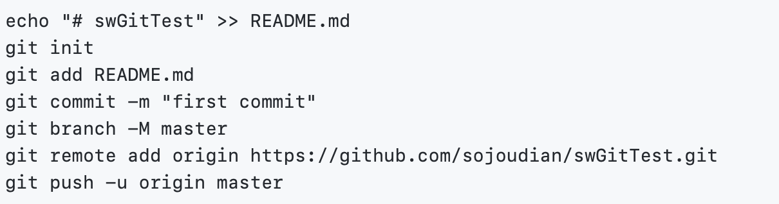
Create a repository
After Installing Git, create a GitHub account and create a repository on the GitHub platform.
Then, create a folder for your project and, using the Visual Studio Code command line, start your journey with git.

Slide 15
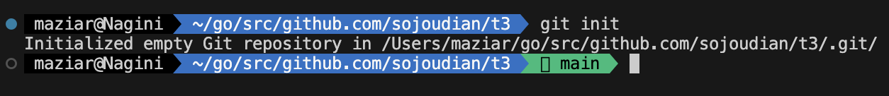
Initialize the repository
“git init” is a command used in the Git version control system to initialize a new repository.

Slide 16

Git init
When you run the “git init” command, Git initializes a new repository and begins tracking an existing directory. It adds a hidden subfolder within the existing directory that houses the internal data structure required for version control.

Slide 17
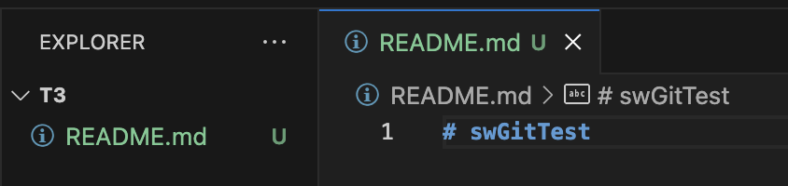
Add a new file to the repository
You can add a new file using the GUI or you can just use the CLI
GUI:
CLI:

Slide 18

Git init breakdown
A new .git subdirectory is created. This subdirectory contains all the necessary metadata and objects for the new repository. This is the heart of the repository where all the tracking information resides.
A new master branch (or main depending on the configuration and version of Git) is created.
It doesn't stage or commit any files in the directory, just prepares the environment for commits to be made later.

Slide 19

Git add
“git add” is a command used in the Git version control system to stage changes for a commit. Before a change (or set of changes) in a file or multiple files can be committed to the Git repository, it must be staged. The staging area is an intermediate area where changes are collected before being permanently stored in the repository's history.

Slide 20
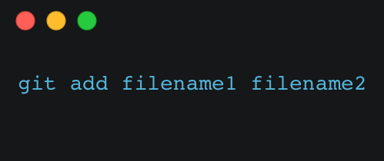
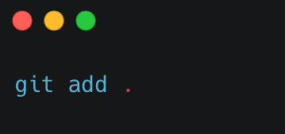
how git add works
Staging Individual Files: If you've made changes to specific files and want to stage them, you can specify each file individually:
Staging All Changes: If you want to stage all changes in the repository, you can use:
This will stage all changes in the current directory and its subdirectories.
It's useful when you've made a lot of changes and want to include them
all in the next commit.

Slide 21
how git add works
After you've staged your changes using git add, you use the git commit command to save the staged changes along with a commit message describing what was done.
It's worth noting that git add doesn't affect the repository in any permanent way; changes are not saved until you run git commit. The staging area simply allows you to group and review your changes before committing them to the repository's history.
In our example the command would be:

Slide 22
Git commit
“git commit” is a command used in the Git version control system to save your staged changes to the repository's history. When you run “git commit”, Git takes the changes that have been staged (with the “git add” command) and stores them in a new "commit" object. This commit object contains a snapshot of the changes, a unique identifier (SHA-1 hash), a reference to the parent commit, a timestamp, and other metadata.

Slide 23
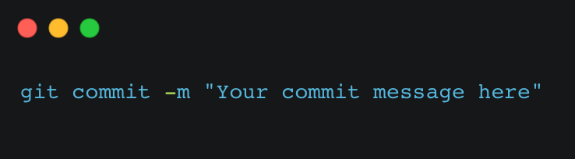
Git commit breakdown
Basic Commit: Once you've staged your changes using git add, you can commit them using:
The “–m” flag allows you to include an inline commit message. The commit message should be a short, descriptive message explaining the changes in this commit.
Interactive Mode: If you run git commit without the -m flag, Git opens an editor (like Vim, Nano, or whatever is set as your default editor) where you can write a more detailed commit message. The editor typically displays the changes being committed (in a comment) to help you write your message.

Slide 24
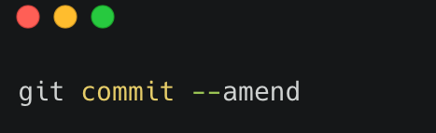
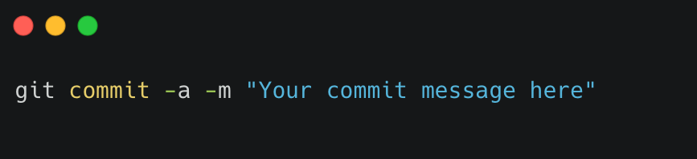
Git commit breakdown
Amend Previous Commit: If you've made an error in your last commit or forgot to include something, you can amend the previous commit using:
This command lets you modify the most recent commit. Be cautious when using this on commits that have been pushed to shared repositories, as it rewrites commit history.
Commit All Changes: Instead of staging changes with git add first, if you want to commit all tracked, modified files in one step, you can use:

Slide 25
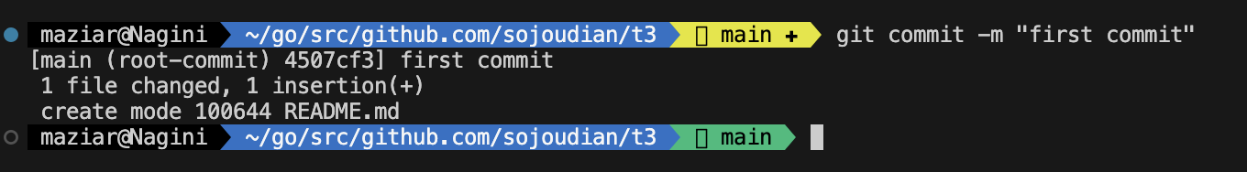
Git commit breakdown
Remember, commits in Git form a chain, with each commit pointing to its parent(s), creating a directed acyclic graph of history. This structure allows Git to trace changes over time and facilitates features like branching and merging.
Finally, a well-crafted commit message is important for maintaining the repository's clarity. It helps other developers (and your future self) understand the purpose and context of each change.
In our example the command would be:

Slide 26
git branch
“git branch” is a command in Git used to manage branches in a repository. Branches represent separate lines of development. Think of them as different paths where you can make changes without affecting the main or other lines of work.
git branch: Lists all branches in your repository. The current branch (where you're working) is highlighted or marked with an asterisk.
git branch new-branch-name: Creates a new branch named "new-branch-name".
git branch -d branch-name: Deletes the branch named "branch-name".
git branch -m old-name new-name: Renames branch "old-name" to "new-name".

Slide 27
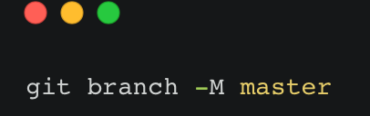
git branch
Branches are essential for trying out new features, fixing bugs, or experimenting without disturbing the stable main code. Once you're satisfied with the work on a branch, you can merge it back into the main line or any other branch.
In our example it would be:

Slide 28
Git remote
git remote add is a command in Git used to link a local repository to a remote repository. This connection allows you to push your local changes to the remote and fetch changes from the remote to your local machine.

Slide 29

Git remote breakdown
git remote add is a command in Git used to link a local repository to a remote repository. This connection allows you to push your local changes to the remote and fetch changes from the remote to your local machine.
Parameters:
[name]: A short, friendly name you assign to the remote URL for easier reference. Commonly, the primary remote repository is named origin.
[URL]: The URL of the remote Git repository. This could be a link to a repository on services like GitHub, GitLab, Bitbucket, or any other Git server.

Slide 30
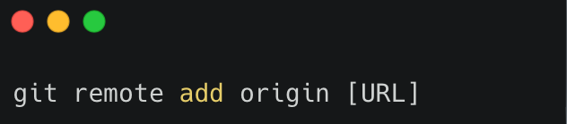
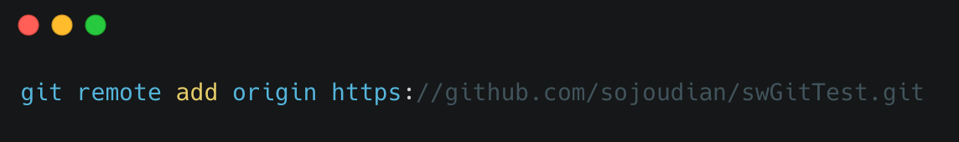
Git remote breakdown
Usage:
If you have a new local repository and you want to link it to an empty repository on GitHub, you would:
Create the empty repository on GitHub.
Get the repository URL (usually ending in .git).
In your local repository's terminal or command line, run:
Replace [URL] with the actual repository URL.
In our example it would be:

Slide 31
Git remote breakdown
After running “git remote add”, you can push your local commits to the remote using “git push” or fetch updates from the remote with “git pull” or “git fetch”. The remote repository essentially serves as a central hub where collaborators can share and synchronize code changes.

Slide 32

Git push
git push is a command in Git used to upload local repository content to a remote repository. It takes the commits you've made in your local repository and transfers them to a remote repository, ensuring that the remote contains the same commit

Slide 33
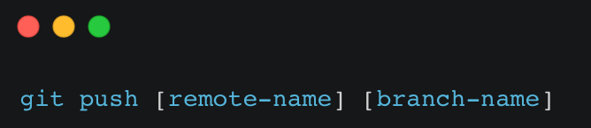
Git push breakdown
Command Format:
Parameters:
[remote-name]: The name of the remote repository to which you want to push your changes. If you've followed conventional naming, this is often origin.
[branch-name]: The name of the branch you want to push.
Common Usage:
If you're working on the main (or master, depending on naming conventions) branch and you want to push your changes to the origin remote, you would run:

Slide 34
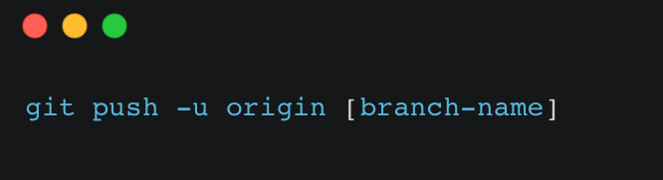
Git push breakdown
Additional Points:
If you're pushing a branch to the remote for the first time, or if you're setting an upstream branch, you might use:
The “-u” flag sets the upstream for the branch, which means that in the future, you can just use “git push” or “git pull” without specifying the remote or branch, and Git will know you're referring to that remote and branch.
If there are changes in the remote repository that you don't have in your local branch, you might be prompted to pull those changes first before you can push. This ensures that histories are synchronized and merged as necessary.
You need to have the necessary permissions to push to a remote repository. On platforms like GitHub, GitLab, and Bitbucket, you might encounter permission issues if you're trying to push to a repo where you don't have write access

Slide 35
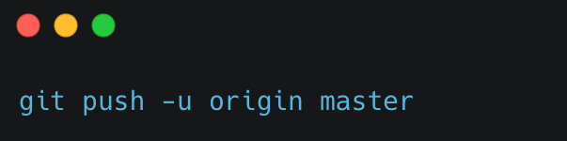
Git push
In our example the git push command would be like:

