Slide 1

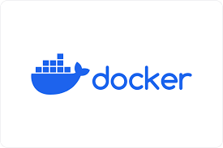
Docker
Maziar Sojoudian

Slide 2
What is docker?
Docker is a software platform that allows you to build, test, and deploy applications quickly, packaging software into standardized units called containers.

Slide 3
What is docker?
Docker is a set of platform as a service products that use OS-level virtualization to deliver software in packages called containers.

Slide 4
What is docker?
Docker is an open platform for developing, shipping, and running applications. Docker enables you to separate your applications from your infrastructure so you can deliver software quickly. With Docker, you can manage your infrastructure in the same ways you manage your applications. By taking advantage of Docker's methodologies for shipping, testing, and deploying code, you can significantly reduce the delay between writing code and running it in production.

Slide 5

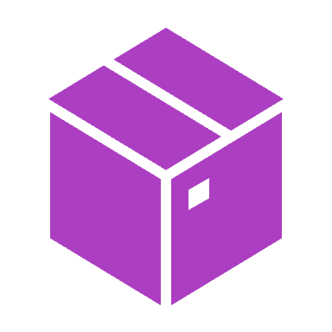
Containers

Slide 6

What is a container?
A container is a standard unit of software that packages up code and all its dependencies, so the application runs quickly and reliably from one computing.

Slide 7
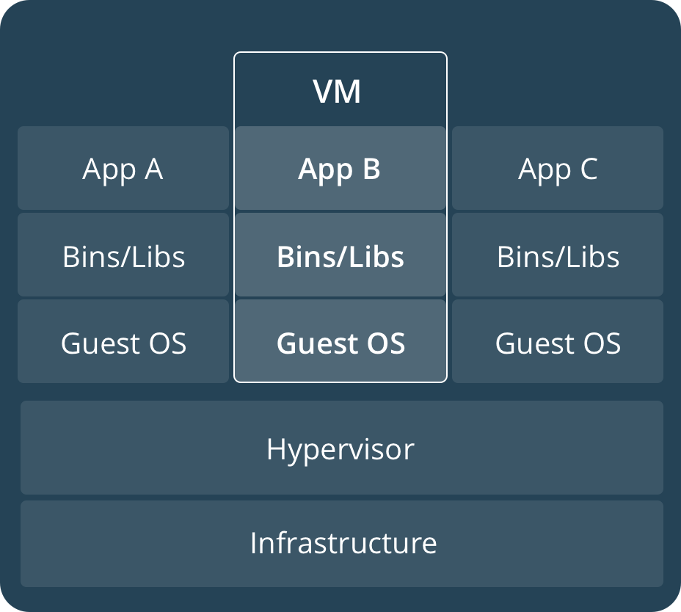
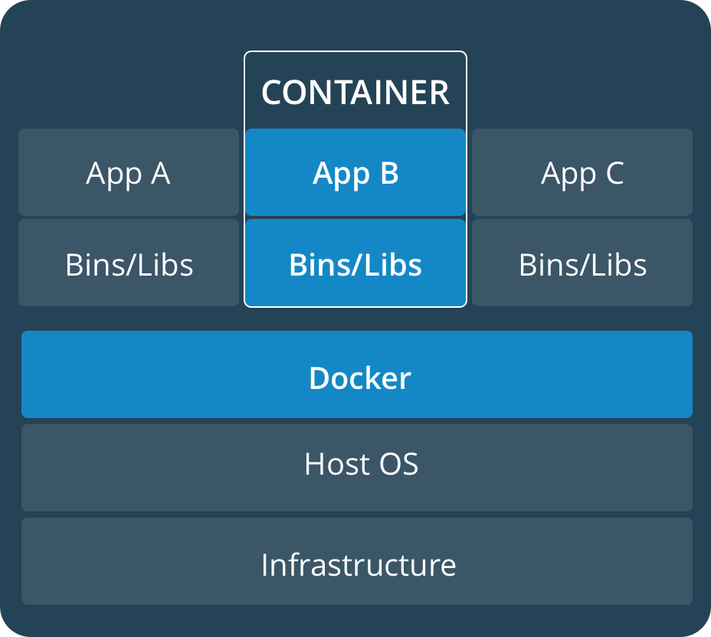
What is a container?
Container ≠ VM
Isolated
Share OS
and sometimes bins/libs

Slide 8
What is a container?
Container ≠ VM
Isolated
Share OS
and sometimes bins/libs

Slide 9

What is a container?
In software engineering, containerization is operating system-level virtualization or application-level virtualization over multiple network resources so that software applications can run in isolated user spaces called containers in any cloud or non-cloud environment, regardless of type or vendor.

Slide 10


Docker image

Slide 11

Docker image
A Docker image is a file used to execute code in a Docker container. Docker images act as a set of instructions to build a Docker container, like a template. Docker images also act as the starting point when using Docker. An image is comparable to a snapshot in virtual machine (VM) environments.

Slide 12

Docker Hub

Slide 13
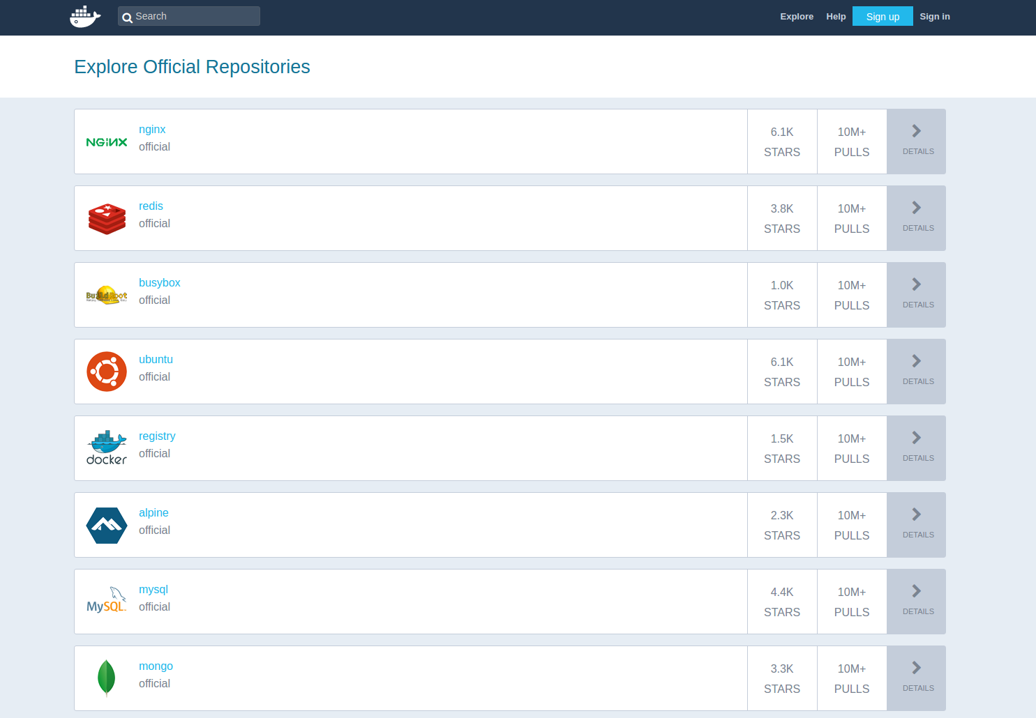
Docker hub
Docker Hub is the world's largest. library and community for container images.

Slide 14

Docker hub
Docker Hub is a cloud-based registry service provided by Docker that allows developers to create, store, and distribute container images. It plays a central role in the Docker ecosystem by offering both public and private storage for container images. Here's a deeper dive into its features and functionalities:
Repository Hosting: Docker Hub allows users to host repositories of Docker images. These repositories can be either public (accessible to anyone) or private (restricted access).

Slide 15
Docker hub
Public Images: Docker Hub contains a vast collection of public images provided both by Docker and the community. These include base images for various operating systems (e.g., Ubuntu, Alpine), databases (e.g., MySQL, MongoDB), applications, and more.
Integration with Docker CLI: Docker Hub is seamlessly integrated with the Docker command-line tool. Using the Docker CLI, users can easily pull images from Docker Hub to their local machine, or push images from their machine to their Docker Hub repositories.

Slide 16
Docker hub
Automated Builds: Docker Hub can automatically build images from source code and Dockerfiles stored in repositories on GitHub or Bitbucket. This ensures that the Docker image is always up-to-date with the source code changes.
Webhooks: After an automated build, Docker Hub can trigger webhooks to notify other systems or services about the updated image, facilitating continuous integration and continuous deployment (CI/CD) pipelines.
Teams & Organizations: Docker Hub allows users to organize their work under teams and organizations. This helps in providing appropriate permissions and access controls to different members for various repositories.

Slide 17
Docker hub
Official Images: Docker Hub hosts "official images" for a range of popular software. These official images are vetted by Docker, Inc. for best practices and security. They serve as a trustworthy and standardized base for building other images and containers.
Security Scanning: Docker Hub provides automated security scanning for private repositories, allowing users to detect known security vulnerabilities in their images.
Rate Limiting: As of my last update in 2022, Docker Hub implements rate limiting for container image pulls based on the type of user (anonymous, free, and paid).
Pricing: While Docker Hub offers free tiers, there are also paid plans available that provide additional private repositories, parallel builds, and other premium features.

Slide 18
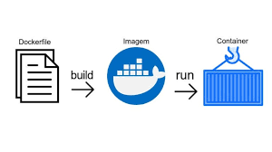
dockerfile

Slide 19
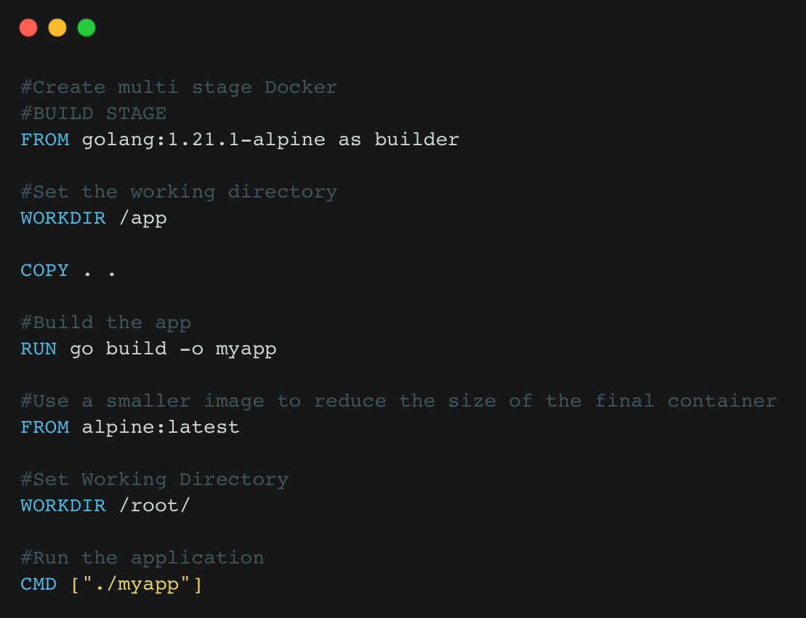
Dockerfile for go

Slide 20

Docker commands

Slide 21
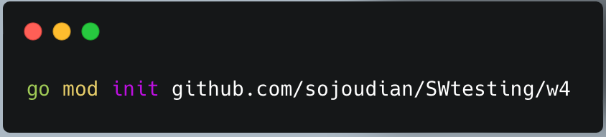
Docker commands
We need to initiate the Go project first.

Slide 22
Docker commands
Second, we have to create the Dockerfile

Slide 23
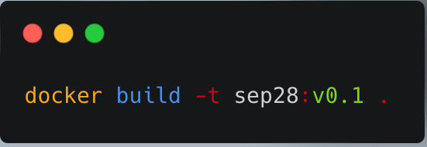
Docker commands
Now, we can Build our Docker container

Slide 24
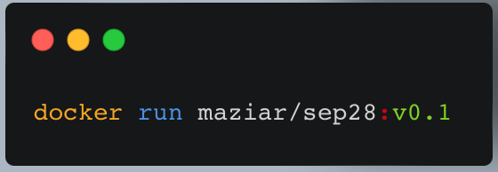
Docker commands
Now, we can run our Docker container

Slide 25
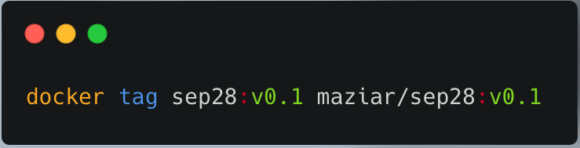
Docker commands
Before pushing our image to the Docker Hub, we need to tag it

Slide 26
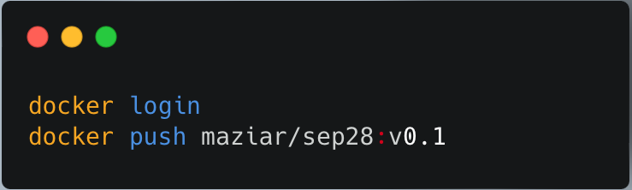
Docker commands
Now we need to login to the Docker hub and push our image.

Slide 27
Docker commands
If you want to use the same image, on another computer you just need to run the following command:

Slide 28

Docker port

Slide 29
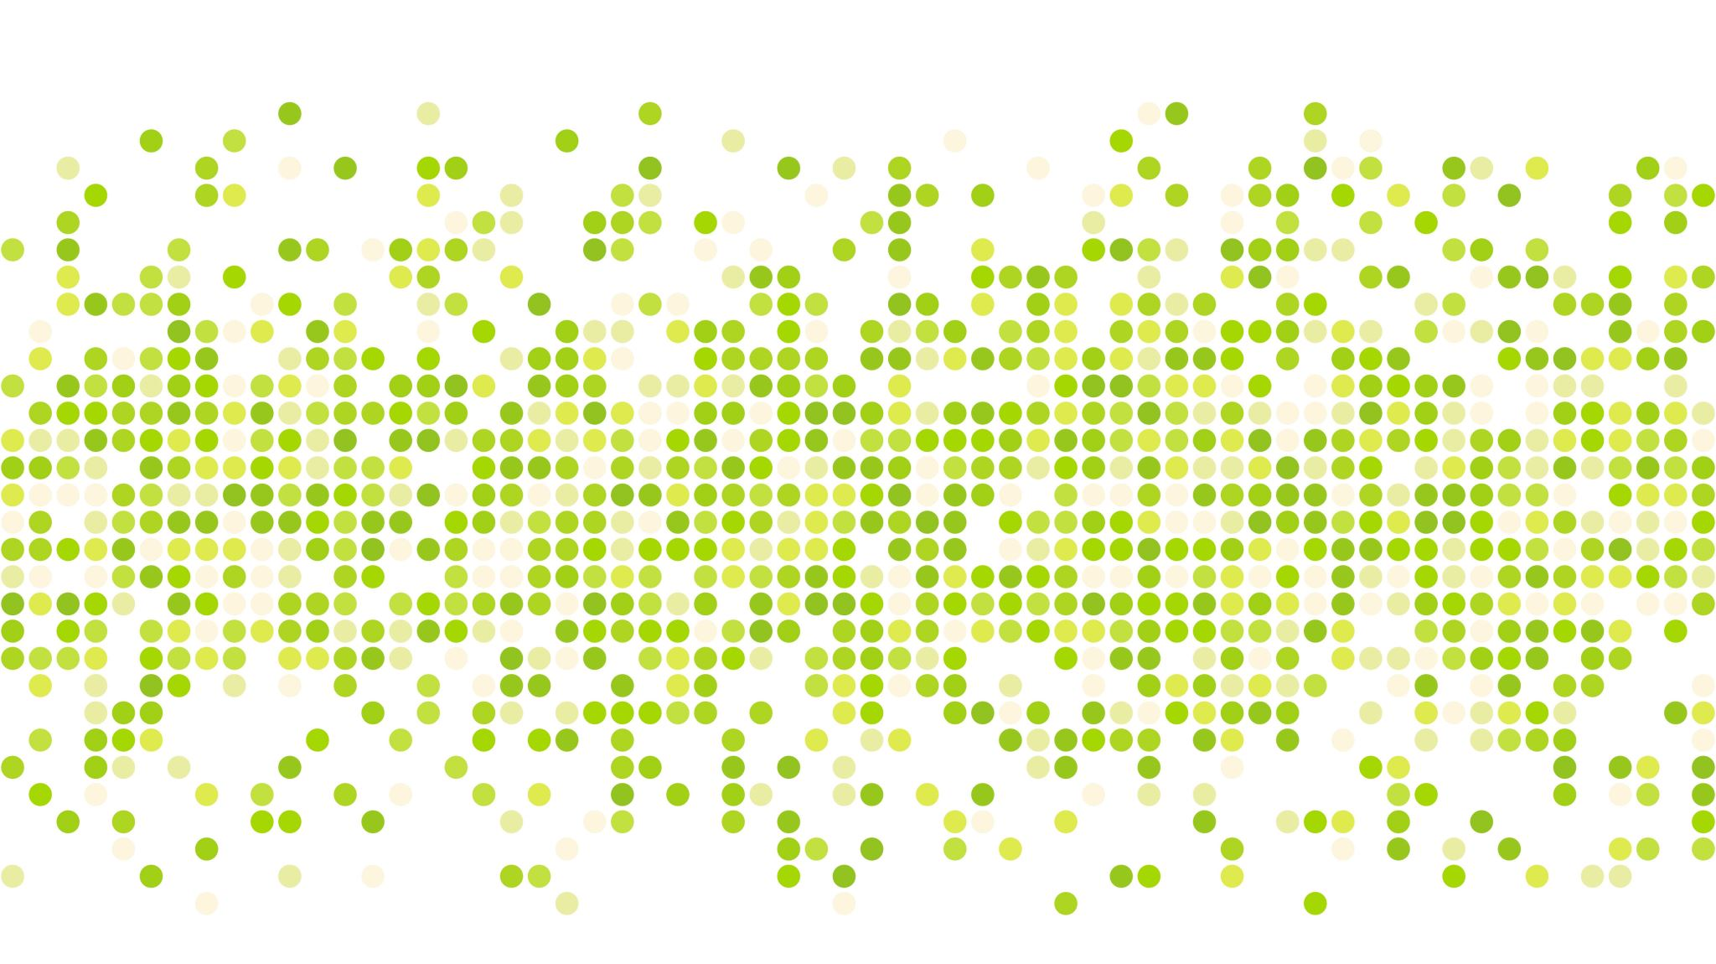
DOCKERFILE

Slide 30


Slide 31
What is a Container?

Slide 32
What is a Container?

