Slide 1
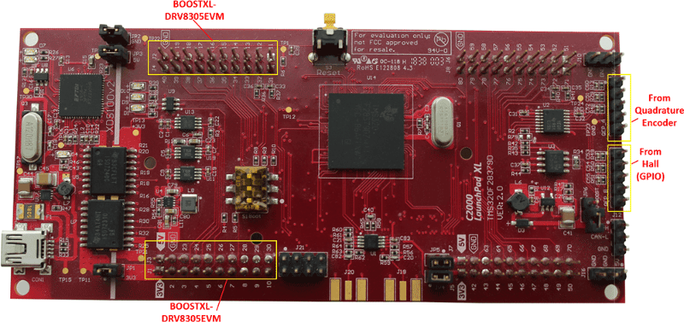
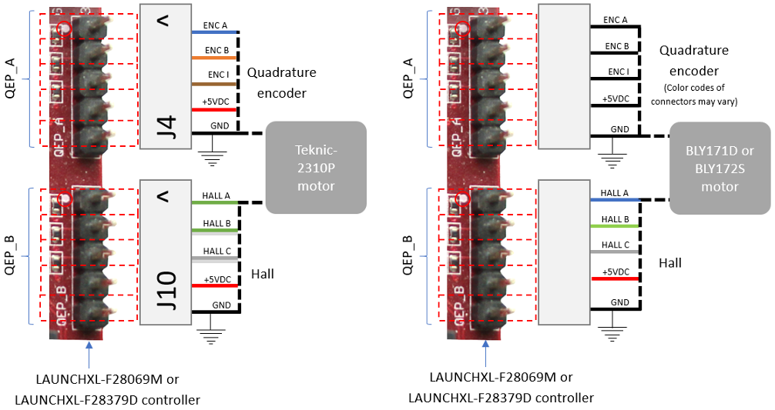
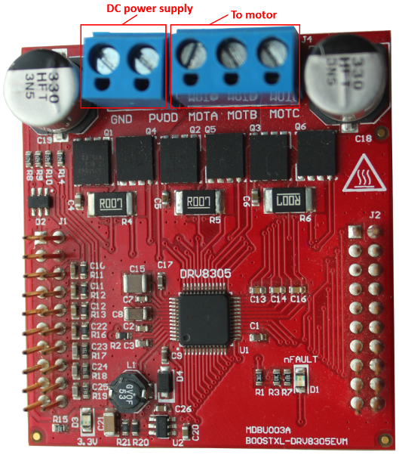
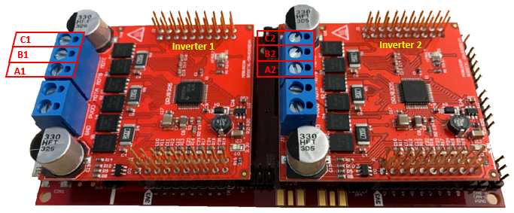
https://de.mathworks.com/help/mcb/gs/hardware-connections.html

Slide 2
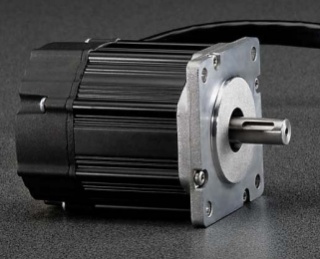
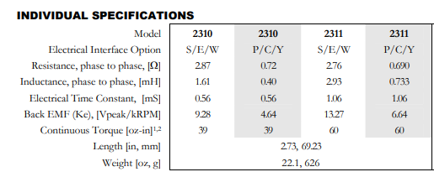
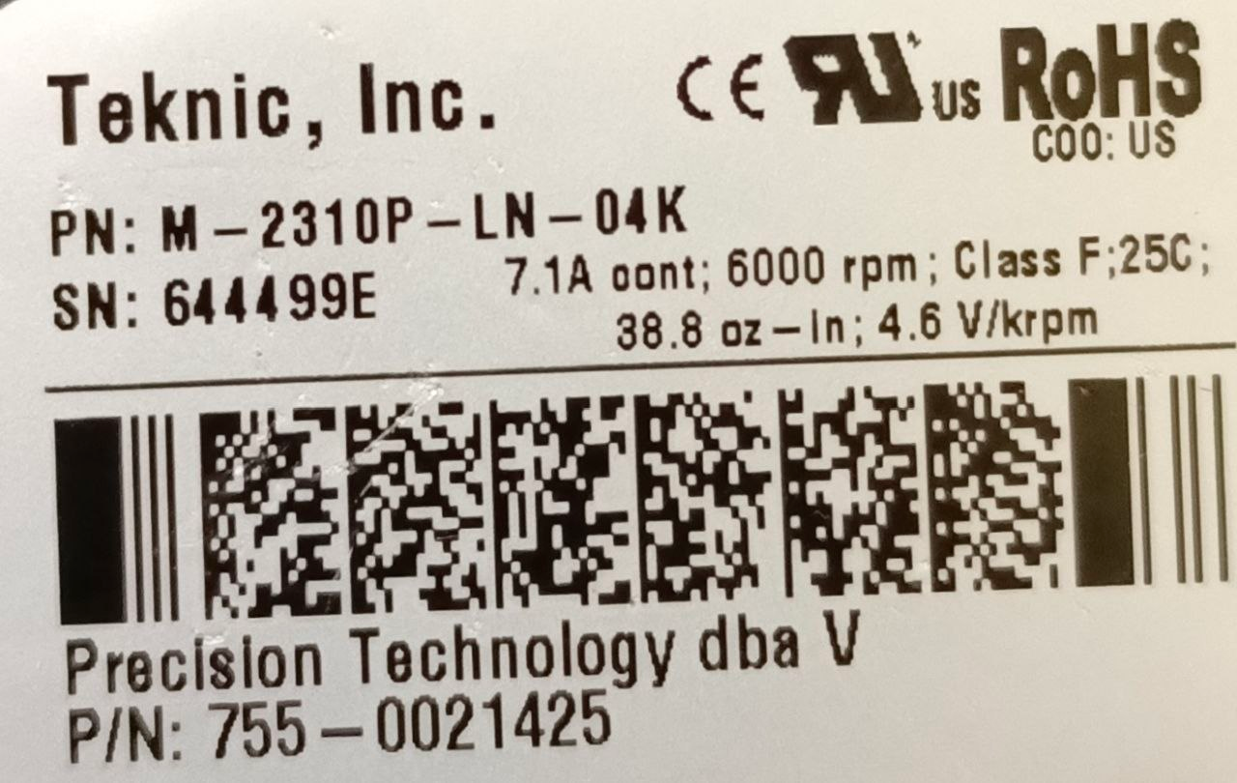
Encoder
4,000 counts/revolution
Motor Poles: 8
Speed : 6000rpm
https://www.teknic.com/files/product_info/N23_Industrial_Grade_Motors_v6.3.pdf

Slide 3
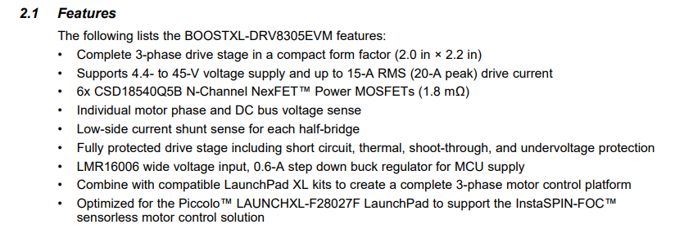
https://www.ti.com/lit/ug/slvuai8a/slvuai8a.pdf?ts=1780539436782

