Slide 1
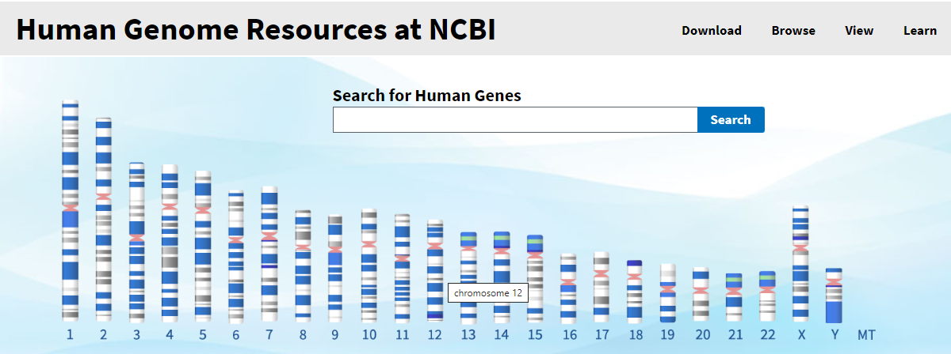

Slide 2
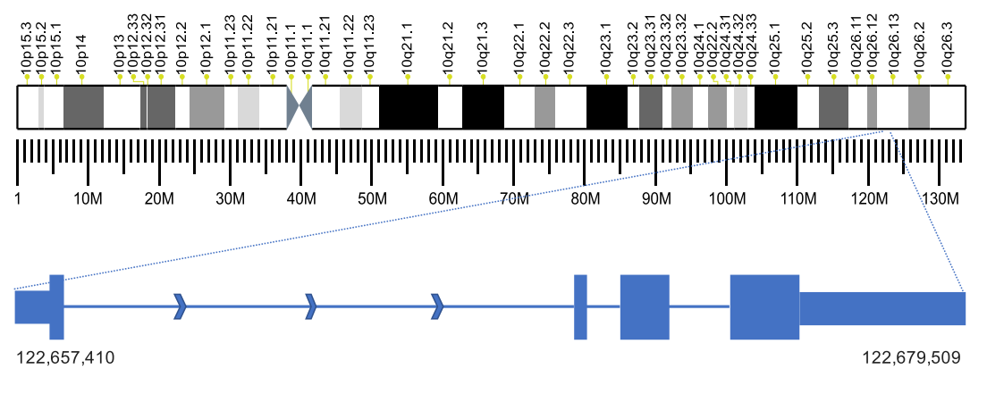
Chromosome sequence scale
130M bp
220K bp
50 bp
----TCAAGGGCACTTAAGGCTGAAAACAAATGGGGAAGCATTCACTGATTT----

Slide 3
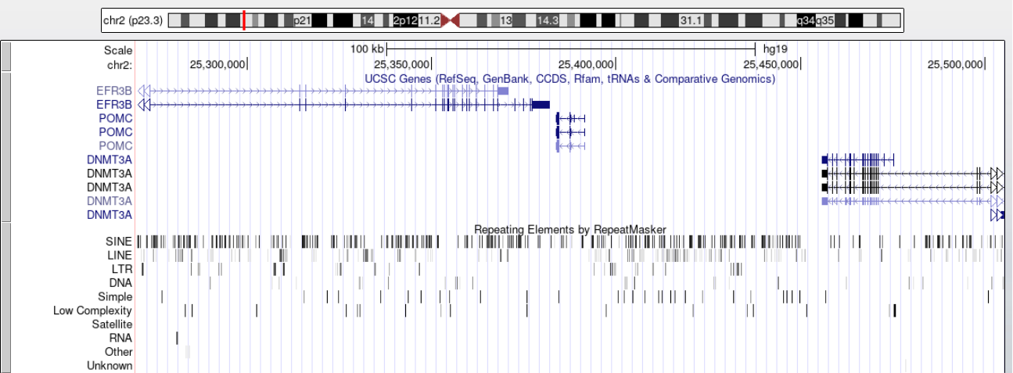
Elements distribution

Slide 4
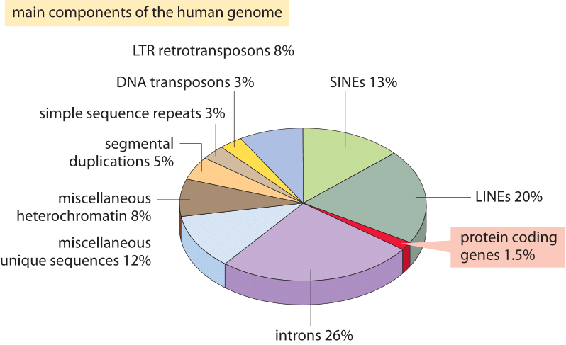
Main components of the human genome

Slide 5

Exon and introns

Slide 6
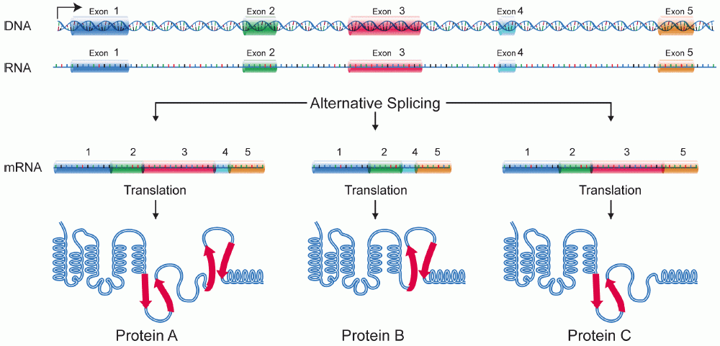
Alternative splicing

Slide 7
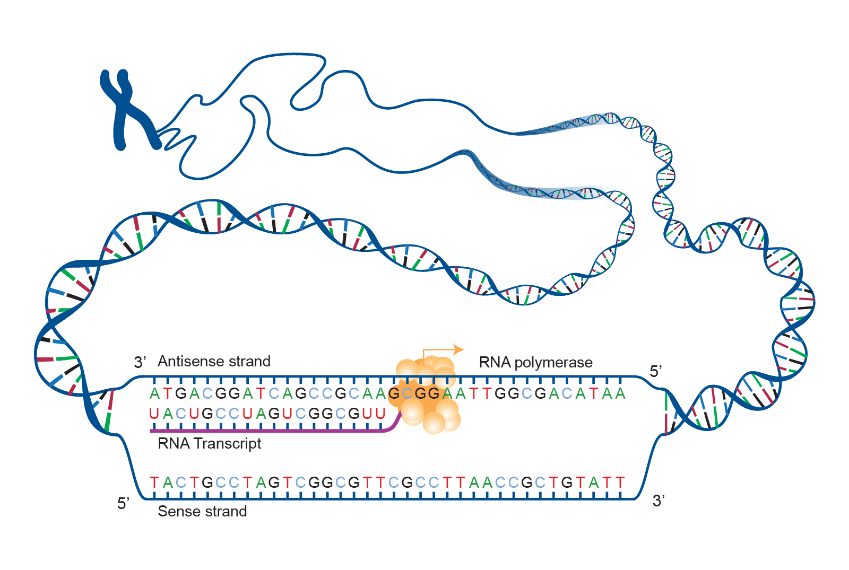
+ and - strand

Slide 8
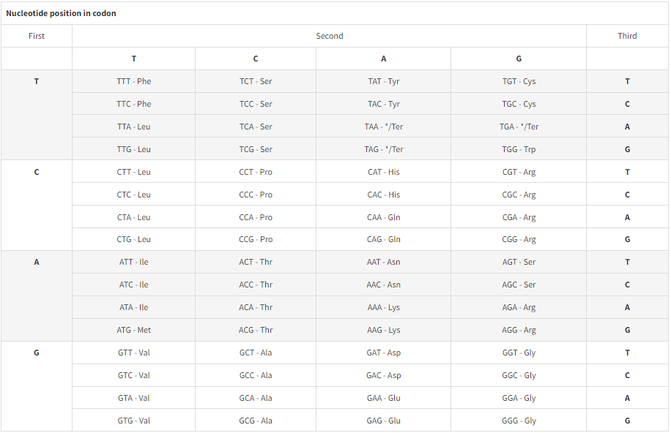
Codons

Slide 9

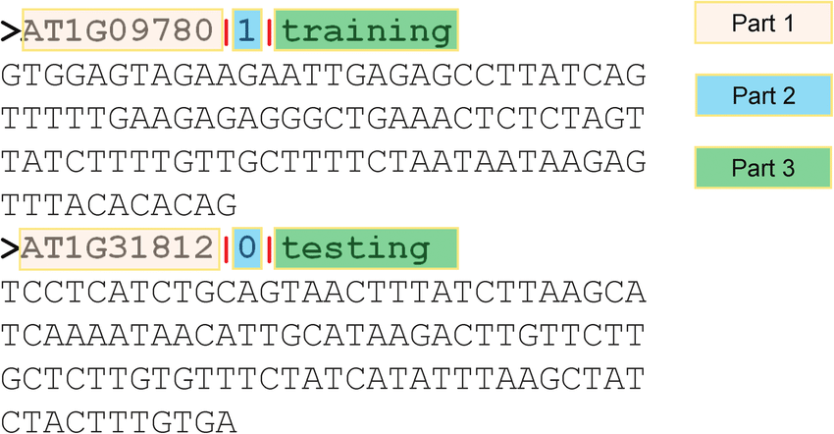

Fasta files

Slide 10
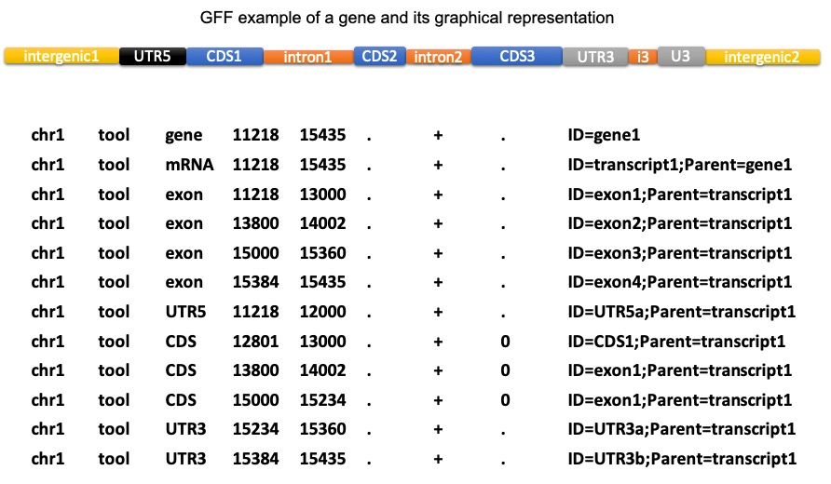
GFF file

Slide 11
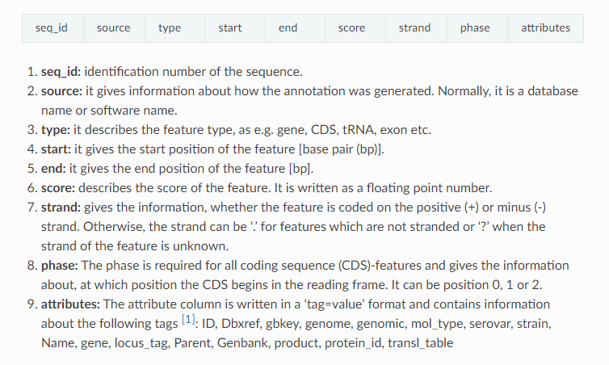
GFF file

Slide 12
