Slide 1
LIVE DEMO
Camunda 8,
running for real.
A hands-on exploration: one BPMN process, a Python worker, in/outbound connectors, a DMN decision, a form, and every boundary event type -- deployed, run, and broken live.
Zeebe · Operate · Tasklist — localhost:8080

Slide 2
WHY ORCHESTRATION
Business logic, scattered.
today
Process steps live inside cron jobs, message handlers, and tribal knowledge -- no single place shows what a process actually does.
today
When something is stuck, you grep logs across five services to find out why.
today
Changing the order of steps means a code change, a review, and a deploy.
Camunda 8 · order-fulfillment demo
2 / 10

Slide 3
THE PLATFORM
One diagram, executed.
BPMN isn't documentation of the process -- it IS the process.
BPMN
The diagram. Defines steps, order, and decisions.
Zeebe
The engine. Runs instances, scales horizontally.
DMN
Decision tables, modeled separately. A business rule task calls one.
Connectors
Prebuilt steps, configured not coded -- outbound (Charge Payment) and inbound (webhook).
Forms
A JSON schema on a user task -- Tasklist renders it, no frontend code.
Boundary events
Timer, error, and message -- three ways to interrupt a task.
Multi-instance
Run one activity per element of a collection, not once per instance.
Operate
Watch every instance live. See exactly where it's stuck.
Tasklist
Where humans complete the manual steps.
Camunda 8 · order-fulfillment demo
3 / 10

Slide 4
UNDER THE HOOD
Five processes, three languages.
None of them know the others' internals -- only the contracts.
orchestration
Zeebe :26500 gRPC · Operate/Tasklist :8080
gRPC job (built-in worker)
gRPC: start / cancel
order_service.py
Python · FastAPI · :8000
connectors
:8086 · outbound + inbound webhook
HTTP POST
order_workers.py
Python · pyzeebe · long-poll
payment_service.js
Node · Express · :8001
gRPC: poll / activate / complete
Camunda 8 · order-fulfillment demo
4 / 10

Slide 5
HOW A STEP RUNS
Code, or configuration.
Three tasks in the same diagram, wired three different ways -- same engine, same contract.
JOB WORKER · Ship Order
Service Task
type: ship-order
polls & activates
Python Worker
order_workers.py
gRPC :26500
completes job
CONNECTOR · Charge Payment
Service Task
type: http-json:1
REST Connector
built-in, zero code
payment_service
:8001/charge
HTTP POST
INBOUND CONNECTOR · Order Canceled
order_service
POST /cancel
Webhook Connector
/inbound/order-canceled
Boundary Event
message, on Confirm Delivery
HTTP POST
correlates by orderId
Camunda 8 · order-fulfillment demo
5 / 10

Slide 6
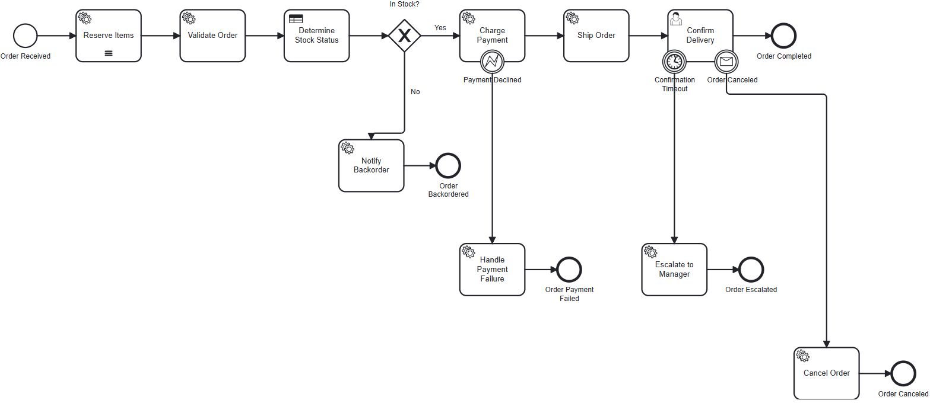
TODAY'S PROCESS
Order Fulfillment
Same happy path as before -- now with six ways an instance can actually end.
Camunda 8 · order-fulfillment demo
6 / 10

Slide 7
WHEN IT BREAKS
No crash. No redeploy.
Bad input reaches the worker -- instead of losing the instance, Zeebe holds it exactly where it failed.
POST /orders {"order_id":"ORD-1003","quantity":0}
INCIDENT · Task_ValidateOrder
Failed job. Error: Invalid quantity 0 for order ORD-1003
WITHOUT ORCHESTRATION
WITH ZEEBE
A failed script exits. Someone notices a missing order, hours later, from a support ticket.
Operate shows the exact instance and error. Fix the variable, click retry, the instance continues -- mid-flow.
Camunda 8 · order-fulfillment demo
7 / 10

Slide 8
WHY IT MATTERS
What you actually get.
see
Every instance, live. We forced a real incident earlier -- Operate showed the exact failed variable and a one-click retry, not a log line to go reconstruct after the fact.
change
Reroute without a deploy. The in-stock threshold is a row in process/dmn/stock-check.dmn, not a Python if -- change the number, redeploy the table, zero code review.
mix
Any language, per step. The order-triggering service is Python; the payment service the connector calls is Node -- proven today, not hypothetical.
trust
Nothing silently drops. Two different failure modes, two different outcomes: an unhandled bug becomes a visible incident; a declined payment becomes a modeled path, not a crash. We triggered both.
Camunda 8 · order-fulfillment demo
8 / 10

Slide 9
BEFORE ANYONE ASKS
What this doesn't prove yet.
Breadth of BPMN concepts is covered. Two different kinds of gap remain, and they're not the same kind of problem.
FEATURE GAPS
PRODUCTION GAPS
Parallel / inclusive gateways -- only the exclusive gateway exists today.
Auth -- still the default demo/demo login; Identity untouched.
Compensation events -- Cancel Order doesn't roll back a reservation or a charge.
Storage -- H2, single-node, file-based; production needs the Elasticsearch exporter or SaaS.
Process versioning & migration -- deploying v2 of a running process, live.
Observability & HA -- Operate's UI only, no alerting; one broker container, not a cluster.
The left column is "haven't gotten to it yet." The right column is "deliberately out of scope for a local demo" -- worth being explicit about which is which.
Camunda 8 · order-fulfillment demo
9 / 10

Slide 10
THANKS
Questions?
Repo, BPMN file, and worker code are all right here -- happy to walk through any piece live.
camunda8-lab / bpmn / dmn / forms / workers / services_python / services_node

