Slide 1

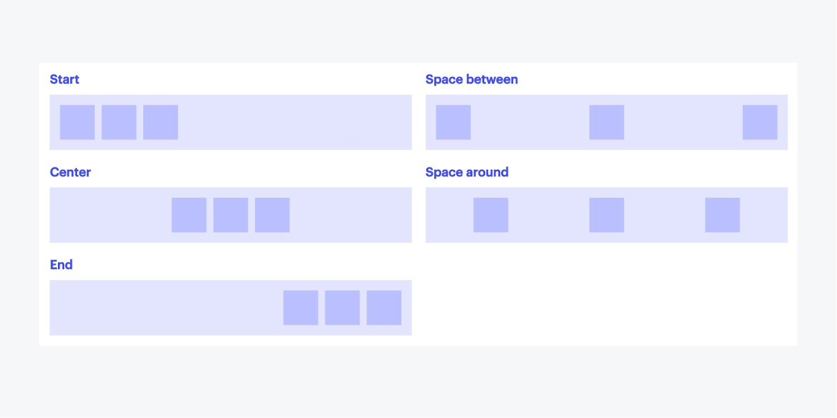
Flexbox
Continue to learn properties applied to:
flex container
flex items
1. Flex container
The flex container properties are:
Flex-direction
Justify-content
Align-item

Slide 2
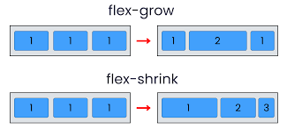
2. Flex item
Align-self
Flex property
Flex-frow
Flex-shrink
Flex-basis
flex-wrap
Magins whit flex

