Slide 1

SOTWARE ENGINEERING
GIT
SESSION 2

Slide 2

S2 – THEORY - LEARNING OBJECTIVES
Understand the benefits of GIT
Work locally with GIT : init, add, commit
Work remotely with GIT : remote, push , pull
Use GIT status

Slide 3

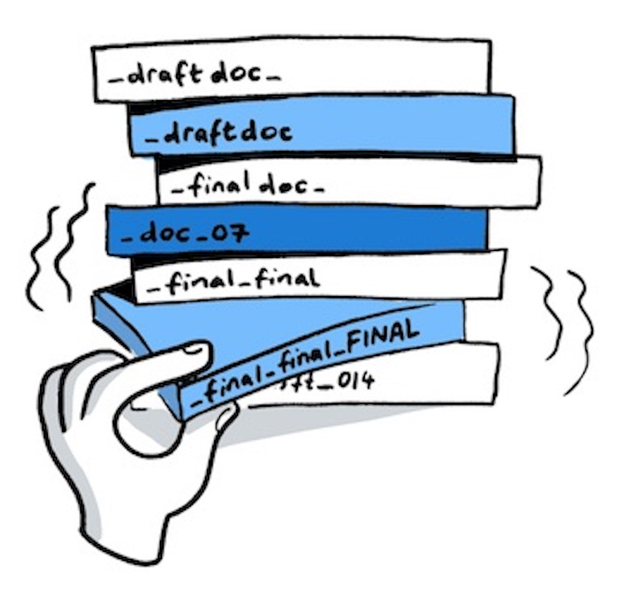
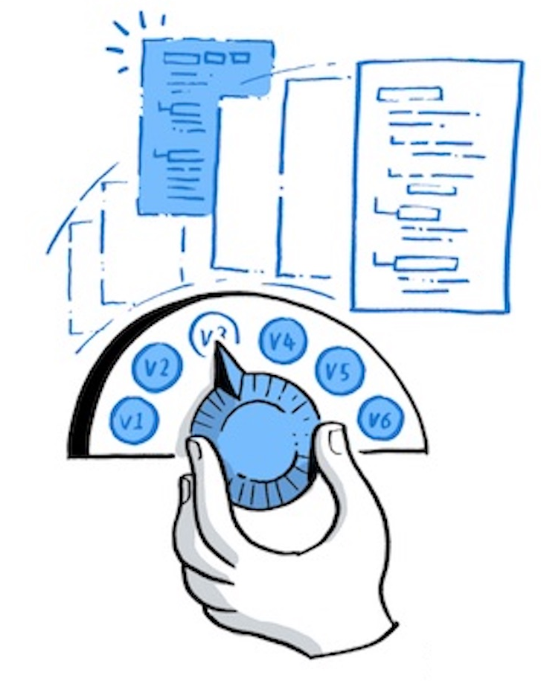
EXPLAIN
What is a Version Control System ?
30 MIN
A version control system, keeps track of all the changes in your project
You can then compare 2 versions or revert a previous version of a file

Slide 4



GIT local repository (on your computer)
GIT INIT
GIT ADD
GIT COMMIT
Create
repository
locally
Add changes
locally
Add commits
locally
Notes:
Teacher demo the steps

Slide 5

Let s start !
We start with a project containing only 1 file
YOUR FILES
Student.txt

Slide 6
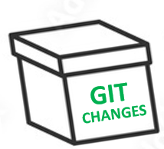

Create a git repository
Run
git init
to create a GIT repository in your project
Run
git status
to check the status of your git files
GIT FILES
YOUR FILES
GIT CHANGES
GIT COMMITS
Student.txt

Slide 7
Track Student
Run
git add Student.txt
to track Student file changes
GIT FILES
YOUR FILES
GIT CHANGES
GIT COMMITS
Student-v1.txt
Student.txt
GIT creates a snapshot of your file

Slide 8
Record the change
Run
git commit
to record the change in the GIT history of commits
GIT FILES
YOUR FILES
GIT CHANGES
GIT COMMITS
Student-v1.txt
First student version
Student.txt
Ronan

Slide 9
What is a commit composed of ?
A commit is composed of a title, the author, and all objects related to this commit
1 – The title
GIT CHANGES
GIT COMMITS
Student-v1.txt
First student version
Ronan
2 – The author
3 – All objects related to this commit
Note : both GIT objects and GIT commit have a unique ID

Slide 10
Create Teacher
Create a new teacher file
YOUR FILES
GIT FILES
GIT CHANGES
GIT COMMITS
Student-v1.txt
First student version
Student.txt
Ronan
Teacher.txt

Slide 11
Track changes
Run
git add .
to create a new snapshot for teacher
GIT FILES
YOUR FILES
GIT CHANGES
GIT COMMITS
Student-v1.txt
First student version
Student.txt
Ronan
Teacher.txt
Teacher-v1.txt

Slide 12
Record changes
Run
git commit
to record the change in the GIT history of commits
GIT FILES
YOUR FILES
GIT CHANGES
GIT COMMITS
Student-v1.txt
First student version
Student.txt
Ronan
Added teacher
Teacher.txt
Teacher-v1.txt

Slide 13
Update student
Update a student file
YOUR FILES
GIT FILES
GIT CHANGES
GIT COMMITS
Student-v1.txt
First student version
Student.txt
Ronan
Added teacher
Teacher.txt
Teacher-v1.txt

Slide 14
Track changes
Run
git add .
to create a new snapshot
YOUR FILES
GIT FILES
GIT CHANGES
GIT COMMITS
Student-v1.txt
First student version
Student.txt
Ronan
Student-v2.txt
Added teacher
Teacher.txt
Teacher-v1.txt

Slide 15
Record changes
Run
git commit
to record the change in the GIT history of commits
YOUR FILES
GIT FILES
GIT CHANGES
GIT COMMITS
Student-v1.txt
First student version
Student.txt
Ronan
Student-v2.txt
Added teacher
Teacher.txt
Teacher-v1.txt
Updated student

Slide 16

GIT with a remote repository (GitHub)
GIT INIT
GIT REMOTE
GIT ADD
GIT COMMIT
GIT PUSH
GIT PULL
Create
repository
locally
Connect
repository
To GitHub
Add changes
locally
Add commits
locally
Push commits
on GitHub
Pull commits
from GitHub
Notes:
Teacher demo the steps

Slide 17

Connect to a remote repository
Run
git remote
T connect your local repository to a remote repository
YOUR FILES
LOCAL REPOSITORY
REMOTE REPOSITORY
GIT CHANGES
GIT CHANGES
GIT COMMITS
GIT COMMITS

Slide 18
Push commits to remote repository
Run
git push
To send the last commits to the remote repository
YOUR FILES
LOCAL REPOSITORY
REMOTE REPOSITORY
GIT CHANGES
GIT CHANGES
GIT COMMITS
GIT COMMITS

Slide 19
Pull commits to remote repository
Run
git push
To get the last commits from the remote repository
YOUR FILES
LOCAL REPOSITORY
REMOTE REPOSITORY
GIT CHANGES
GIT CHANGES
GIT COMMITS
GIT COMMITS

Slide 20


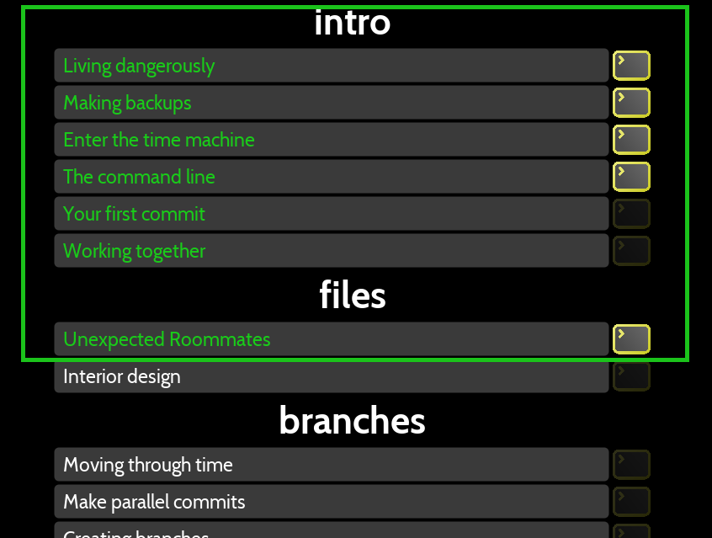
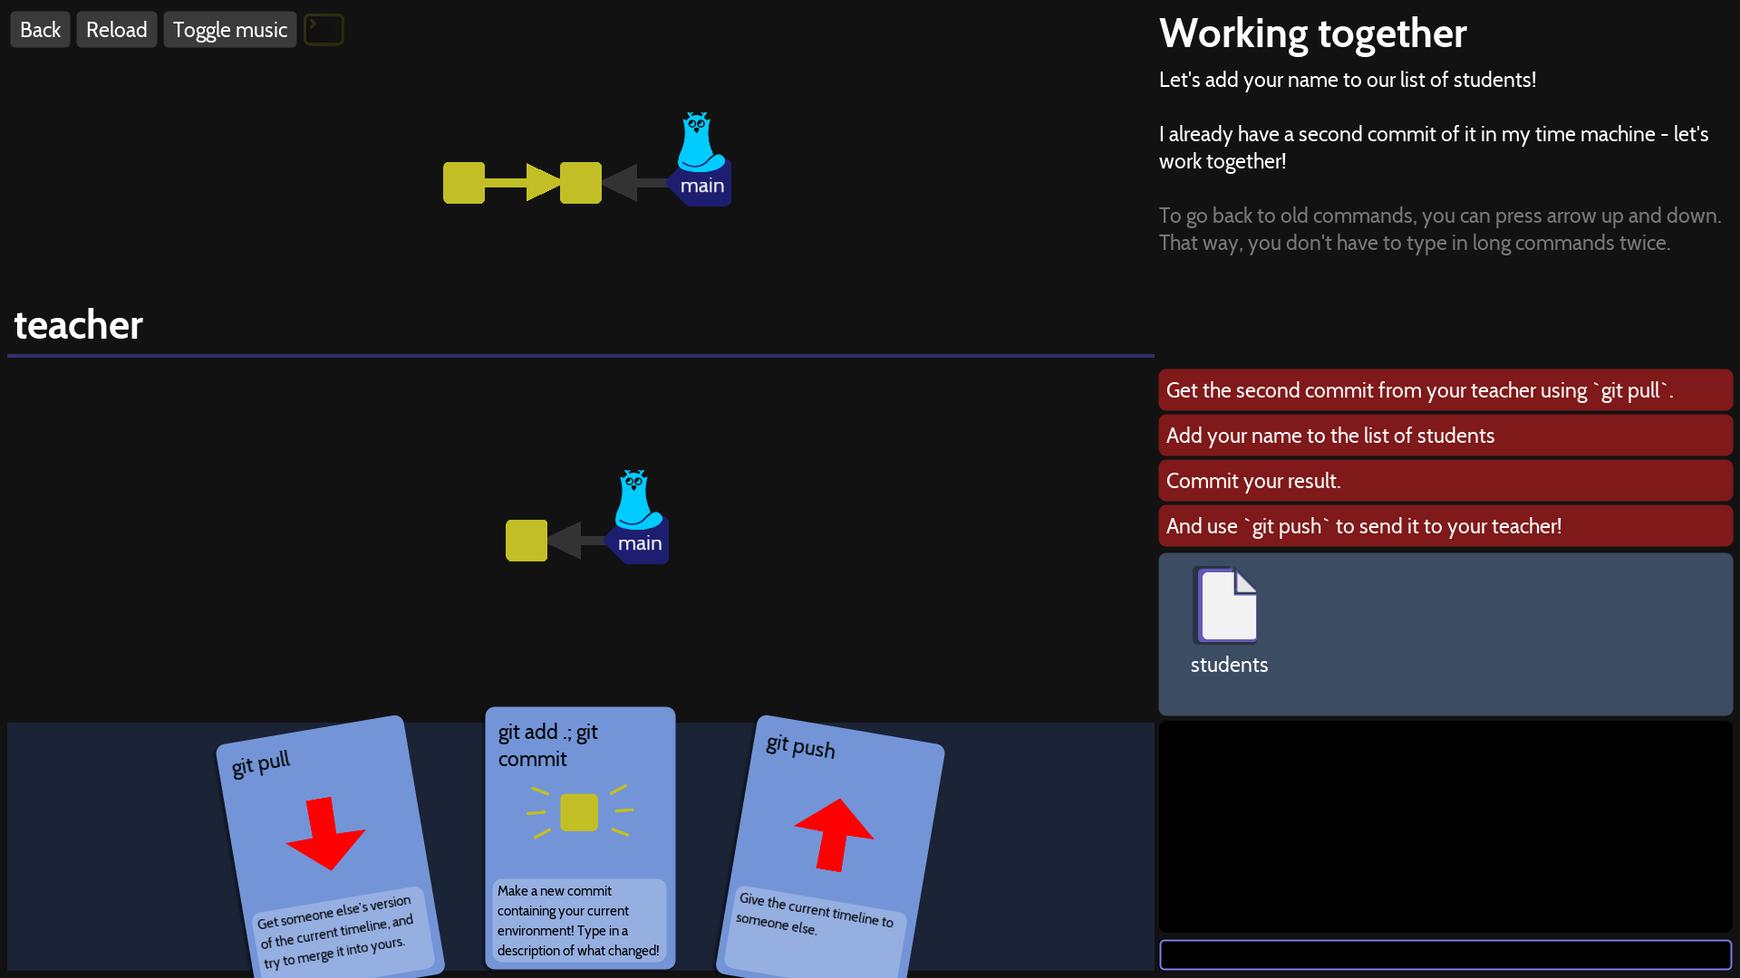
PLAY
Ho my Git
30 MIN
Perform in team the 7 first challenges

Slide 21
Summary
Create a repository
git init
a specific file change
git add <file>
LOCALY
Track
all new files change
git add .
Commit changes
git commit – m <message>
Connect repository to remote repo
git remote <repository>
REMOTLY
Push commits to remote repository
git push
Get commits from remote repository
git pull
Check status
git status

Slide 22
QUIZ
Relace the ?? With the appropriate GIT action
REMOTE
COMMIT
PUSH
CHECKOUT
PULL
ADD
YOUR FILES
LOCAL REPOSITORY
REMOTE REPOSITORY
??
??
??
SNAPSHOTS
COMMITS
??
??
??

Slide 23
NOW CAN YOU…
Understand the benefits of GIT
Work locally with GIT : init, add, commit
Work remotely with GIT : remote, push , pull
Use GIT status

