Slide 1
Machine Learning for Stroke Prediction. Leveraging Data Analytics to Identify Risk Factors and Improve Health Outcomes.
Bobby Sokhi – Talha Ghumra – Cameron Jordan.

Slide 2
Layout of this Presentation :
Part 1: Data Preprocessing.
Part 2: Data Analysis.
Part 3: Data Classification.

Slide 3
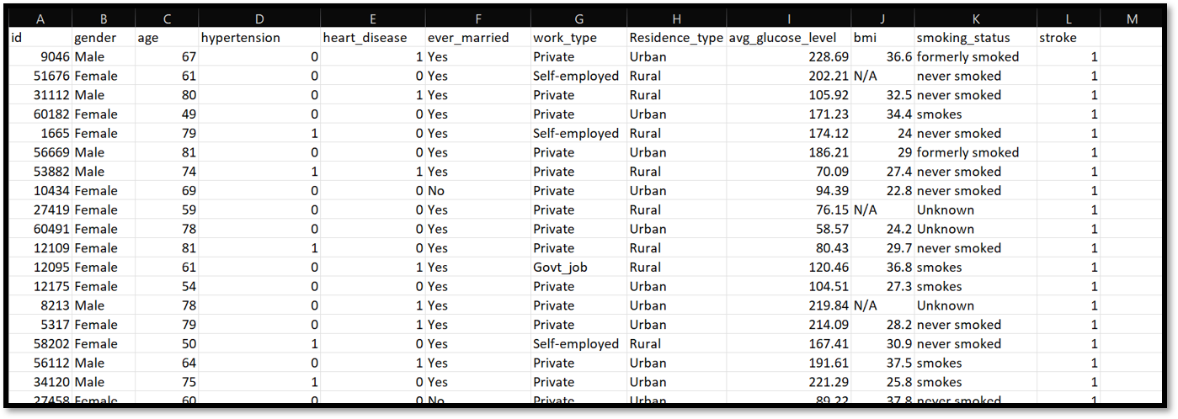
Health Care Dataset:
No. of Patients: 5100 ~ Independent Var: 10 ~ Dependent Var: 1

Slide 4
Part 1: Data Preprocessing
Importing Data
The Basics:
Dropping columns
Filling Null Values
Converting Categorical Data

Slide 5

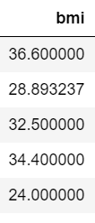
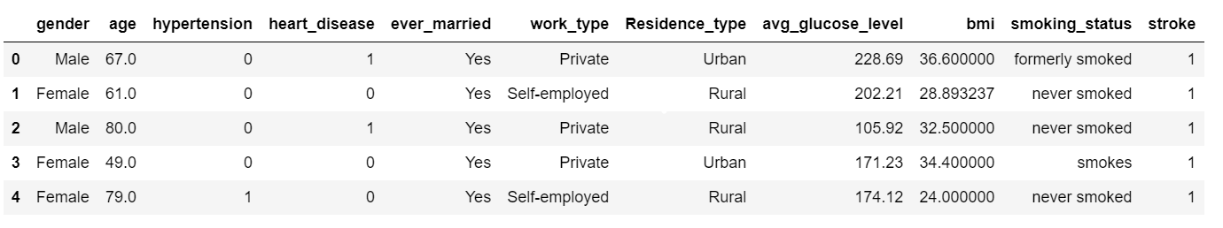
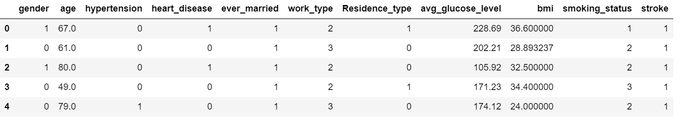
For Clarity:

Slide 6
Part 2: Data Analysis
01
Visualizing Data
Main Objectives:
02
Imbalanced Data

Slide 7
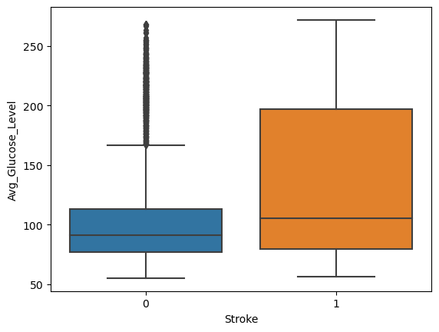
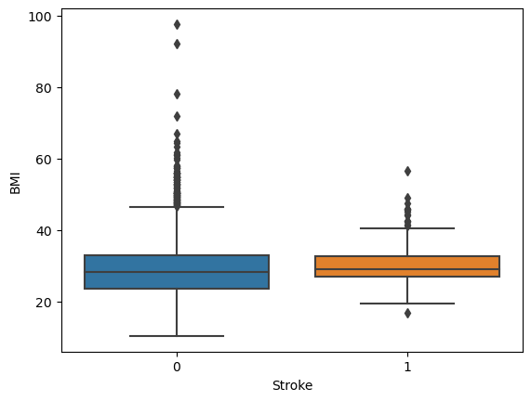
Outlier Detection:
We can see that BMI is not a significant factor for Stroke Victims i.e what really is important is the patients average glucose level. This insight could lead into further studies between Diabetes & Stroke.

Slide 8
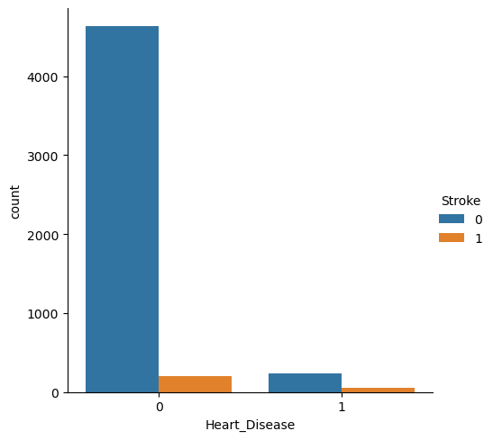
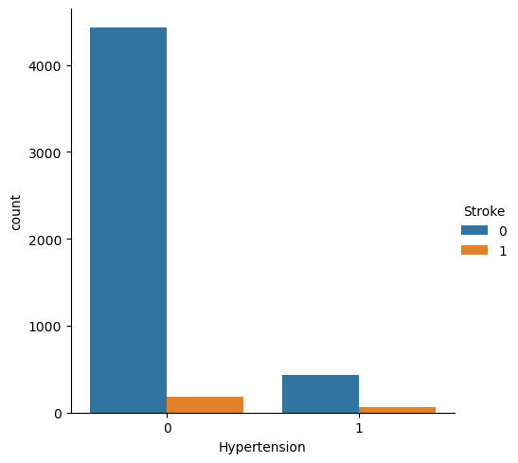
Visualizing the population with Hypertension and Heart Disease with and without Stroke:

Slide 9
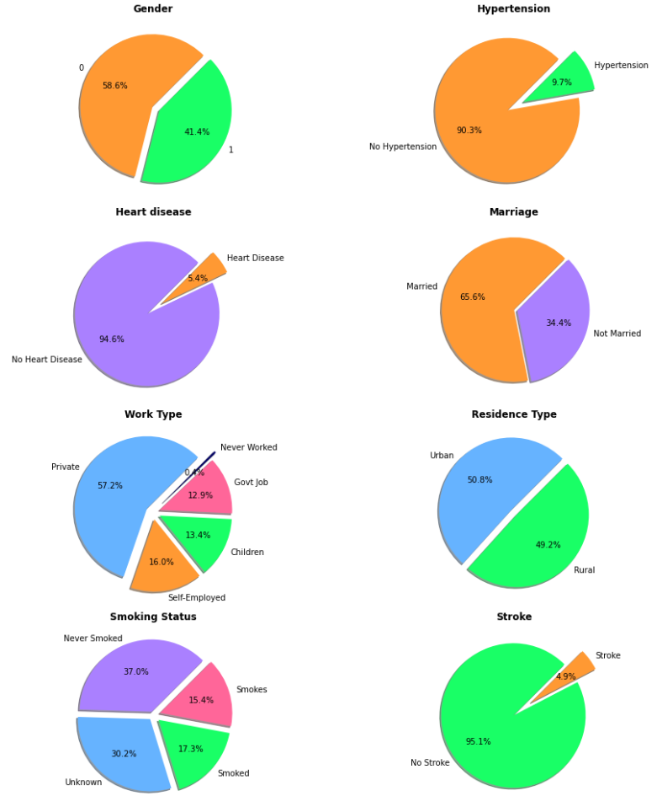
Distribution Of Data:

Slide 10
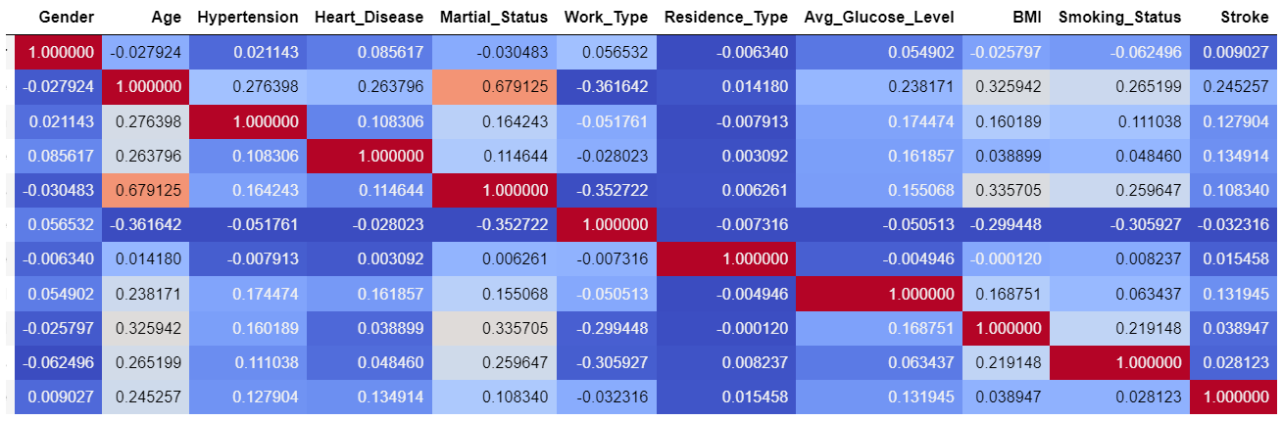
Correlation Matrix:

Slide 11
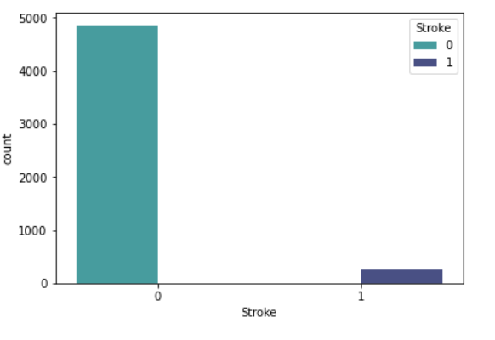
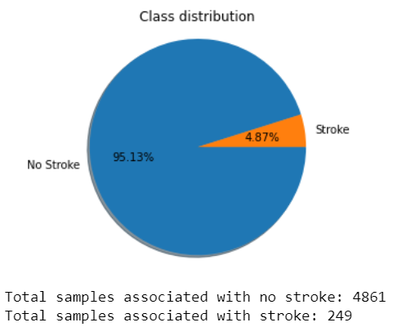
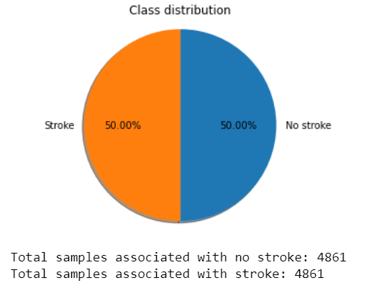
Handling Imbalanced Data:

Slide 12
Part 3: Data Classification
04
KNN
03
Random Forest
02
Decision Tree
01
Logisitc Regression

Slide 13
Hyper Parameter Tuning:
GridSearchCV
RandomizedSearchCV
Search Space

Slide 16
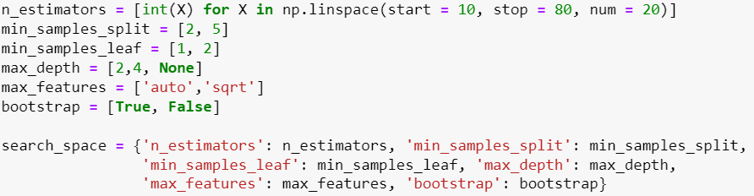
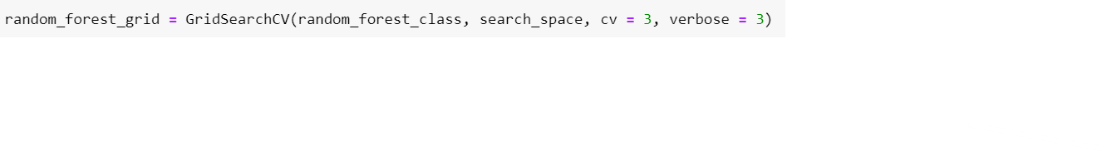

Slide 17
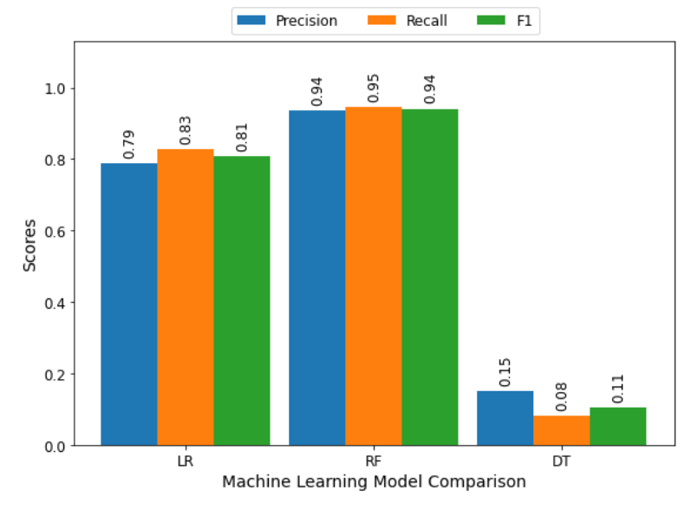
Precision Score – Recall Score – F1 Score

Slide 18
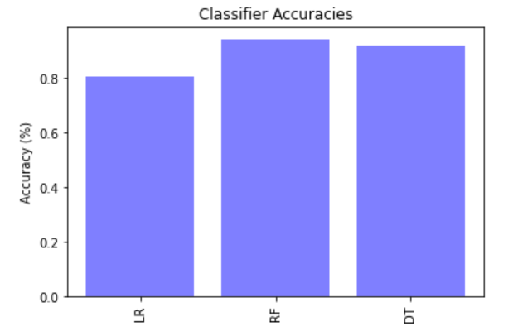
ML Classifier Accuracies:

Slide 19
ML Web Application Flow Chart:
01
02
03
04
CMD ~ Terminal
Backend ~ Flask
Frontend ~ HTML & CSS
New Data ~ SQLAlchemy
05
06
07
Comparison of Old & New Data
Classification Method.
Prediction

Slide 20


References:

Slide 21
Any Questions ?

Slide 22
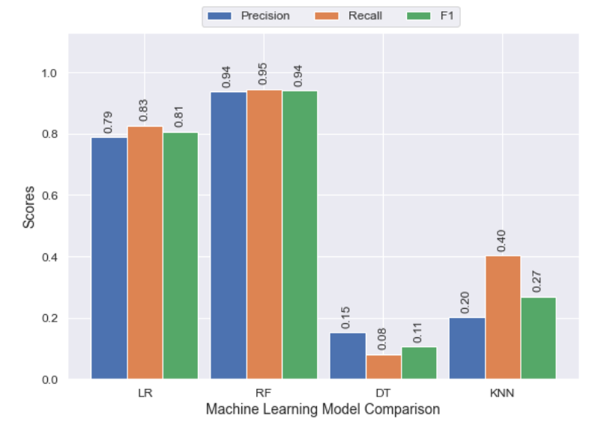
Precision Score – Recall Score – F1 Score (KNN Inc.)

Slide 23
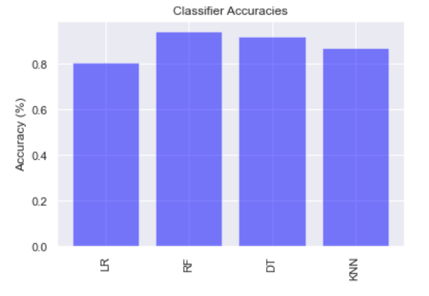
ML Classifier Accuracies (KNN Inc.)

Slide 24
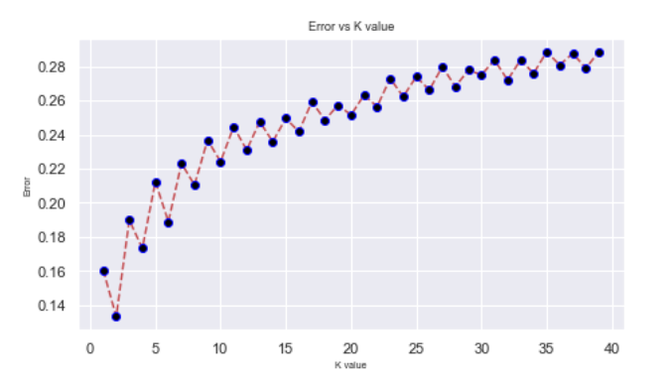
KNN Error Graph:

Slide 25
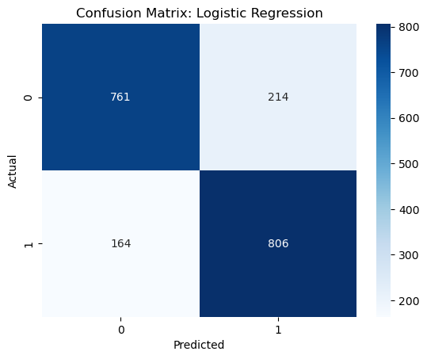
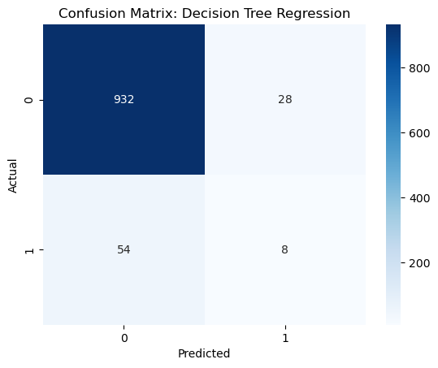
Confusion Matrices:
81% Accuracy ~ 83 % Recall. We notice that rebalancing data improves our Stroke Prediction.
92% Accuracy ~ 13% Recall. Our accuracy is high but our main goal is to predict stroke so 13% recall is extremely poor performance i.e without rebalancing data we achieve poor performance.

Slide 26
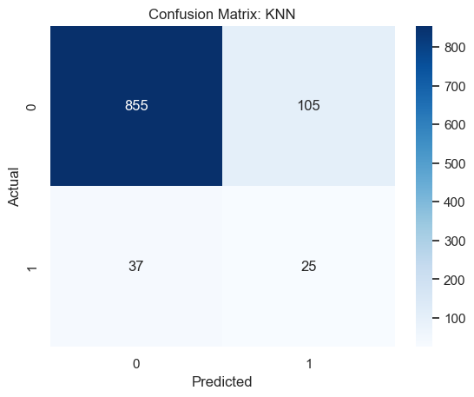
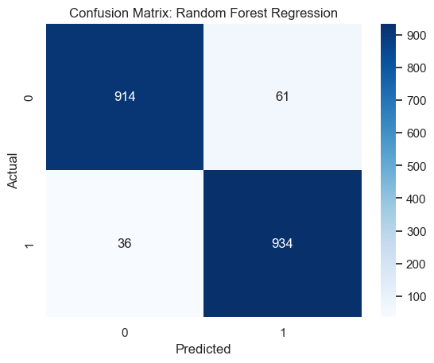
Confusion Matrices Cont:
95% Accuracy ~ 96% Recall. With SMOTE, we create synthetic examples of the data with Stroke. Increasing and balancing our data and using one of the strongest methods of regression, we are able to vastly improve the Recall measure.
86% Accuracy ~ 40% Recall. An improvement from decision tree but not as good as logistic regression. This might be caused because of no hypertuning.

Slide 27
Conclusion:
According to world-stroke.org 1 in 4 people will suffer a stroke and our data consisted of about 5%. Our insight shows a need for deeper knowledge on stroke indicators and further research. Given avg glucose level was one of the strongest indicators, a recommended starting point would be to see if there is a relationship between Diabetes and Strokes. I more comprehensive data set, with strong indicators, can vastly improve stroke recognition.

