Slide 1
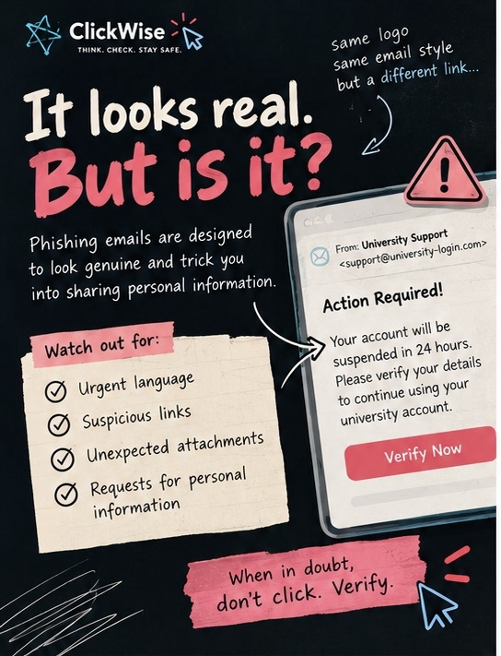
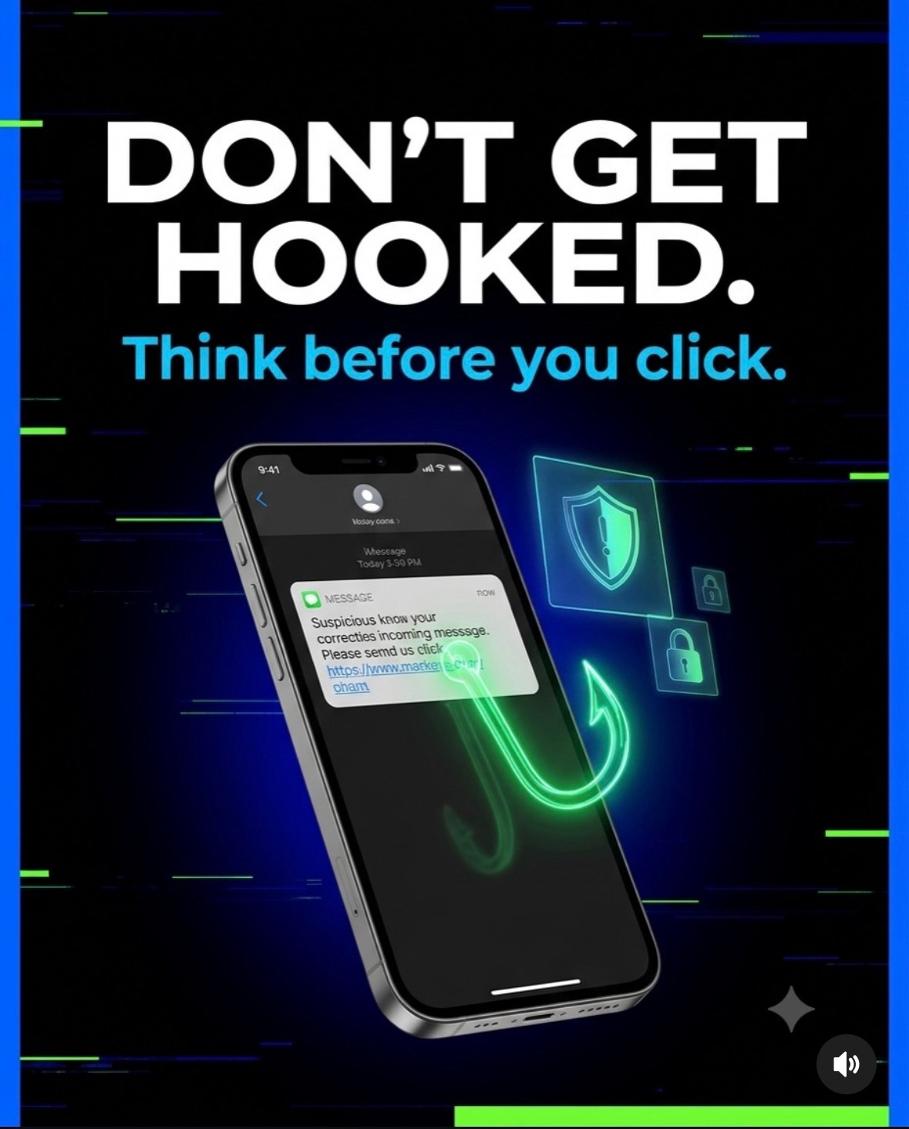
ClickWise
HLAC · HUMAN-CENTRED SECURITY AWARENESS
Think. Check. Stay safe.
A student phishing and password awareness campaign, measured with HumanFactor
[Group member names] · October 2026
Notes:
Presenter A.
Good morning everyone. We're [names], and our project is ClickWise: a security awareness campaign for students about phishing, scams and passwords.
Our tagline is "Think. Check. Stay safe.", three habits that stop most scams.
In the next fifteen minutes we'll show you why we picked this topic, the campaign we built (posters and an Instagram account), the platform we built to measure whether it works, and what we learned.

Slide 2
Real, or phish?
You have five seconds. Would you click?
Three clues give it away:
1 From: support@university-login.com: a look-alike domain
2 "Suspended in 24 hours": urgency to stop you thinking
3 "Verify Now": a button asking for your login details
When in doubt, don't click. Verify.
Notes:
Presenter A.
Quick show of hands: who has had a "your parcel is held" text, or an email saying your account will be suspended, in the last month? [pause]
Here is one of our posters. It looks like a normal university email: the logo and layout are right.
But there are three clues. The sender's domain is "university-login.com", not the university's own. It creates urgency: suspended in 24 hours. And it wants you to press "Verify Now" and type in your login.
Most people don't fall for scams because they're careless. They fall for them because the scam is designed for the five seconds when they aren't thinking. That's the problem our campaign targets.

Slide 3
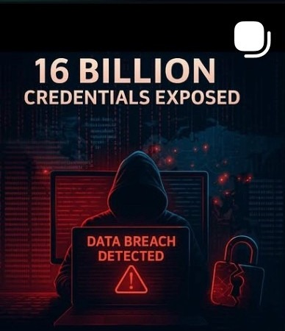



Attackers target people, not firewalls
68%
Phishing is cheap
One email reaches thousands of inboxes at no cost.
of breaches involved a human element: a click, a reused password, a mistake
One password, many doors
Verizon, 2024 Data Breach Investigations Report
A single leaked, reused password unlocks email, banking and social accounts.
16 billion
People make the call
login credentials found in leaked datasets, many reused across accounts
Filters miss messages that look normal. People decide whether to click.
Our Instagram post on the same story
Cybernews research, June 2025
Notes:
Presenter A.
Why does this matter? Verizon's 2024 breach report found that about two-thirds of breaches involved a human element: someone clicked, reused a password or made a mistake.
And in June 2025, researchers at Cybernews reported 16 billion leaked login credentials. We turned that story into an Instagram post.
So the weakest point isn't the firewall. It's the moment a person decides whether to click. That's where awareness training helps.
[Check both statistics against the original sources before presenting.]

Slide 4




Why students, and what we want them to do
Our audience: university students, 18+
1
SPOT it
New university accounts
Recognise the signs of phishing, smishing and impersonation
Logins and student emails that attackers impersonate
Constant scam texts
2
VERIFY it
Parcel fees, bank OTP calls, "send me the code"
Check through a trusted route: open the app yourself, never the link
Links shared in group chats
Fast sharing, little checking
3
REPORT it
Reused passwords
One leak exposes every account
Stop, secure the account, tell IT or the platform
Notes:
Presenter B.
We chose university students because they're targeted constantly. They have new university accounts that attackers copy, they get scam texts about parcels and bank codes, they share links quickly in group chats, and many reuse the same password everywhere.
We set three learning goals, which run through all our content: SPOT the scam, VERIFY through a trusted route, and REPORT it.

Slide 5





One campaign, three parts
CONTENT
CHANNEL
MEASUREMENT
ClickWise
@cyber.decoded_
HumanFactor
4-part poster and infographic series: passwords, phishing email, OTP scams, what to do
Instagram account: 5 posts, carousels with music, a decision flowchart
Web platform we built: anonymous PRE/POST survey and an analytics dashboard
How they connect
PRE survey
Campaign: posters + Instagram
POST survey
Paired analysis
Notes:
Presenter B.
The program has three parts that work together.
ClickWise is the content: a four-part poster series.
@cyber.decoded_ is our Instagram channel, where the content reaches students.
HumanFactor is the web platform we built to measure whether any of it works.
The flow is a classic pre/post design: students take a short survey before the campaign, see the campaign, then take the same survey again. We compare each person's two scores.

Slide 6
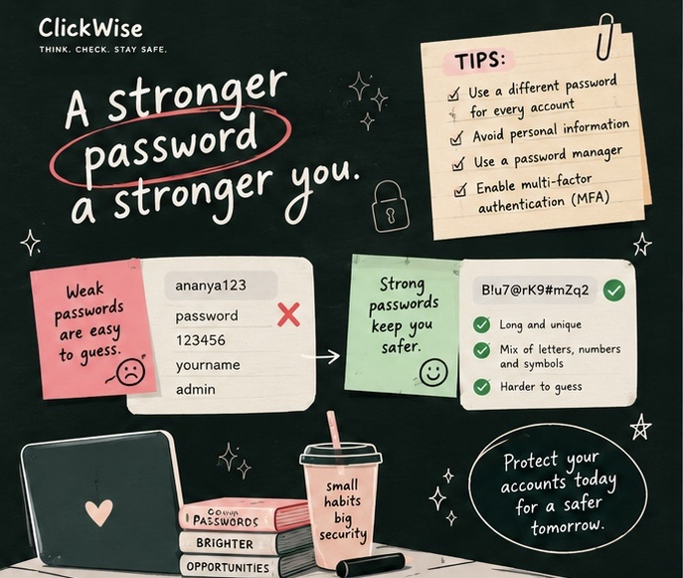
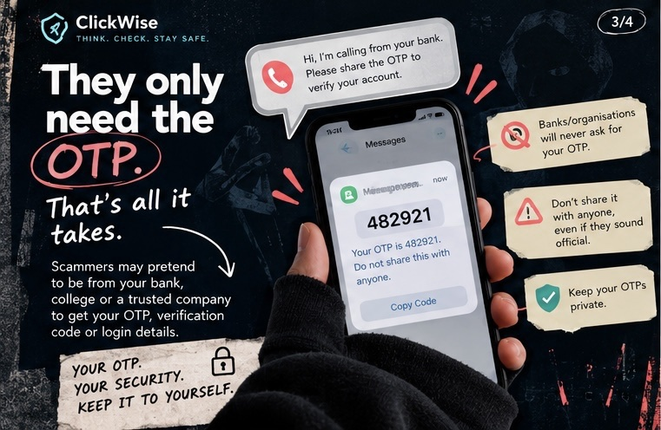
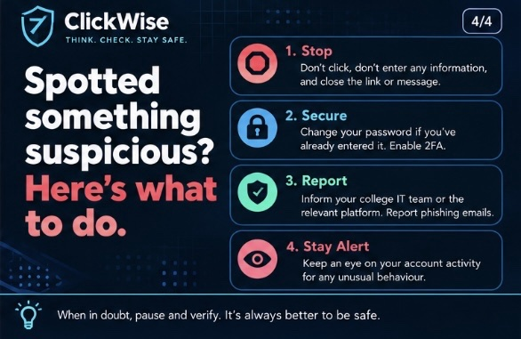
ClickWise: four posters, four habits
Design choices
One message per poster
A concrete action, not just a warning
Real-looking examples: email, OTP SMS
Friendly hand-drawn style, not fear
Notes:
Presenter B.
These are our four ClickWise posters.
"It looks real. But is it?" teaches the warning signs of phishing emails.
"A stronger password, a stronger you" contrasts weak and strong passwords and pushes password managers and MFA.
"They only need the OTP" covers the bank-call scam: no real bank will ever ask for your one-time code.
And "Spotted something suspicious?" gives four steps: stop, secure, report, stay alert.
Each poster carries one message and one action, using examples that look like what students actually receive. We kept the tone friendly rather than scary, because fear tends to make people tune out.

Slide 7
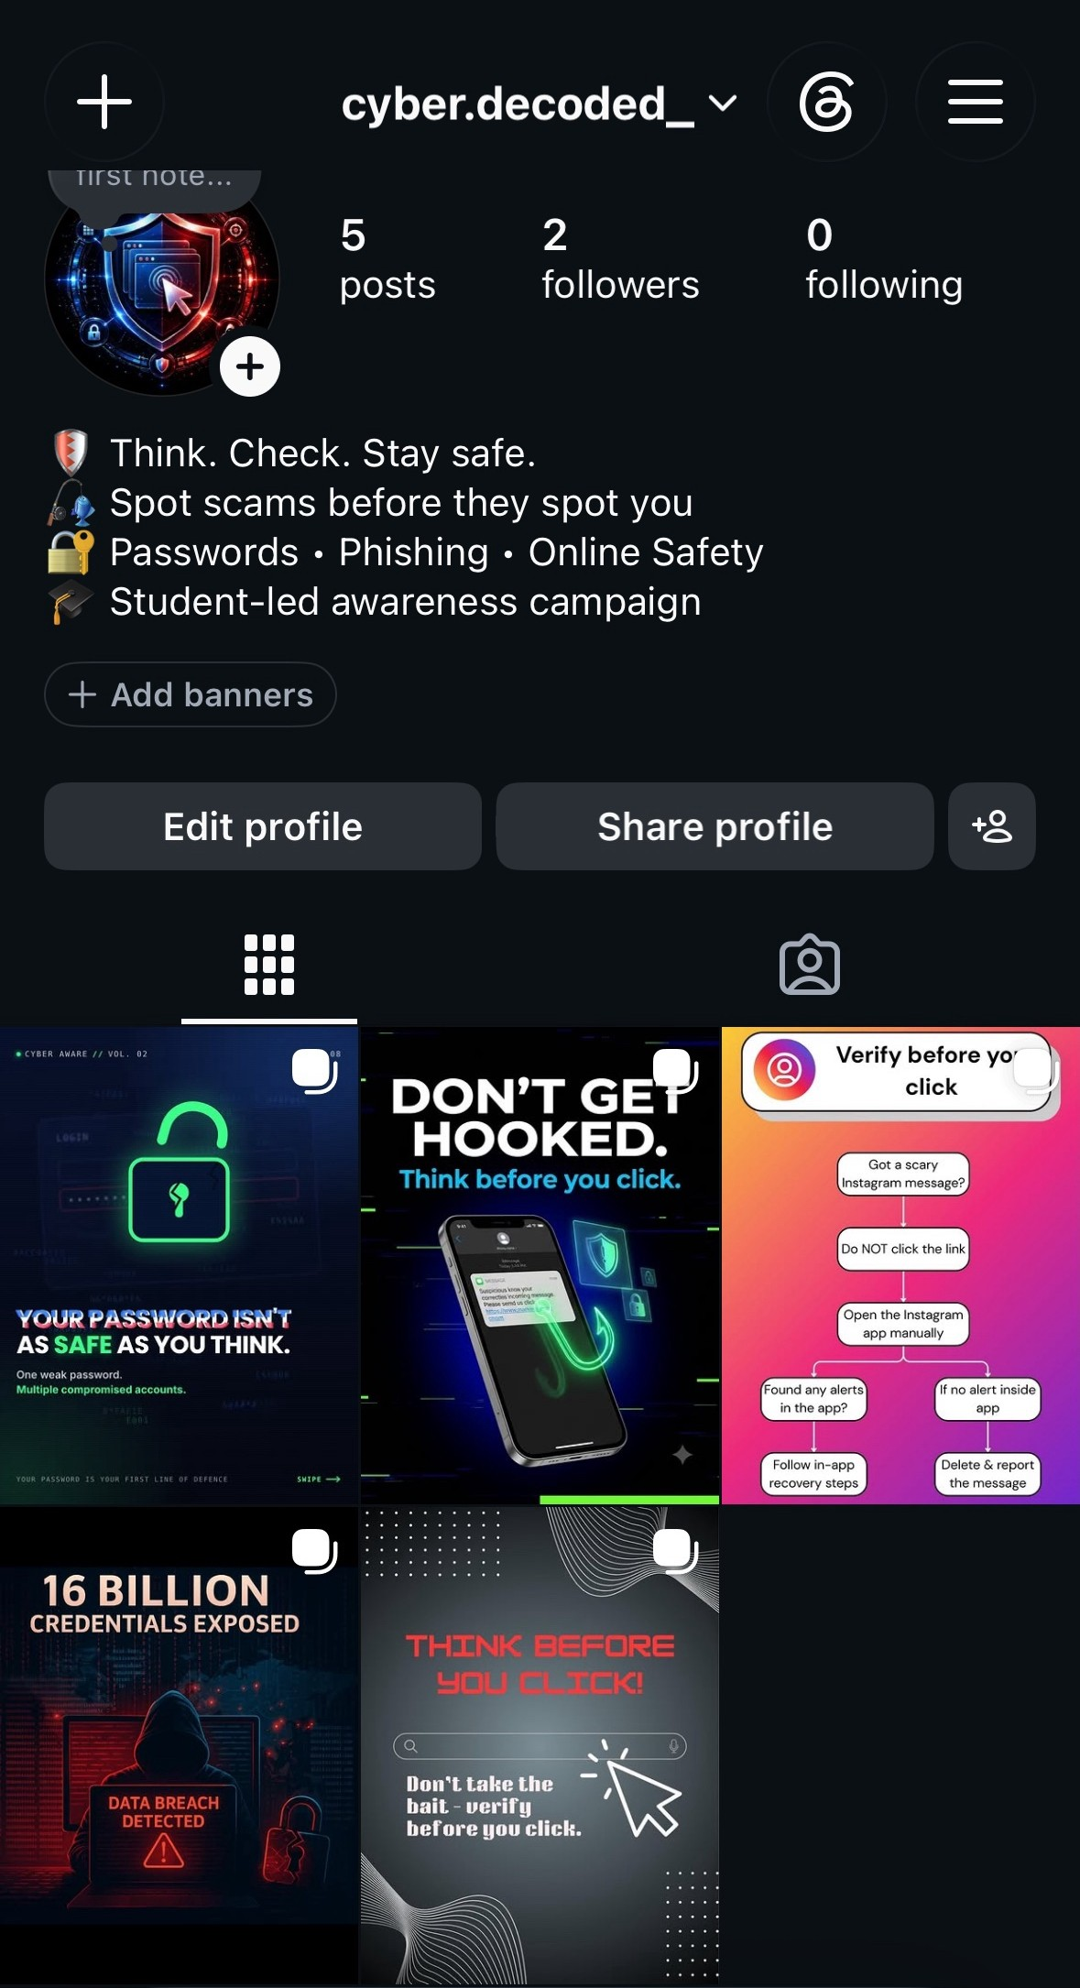
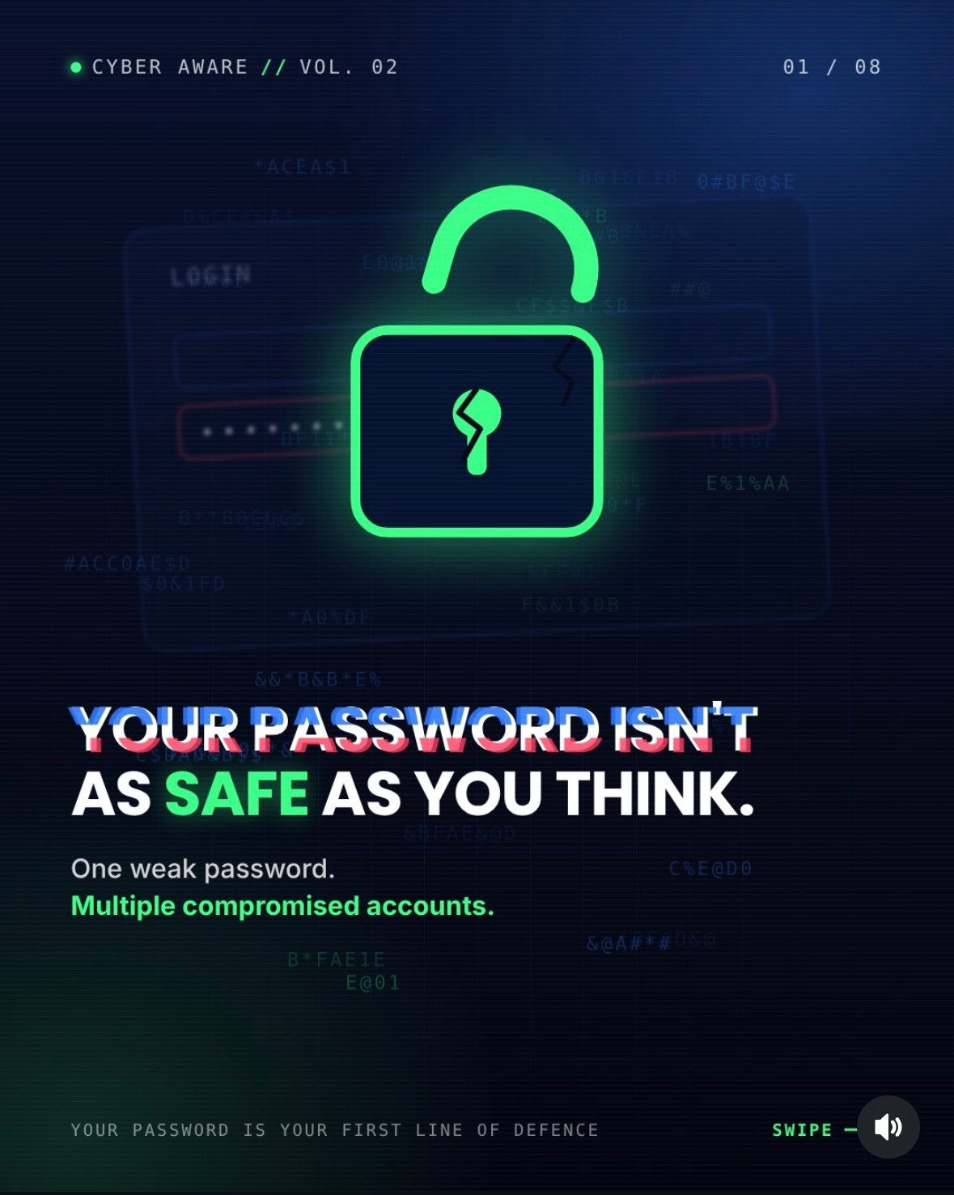
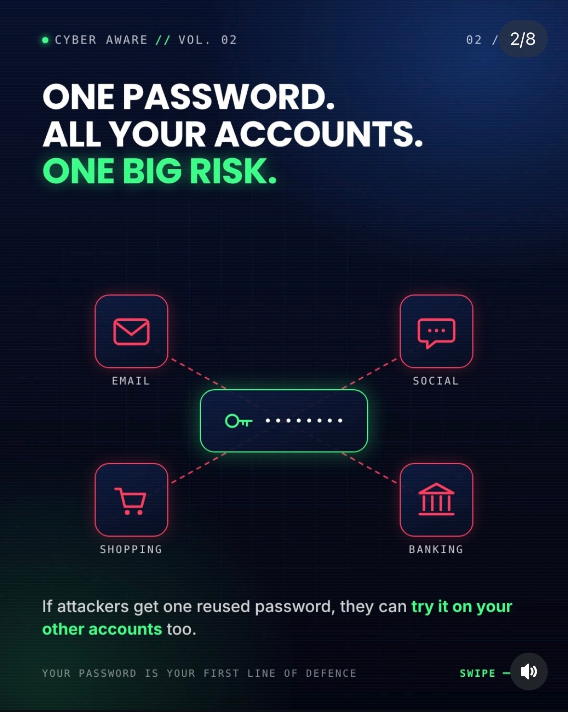

@cyber.decoded_ on Instagram
Platform playbook
Swipeable carousels
Story in 8 frames
Scroll-stopping hooks
"Don't get hooked."
Trending audio
8-slide carousel "Cyber Aware Vol. 02": one reused password, four accounts at risk
Reels-style reach
Early reach, honestly: 5 posts · 2 followers · about 1 like per post, measured 9–11 hours after posting.
Decision flowchart
Verify before you click
Notes:
Presenter C.
Our social media channel is the Instagram account @cyber.decoded_. Its bio is "Think. Check. Stay safe. Spot scams before they spot you."
We posted five pieces. This one is an eight-slide carousel showing how one reused password puts your email, social, shopping and banking accounts at risk. Others include "Don't get hooked", a data-breach post, and a flowchart for what to do when you get a scary Instagram message.
We followed Instagram practice: carousels people swipe through, strong opening hooks, trending audio, and simple visual decision aids.
To be honest about reach: at the time of these screenshots, the account had 2 followers and about one like per post. The account was brand new and the posts were less than half a day old. We come back to this in lessons learned.

Slide 8



Delivery plan and timeline
Planned schedule
Week 0
Weeks 1–2
Week 2
Week 3
Week 4
PRE survey
Campaign live
Engagement
POST survey
Analysis
Link shared in class and group chats; QR code on posters
Posters on noticeboards; Instagram posts and stories
Instagram poll and quiz stickers; reply to comments and DMs
Same scenarios, same anonymous code
Paired results, Instagram analytics, final report
Posting schedule
3 posts a week
7–9 pm
Daily stories
Hashtags
Mon · Wed · Fri
When students scroll most
Re-share, polls, reminders
#CyberAware #ThinkBeforeYouClick
Notes:
Presenter C.
Here's the delivery plan. In week zero we open the PRE survey, sharing the link in class and group chats and on posters with a QR code.
In weeks one and two the campaign runs: posters on campus noticeboards, and Instagram posts three times a week on Monday, Wednesday and Friday evenings, between 7 and 9 pm when students are most active, with daily stories.
In week two we add interactive polls and quiz stickers. In week three participants take the POST survey with the same code. Week four is analysis.
This is the planned schedule. The live run starts once we have approval.

Slide 9
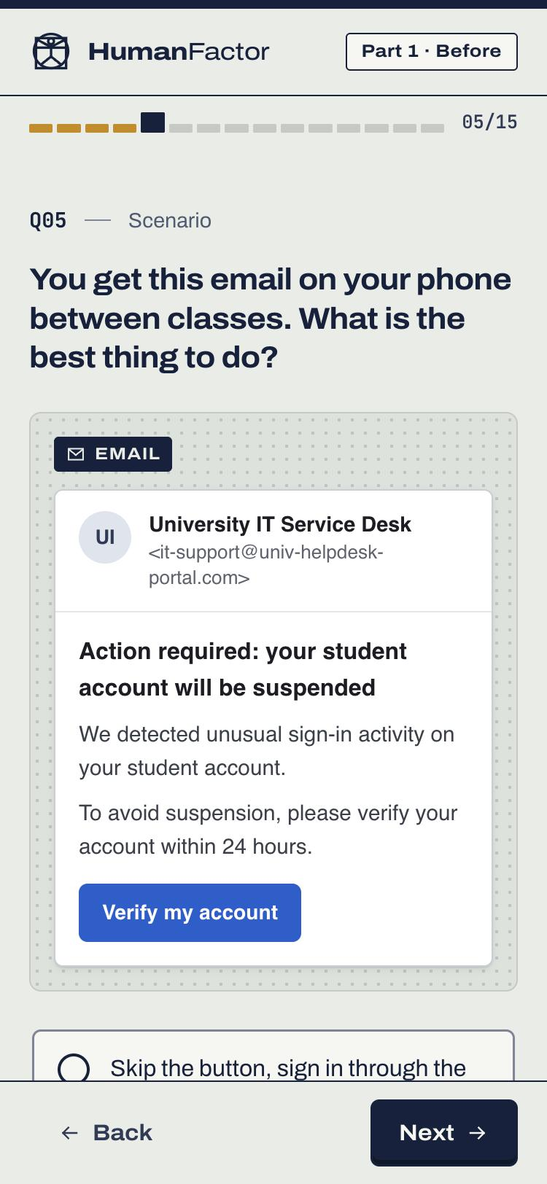

Measuring knowledge, not just opinions
Same 10 scenarios at PRE and POST
An anonymous code links PRE to POST
Real-looking emails, texts, URLs and QR codes. Answer options shuffled for each person
A random code issued at PRE, no names or emails, so we can compare each person's two attempts
Knowledge kept separate from confidence
Scored on the server, never shown
Confidence asked before the scenarios, estimated score asked after, so we can measure overconfidence
Participants don't see answers or scores, so the survey itself doesn't teach
PRE: 15 questions, about 7 min · POST: 13 questions, about 6 min · 10 scored items, 1 point each
Notes:
Presenter D.
Instead of using Google Forms, we built our own survey platform, HumanFactor, because we wanted to measure what people can actually do, not just what they say.
Each scenario shows something realistic, like this account-suspension email, and asks what you'd do. The ten scenarios are the same before and after, with the answers in a different order each time.
To compare the same person over time without collecting names, each participant gets a random code at PRE and enters it again at POST.
We ask confidence separately from knowledge, so we can see whether people overestimate themselves.
And participants never see the answers or their score, so the first survey doesn't teach them.

Slide 10
Why these 10 questions
5 TOPICS × 2 SCENARIOS, EACH MATCHED TO CAMPAIGN CONTENT
How each item was chosen
Email phishing
1 Suspension email
4 Warning signs
1
The attacks students actually get
→ "It looks real. But is it?" poster
Every scenario copies a real email, text, DM or QR sticker
Links & websites
2 Reading a URL
3 The padlock
2
Tests an action, not a definition
→ "Verify before you click" post
"What should you do?", with one defensible best answer
SMS & QR scams
5 Parcel-fee text
9 QR sticker
3
Wrong answers are diagnostic
→ "Don't get hooked" post
Each distractor is a real misconception, e.g. "padlock = safe"
Account security
6 Sign-in prompts
10 After a leak
4
Fair to everyone
→ "Spotted something suspicious?" poster
No jargon, no leading cues, balanced option lengths, an "I'm not sure" option
Impersonation
7 Friend's code
8 Lecturer gift card
5
The same items PRE and POST
→ "They only need the OTP" poster
The most defensible comparison at n ≈ 30; options shuffled
Notes:
Presenter D.
Why these ten questions, and not others?
First, coverage. We picked the five ways students actually get attacked (email phishing, fake links and websites, scam texts and QR codes, account takeover, and impersonation) and wrote two scenarios for each. Every topic matches a piece of our campaign, so the survey measures exactly what the campaign teaches. If the posters work, these are the scores that should move.
Second, how each item was chosen.
One: realism. Every question shows something students have really received: a university suspension email, a parcel-fee text, a friend asking for a code, a QR sticker on a parking meter.
Two: we test behaviour, not vocabulary. We never ask "what is smishing?". We ask "what should you do?", and there's one answer a security professional would defend.
Three: the wrong answers are real mistakes people make, such as trusting the padlock or approving a sign-in prompt just to make it stop. So a wrong answer tells us which misconception someone holds. Item 9 even re-checks the padlock belief from item 3 in a different context.
Four: fairness. No jargon, the question never hints that something is a scam, the correct answer isn't always the longest, and "I'm not sure" lets people admit uncertainty instead of guessing.
Five: we use the same questions before and after, because with about 30 participants we can't validate two different versions. We shuffle the options and treat the testing effect as a caveat.

Slide 11
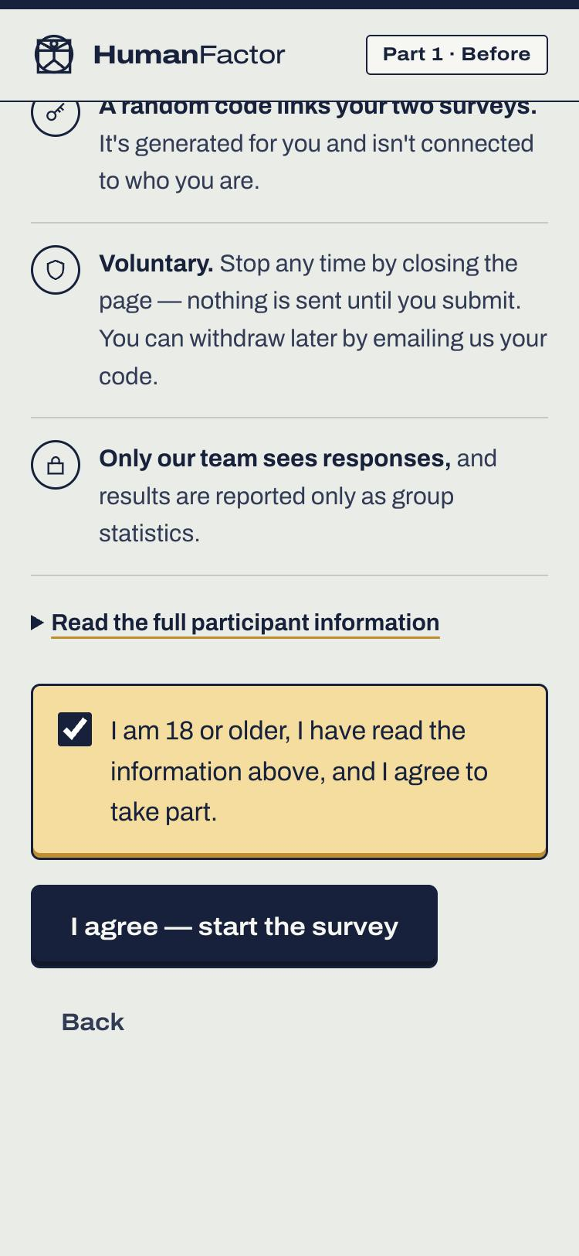




Ethical and accessible by design
Ethics
Accessibility
Informed consent first
Keyboard and screen reader
Plain-language notice and an 18+ confirmation before any question
Every control reachable and labelled
Anonymous
No names, emails, student IDs or IP addresses
High contrast
WCAG AA colours, light and dark mode
Voluntary
Stop at any time; withdraw later by quoting your code
Mobile-first
Restricted access
Large touch targets for most students on phones
Password-protected dashboard, group-level reporting only
Reduced motion and plain words
No answers shown
Animations can be turned off; short sentences
So the PRE survey doesn't teach the answers
Notes:
Presenter D.
Ethics were built in from the start, as the assignment requires.
Nobody sees a question until they've read a plain-language consent notice and confirmed they're 18 or over. We collect no names, emails, student IDs or IP addresses. Taking part is voluntary, and you can withdraw later by quoting your code. Only our team can see the data, through a password-protected dashboard, and we only report group-level results.
On accessibility: everything works with a keyboard and screen reader, colours meet WCAG contrast, it's designed for phones first, and motion can be turned off.

Slide 12
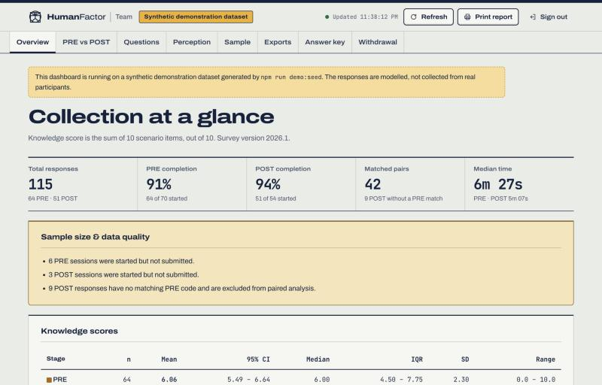
HumanFactor: survey and live dashboard
63
automated tests pass
Scoring, statistics, code matching, API
184/184
dashboard figures re-verified
Independently recomputed from raw data
R
used to check the statistics
t-test, Wilcoxon, confidence intervals
Exports: response CSV, item summary, codebook, report summary
github.com/sokhiaryan/HumanFactor
Notes:
Presenter D.
This is the HumanFactor dashboard. Once responses come in, the team can see completion, score distributions, paired before-and-after change, per-question accuracy and misconceptions, and export everything to CSV for the report.
Because we're making claims from these numbers, we tested it carefully. 63 automated tests pass. We checked the statistics against R. And an independent script recomputes 184 figures directly from the raw database; all 184 match the dashboard.
The code is on GitHub.

Slide 13
Scores rose after the campaign
Demonstration of our analysis pipeline · live results to follow
Matched participants (n = 42), score out of 10
% correct per scenario
PRE
POST
6.30 → 7.48
1 Suspension email
73%
75%
2 Reading a URL
42%
59%
+1.18
3 Padlock
44%
mean change (95% CI +0.61 to +1.75)
67%
4 Warning signs
67%
78%
p < .001
paired t(41) = 4.19; Wilcoxon agrees
5 Parcel SMS
70%
86%
6 Sign-in prompts
47%
d = 0.65
a moderate effect size
59%
7 Friend's code
63%
82%
8 Gift-card ask
72%
31 improved 5 unchanged 6 declined
90%
9 QR sticker
63%
Observed change, not proof of cause: no control group, repeated questions, self-selection.
78%
10 After a leak
66%
73%
Notes:
Presenter A.
These results come from our demonstration dataset, which we use to check the analysis pipeline. The live results will replace them once we run the study.
Here is the analysis we'll report. Among people who took both surveys, the average score went from 6.3 to 7.5 out of 10, a gain of about 1.2 questions. The paired t-test and the Wilcoxon test both show this is very unlikely to be chance, and the effect size is moderate.
At the individual level, 31 people improved, 5 stayed the same and 6 declined.
On the right you can see every scenario improved, most of all reading URLs, the padlock question, and the friend asking for a code.
We are careful to call this observed change, not proof the campaign caused it. There's no control group, people see the same questions twice, and the people who volunteer may be more motivated.

Slide 14
Where students go wrong
Demonstration of our analysis pipeline · live results to follow
% of PRE respondents holding each misconception
Our response
"The padlock means the site is safe"
Padlock = safe
Gap: nothing covers it yet
31%
Next post: the padlock means encrypted, not trustworthy
Unexpected sign-in prompts ignored
Sign-in prompts
Covered by poster 4/4
25%
"Spotted something suspicious?": change your password, turn on 2FA
Irrelevant details seen as warning signs
Warning signs
Covered by the email poster
23%
"It looks real. But is it?": urgency, links, attachments, data requests
Brand at the start of a URL = real site
Brand in the URL
Covered by an Instagram post
17%
"Verify before you click": open the app yourself, never the link
Biggest topic gains: links and websites 43% → 63% · impersonation 67% → 86%
Notes:
Presenter B.
The most useful part of the analysis is what people get wrong. Again, these are demonstration figures.
The top misconception is that the padlock in the browser means a site is safe. It only means the connection is encrypted; scam sites have padlocks too.
Others: not realising that an unexpected sign-in prompt means someone already has your password; trusting irrelevant details like logos; and reading the brand at the start of a URL as the real domain.
On the right we map each misconception to our content. Three are covered by existing posters. The padlock is a gap: none of our pieces address it yet, so it becomes our next post. This is the point of measuring: the data tells us what to make next.

Slide 15
Confidence outruns skill
Demonstration of our analysis pipeline · live results to follow
Items correct out of 10: estimated vs actual
Overconfidence
Estimated
Actual
+1.44 → +0.43
7.6
questions overestimated, PRE → POST
7.1
7.2
5.7
Does confidence predict skill?
ρ 0.15 → 0.41
barely at first, much more after the campaign
PRE
POST
Notes:
Presenter C.
This finding is the strongest argument for awareness training. Demonstration figures again.
Before the campaign, people estimated they'd get about 7 out of 10, but actually got about 5.7. They overestimated by nearly one and a half questions. After the campaign, the gap shrinks to under half a question.
At the start, confidence barely predicts skill: the correlation is 0.15. Afterwards it rises to 0.41. People become more accurate about what they know.
This matters because an overconfident person doesn't stop to check. The habit we're teaching, "Think. Check.", only works if people realise they need to.

Slide 16


Challenges and lessons learned
CHALLENGE
WHAT WE LEARNED / CHANGED
A new Instagram account has almost no reach (2 followers)
Content alone isn't enough. Distribution needs a plan: group chats, collaborations, peak-time posting
Getting 30+ participants to do both surveys
Keep it short (6–7 min), put a QR code on every poster, send a reminder for the POST survey
Matching PRE and POST without names
A random code with a built-in check character catches typos when people re-enter it
The PRE survey could teach the answers
No answers or scores are shown until the study ends
Ethics before data
Consent, anonymity and withdrawal were built in first, and approval comes before launch
Notes:
Presenter C.
Some honest reflections.
First, reach. Making good content was the easy part. A new account with two followers reaches almost nobody. Distribution needs as much planning as design.
Second, participation. The assignment recommends 30 or more, and people have to take the survey twice. So we kept it to six or seven minutes, put QR codes on the posters, and plan a reminder.
Third, anonymity versus matching. We solved it with a random code that has a check character, so typos are caught.
Fourth, a survey can accidentally teach. We show no answers until the study ends.
And finally, ethics come before data. Consent and anonymity were built in from day one.

Slide 17
Next steps and recommendations
1
Grow reach
Cross-post to class group chats; collaborate with society and department accounts; use polls
Think.
Check.
Stay safe.
2
Run the live study
Survey QR code (added at launch)
PRE → campaign → POST with 30+ students, after ethics approval
3
Close the padlock gap
A new post on what HTTPS does and doesn't mean
4
Strengthen the evidence
Follow @cyber.decoded_ and take part when the survey opens.
A comparison group, plus a simulated phishing test if ethics allow
5
Check it lasts
Questions?
A follow-up survey 4–6 weeks later to measure retention
Notes:
Presenter D.
To wrap up, five next steps.
One: grow reach by cross-posting to group chats and working with student society accounts.
Two: run the live study with 30 or more students once we have ethics approval.
Three: close the gap the data showed us with a post about the padlock.
Four: strengthen the evidence with a comparison group, and a simulated phishing test if ethics allow it.
Five: check whether the effect lasts with a follow-up a month or so later.
Our message is the same as our tagline: Think. Check. Stay safe. Please follow @cyber.decoded_ and take part when the survey opens.
Thank you. We're happy to take questions.

Slide 18

References
Verizon (2024). 2024 Data Breach Investigations Report. verizon.com/dbir
Cybernews (June 2025). Research on 16 billion leaked login credentials. cybernews.com
HumanFactor source code, survey design and analysis report: github.com/sokhiaryan/HumanFactor
Campaign materials: ClickWise poster series and the Instagram account @cyber.decoded_
Results on slides 13–15 come from a demonstration dataset used to validate the analysis pipeline before launch.
Notes:
Backup slide with sources; not presented unless asked.

