Slide 1
Sales Performance Analysis of Retail Chain
Name: Sokratis Efthymiou
Date: 10 Aug 2024

Slide 2

Business Scenario
This analysis focuses on a retail chain aiming to enhance its sales and inventory strategies.

Slide 3

Table of Contents
Introduction
Methodology
Results
Discussion
Conclusion
Appendix
Stock ID: 47857043

Slide 4

Introduction

Slide 5

Introduction
This analysis focuses on a retail chain aiming to enhance its sales and inventory strategies. The retail chain operates across multiple regions and offers a diverse product range. The purpose of the analysis is to uncover key sales trends, evaluate product performance, and assess regional sales data. By examining sales patterns over time and across various cities and stores, the analysis seeks to identify high-performing products, optimize inventory levels, and provide strategic recommendations to improve overall profitability and operational efficiency.

Slide 6

Methodology

Slide 7
Data Details
We began with six CSV files containing various datasets: sales.csv, product_hierarchy.csv, store_cities.csv, store_names.csv, city_names.csv, and product_names.csv. These datasets included information on sales transactions, product hierarchies, store locations, and city names. The initial data was raw and needed cleaning and integration. We used Excel to merge these datasets, ensuring that related columns (like product IDs, store IDs, and city IDs) aligned correctly to form a comprehensive dataset for analysis.

Slide 8
Module 1: Data Cleaning and Preparation Using Excel
The initial data was raw and needed cleaning and integration. We used Excel to merge these datasets, ensuring that related columns (like product IDs, store IDs, and city IDs) aligned correctly to form a comprehensive dataset for analysis.

Slide 9
Module 2: Data Querying and Analysis Using PostgreSQL
In PostgreSQL, we performed detailed data analysis using SQL queries. We created data cubes with the ROLLUP function to aggregate sales data across different dimensions, such as store and time. This helped in summarizing sales figures at various levels (e.g., by month and by store). We also summarized sales data along product hierarchies to understand sales distribution and performance across different product levels. Additionally, we analyzed sales trends over time and across regions to identify patterns and performance insights.

Slide 10
Module 3: Data Visualization and Statistical Analysis
Using Excel, we visualized the sales data through various types of charts:
Line Chart: To observe sales trends over time.
Bar Chart: To compare total sales across different stores.
Sunburst Chart: To display hierarchical relationships and sales distribution across products and stores.
Scatter Plot: To explore the relationship between sales and stock levels. In statistical analysis, we conducted regression analysis to understand the impact of time on sales, interpreting coefficients, p-values, and R-squared values to gauge the strength and significance of relationships in the data

Slide 11
Module 4: Data Visualization and Dashboards Using Tableau
We imported the cleaned and integrated data into Tableau to create interactive visualizations:
Bar Chart: To show total sales and revenue per city.
Line Chart: To track sales trends over time.
Scatter Plot: To analyze sales versus stock levels with revenue highlighted by color and stock levels shown by size.
Packed Bubbles Chart: To visualize the distribution of sales across different categories. Dashboards were created to consolidate these visualizations, providing a comprehensive overview of sales performance. We used interactive elements like filters and highlight actions to allow users to drill down into specific data points and gain actionable insights.

Slide 12
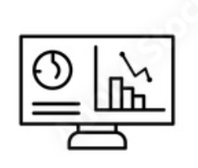
Results

Slide 13
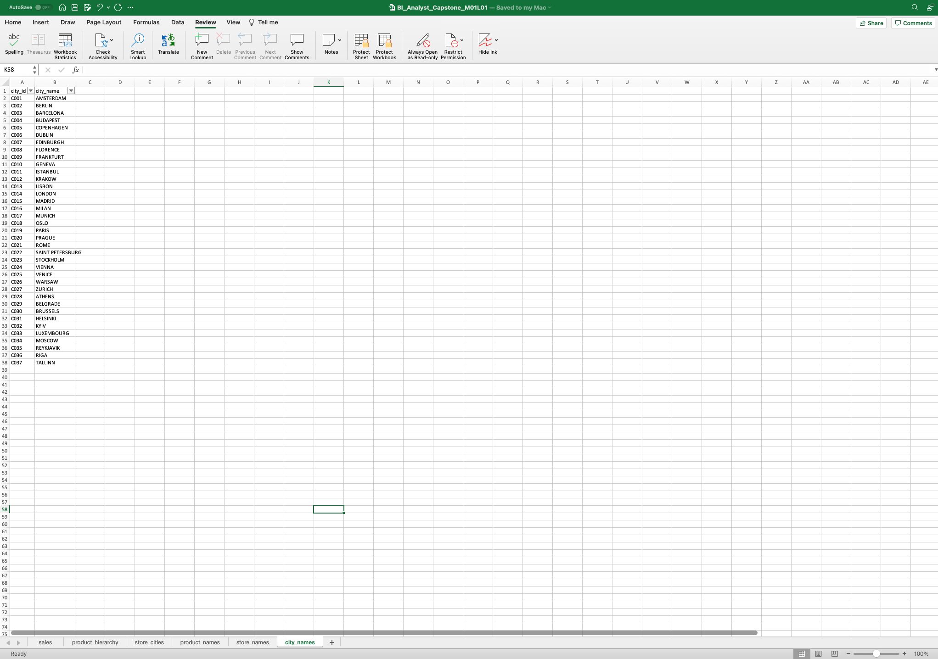
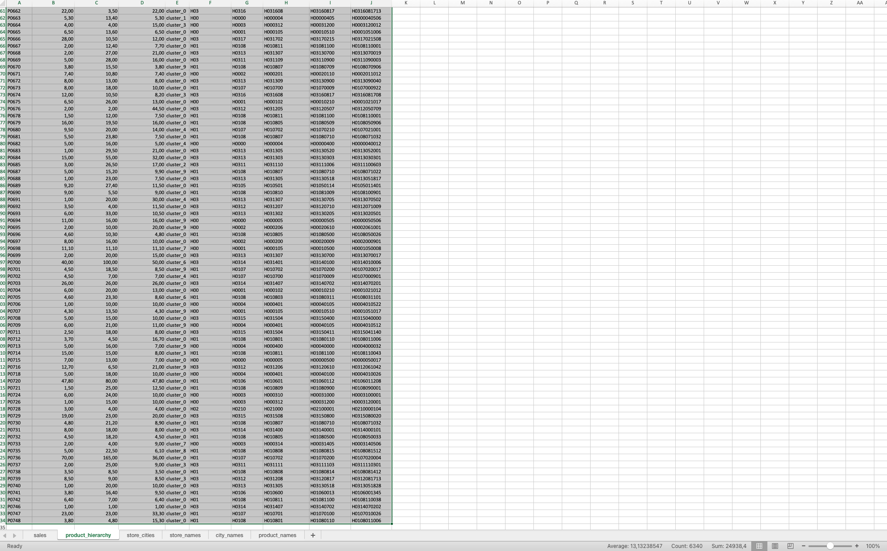
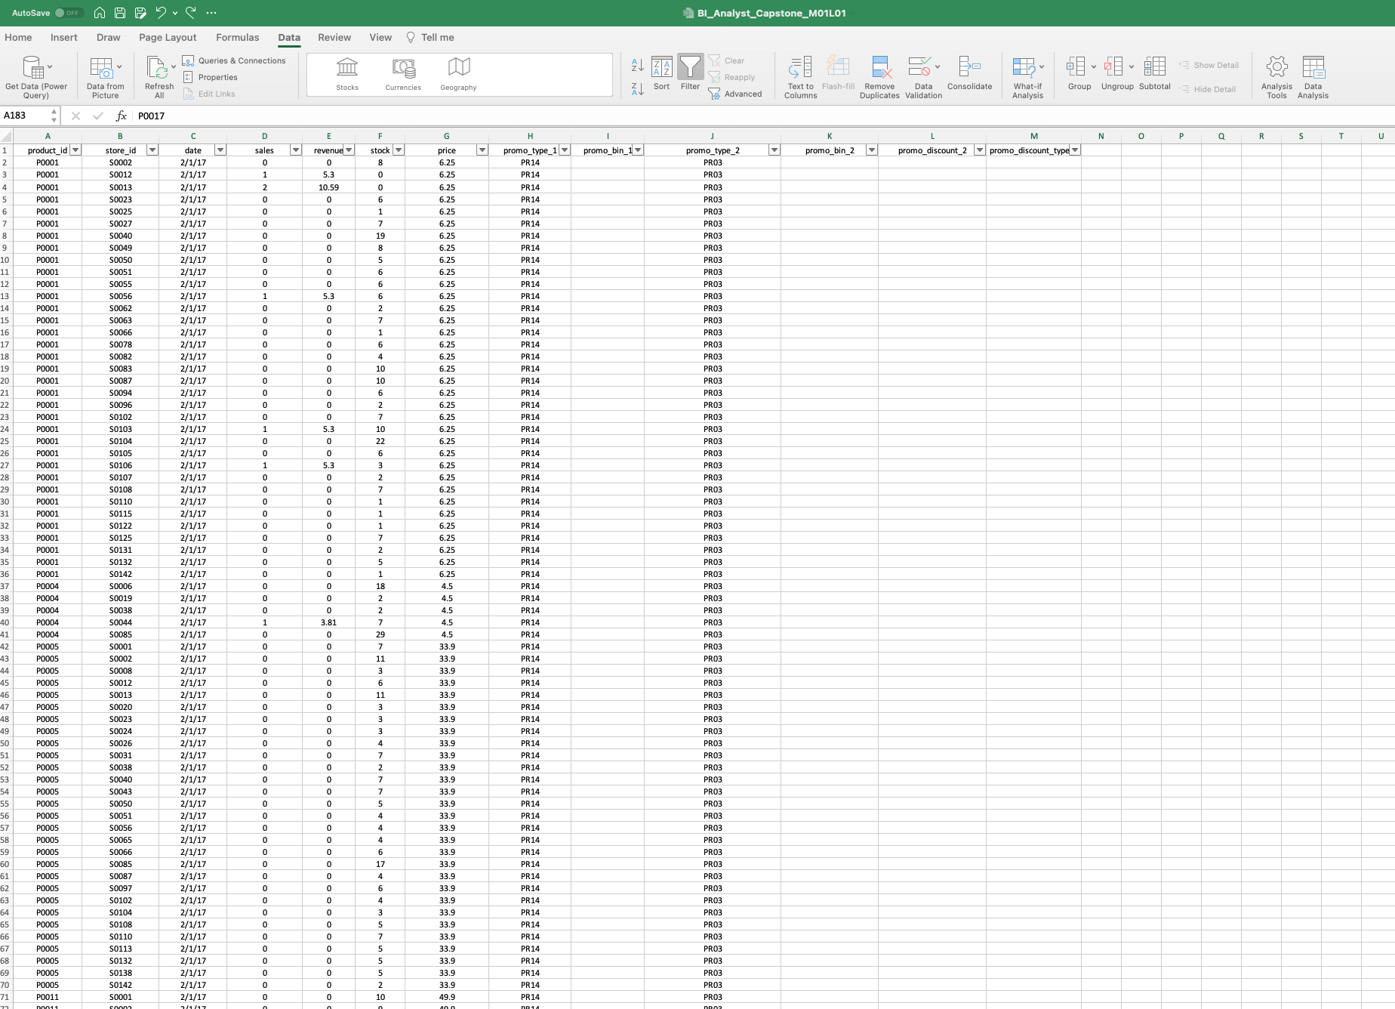
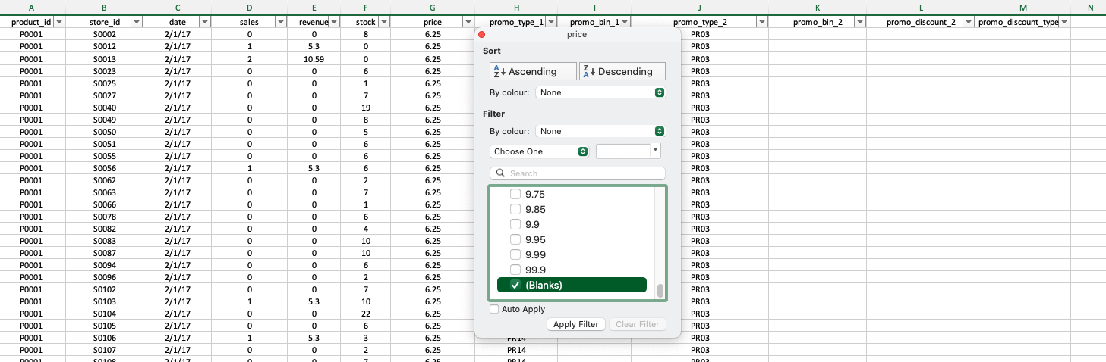
Module 1, Lesson 1: Data Cleaning and Preparation
In this phase, we consolidated multiple datasets from CSV files, including sales, product hierarchies, store information, and city data. The cleaned dataset integrated relevant columns (e.g., product IDs, store IDs, and city IDs), ensuring that all records were accurate and complete. This prepared dataset was essential for accurate and reliable analysis, enabling us to perform subsequent tasks such as trend analysis and data visualization effectively. Proper data cleaning ensures that the insights derived are based on a robust and error-free dataset, leading to more actionable and reliable conclusions.

Slide 14
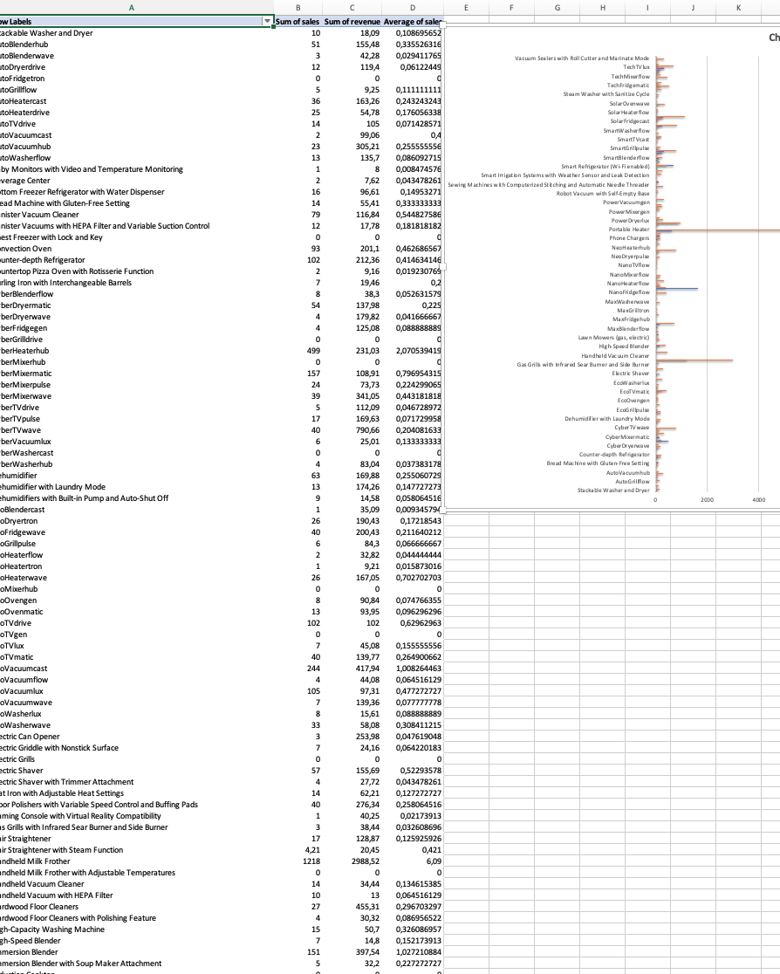
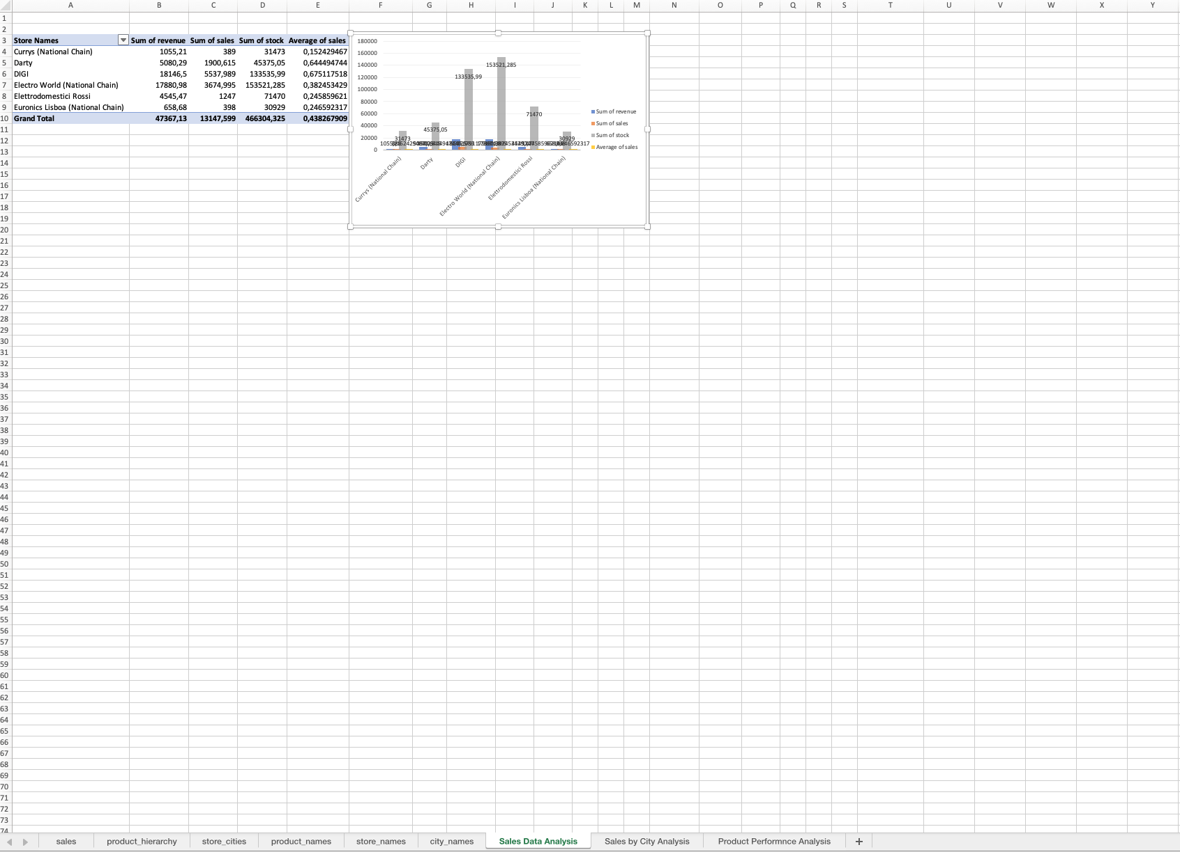
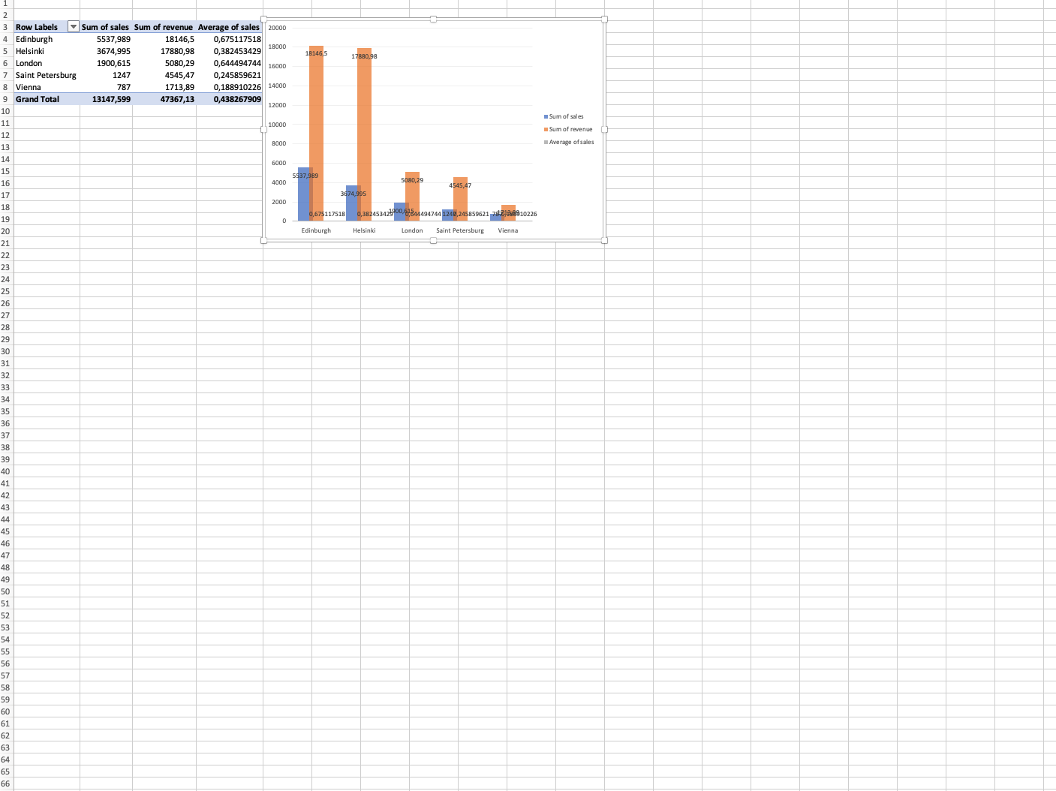
Module 1, Lesson 2: Data Analysis Using Pivot Tables
Sales Data Analysis: This pivot table summarizes total sales across all products and stores, providing an overview of overall sales performance. It helps in identifying trends and patterns in sales volume, which is critical for assessing business performance and making strategic decisions.
Sales by City Analysis: This analysis breaks down sales data by city, revealing regional performance differences. Understanding sales distribution across cities aids in regional marketing strategies, resource allocation, and identifying areas needing attention or opportunities for growth.
Product Performance Analysis: This pivot table evaluates the performance of various products. By analyzing product sales, businesses can identify bestsellers and underperformers, informing inventory management, promotional strategies, and product development efforts.

Slide 15
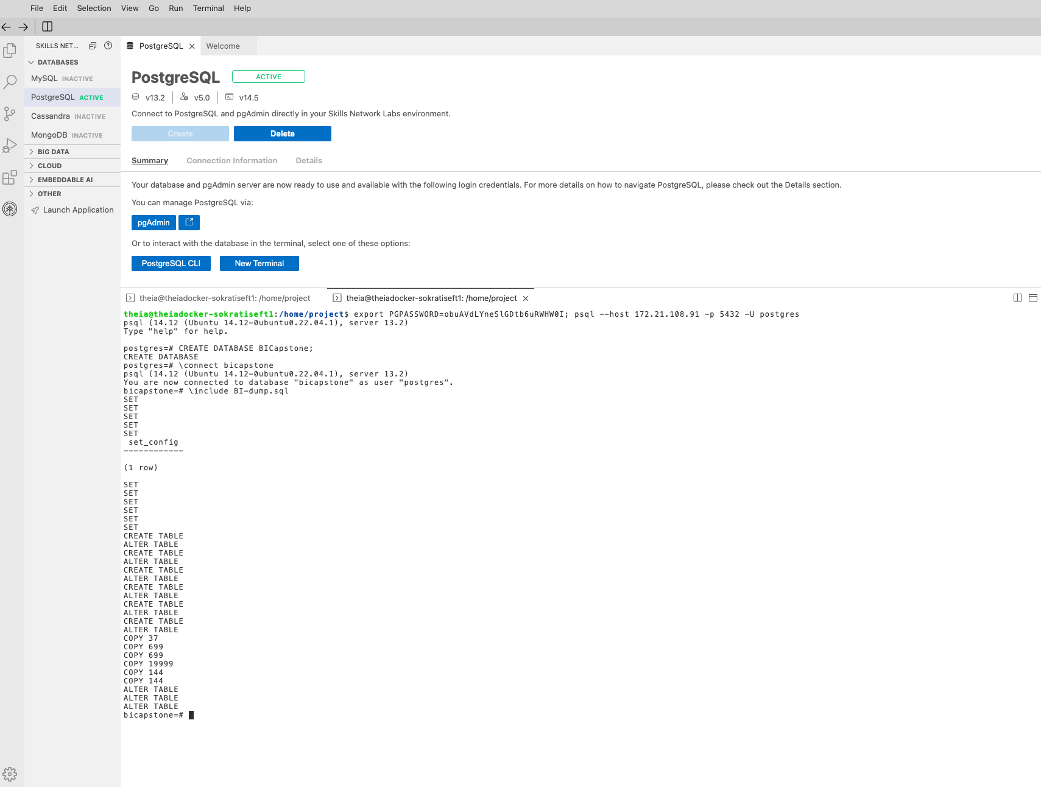
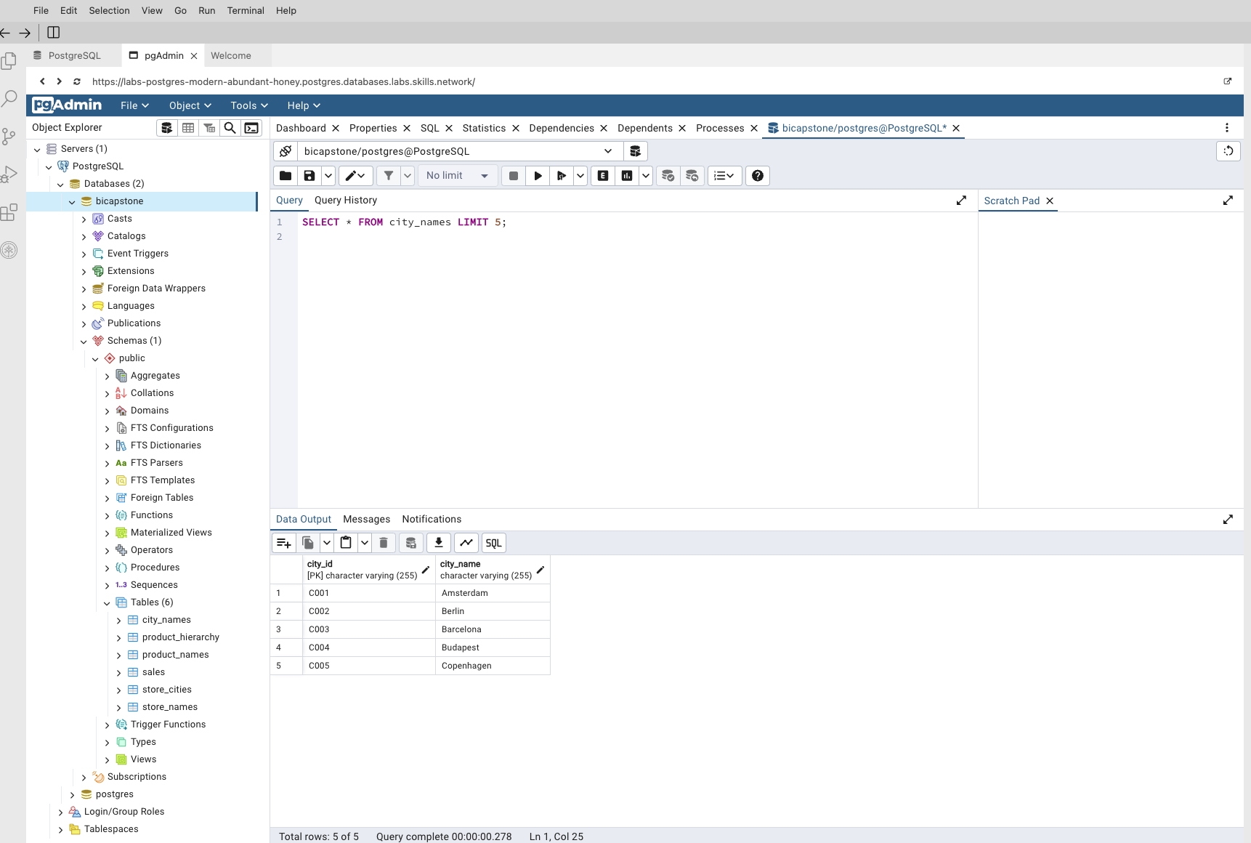
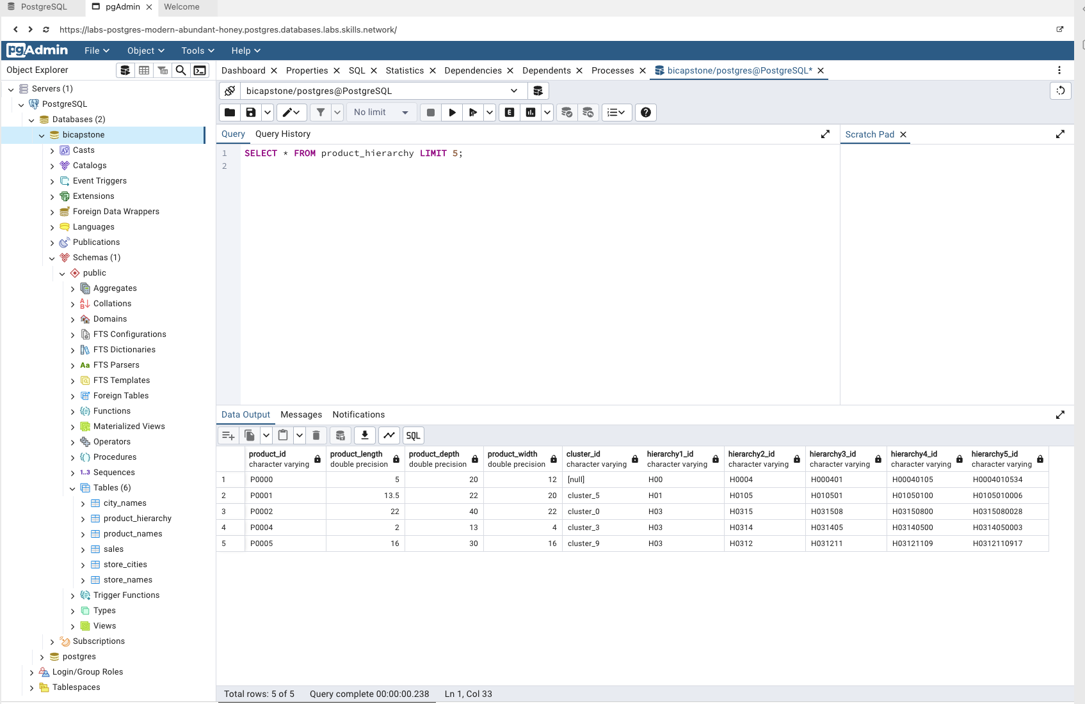
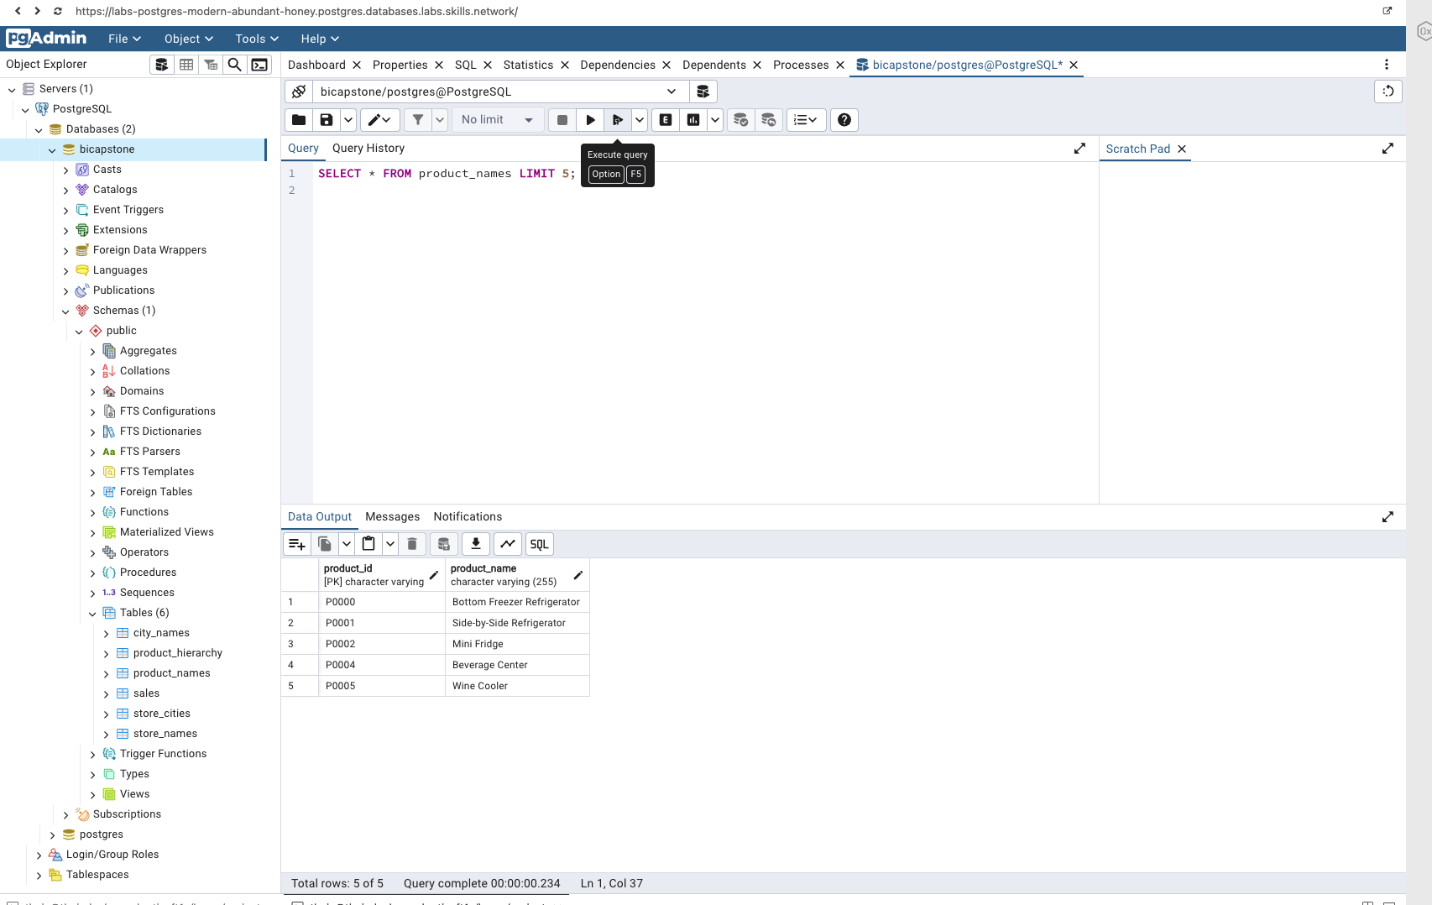
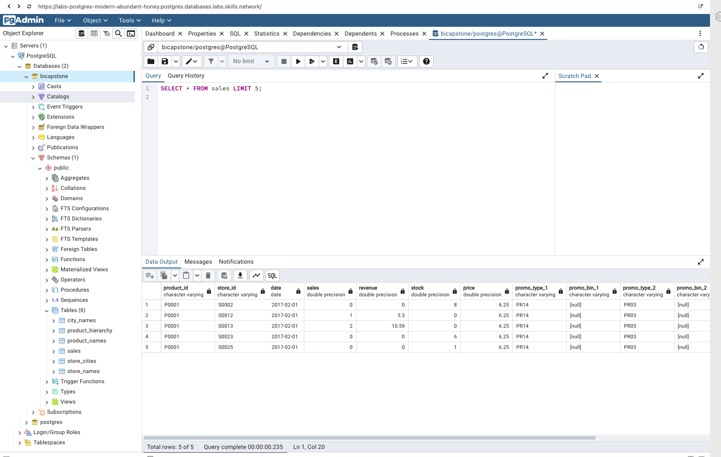
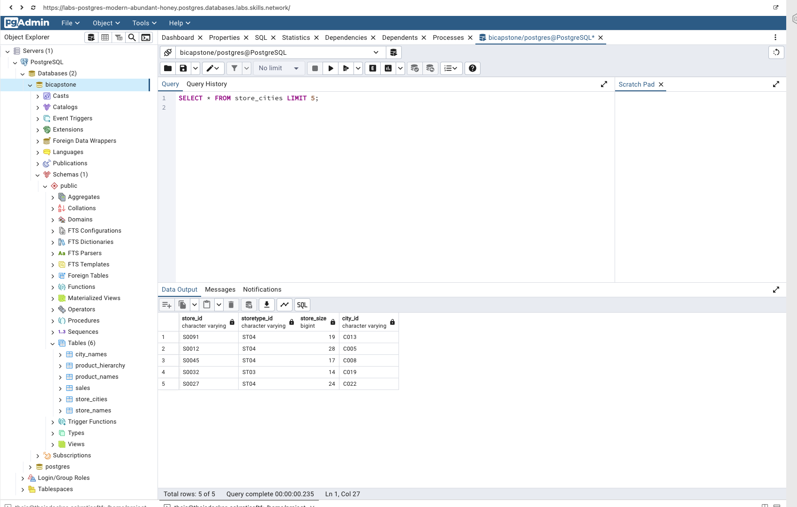
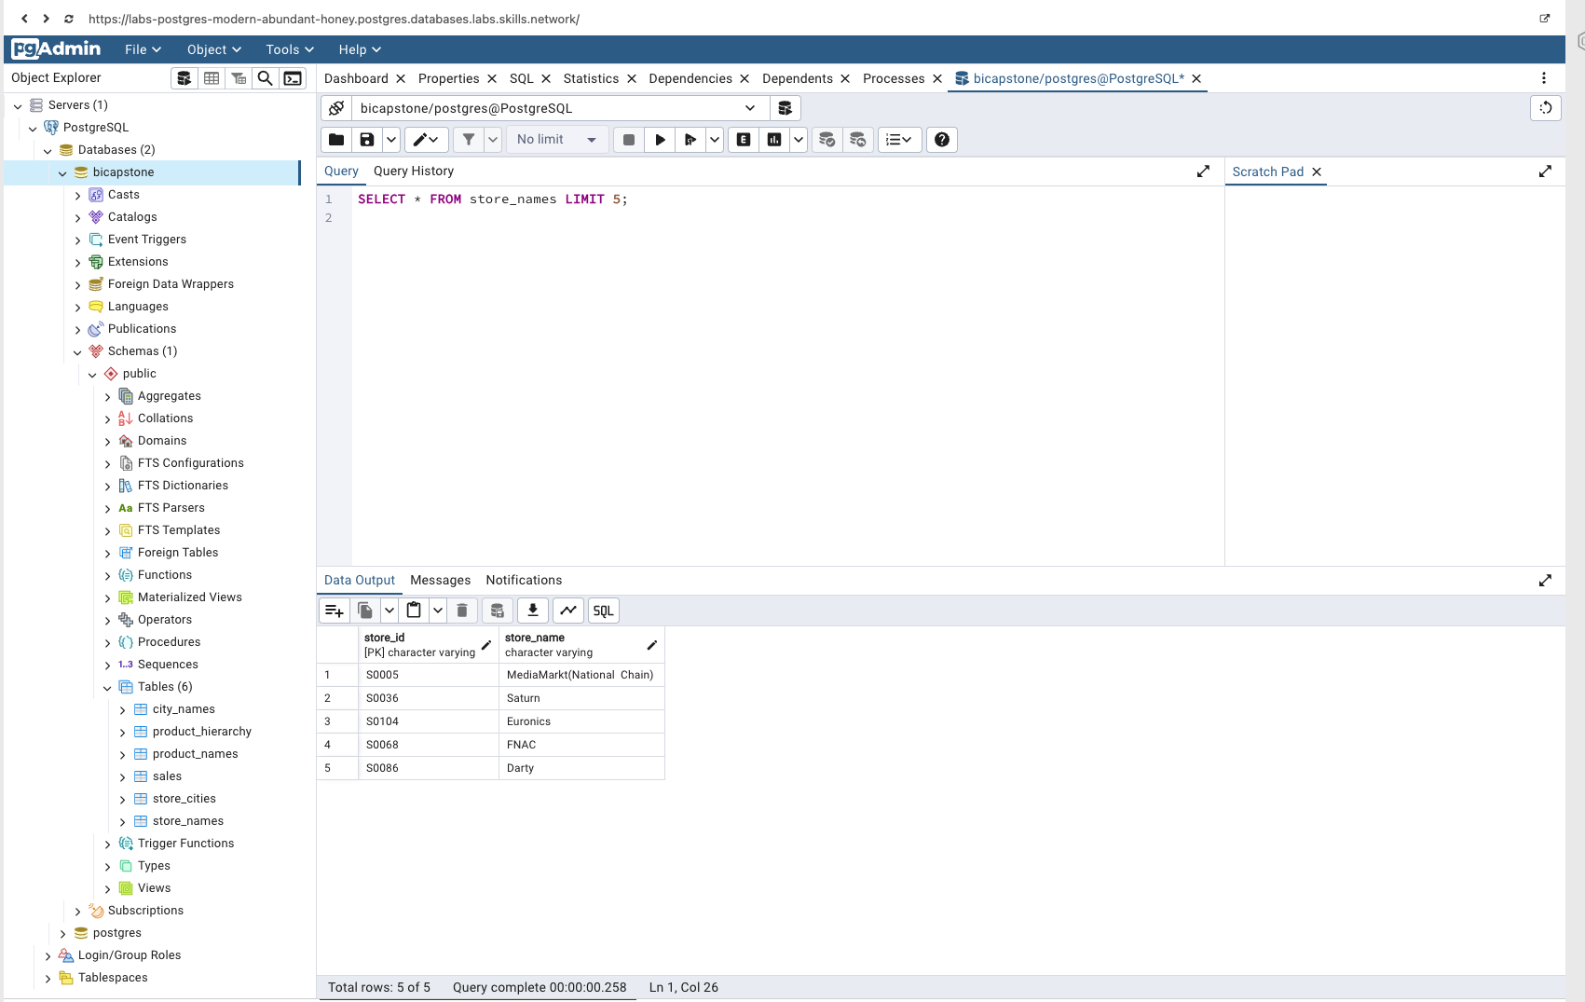
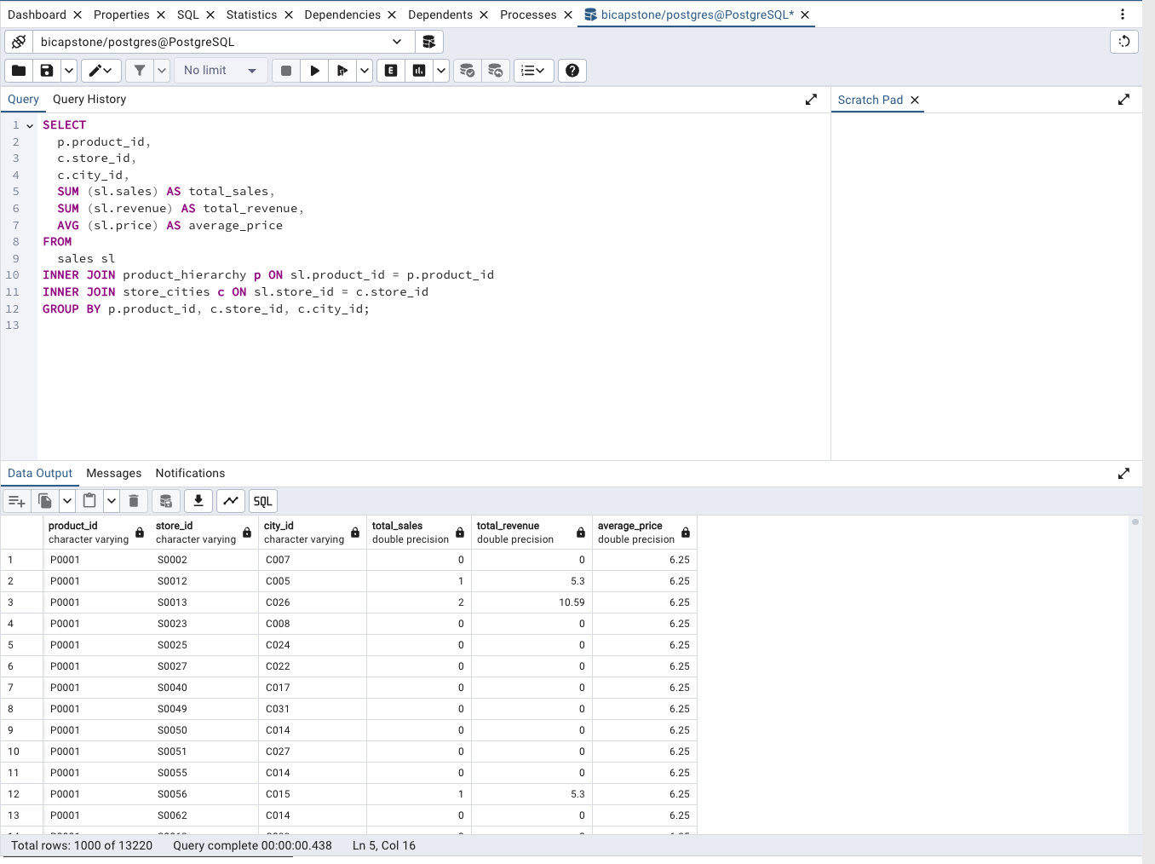
Module 2, Lesson 1: Data Querying Using PostgreSQL
Setting up the database in PostgreSQL is crucial for structured and efficient data analysis. By organizing data into tables and using SQL queries, you can extract, manipulate, and analyze data effectively. This setup facilitates:
Efficient Data Retrieval: Queries like the one shown for checking data help ensure that data is present and correctly formatted.
Structured Analysis: SQL queries for performance analysis allow for the aggregation of data, making it easier to identify trends and insights.
Scalability: PostgreSQL handles large datasets efficiently, supporting complex queries and analyses necessary for in-depth business intelligence.
Overall, setting up the database provides a robust foundation for executing detailed data analysis and generating actionable insights.

Slide 16
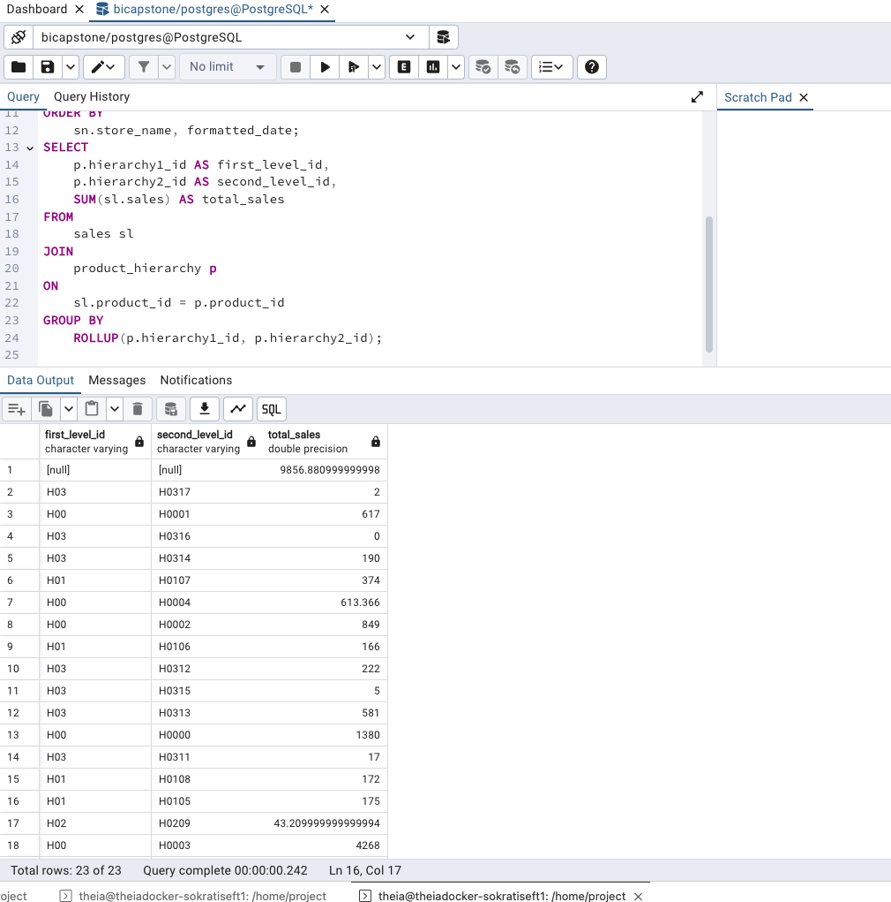
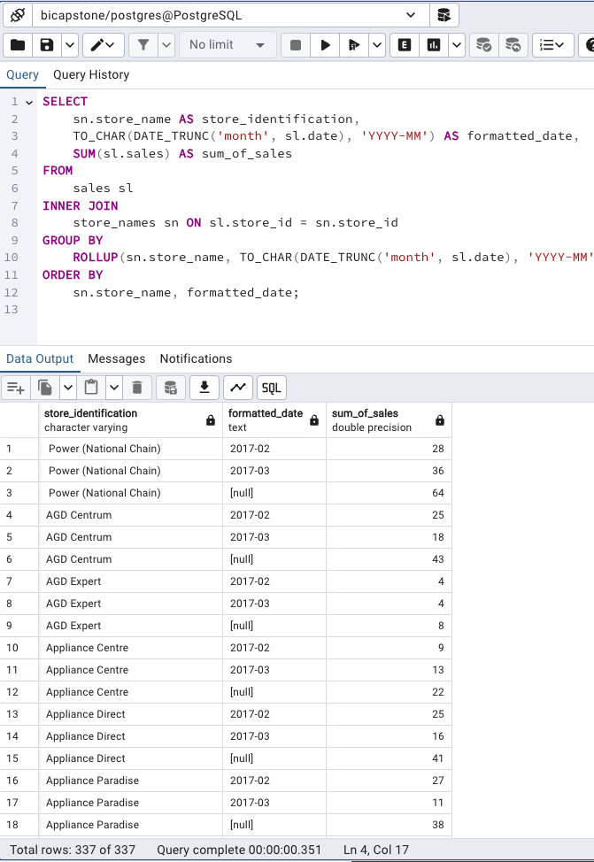
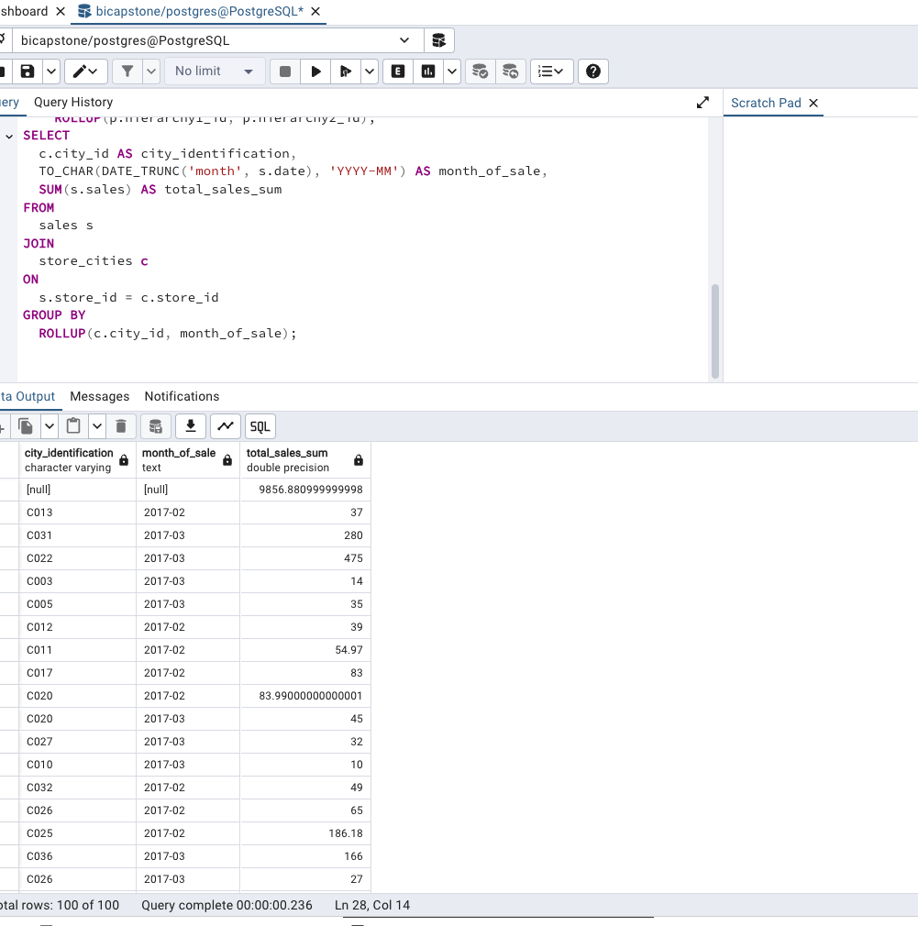
Module 2, Lesson 2: Data Analysis Using PostgreSQL
The analysis performed using PostgreSQL provides valuable insights for optimizing sales strategies and stock management:
Data Cubes with ROLLUP: This operation aggregates data at multiple levels, providing a comprehensive view of sales across different hierarchies. It helps in identifying overall sales performance and areas needing attention.
Data Summarization Along Hierarchies: By summarizing data based on product and store hierarchies, you can understand how different categories and stores contribute to overall sales. This helps in making informed decisions about product placement and store performance.
Sales Trends Over Time and Across Regions: Analyzing sales trends by month and city reveals patterns and fluctuations in sales performance. This insight is crucial for inventory management, marketing strategies, and regional sales planning

Slide 17
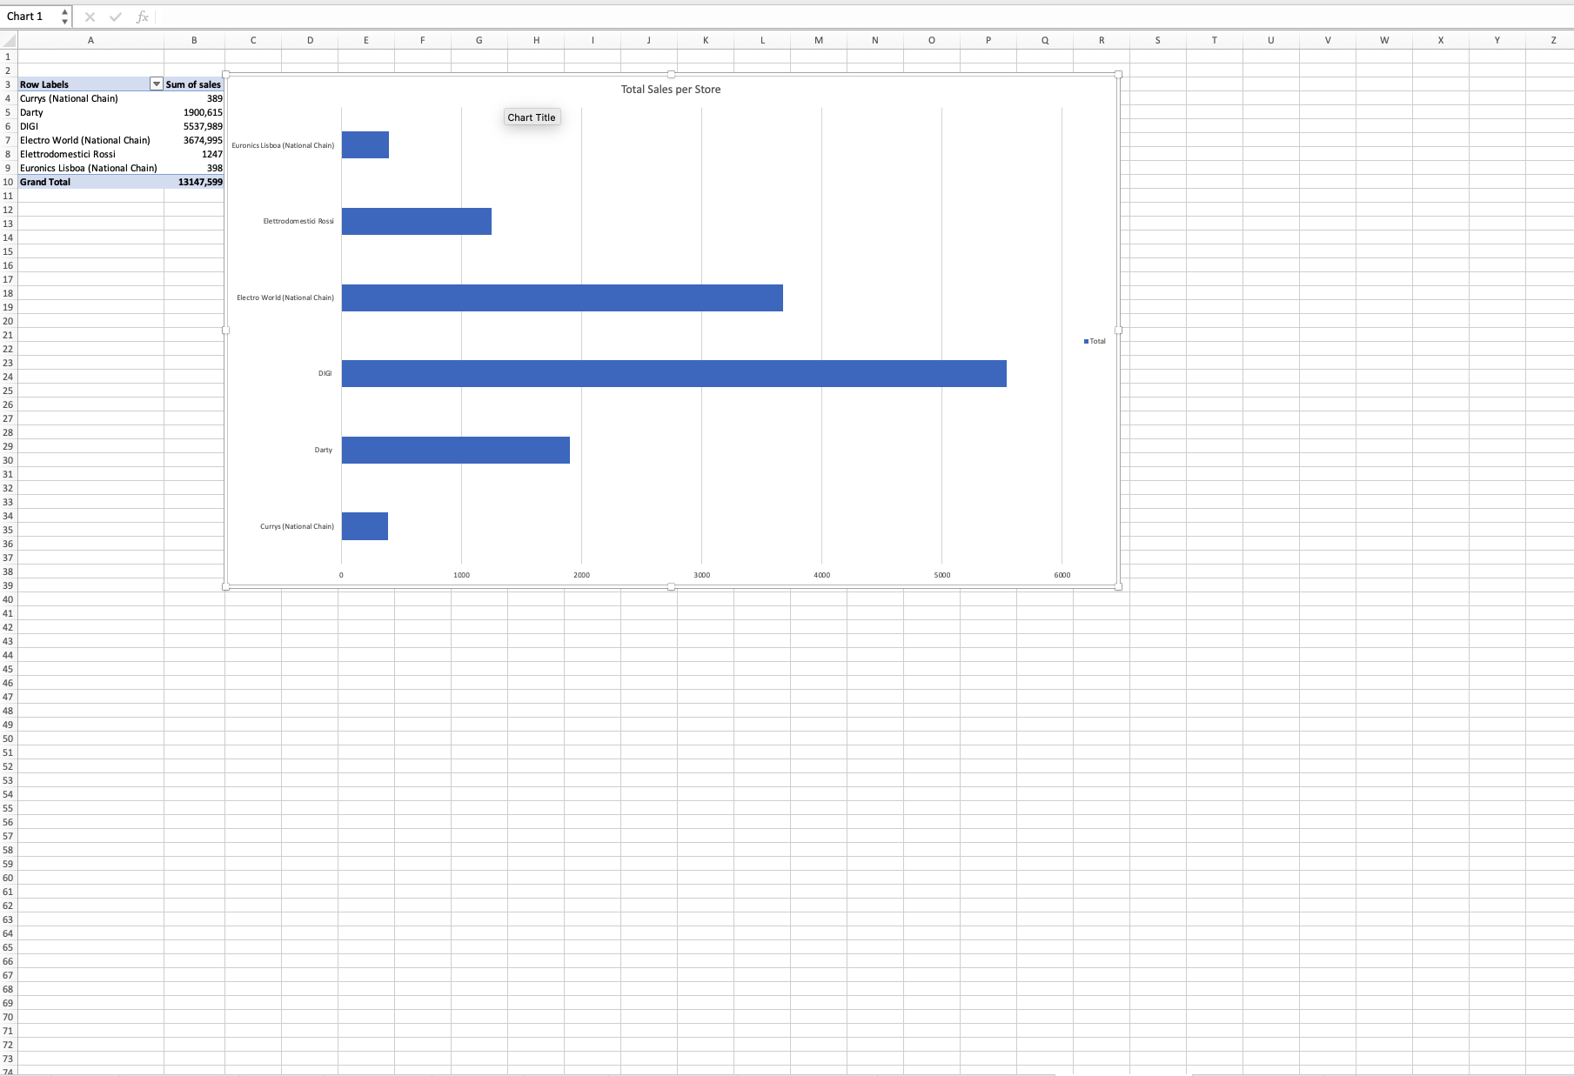
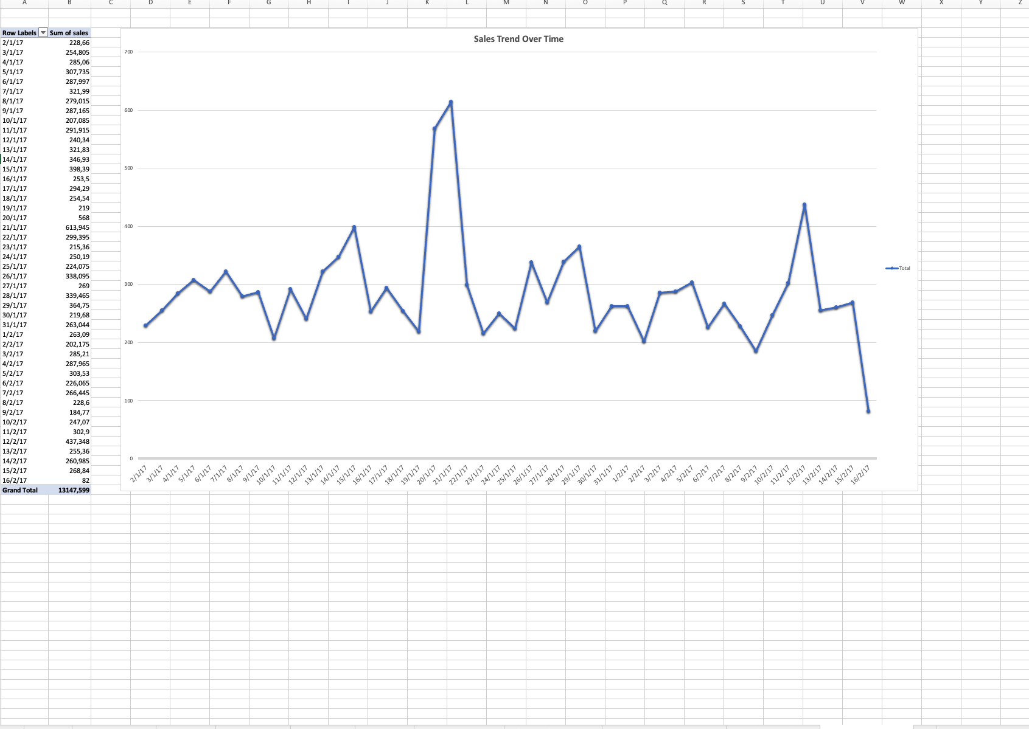
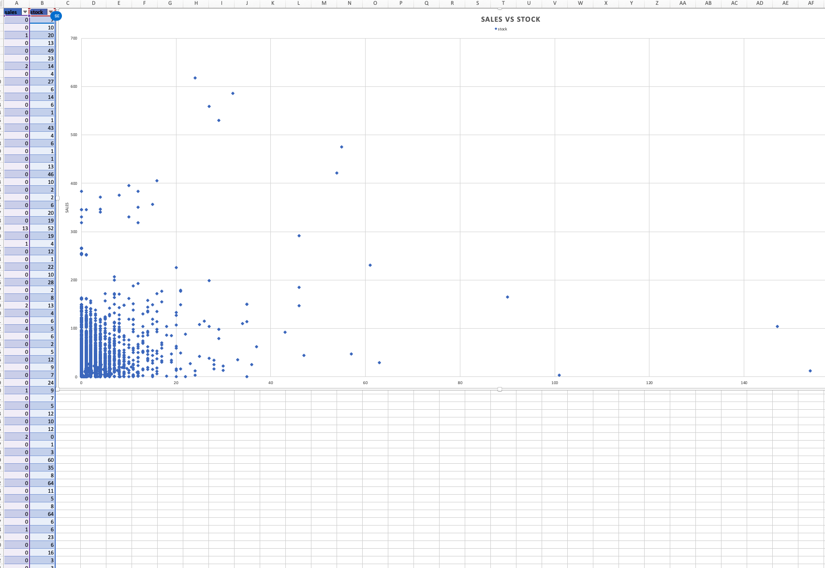
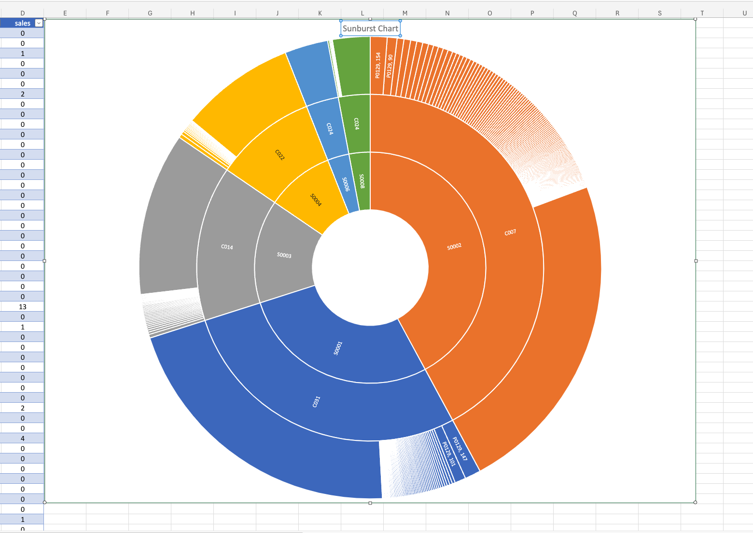
Module 3, Lesson 1: Data Visualization Using Excel
The charts created using Microsoft Excel provide various perspectives on the sales data:
Line Chart: The line chart illustrates trends over time, helping to identify patterns, such as seasonality or growth trends. This visualization is essential for understanding how sales performance evolves and planning accordingly.
Bar Chart: The bar chart shows total sales per store, making it easy to compare performance across different locations. It highlights top-performing stores and those that may require additional support or resources.
Sunburst Chart: The sunburst chart provides a hierarchical view of sales distribution across products, stores, and cities. This visualization helps in understanding the relationship between different levels of the hierarchy and identifying which products are performing well in which stores and cities.
Scatter Plot: The scatter plot visualizes the relationship between sales and stock levels, helping to explore whether there is a correlation between the availability of stock and sales volumes. This insight is valuable for optimizing inventory levels and improving sales performance.

Slide 18
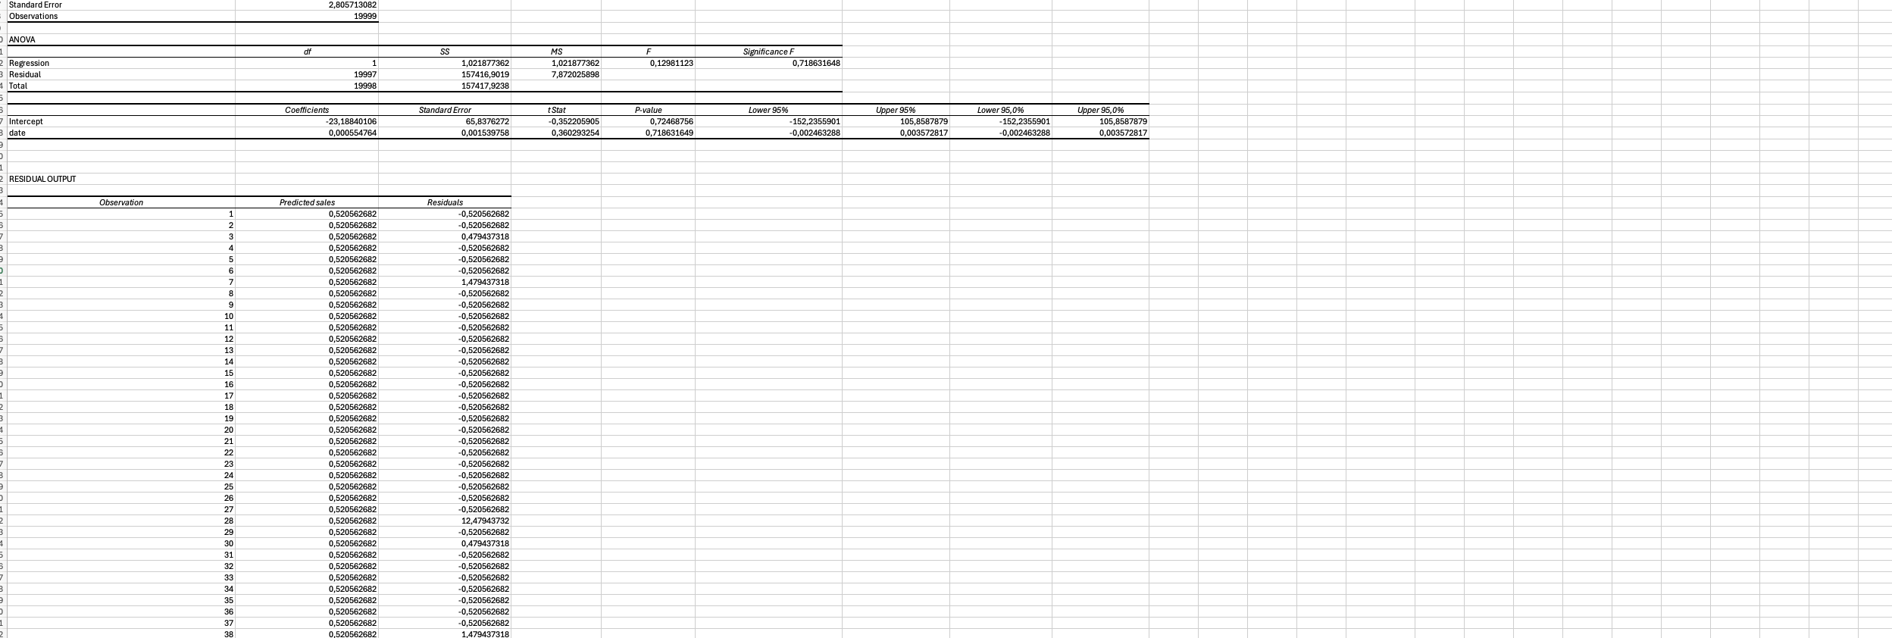
Module 3, Lesson 2: Statistical Analysis
P-Values:
Definition: P-values indicate the probability that the observed relationship between the dependent and independent variables is due to chance. A lower p-value (typically < 0.05) suggests that the relationship is statistically significant.
Interpretation: In the regression analysis, if the p-value for the Date variable is less than 0.05, it indicates that the relationship between sales and the date is statistically significant, implying that time trends have a meaningful impact on sales.
R-Squared Value:
Definition: The R-squared value represents the proportion of variance in the dependent variable (Sales) that is predictable from the independent variable (Date). It ranges from 0 to 1, with higher values indicating a better fit of the model.
Interpretation: If the R-squared value is, for example, 0.75, this means that 75% of the variance in sales can be explained by the changes in the date. A high R-squared value suggests that the model explains a significant portion of the variability in sales, making it a good predictor for future sales trends.

Slide 19
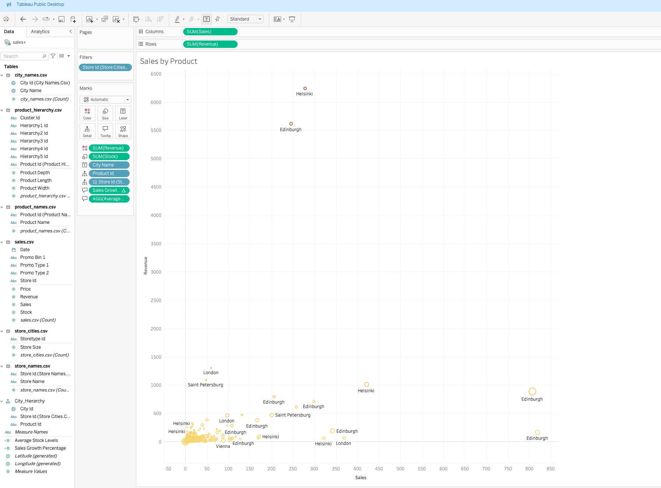
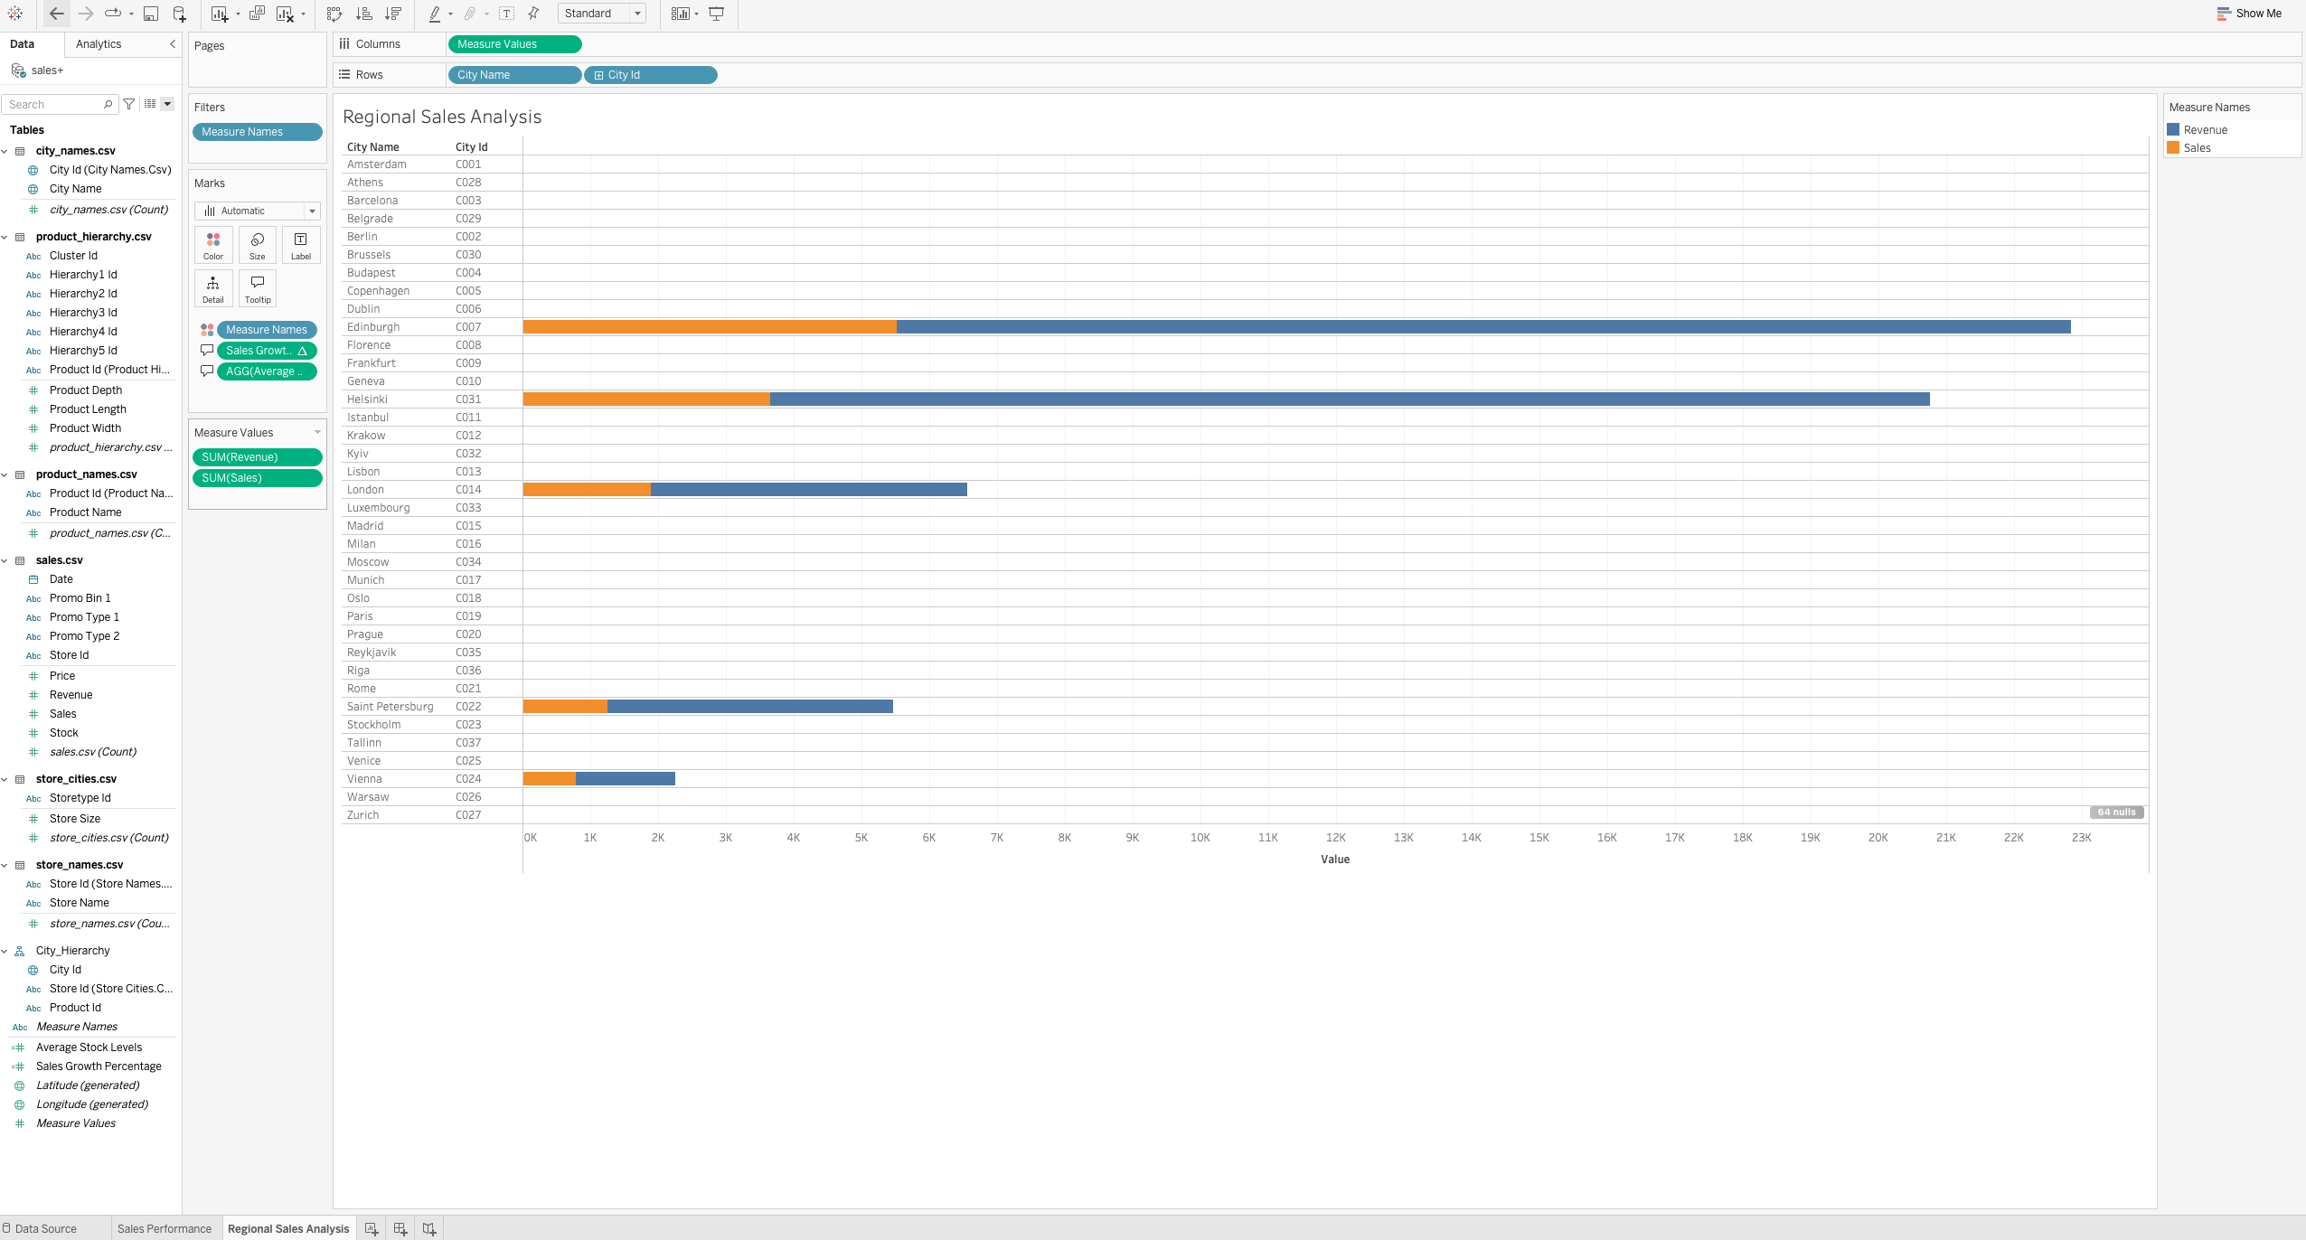
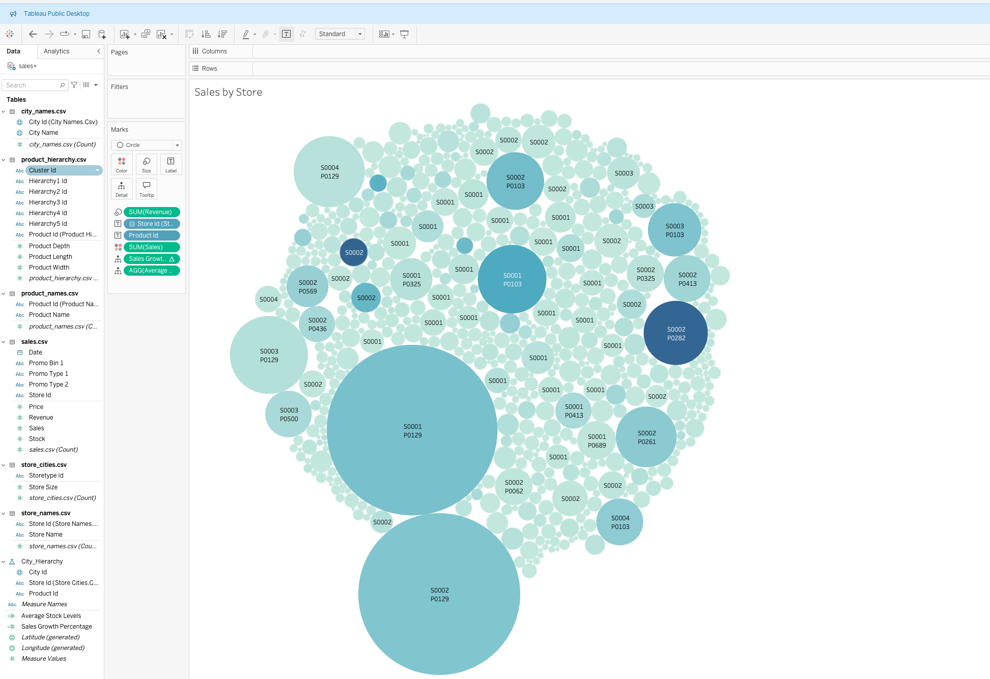
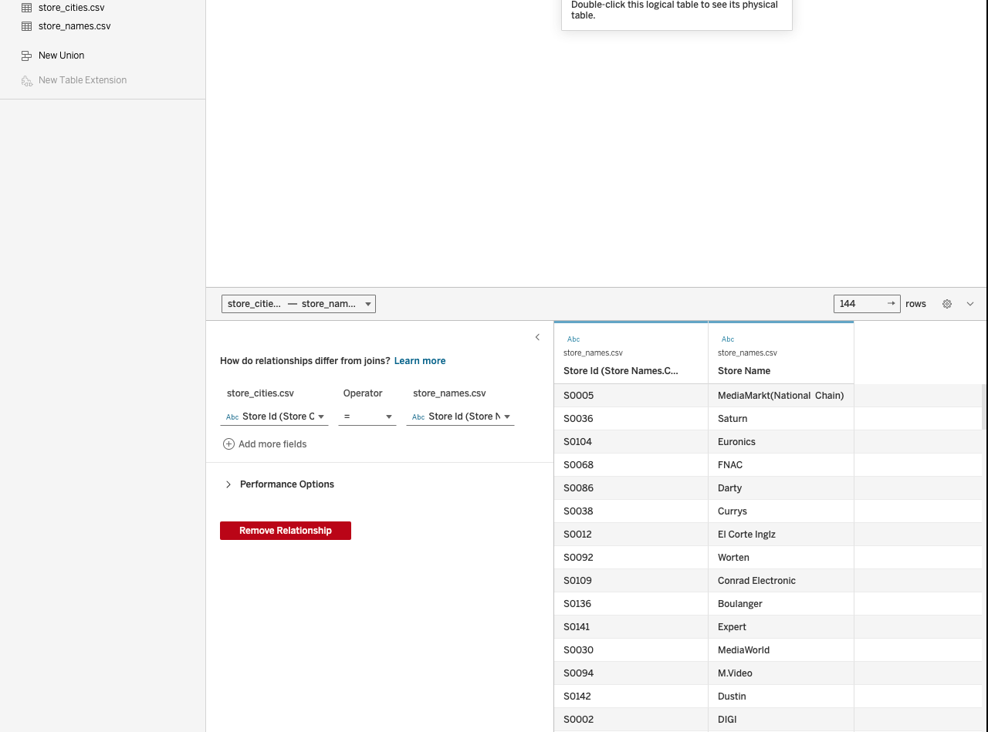
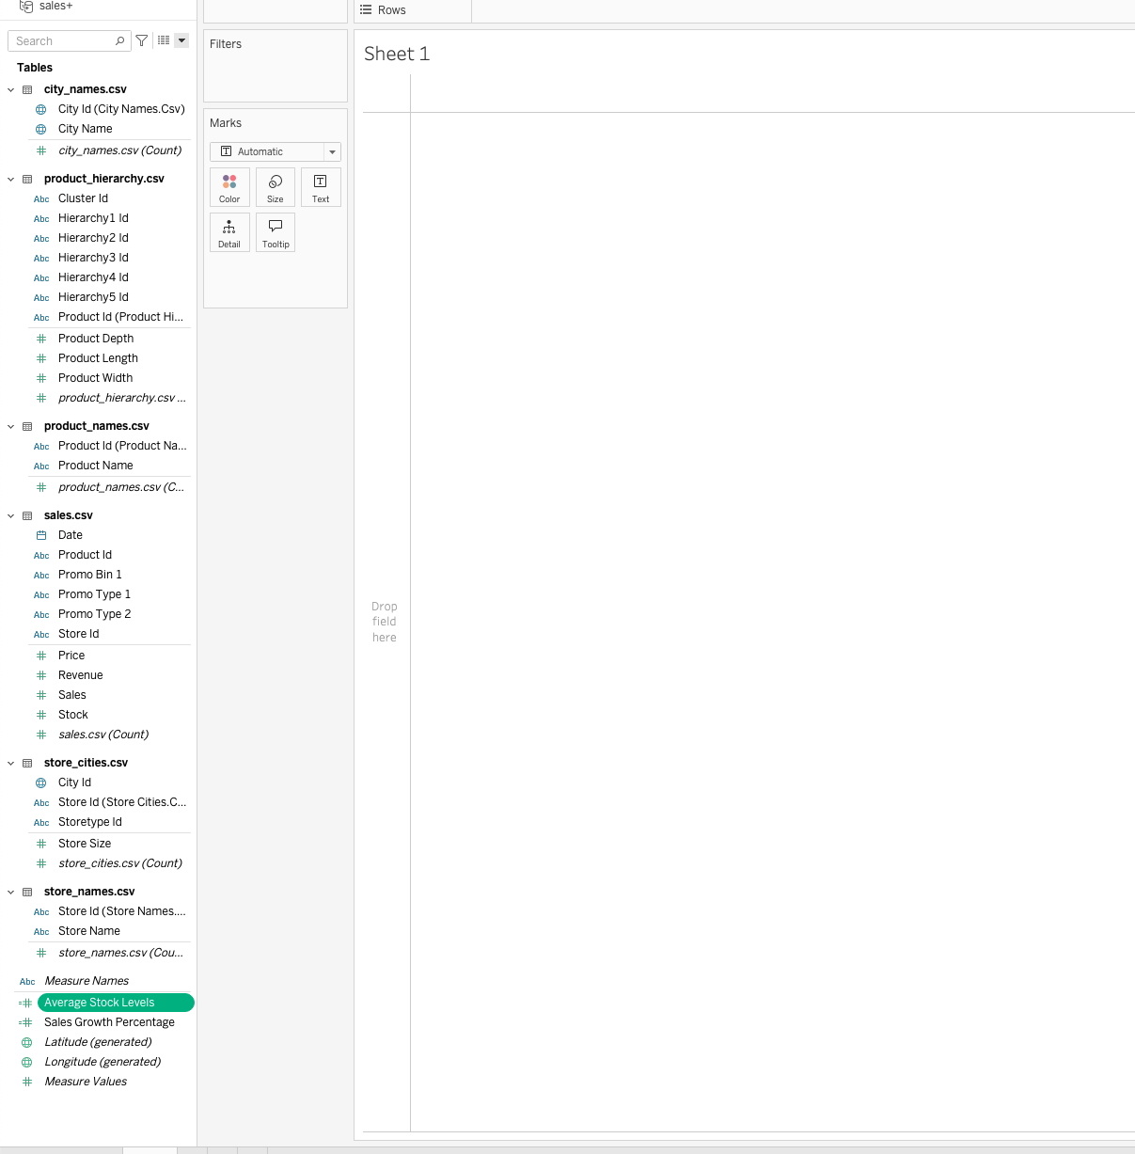
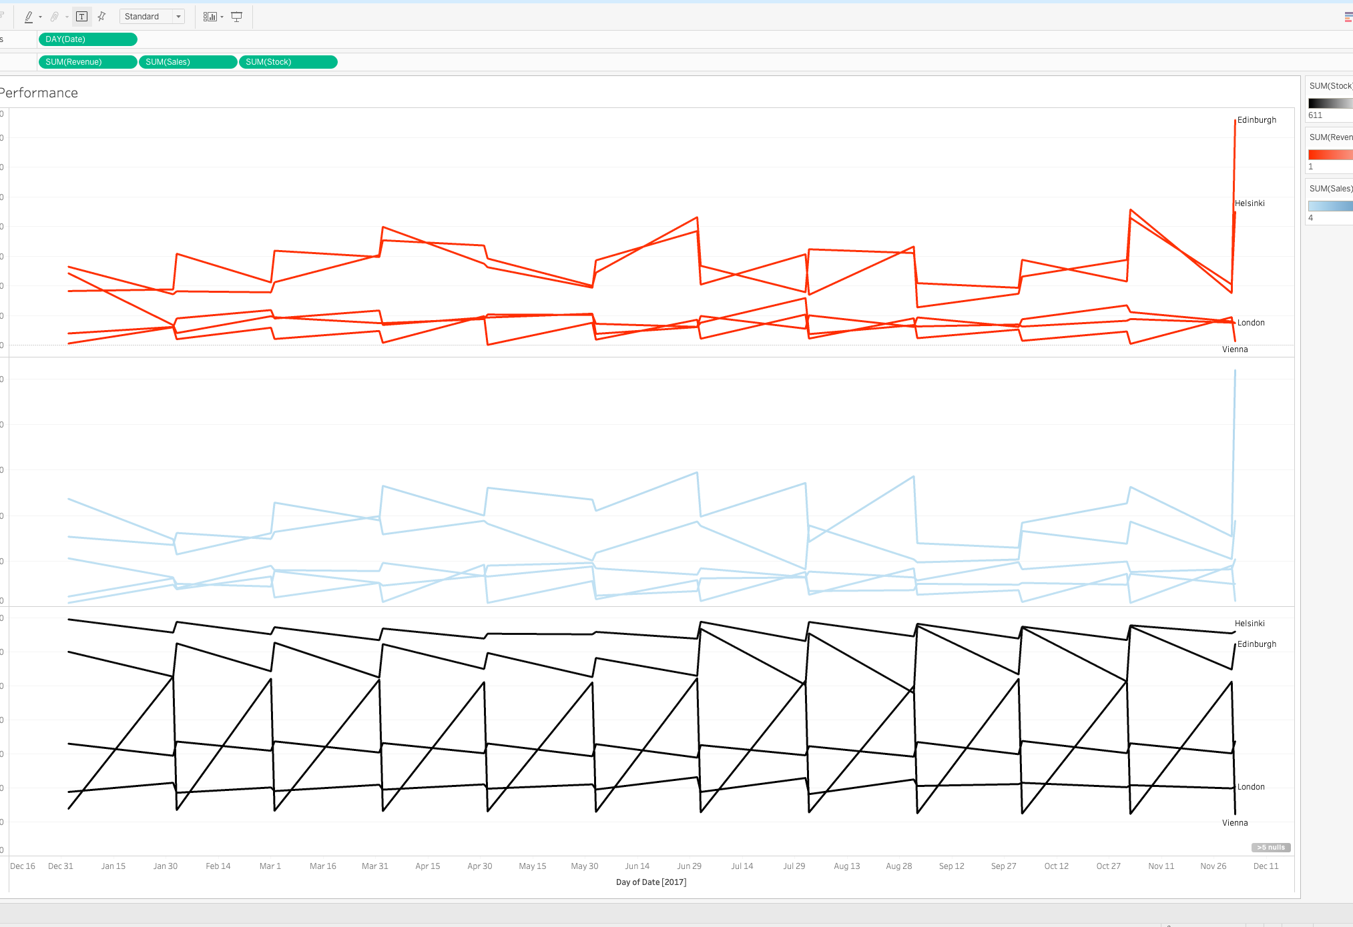
Module 4, Lesson 1: Basic Tableau Visualizations
Line Chart: Displays trends over time, allowing the identification of patterns and shifts in sales. This helps in understanding seasonal variations and the impact of time on sales performance.
Bar Chart: Provides a clear comparison of total sales across different stores or cities, helping to pinpoint high and low-performing locations.
Scatter Plot: Shows the relationship between sales and stock levels, with revenue represented by color and stock levels by size. This aids in identifying potential correlations and outliers.
Packed Bubbles Chart: Visualizes sales data in a hierarchical manner, with bubble sizes representing sales volumes and colors indicating categories or regions. This chart is useful for seeing the distribution of sales among different products and stores.

Slide 20
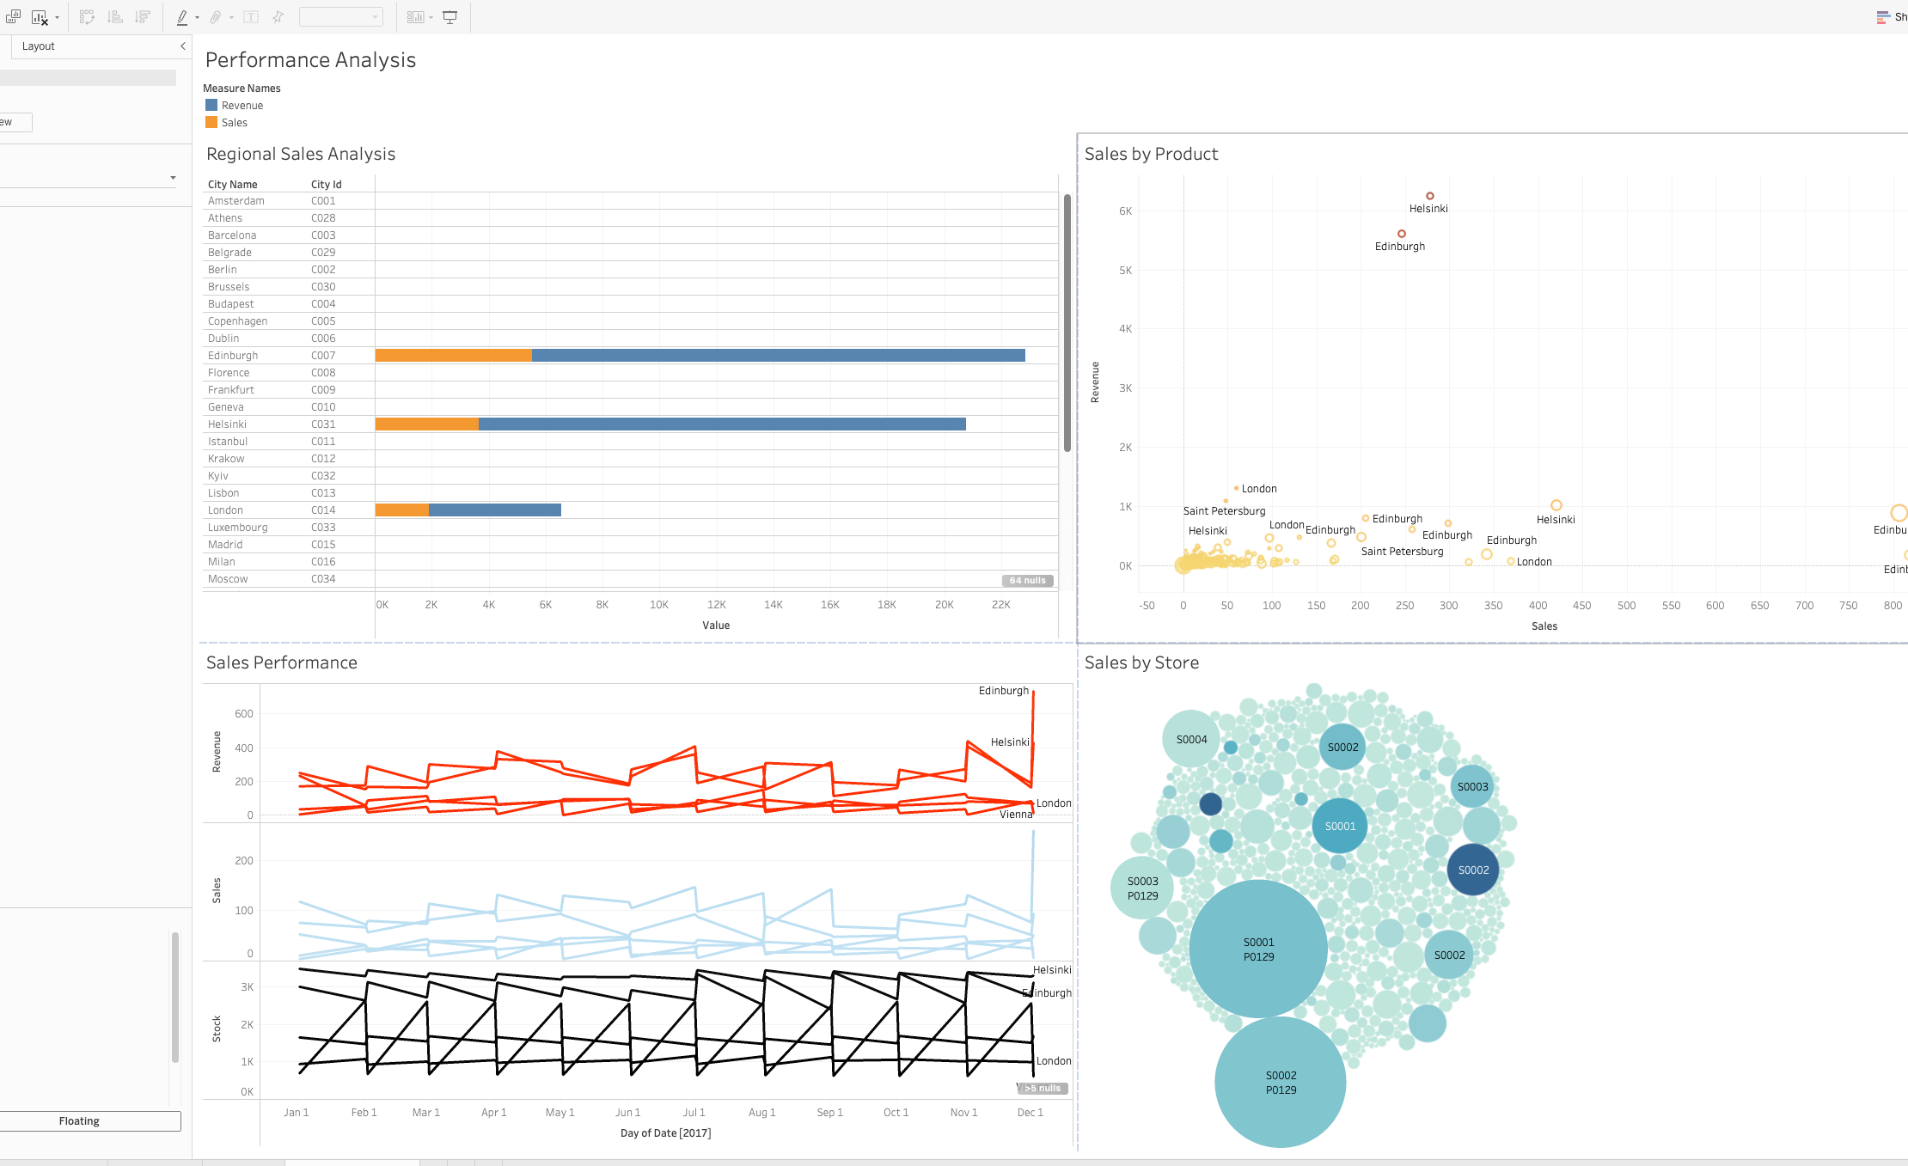
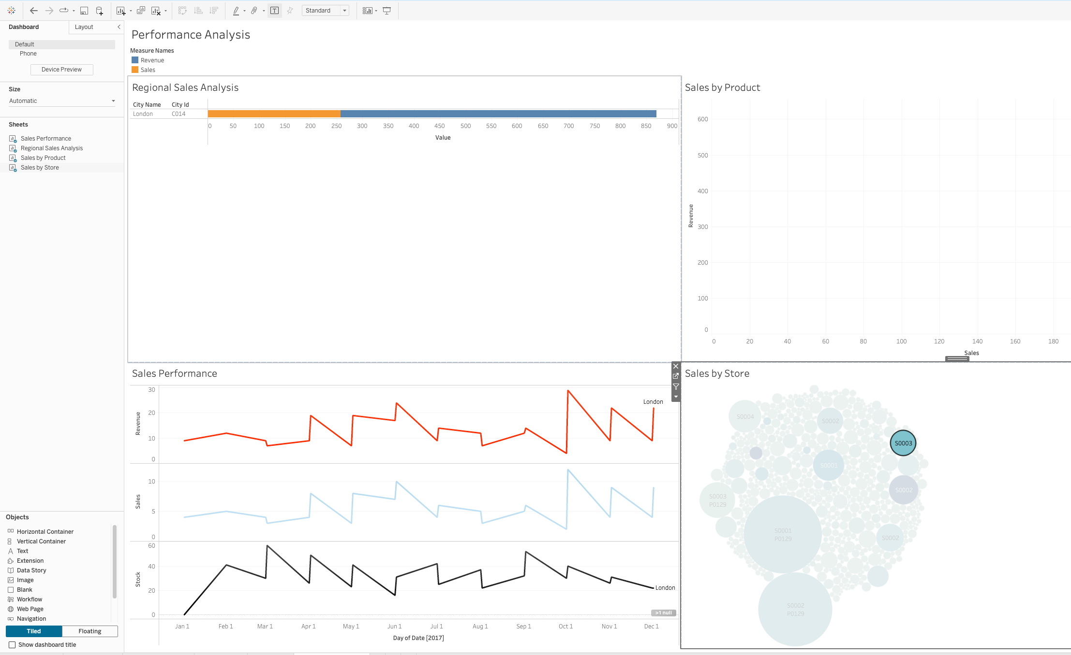
Module 4, Lesson 2: Advanced Visualizations Using Tableau
Dashboard with All Worksheets Added and Arranged: The dashboard integrates various visualizations, providing a comprehensive view of the sales performance. This consolidated view allows stakeholders to quickly access and interpret multiple data aspects in one place.
Filter Dashboard Action: By implementing filter actions, users can interactively explore data subsets, such as focusing on specific regions or products. This dynamic filtering capability supports detailed analysis and more precise decision-making based on targeted insights.

Slide 21

Discussion

Slide 22
Insights and Recommendations
Key Insights:
Sales Performance: Identified high and low-performing stores and products, helping focus resources where they are most effective.
Stock Levels Impact: Higher stock levels generally lead to higher sales, highlighting the need for better inventory management.
Seasonal and Regional Trends: Sales trends vary by season and region, suggesting targeted marketing and preparation for peak periods.
Effectiveness of the Presentation:
The presentation uses clear visualizations (line, bar, scatter, and packed bubbles charts) and dashboards to make complex data easily understandable, aiding stakeholders in quick decision-making.
Recommendations:
Optimize Inventory: Align stock levels with demand to boost sales.
Focus Resources: Invest in successful regions and products while improving weaker areas.
Prepare for Peaks: Adjust inventory and marketing for peak seasons based on historical trends.
Data-Driven Decisions: Continue using insights to guide strategic planning.

Slide 23

Conclusion

Slide 24
Summary
Main Findings:
Sales Trends: Identified regional variations and peak sales periods.
Stock vs. Sales: Higher stock levels correlate with increased sales.
Product Performance: Key products significantly impact revenue.
Seasonal Patterns: Noted fluctuations requiring adjusted strategies.
Conclusions:
Optimize Stock: Improve inventory to boost sales.
Target High-Performing Areas: Focus on successful regions and products.
Prepare for Peaks: Adjust strategies for seasonal trends.
Data-Driven Decisions: Use insights to enhance business performance.
Appendix:
Charts & Tables: Include relevant visualizations and data tables from the analysis.

Slide 25

Appendix

Slide 26
Appendix #
Include any relevant additional charts, worksheets, or tables that you may have created during the analysis phase

